Slide 1
You Go Where You Look
Jeffrey E. Hansen, Ph.D.
Clinical Director, Holdfast Recovery
Director, NeuroFaith

Slide 2

Hebrews 12:1-2 (NIV)
“Therefore, since we are surrounded by such a great cloud of witnesses, let us throw off everything that hinders and the sin that so easily entangles. And let us run with perseverance the race marked out for us, fixing our eyes on Jesus, the pioneer and perfecter of faith. For the joy set before him he endured the cross, scorning its shame, and sat down at the right hand of the throne of God.”

Slide 3

Motorcycle Target Fixation https://www.youtube.com/watch?v=dZ2M7cpLGC4

Slide 4

Matthew 14:29-30 (NIV)
‘Come,’ he said. Then Peter got down out of the boat, walked on the water and came toward Jesus. But when he saw the wind, he was afraid and, beginning to sink, cried out, ‘Lord, save me!’
(This verse reminds us of what happens when we take our eyes off Jesus.)

Slide 5

Psalm 16:8 (NIV)
“I keep my eyes always on the Lord. With him at my right hand, I will not be shaken.”

Slide 6

Colossians 3:1-2 (NIV)
“Since, then, you have been raised with Christ, set your hearts on things above, where Christ is, seated at the right hand of God. Set your minds on things above, not on earthly things.”

Slide 7

2 Corinthians 4:18 (NIV)
“So, we fix our eyes not on what is seen, but on what is unseen, since what is seen is temporary, but what is unseen is eternal.”

Slide 8

Isaiah 26:3 (NIV)
“You will keep in perfect peace those whose minds are steadfast, because they trust in you.”
(While not explicitly mentioning eyes, this verse speaks to the importance of a steadfast focus on God.)

Slide 9

Proverbs 4:25-27 (NIV)
“Let your eyes look straight ahead; fix your gaze directly before you. Give careful thought to the paths for your feet and be steadfast in all your ways. Do not turn to the right or the left; keep your foot from evil.”
(This speaks to maintaining focus and avoiding distractions.)

Slide 10
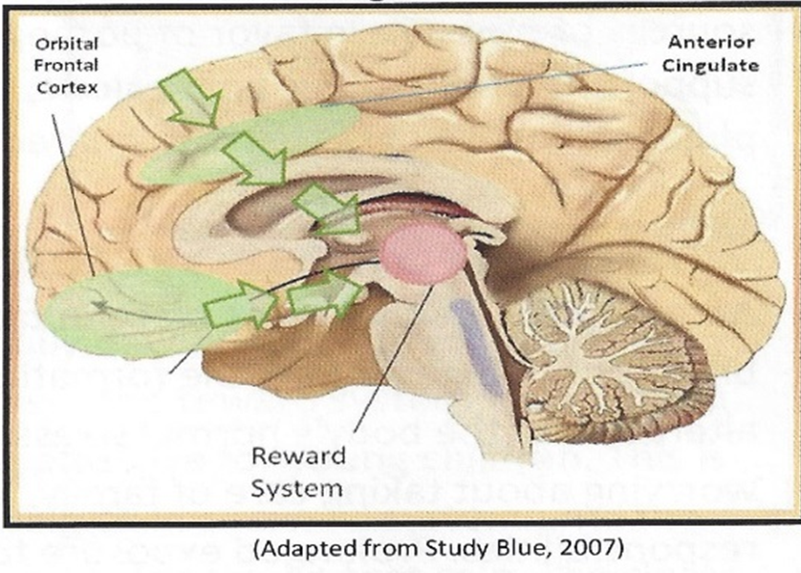
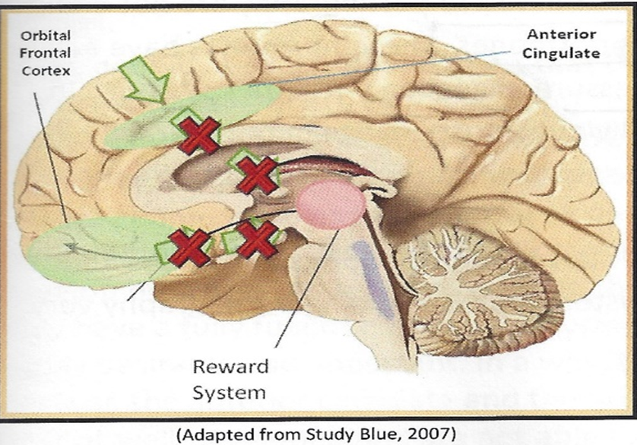
Impact of Hypofrontality – not a good thing:
Two areas of the brain, the anterior cingulate and the orbital frontal cortex, serve as a protective mechanism to override the reward system’s desire for ever increasing dopamine. Sadly, hypofrontality involves the rewiring of our brain so that when an impulse to engage in a dopamine-related behavior is activated, the brain ends up shutting down its ability to override the reward system. This is the breeding ground for horrible choices and impacts on social development in a really bad way.

Slide 11
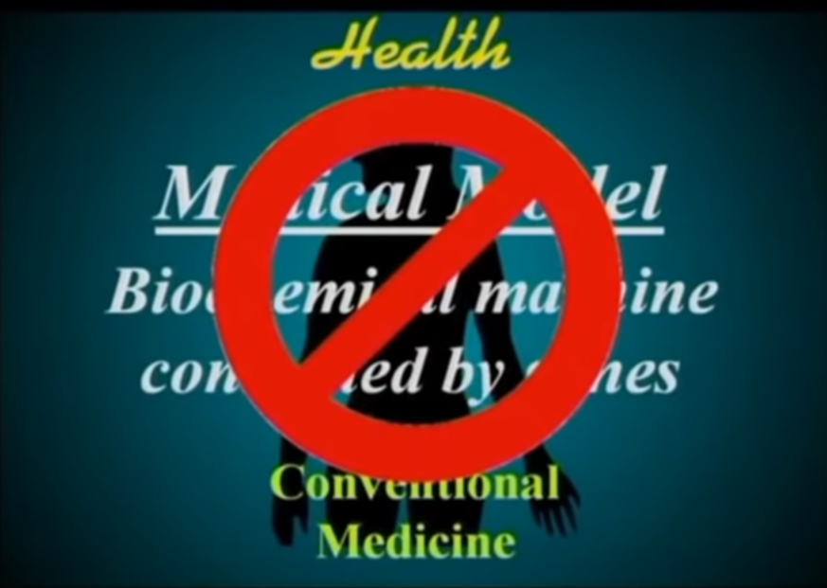
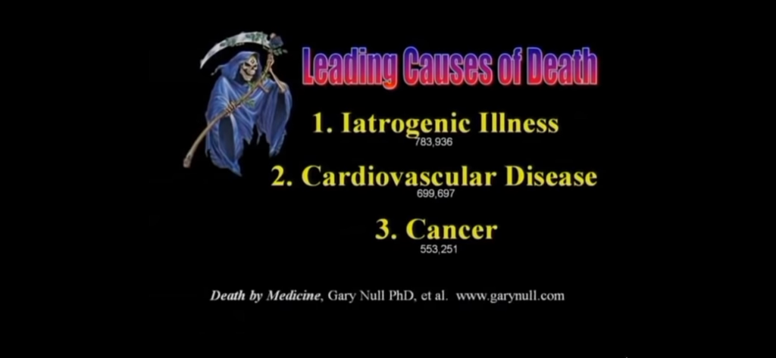
Current Medical Model
The current Newtonian-based medical model is brilliant when it comes to such things as mechanical surgeries, excising cancers, etc., but falls short on many fronts. Sadly, as reported by Dr. Bruce Lipton, cellular biologist and medical school professor and Stanford research scholar, iatrogenic (illness caused by medical examination or treatment) is the number one cause of death in the US, ahead of cancer and cardiovascular disease.

Slide 12
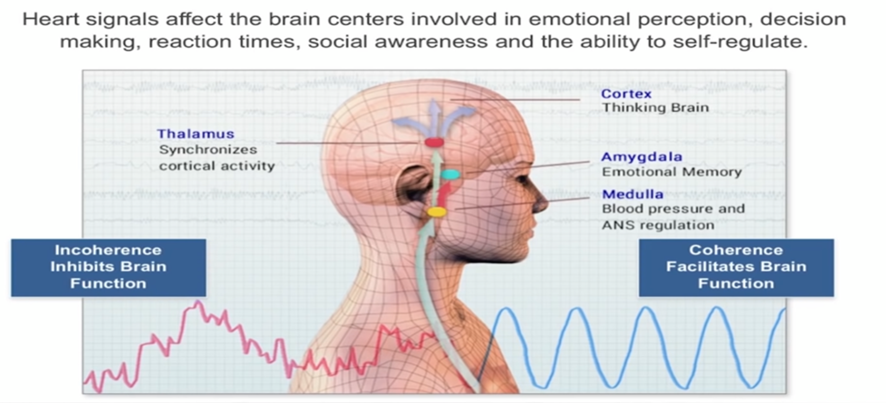
Heart-to-Brain
Dr. McCraty notes that the heart communicates to the brain in four main ways: (1) nerves connecting the heart to the brain, particularly the vagus nerve, (2) hormones, (3) blood pressure shifts, and (4) electromatic waves.
When the heart is coherent, it sends messages to the brain that, likewise, promote brain coherence which allow the brain to be more integrated and efficient and, to the contrary, an incoherent heart inhibits cortical function.
Click: https://youtu.be/3Vh9qEblTOE

Slide 13
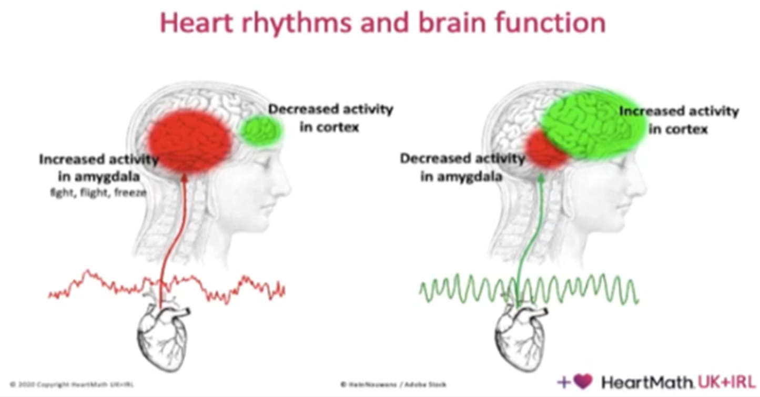
The left slide nicely shows that when the heart is in a negative emotional state and, hence, incoherent, it sends signals to the brain that increase the activity of the amygdala (which tends to fous on negative emotion) to become very active and the prefrontal cortex (which we need of good decision-making) to attenuate.
On the other hand, when the heart is in a positive emotional state of love, appreciation and gratitude, and hence, coherent, it sends signals to the brain that quiet down the amygdala and increase the activity of the prefrontal cortex.

