Slide 1
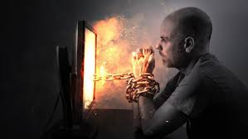
Pornography Addiction – and the Demise of Mind, Body, and Soul
Jeffrey E. Hansen, Ph.D.
Madigan Army Medical Center
Vice is a monster of so frightful mien
As to be hated needs but to be seen
Yet seen too oft, familiar, with her face,
We first endure, then pity, then embrace.
“The views expressed are those of the author and do not reflect the official policy of the Department of the Army, the Department of Defense, or the U.S. Government.”

Slide 2

In the words of
Stephen Arterburn, world renowned expert on sexual addiction,
“I don’t know of know of any plague to ever reach into the homes and families all over the world and create as much damage or heartaches than the struggle of lust, affair, pornography, perversion, and sexual addiction. It seems that everywhere I look, it gets worse and worse. The Internet exploded the problem, and now cell phones transport pornography more portably than the computer and facilitates affairs with greater accessibility and secrecy” (cited in Roberts, 2008, p.9).

Slide 3
The Toll
I have seen boys as young as 11 attempt to rape children as young as 3 after getting steamed up on porn.
I have seen normal adolescent sexuality be hijacked and rewritten from something wonderful to something perverse.
I have seen men go to jail and lose their careers.
I have seen countless marriages fail – the toll is enormous and is mounting every day.
The Utah state legislature has wisely declared pornography a national epidemic that is ripping the fabric of our society (Barta, 2018).

Slide 4
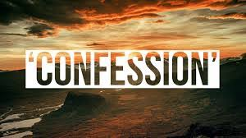
Let me go first:
You may or may not be struggling with pornography, but even if you aren’t, you undoubtedly know someone who is and your knowledge of fact from fiction and how to become free can possibly save the mind, body, and soul of that person.
I want you to know that I offer no judgement for those who struggle. I, myself, struggled with soft porn magazine addiction as a teen and as a young man, a problem that carried into my marriage which it almost destroyed.
I was lucky enough to have a wonderful wife who chose to not leave me and instead helped me engage in a life-saving therapy experience with a man who did not judge me and showed me the way out. I will forever be thankful and fully indebted to my wife and to Dr. Ebeye.

Slide 5

My Favorite Authors Deserve Credit
Barta, M. (2018). TINSA: Trauma Induced Sexual Addiction. North Charleston, SC: CreateSpace Independent Publishing Platform.
Doan, A. (2012). Hooked on Games. Coralville, IA: F.E.P. International, Inc.
Fradd, M. (2017). The Porn Myth: Exposing the Reality Behind the Fantasy of Pornography. San Francisco, CA: Ignatius Press.
Foubert, J. (2017). How Pornography Harms: What Today’s Teens, Young Adults, Parents, and Pastors Need to Know. Bloomington, IN: LifeRich Publishing.
Dines, G. (2010). Pornland: How Porn has Hijacked our Sexuality. Boston, MA: Beacon Press.
Skinner, K. (2005). Treating Pornography Addiction: The Essential Tools for Recovery. Lindon, UT: K. Skinner Corporation.
Turner, A. (2017). Breaking the Feedback Loop: How I Liberated myself from Internet Addiction and you can too. Lexington, KY: Phanarian II.
Zimbardo, P. and Coulombe, N. (2016). Man Interrupted. Newburyport, MA: Red Wheel/Weiser, LLC.
Wilson, G. (2014). Your Brain on Porn. UK: Commonwealth Publishing.

Slide 6

So How is it?
40 million American people regularly visit porn sites (Webroot, 2019).
35% of all internet downloads are related to pornography (Webroot, 2019).
34% of internet users have experienced unwanted exposure to pornographic content through ads, pop up ads, misdirected links or emails (Webroot, 2019).
The societal costs of pornography are staggering. The financial cost to business productivity in the U.S. alone is estimated at $16.9 Billion annually; but the human toll, particularly among our youth and in our families, is far greater (Weebroot, 2019).
40 million American people regularly visit porn sites (Webroot, 2019).
35% of all internet downloads are related to pornography (Webroot, 2019).
One-third of porn viewers are women (Webroot, 2019).
Between 2008 and 2011, exposure to porn among boys under the age of 13 jumped from 14% to 49%. Boys’ daily use more than doubled. (Sun et al. 2016)

Slide 7

So How Did I get Addicted to Porn in the First Place?
Writers have described addiction as being a function of:
Lack of connected living (Hari, 2015)
Trauma (Barta, 2018)
It started off as just plain fun
Some blend of the above (emphasis mine)

Slide 8

The Question of Shame and Moral Failure
Although a descent into addiction can lead to moral issues (e.g., lying to cover, sexual acting out, etc.) it is generally not moral failure that first sets pornography addiction into motion. This is essential to know as shaming only makes matters worse.
Dr. Ted Roberts, who served in Vietnam as a fighter pilot, then became pastor, and subsequently distinguished himself as an expert in the treatment of sexual addictions writes, “Guilt is about what we have done, but shame is about who we are. With guilt we can always get a fresh start. With shame we are caught in a noose, because the problem stays with us…The critical issue to remember about same is that it causes incredible pain” (Roberts, 2008, p 73 – 74).

Slide 9
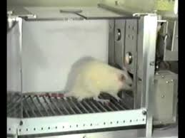
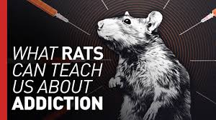
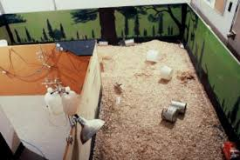
Connection is a Big Deal – The Rats Know
In the 1960’s, psychologist, B.F. Skinner, conducted a series of studies involving rat behavior in what became known as Skinner Boxes.
  Skinner’s rats became hopelessly addicted.
  Skinner concluded that the power of the addiction was solely in the drug itself.
Dr. Bruce Alexander – There is something more to this! Rat Park experiments (Alexander, 1979, 2010)
  Rat Park rodents never became addicted, in fact, most of them never even touched the morphine water at all.

Slide 10
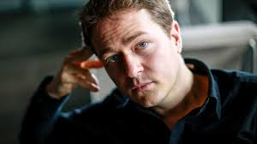
In the Words of Johann Hari (2015)
“Addiction is about bonding.
If you can’t do it with people, you will do it with a substance.
Now that might be gambling, that might be media, that might be cocaine, that might be cannabis.
You will bond to something because that is our nature.
That’s what we want as human beings.”

Slide 11
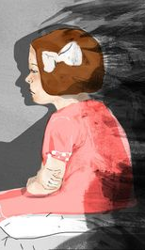
The Role of Trauma
Dr. Michael Barta, in his excellent book on sexual addictions, TINSA – Trauma Induced Sexual Addiction posits, along with several other writers, that sexual addiction has long been hindered by the disorder’s poorly understood cause. He notes and describes:
Sexual addiction and specifically pornography addiction are typically triggered by early trauma
Dopamine and self-regulation worsen addiction
There is a relationship between the brain, the nervous system, and addiction

Slide 12
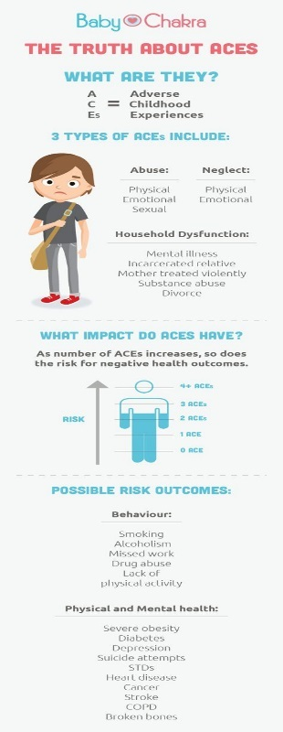
The Role of Trauma
Adverse Childhood Experiences (ACE)
In the mid-1980’s, Dr. Vincent Felitti was commissioned by Kaiser Permanente to explore the issues of obesity, as nothing this hospital group was doing helped put a dent in improving this epidemic.
His research led him to explore the impact of what he called the Adverse Childhood Experiences (ACE) Study (Felitti et al., 2014).

Slide 13
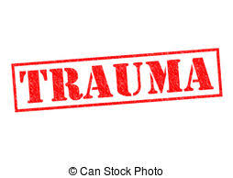
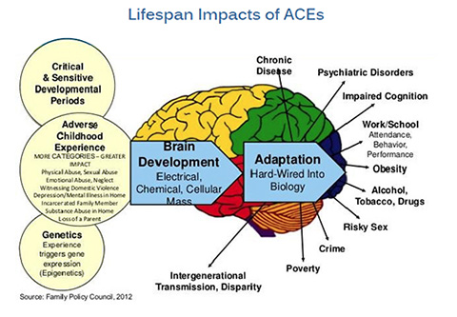
The Role of Trauma
Adverse Childhood Experiences (ACE)
The results indicated that for every category of traumatic experience we have had as a child, we are dramatically more likely to be depressed as an adult.
  If we have had six categories of traumatic events as a child, we are five times more likely to become depressed as an adult and
  If we have had seven categories, we are a terrifying 3,100 percent more likely to commit suicide as an adult (Felitti et al., 2014; Felitti 2004; Felitti and Anda, 2009).

Slide 14
The Role of Trauma
Adverse Childhood Experiences (ACE)
The ten reference categories experienced during childhood or adolescence are as below, with their prevalence in parentheses (Felitti and Anda, 2009):
Abuse
Emotional – recurrent threats, humiliation (11%)
Physical - beating, not spanking (28%)
Contact sexual abuse (28% women, 16% men; 22% overall)
Household dysfunction
Mother treated violently (13%)
Household member was alcoholic or drug user (27%)
Household member was imprisoned (6%)
Household member was chronically depressed, suicidal, mentally ill, or in psychiatric hospital (17%)
Not raised by both biological parents (23%)
Neglect
Physical (10%)
Emotional (15%)

Slide 15
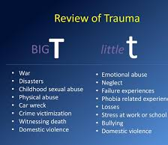
The Role of Trauma
Adverse Childhood Experiences (ACE)
The experts in the field divide trauma into two categories:
Big T trauma: Traumas that are associated with horrific single events such as natural disasters, terrorism, and war.
Little t trauma: Trauma that are smaller in nature such as bullying, neglect, and betrayal.
  The long-term consequences of “little t” traumas are tremendous and often lead to an inability or impaired ability to access appropriate responses to threatening events and can lead to chronic hyperarousal, intense anxiety, panic, mood instability, poor emotional/behavioral regulation, feelings of powerlessness, helplessness, shame, and even immobility. Of all little t traumas, relational trauma is particularly devastating.

Slide 16
The Role of
Adverse Childhood Experiences (ACE)
Examples of small “t traumas” that can pave the way to pornography addiction as noted by Barta (2015):
They were not attuned to by their caregiver
They were invalidated for the child they were
They were not recognized emotionally
They were rejected
They were subjected to parental separation or divorce
They were made to feel inadequate
They were made to feel responsible or making the family feel good
They were sexually abused
They were punished for being authentic
They were controlled by anger
They were made to feel responsible for regulating the feelings and emotions of others
They were not taught how to deal with their own emotions and/or were punished when trying to do so
They were made to feel unsafe
They were inappropriately disciplined/punished – kicked, slapped, or violently shaken
They experienced the loss of a pet, young love, or friendship

Slide 17
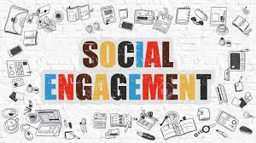
The Role of
The Role of
Adverse Childhood Experiences (ACE)
Most important to normal development is “social engagement” which is the ability to know, understand, regulate, and express emotions in the present moment. Even though everyone is born with a social engagement system (i.e., a neurological system that promotes human connection), we know that early trauma can disrupt its normal development.
Anda et al (2018) note, “Early adverse experiences may disrupt the ability to form long-term attachments in adulthood. The unsuccessful search for attachment my lead to sexual relations with multiple partners with resultant promiscuity and other issues related to sexuality” (e.g., pornography addiction, emphasis ours).
As a result of adverse developmental trauma, the ensuing loss of connection with our inner self, our bodies, others, and the world around us, we are predisposed to engage in addictive behaviors to relieve the emotional dysregulation that torments us.

Slide 18
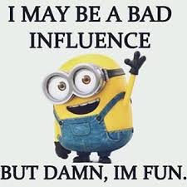
It’s just Fun!
Many young people accidentally discover pornography, many others are introduced to it by another person, usually a peer or a sibling.
And, indeed they find it tantalizing and fun.
They are not seeking to avoid pain nor are they necessarily suffering from a loss of connection to good living.
So what starts off innocently enough, ends up changing their neurology and they “accidentally” become hopelessly addiction

Slide 19
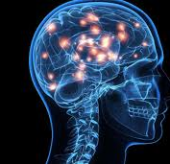
The Neuroscience of Addiction
The Role of Dopamine
  Sensitization
  Desensitization
Hypofrontality – Not a good thing
The Marriage of Triune Brain therapy and Polyvagal Theory

Slide 20
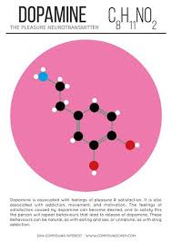
How the Brain Gets Hooked on Digital Drugs
As Kardaras(2016) stated in his book, Glow Kids, in order to fully understand addiction, we need to understand the brain’s reward system and the impact of dopamine on that reward pathway.
Specifically, how much dopamine is activated by a substance or behavior is correlated directly with the addictive potential of that substance or behavior.
Dopamine, as many of us know, is the “feel-good” neurotransmitter that is the most critical and important part of the addiction process. Dopamine was discovered in 1958 by Arvid Carlsson and Niles-Ake Hillarp at the National Heart Institute of Sweden.

Slide 21
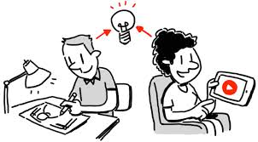
Functions of Dopamine
Dr. Susan Weinschenk (2009) noted that dopamine is created in various parts of the brain and is critical in several brain functions to include:
Thinking
Moving
Sleeping
Mood
Attention
Motivation
Seeking and reward
Inspired to watch because of Dopamine

Slide 22
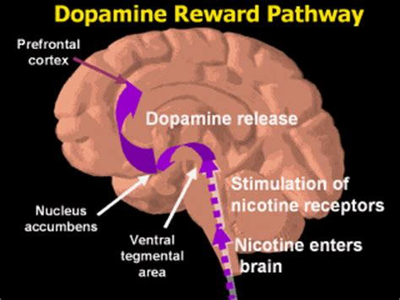
Dopamine Reward Pathway
The mesolimbic pathway is a collection of dopaminergic(i.e., dopamine-releasing) neurons that project from the ventral tegmental area (VTA) to the ventral striatum, which includes the nucleus accumbens (NAcc) and olfactory tubercle. It is one of the component pathways of the medial forebrain bundle, which is a set of neural pathways that mediate brain stimulation reward.

Slide 23
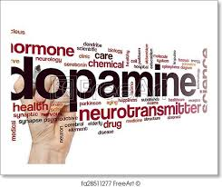
More on Dopamine
When an individual performs an action that is satisfying to a need or fulfills a desire, dopamine is released into the nucleus accumbens, a cluster of nerve cells beneath the cerebral hemispheres that are specifically associated with reward and pleasure. This is also known as the brain’s “pleasure center.”
Natural dopaminergic activities, such as eating and sex, usually come after effort and delay and serve a survival function.
These are called the “natural rewards” as contrasted with addictive chemicals/behaviors (which can highjack the same circuity).
Addictive drugs and behaviors, such as gambling and video gaming, actually offer a short-circuit to this process which only ends up flooding the nucleus accumbens with dopamine and does not serve any biological function.

Slide 24
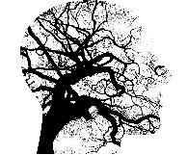
Dopamine vs Endogenous Opioids
Although dopamine has been referred to as the “pleasure molecule,” it is in actuality more about seeking and searching for pleasure, rather than pleasure itself. Dopamine is more involved in drive and motivation to seek.
The “final reward” or what we experience as feelings of pleasure, Wilson (2014) writes, involve the release of endogenous opioids.
You can think of dopamine as “wanting” and opioids as “liking.”
As psychologist Dr. Weinschenk explains, “Dopamine causes us to want, desire, seek out and, search; however, the dopamine system is stronger than the opioid system and we hence seek more than we are as satisfied…” (Weinschenk, 2009).
“Addicts want it more but gradually like it less. Addiction might be
thought of as “wanting gone amok.” (Wilson, 2014).

Slide 25


Bought the BMW but still wANTING the Ducati Diavel

Slide 26

Dopamine and DeltaFosB “Keep doing it!”
Highly salient activities, in this case addiction, lead to the accumulation of DeltaFosB, a protein that activates the genes involved with addiction. The molecular changes it potentiates are almost identical for both sexual conditioning and chronic drug use. Specifically, DeltaFosB rewires the brain to crave IT whatever IT is.
In a sense, dopamine is like the foreman on a construction site barking orders and DeltaFosB is the worker on the site. Dopamine is yelling, “This activity is really important, and you should do it again and again.”
DeltaFosB is responsible for ensuring that you remember and repeat the activity.
This repeated process produces what is called sensitization which is based on the
principle, “Nerve cells that fire together wire together” as noted by Canadian
researcher Donald Hebb in 1949. Repeated activity strengthens
cell connections.

Slide 27
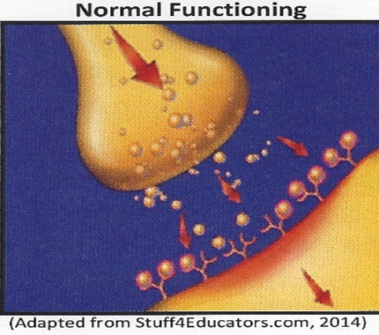
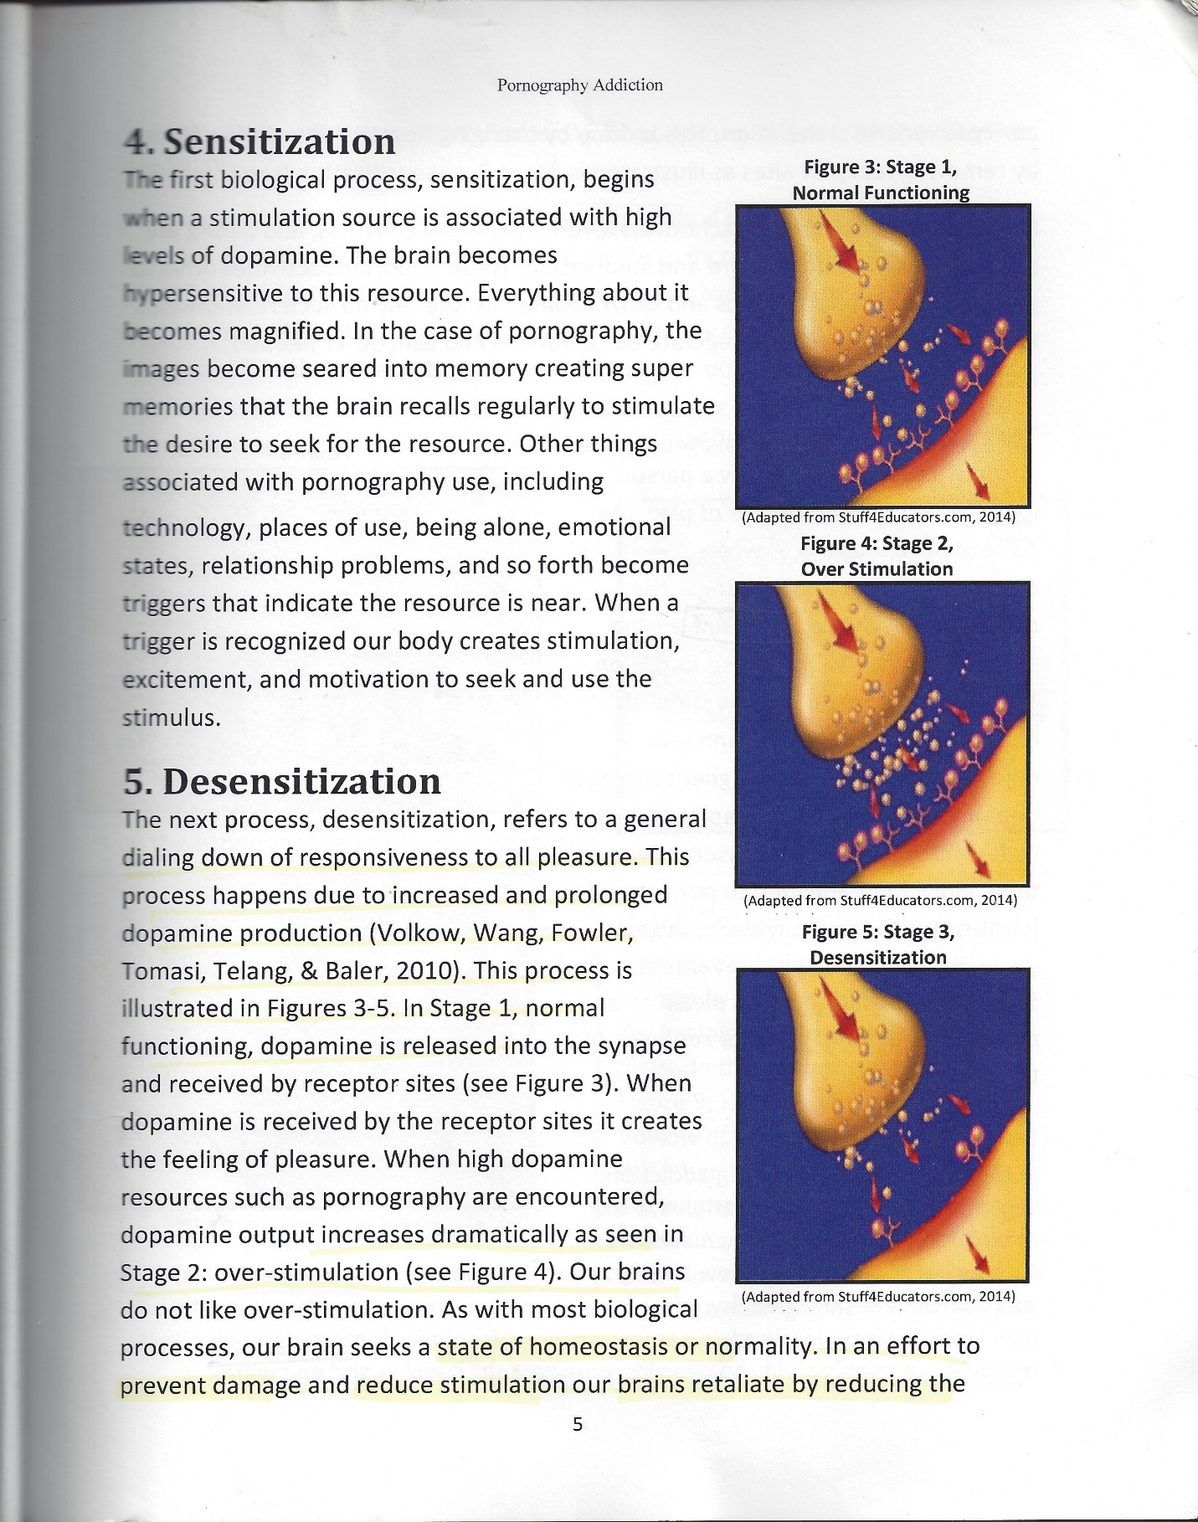
Dopanergic Downregulation at the Synaptic Level

Slide 28
So, we see that chronic overstimulation can lead to two opposite effects:
Increased dopamine activity (wanting/seeking it more) –
sensitization via DeltaFosB
01
Decreased dopamine and opioid activity (liking it/enjoying it less) – desensitization via CREB
02

Slide 29
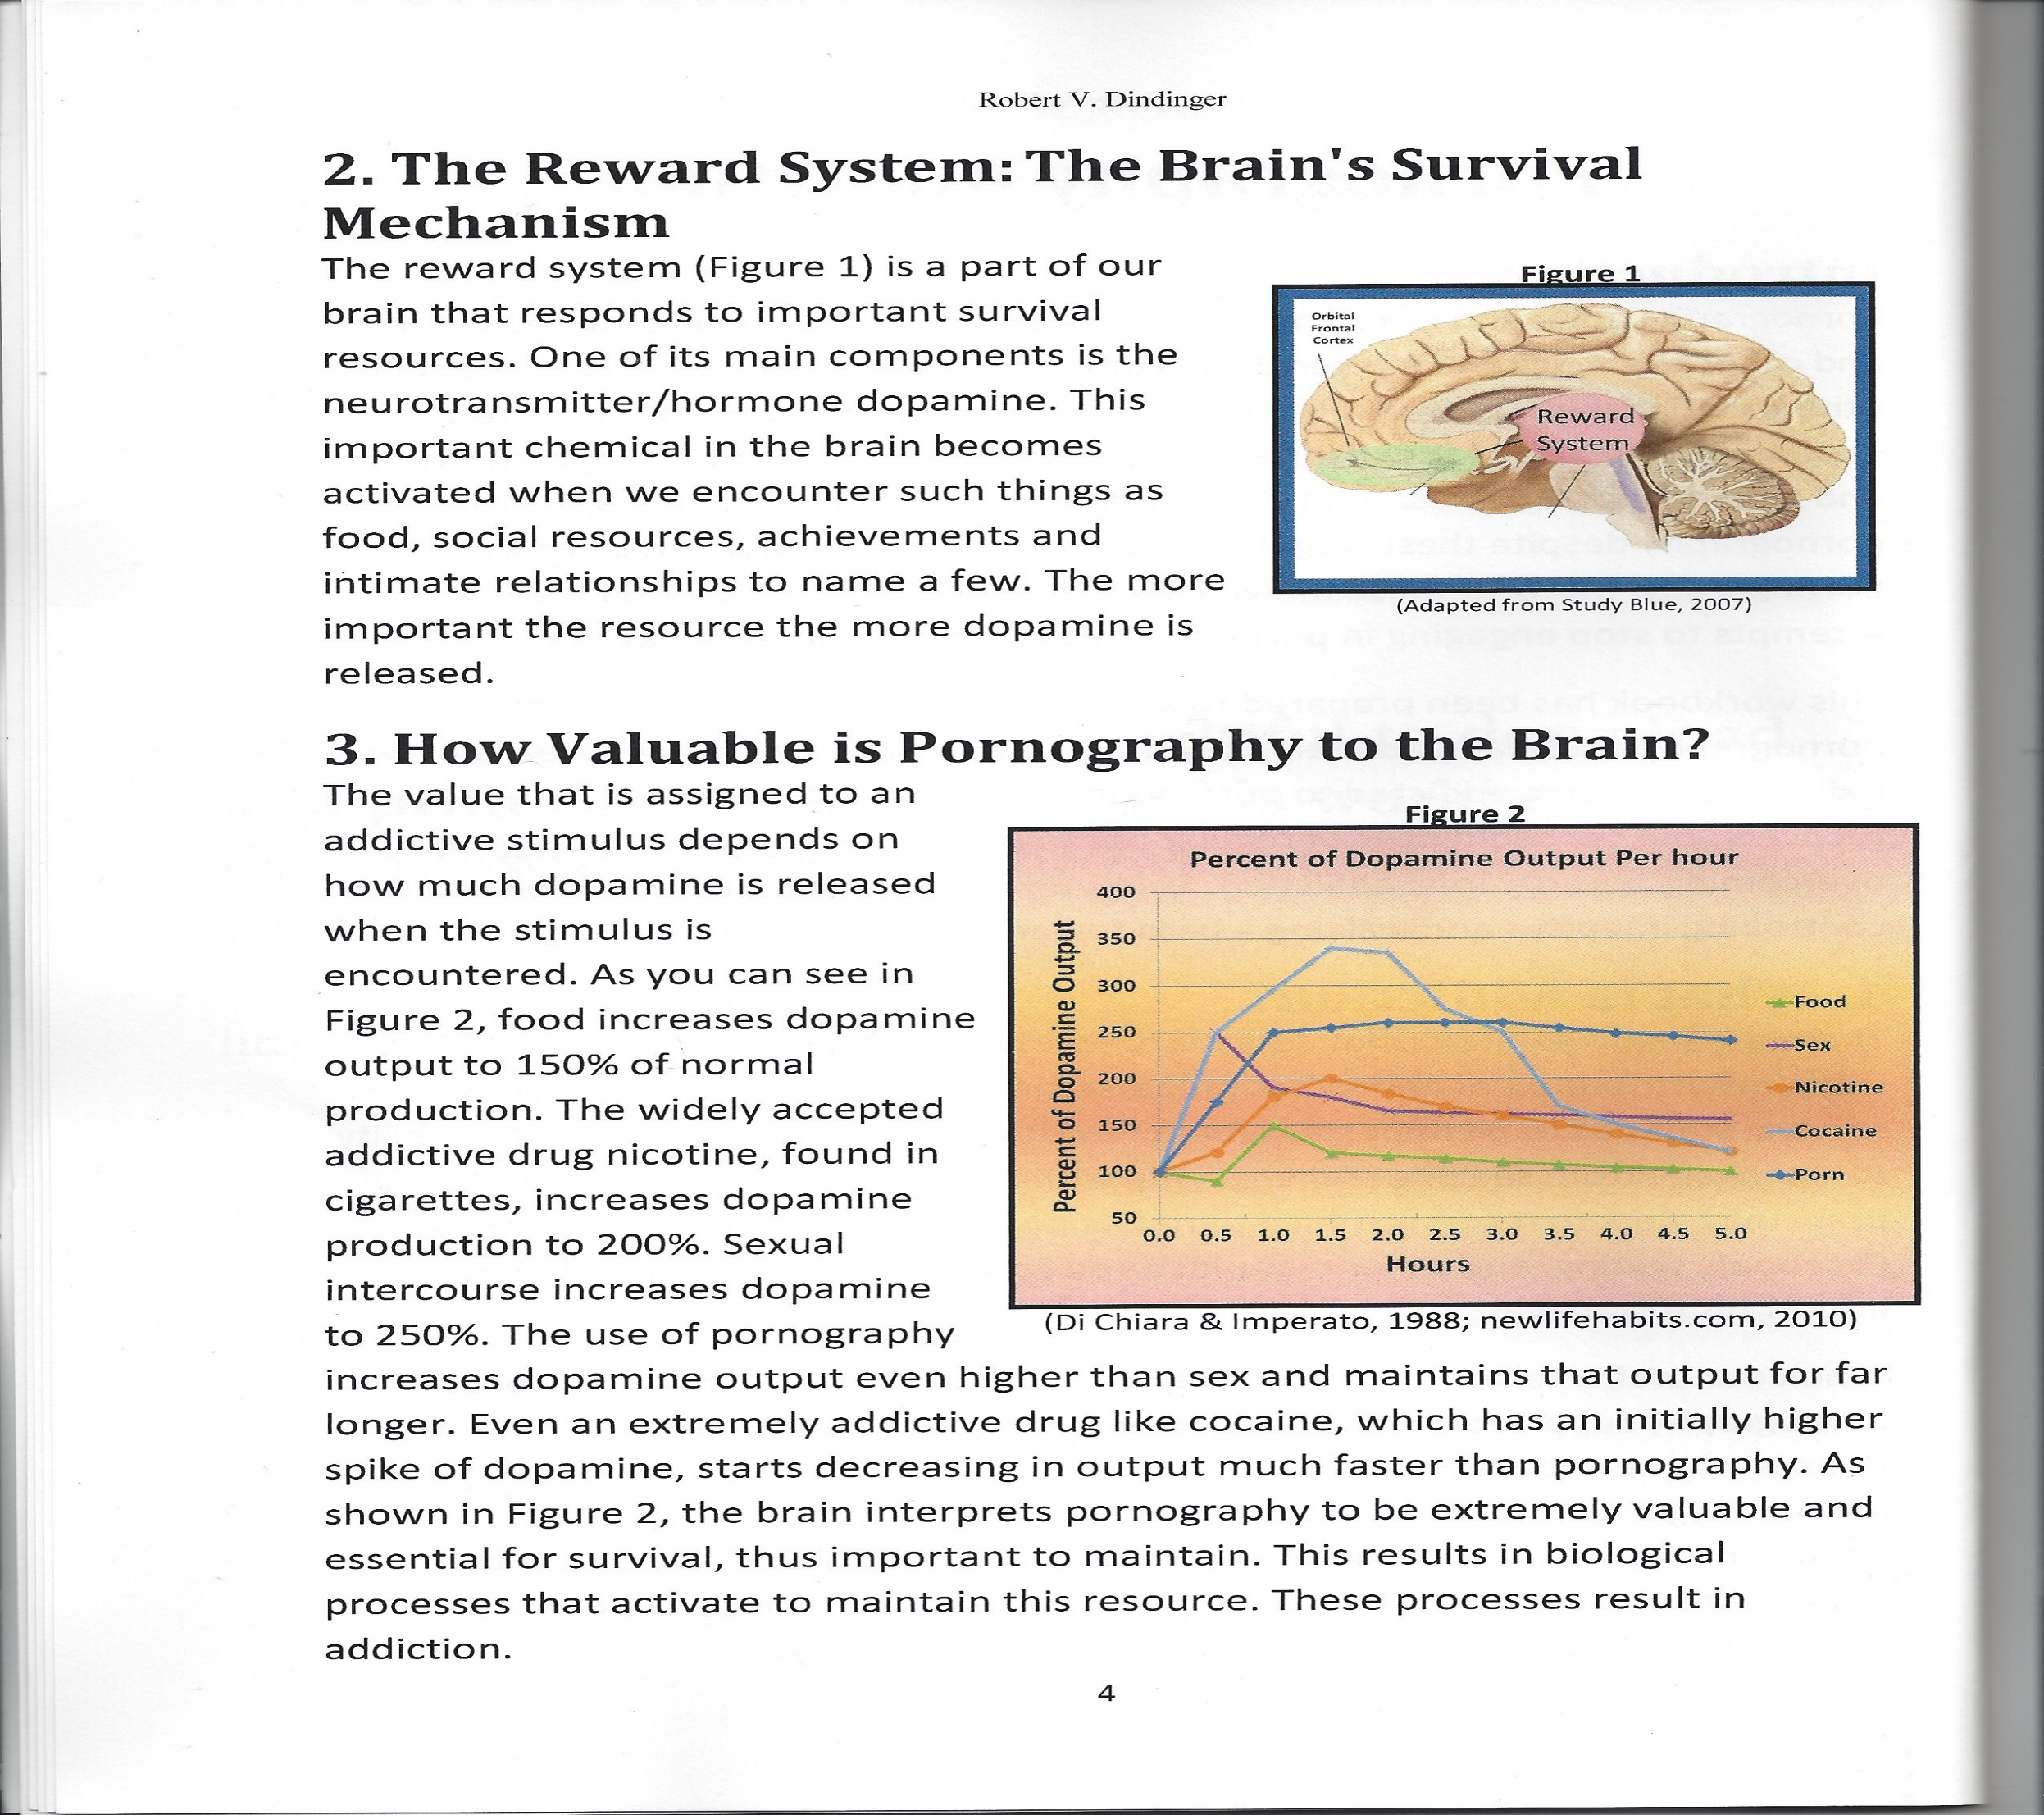
What Cranks Us Up
Summary of dopamine increases:
Food – 150% increase
Nicotine – 200% increase
Snorting cocaine – 350% increase
Sexual intimacy – 250% increase
Pornography – 250% increases and stays elevated for longer – even when compared to cocaine

Slide 30
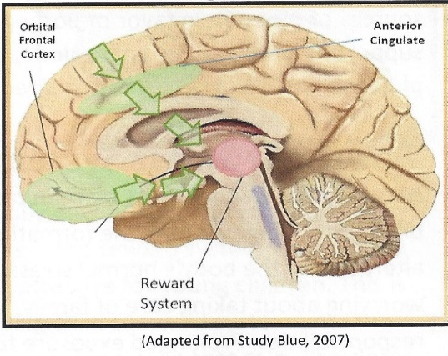

Impact of Hypofrontality – not a good thing:
Two areas of the brain, the anterior cingulate and the orbital frontal cortex, serve as a protective mechanism to override the reward system’s desire for ever increasing dopamine increase. Sadly, hypofrontality involves the rewiring of our brains so that when an impulse to engage in a dopamine-related behavior activated, the brain ends up shutting down its ability to override the reward system. This is the breeding ground for horrible choices an impacts on social development.

Slide 31
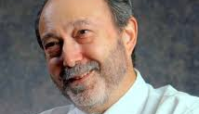

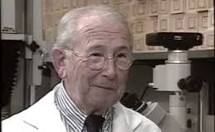
The Marriage of Triune Brain Theory and Polyvagal Theory
Barta (2018) proposes a model that demonstrates how the brain and the nervous system work together to fuel addiction. In his model which he calls TINSA (Trauma Induced Sexual Addiction), he pairs some of the greatest minds in neurology and psychology to include:
Dr. Stephen Porges’ Polyvagal Theory
Dr. Paul Maclean’s Triune Brain Theory’

Slide 32
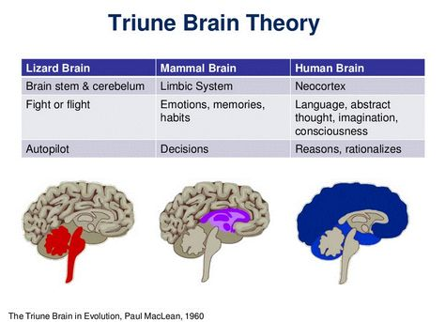
Triune Brain Theory
MacLean proposed that there are there are three distinct formations in our brain which are used in different situations for everyday survival purposes. These specific structures developed sequentially on top of each other at different times during the evolution of the brain for the purposes of giving the organism the ability to survive during that period of time. Even though the brain became more advanced and adaptive, the older more primitive structures of the brain still play a very important role in thought, process, and behavior.

Slide 33
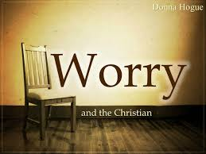
Triune Brain Theory
For my Christian friends who might worry about this model contradicting sensitivities about creationism – not to worry.
As explained by Dr. Andy Doan, M.D. Ph.D., Christian Ophthalmology surgeon and neuroscience researcher, by personal communication and paraphrased by me, “God is very efficient, and He included in our more developed brain substructures that He already designed for lower life forms/animals.
No need to re-do what was already perfect and efficient”.

Slide 34
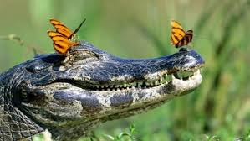
Triune Brain Theory
The Reptilian Brain (or Reptilian Complex)
As the name suggests, this is the most primitive brain and it developed about 500 million years ago in fish and later reptiles.
Its roles include sensation, instinctual reaction, breathing, temperature regulation.
TINSA hypothesizes that the reptilian complex promotes certain survival functions as well, most specifically, immobilization or freeze.
We often see lizards, for example, freeze in the face of danger such as a lunch-starved predator in an instinctive reaction that can be life-saving (sadly for the lizard, it doesn’t always work, and he sometimes ends up being snack anyway). We also see this in humans in the face of terrifying situations.
Like our lizard friends, it sometimes works, and other times gets us killed.

Slide 35
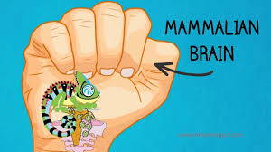
Triune Brain Theory
The Mammalian Brain (or Limbic System)
Later, about 150 million years ago, the limbic system first appeared in small animals.
This system developed as critters were able to move more freely about as they were now equipped with extremities.
As such, it often became necessary to either fight off or flee from would-be predators.
In addition, the capacity to have memory and emotions developed. This enabled the animal to control the body’s response to danger and to remember that danger as well as the ability to be vigilant and scan the surrounding environment for potential dangers.
Like critters, we often revert to this neurological system when we act instinctively.

Slide 36
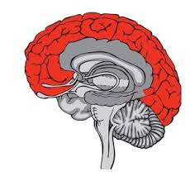
Triune Brain Theory
The Frontal Lobe (or Neocortex)
According to MacLean (1990), the frontal lobe came on board only about 2 or 3 million years ago.
As in the reptilian brain and the limbic system, the purpose of this brain formation is to react to and protect us from danger.
But unlike or more primitive neighbors, this system reacts consciously. Very importantly, there was a need to develop a system that made possible more “civilized” responses to threats and at the same time one that offered the possibility to connect to others for safety.
Therefore, the frontal lobe allows us to access a new way of surviving based on socialization. This makes it possible for us to use analysis, logic and decision-making, and this is what specifically separates us from other lower-ordered animals that rely on instincts alone for survival.

Slide 37

Triune Brain Theory
To bring it home:
To bring it home, on topside we have the cortical brain consisting of the frontal lobe which is the most recently developed portion of the brain, i.e., the conscious, thinking brain.
According to Barta (2018), addicts to include pornography addicts, live much more in their unconscious, emotional, and instinctual brains than in their frontal lobe or social engagement system.
As such, when the limbic and reptilian brain take charge, the conscious brain switches off and the higher order brain is essentially hijacked, and we end up not thinking and instead just reacting. As a result, consequences and not weighed very heavily, if at all.
At the bottom, we have our subcortical, unconscious brain, which is made up of the reptilian and limbic complexes and is directed largely by raw instinct and emotions which often results in immediate knee-jerk reactions that happen in a split second.

Slide 38
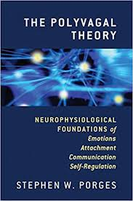
Polyvagal Theory
In order to move forward in our understanding of what his happening to us as we progress toward addiction, we must understand the Steven Porges’ Polyvagal Theory and then integrate this knowledge with Triune Brain Theory.
So, first a little anatomy.
The Autonomic Nervous System is a control system that acts largely unconsciously and regulates bodily functions such as heart rate, digestion, respiratory rate, pupillary response, urination, and even sexual arousal. It has two main subdivisions:
      Sympathetic
      Parasympathetic

Slide 39
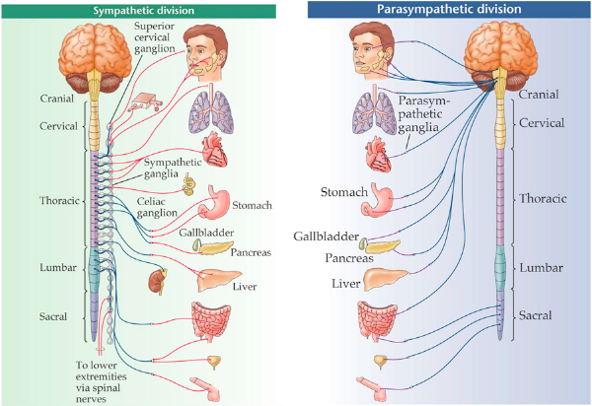
Polyvagal Theory
Autonomic Nervous System

Slide 40
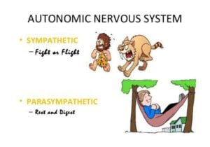
Polyvagal Theory
Autonomic Nervous System
Sympathetic Division: Prepares the body for stressful or emergency situations – fight or flight. Thus, the sympathetic division increases heart rate and the force of heart contractions and widens (dilates) the airways to make breathing easier. It causes the body to release stored energy. Muscular strength is increased. This division also causes palms to sweat, pupils to dilate, and hair to stand on end. It slows body processes that are less important in emergencies, such as digestion and urination (Merck Manual).
Parasympathetic Division: Generally, the parasympathetic division conserves and restores calm/homeostasis. It slows the heart rate and decreases blood pressure. It stimulates the digestive tract to process food and eliminate wastes. Energy from the processed food is used to restore and build tissues (Merck Manual).

Slide 41
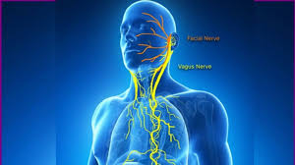
Polyvagal Theory Autonomic Nervous System
Steven Porges discovered that the parasympathetic division of the Autonomic Nervous System consists of two branches which lead to two different responses.
The main nerve in the parasympathetic nervous system is the 10th cranial nerve, aka vagus nerve, which is the largest of the 12 cranial nerves and has huge implications for our well-being and health.
The vagus nerve has two very distinct branches:
      Dorsal vagal nerve
      Ventral vagal nerve

Slide 42
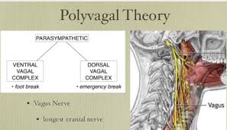
Polyvagal Theory
Autonomic Nervous System
Dorsal Vagal Nerve: Barta (2018) notes that the most primitive form of defense occurs when the dorsal vagal nerve is activated. When activated, the dorsal vagal nerve promotes shutdown, freeze, and collapse. An example of this shutdown is when a gazelle, for example, is being stalked by a lion and when trapped with no possible way to flee, drops down and appears to be deader than a doornail. This not a conscious process but is, rather, a very primitive and unconscious one.
Ventral Vagal Nerve: Barta (2018) writes that the second response of our parasympathetic nervous system (the first being freeze and collapse as noted above) is responsible for our ability to engage socially and to handle social relationships. According to Barta, the social engagement system is controlled by our ventral vagus nerve which is a very smart nerve with a rapid response time. As such, it allows us to “know” if we are safe enough so we can calm our defenses through a process of “neuroception” which is roughly translated as the brain’s ability to sense safety. This serves not only bonding needs but allows us to shift out of sympathetic arousal and move into parasympathetic calm or to downshift from activation to calm.

Slide 43
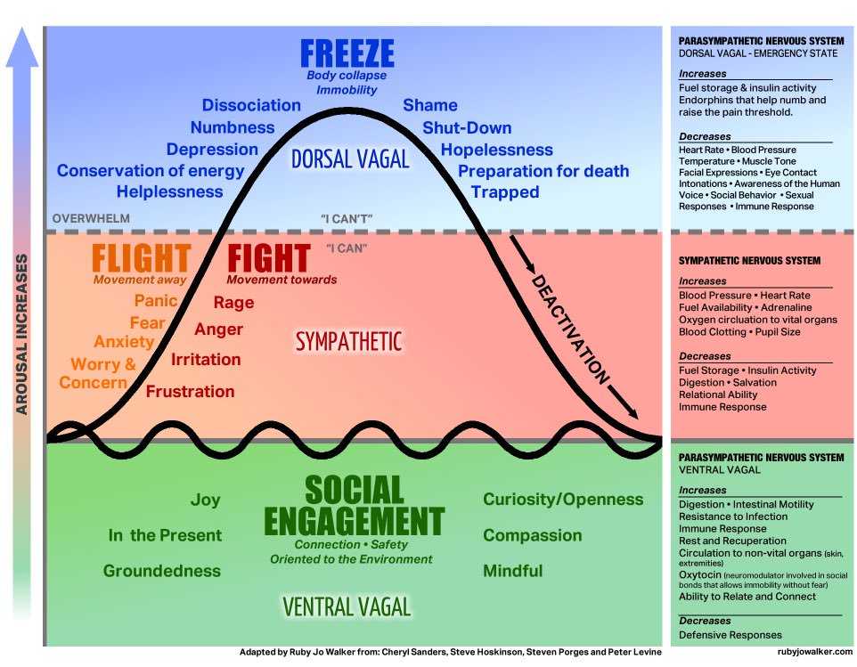
Polyvagal Theory
Autonomic Nervous System

Slide 44
The Marriage of Maclean’s Triune Brain Theory with Porges’ Polyvagal Theory
Through the marriage of Maclean’s Triune Brain Theory with Porges’ Polyvagal Theory, we can:
Explain the how each part of the triune brain is correlated with the three responses of the autonomic nervous system (Barta, 2018).

Slide 45
The Marriage of Maclean’s Triune Brain Theory with Porges’ Polyvagal Theory

Slide 46
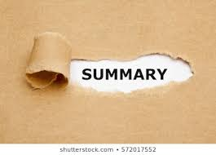
In
Excessive media and specifically pornography serve to dangerously pull us out of the neocortex (wise thinking and conscious state) and into our reptilian brain (reflexive and unconscious state).
At the same, this behavioral addiction shuts down much needed parasympathetic calmness and safety as well as connection and social engagement
It artificially fires up sympathetic arousal which impacts on our health emotionally, physically, and spiritually.

Slide 47
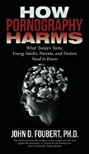
Part Three – The Impact of Pornography
In his compelling book, How Pornography Harms, Professor and Dr. John Foubert, an interdisciplinary scholar who has studied sexual violence since 1993 and the harms of pornography since 2006, reminds us of how, in contrast to a mountain of data available, the tobacco industry icons testified before Congress in 1994 that they believed that cigarettes were not addictive or harmful.
In a very similar way, Dr. Foubert notes that there are powerful voices today that try to convince us that pornography isn’t harmful either (Atwood et al., 2014). He adds that there are over 100 studies that demonstrate that pornography harms people, often horribly and sometimes irrevocably (Malamuth et al., 2000; Peter et al., 2016).

Slide 48
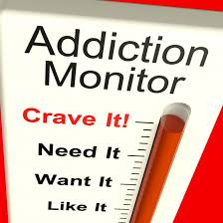

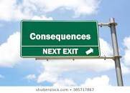
The Three C’s of Addiction
Wilson (2014) notes that all addictions, regardless of their differences, result in an established set of “core brain changes” which, in turn, present as recognized signs, symptoms, and behaviors such as those listed in the Three C’s:
Craving and Preoccupation with obtaining, engaging in or recovering from the use of the substance or behaviors in question.
Loss of Control in using the substance or of engaging in the behavior and noted by increasing frequency or duration, larger amounts or intensity, and/or increasing the risk and behavior in an effort to obtain the desired effect.
Negative Consequences in physical, social, occupational, financial, or psychological areas.

Slide 49

The Impact of Pornography on the Body
Dr. Donald Hilton, who has authored many studies on the addictive nature of pornography, referenced research that shows that the more people watch pornography, the more their brains actually shrink.
Research has also demonstrated that watching pornography slows down the working memory (Laier, et al., 2013).
Kuhn and Gallinat (2014) found decreased gray matter in the brain areas that are responsible for decision making and motivation of porn seekers.

Slide 50

The Impact of Pornography on the Body
It is frightening that you don’t even have to be “addicted” to porn but that merely using it begins to change the brain in negative ways. So, if you ever thought that pornography was making you dumber, you were absolutely right.

Slide 51
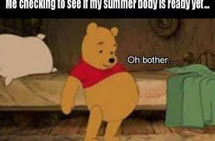
Impact of Excessive Pornography on the Body
Excessive pornography use can trigger Metabolic Syndrome. Metabolic syndrome is a combination of the following (Dunckley, 2015):
  High blood pressure
  Midsection weight gain (spare tire)
  Abnormal cholesterol levels
  High fasting blood sugar
Metabolic Syndrome is a serious condition and, if left unchecked, can
promote:
  Diabetes
  Heart disease
  Stroke

Slide 52

In the words of Dr. Andrew Doan
“I had pain from my clicking finger all the way up to my forearm. And my cortisol levels were shot - through my hypothalamic-adrenal-pituitary axis (HPA), so I was getting fat because I had all of this cortisol floating around. I didn’t exercise, so I was retaining more body fat. And then finally my HPA axis was all dysregulated so I was more prone to infection - I had pimples all over my face, I had stretch marks beginning. And then, finally, I got an infection in my armpit!
So, in addition to the carpel tunnel, I had this armpit infection that was streaking down my arm. And on top of that, because my blood pressure was going up because of the gaming adrenaline rush - my blood pressure was high, my cholesterol was high. And because my blood pressure was high, and I was sitting all of the time, I had hemorrhoids the size of walnuts. - I mean, literally! I was a young man - I was pissed off. Why do I have hemorrhoids like some pregnant women do? We’re talking about bloody, painful hemorrhoids…So I’m convinced that if people are addicted to this thing, it’s going to ruin their lives. It almost ruined mine - and it almost ruined my son and almost destroyed his confidence and his opportunities” (Kardaras, 2016).

Slide 53
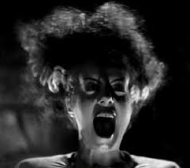
Excessive Pornography Promotes Hyperarousal
Blood Flow Shifts: When a person is under stress, blood flow to the brain is shunted away from the higher regions of the brain, i.e., the cortex, and directed to the more primitive parts of the brain, i.e., the limbic or old brain in an effort to promote survival.
Elevated Cortisol: Chronically elevated cortisol is associated with obesity, diabetes, hormone imbalance, metabolic syndrome, and high blood pressure as previously noted (Pervanidou et al., 2011).
Oxidative Stress: When the cell’s natural defenses are overwhelmed due to excessive stress, the antioxidants or scavengers are depleted, and oxidative stress or excessive free radicals develop. Free radicals cause inflammation, tissue damage, and decreased efficiency.

Slide 54

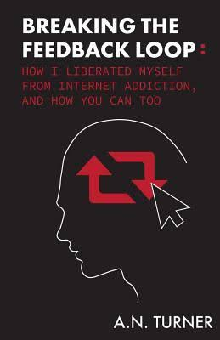
The Impact of Media on Depression
A.N. Turner (2017) writes of his own struggle with depression secondary to media/porn overconsumption,
“My relationship with the Internet was not alleviating feelings of loneliness; it was amplifying my loneliness, bringing me to a state of frustrated depression. I felt boxed in, unable to breathe, trapped in an inescapable thought bubble of my own f*ed up, addictive desires. I conditioned myself to need constant stimulation. I couldn’t read, talk, study, or play the piano – all things that I love – because it all seemed too slow, too one-note…I was always tired, yet always racing in a mad frenzy. I couldn’t focus. I was anxious. I was unable to engage in solitude. My thoughts were a jumble.”

Slide 55
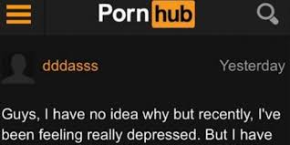
Excessive Pornography and Depression
We are, on a surface level, the most connected society that has ever walked the planet.
Each second, we send over 7,500 tweets, 1,394 Instagram photos, and over two million emails and view over 119,000 YouTube videos (Internet Live Stats, website, www.internetlivestats.com).
Americans send 69,000 texts a second, which translates to over six billion texts sent out in the US daily. Paradoxically, the more connected we think we are with the façade of the Internet, the more disconnected and depressed we actually become.
As Johann Hari (2015) said in a Ted Talk, “We are the most disconnected society that has ever been, surely.”

Slide 56
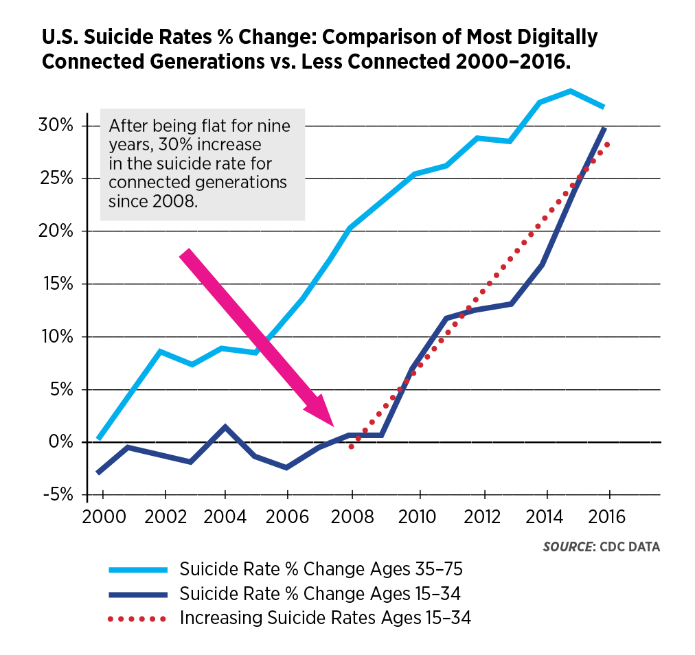
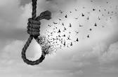
Excessive Pornography and Depression
A 2018 study conducted by Blue Cross and Blue Shield revealed that that the highest rate of growth in depression has occurred in the youngest and the most digitally connected age bracket (see chart below).

Slide 57
Excessive Pornography and Depression
The connection between general media consumption to include gaming and social media and depression is well-established by Kardaras (2016)
A 2012 Missouri State University study of 216 students revealed that 30 percent of Internet users showed signs of depression and that the depressed kids were more intense web users.
A 2014 study looked at 2,293 seventh-graders and found that Internet addiction led to increased depression, hostility, and anxiety.
A 2014 study conducted in Pakistan with 300 graduate students found a positive correlation between Internet addiction and depression and anxiety.
A 2006 Korean study involving 1,573 high school students found a correlation between Internet addiction, depression, and thoughts of suicide.
Recently, the term Facebook Depression has emerged – namely, the more “friends” one has on Facebook, the higher the likelihood of depressive symptoms (Kardaras, 2016).

Slide 58

Excessive Pornography and Depression
Dr. David Skinner, a sexual addiction expert, wrote about a non-peer-reviewed online study in his blog comprised of 450 subjects, mostly men, and
He found that individuals who viewed pornography three to five times per week and/or daily scored much higher on a standard measurement for depression and included it as a part of a free online survey found at growthclimate.com.
The individuals who viewed pornography three to five times per day scored on average nearly 15 on the depression survey and those who viewed it daily scored on average 21 compared to the general population score of 6.5.

Slide 59

Excessive Pornography and Depression
As noted in MetalHelp.net (2016), researchers have concluded that compulsive and at-risk cybersex users experience guilt, depression, and anxiety. The writers conclude that this may both result from pornography usage and perpetuate further behavior.
Weaver et al. (2011) found that adult users of pornographic material reported greater depressive symptoms, poorer quality of life, more mental‐ and physical‐health diminished days, and lower health status than compared to nonusers.

Slide 60
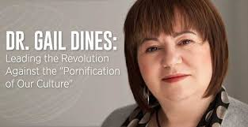
Excessive Pornography and Depression
Dr. Gail Dines concluded that studies indicate that porn users experience:
  • higher incidence of depressive symptoms
  • lower degrees of social integration
  • decreased emotional bonding with caregivers
  • increased conduct problems
  • higher levels of delinquent behavior
https://www.culturereframed.org/
Dr. Dines is professor emerita of sociology and women’s studies at Wheelock College in Boston.

Slide 61
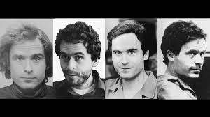
The Impact of Pornography on Sexual Aggression and Violence
In the chilling words of Ted Bundy, serial murder:
"I think people need to recognize that those of us who have been influenced by … pornographic violence-are not some kind of inherent monsters. We are your sons and we are your husbands. … Any pornography can reach out and snatch a kid out of any house to-day."
"I've lived in prison for a long time … and I've met a lot of men who were motivated to commit violence just like me. And without exception every one of them was deeply involved in pornography -- deeply influenced by an addiction. There is no question about it. The FBI's own study shows that the most common interest among serial killers is pornography." (Dobson interview, 1989).

Slide 62

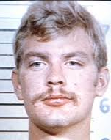
The Impact of Pornography on Sexual Aggression and Violence
In the words of Jeffrey Dahmer, serial killer who drugged and killed 17 men and boys as related in a confession to the FBI in 1992:
"heavy drinking, pornography, and masturbation" -- admitting while in the U.S. Army he found graphic porn in Germany and spent thousands of dollars on it. He admitted to killing as often as once a week. (APB News, 2000).

Slide 63

The Impact of Pornography on Sexuality
Inability to achieve orgasm during sex:
Gary Wilson (2017) in Your Brain on Porn, one of the best books on the neurological impact of pornography addiction, writes that years of porn use can cause a variety of sexual symptoms which lie on a spectrum. Often porn users report that delayed ejaculation or inability to orgasm (anorgasmia) was a prelude to full blown erectile dysfunction.
Citing one 29-year-old young man from Gary Wilson’s forum stated, “17 years of masturbation and 12 years of escalating to extreme/fetish porn. I started to lose interest in real sex. The buildup and release from porn became stronger than it was from sex. Porn offers unlimited variety. I could choose what I wanted to see in the moment. My delayed ejaculation during sex became so bad that sometimes I could not orgasm at all. This killed m y last desire to have sex” (Wilson, 2017, p. 41).

Slide 64
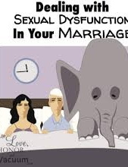
The Impact of Pornography on Sexuality
Unreliable erections during sexual encounters:
Between 1948 and 2002, the historical rates for ED in men under 40 were consistently around 2% to 3% and did not go up very much until age 40. (de Boer, B. et al. (2004). However, as noted by Wilson (2017), at least six studies have found ED rates of about 14% to 33% in young men, which constitutes a staggering 1000% increase in just the last 15 years (Park, 2016).
In fact, adolescents are suffering disproportionately as noted by in a Canadian study which showed that problems in sexual functioning are sadly higher in adolescent males than in adult males. In a two-year period 78.6% of males aged 16-21 reported a sexual problem during partnered sexual activity (O’Sullivan et. al., 2016):
  Erectile dysfunction - 45%
  Low sexual desire - 46%
  Difficulty climaxing – 24%

Slide 65

The Impact of Pornography on Sexuality
Scary and alarming porn fetish tastes:
Gary Wilson (2017) writes that once upon a time, men could trust their penises to tell them everything they needed to know about their sexual preferences and orientation. However, our brains are very plastic (or able to change with experience). As such, our brains change with experience with or without our conscious participation.
Wilson notes, that as a function of porn involvement, porn users often move from one genre to another and will often arrive in places that they find very disturbing and/or confusing.
As a result, a previously defined heterosexual boy might ultimately find himself enjoying homosexual pornography and then begin to question his sexuality.
Additionally, many men end up viewing child pornography as they have habituated to everything else. As has been said, “I did it all and then got bored (habituated) with it all and thus (child porn) was the final taboo that excited me.

Slide 66


The Impact of Pornography on Sexuality
Scary and alarming porn fetish tastes - continued:
Downing et al. (2016) conducted a study that found that it is now quite common to find men who view porn that is inconsistent with their sexuality. Specifically, they reported that heterosexual-identified men in the study reported viewing porn containing male same-sex behavior (20.7%) and gay-identified men reported viewing heterosexual behavior in porn (55%).
Wilson (2017) notes that it is very sad that porn users are ignorant of how common it is to escalate; often leaving porn users in the end, feeling very anxious, demoralized, and hopeless. He adds that it can be especially distressing to escalate through porn fetishes that ultimately cast doubt on one’s sexual orientation.

Slide 67

The Impact of Pornography on Women and How They are Viewed
Dr. Foubert (2017) writes that the root of many acts of violence against women, to include sexual violence, lies in a process in which a person sees another person as more of an object than a flesh-and-blood human being. In an effort to study this process, a research team from the Netherlands investigated the relationship between adolescents viewing pornography and whether or not they ended up believing that women were more objects than real people. The results revealed that the more that young males and females viewed porn, the more they took on a mindset that females indeed are objects (Peter et al., 2007; 2009).
In a review of previous studies on the objectification of women, Klassen and Peter (2015) noted that Internet pornography promotes gender inequality between the sexes because it treats women as sex objects, subordinates them, and depicts rape and violence against them. They conducted a content analysis of 400 popular pornographic Internet videos from the most visited pornographic Web sites and concluded that objectification was depicted more often for women than for men and men were shown as dominant and women as submissive

Slide 68


The Impact of Pornography on Women and How They are Viewed
Instead of a woman being seen as a lovely and beautiful human being, she is now far too often being devalued to nothing more than an object to satisfy basic animal desires that are triggered and then played out online. Men ask of their partners, and I use that term loosely, to play out their fantasies as spawned by what they have previously seen. There is little to no interest in satisfying the desires of their partners and leaving them happy and fulfilled.
Sex is, hence, far too dopamine-driven, with too little oxytocin. Oxytocin has been called the “love hormone” that also acts as a powerful neurotransmitter in the brain. The body releases oxytocin during physical touch and skin-to-skin contact such as hugging, cuddling, kissing, and other sexual behaviors.
Oxytocin brings on feelings of calmness, security, and contentment—feelings often associated with pair bonding. Oxytocin activates brain areas associated with pleasure and reward, likely because the body releases dopamine in coordination with oxytocin as the result of physical touch. Oxytocin also plays a role in pregnancy and nursing, and mother-infant attachment (The neurobiology of romantic love, 2018).

Slide 69

The Impact of Pornography on Sexual Aggression and Violence
In his book, How Pornography Harms, Dr. Foubert (2017) notes that there are over 100 studies which show that pornography is correlated with and is the cause of a wide range of violent behaviors and about 50 studies that show a strong relationship between pornography and sexual violence (Peter et al., 2016 & Malamuth, 2000).
Kingston et al. (2009) write that researchers have also found that pornography use specifically increases the likelihood that a man will commit acts of sexual violence against women, especially if the man in question has additional risk factors such as impulsivity and if the pornography use is frequent.

Slide 70

The Impact of Pornography on Sexual Aggression and Violence
Dr. Mary Ann Layden found evidence of increased violent acts towards women by males who consume pornography.
If men are hostile in attitude toward women, are promiscuous sexually, and are frequent consumers of pornography, they are much more prone to be both physically and sexually aggressive toward women.
Pornography teaches, gives permission, and eventually triggers attitudes and behaviors that are destructive to both the user and to others. The damage is evident regardless of sex or of age. In her own words, “Pornography is a widely influential and very toxic teacher” Layden, 2010).

Slide 71

The Impact of Pornography on Sexual Aggression and Violence
Owens et al (2012) and Sun et al. (2016) reported that research findings consistently link the viewing of violent pornography to increased tendencies for sexually aggressive behavior
Stanley et al. (2016) reported that there is a clear association between regular viewing of online pornography and perpetration of sexual coercion and abuse by boys.
Stanley et al. (2016) found that both regularly watching pornography and sending or receiving sexual images or messages were associated with increased probability of being a perpetrator of sexual coercion.
Dr. Walther DeKeseredy (2016) reported that among divorce people he studied, 30% stated that their husband’s pornography use was integral to the sexual abuse they suffered in their marriage.

Slide 72

The Impact of Pornography on Sexual Aggression and Violence
The verdict is in!
Wright et al. (2016) conducted an excellent and exhaustive meta-analysis of 22 studies from 7 different countries and concluded:
“The accumulated data leave little doubt that, on the average, individuals who consume pornography more frequently are more likely to hold attitudes conducive to sexual aggression and engage in actual acts of sexual aggression than individuals who do not consume pornography or who consume pornography less frequently.”

Slide 73

The Impact of Pornography on the Soul
“The eye is the lamp of the body. So, if your eye is healthy,
your whole body will be full of light, but if your eye is bad,
your whole body will be full of darkness.
If then the light in you is darkness, how great is the darkness!”
- Matthew 6:22-23
I do not ascribe to blaming and shaming and am not of the belief that most people fall into addictive patterns primarily as a function of moral failure, That said, I do believe that the pursuit into pornography most inevitably leads us down a path that precipitates the demise of the soul.

Slide 74

The Impact of Pornography on the Soul
Anyone in the Jewish tradition will remember that a core belief in Judaism is that man and woman are created in the image of God and deserve to be treated with respect and dignity. Judaism sanctions, indeed hallows, the positive enjoyment of sexuality within the context of an overall relationship between husband and wife.
Pornography represents the very antithesis of that tradition. It makes people into objects by reducing sex to an impersonal, mechanical activity. It denies the image of God within us.
Pastor Driscoll (1989) notes that God tells us that people tend to satisfy their thirst not by drinking from His streams of living water but instead by drinking from man-made toilets. As a result, we lose what could have brought us refreshment to a poison that ultimately blackens us.

Slide 75

The Impact of Pornography on the Soul
Aside from the question of sin, the Catechism of the Catholic Church notes that there is another closely allied principle, which we call "Morality."
We first observe that there is a wide belief that "Deep within his conscience man discovers a law which he has not laid upon himself but which he must obey. Its voice calls him to love to do good and avoid evil. It is sometimes called natural law and allows him or her to recognize the moral quality of any act whether it is good or bad.
Conscience and the ability to seek good and avoid evil is inscribed in his heart by God" (Catechism of the Catholic Church, 1992).
When we go against this principal, we believe that we degrade that voice and lose a higher guidance that serves to protect us. In so doing, the decent to darkness accelerates to the point that those who love us, and we as well, no longer know the person we have become.

Slide 76

The Impact of Pornography on the Soul
Dr. Rob Dindinger (2014) writes in his book, Pornography Addiction: Breaking the Chains,
Morals begin to change…In these situations people tend to change their moral structure to include pornography as an acceptable behavior.
The result is that all actions that support the view that pornography is bad are then judged to be irrelevant and wrong…Many people turn away from monogamous relationships, marriage, religious activities, family, ‘judgmental friends,’ and other forms of pleasure in favor of pornography.

Slide 77

The Way Out
The good news is that there is a way out if you want it bad enough and if you are willing to do the hard work.
Let’s start with what does not work. Most important is shame. Telling yourself or another person who is struggling with pornography addiction that you or they are a moral failure or a bad person, will not help you or them heal and, in fact, it can very often make matters far worse.
I have seen porn addicted people in my practice who have attempted suicide by hanging and/or by handguns because they were so wracked with guilt and shame and they tragically felt that the only escape was death.
So be compassionate and kind to others and to yourself.

Slide 78

The Way Out
The Five Strategies:
  Get connected to healthy living (Hari, 2018)
  Make a U-Turn on the Superhighway (Fradd, 2017; Skinner, 2005)
  Seek online help
  Learn healthy self-regulation skills
  Accountability

Slide 79

Strategy One: Johann Hari’s 8 Point Model for Connected Living
One: Connection to Meaningful Work:
  A lack of control and little connection between effort and reward are highly predictive of depression and suicide in the workplace. (Marmot et al., 2002).
  Gallup study found that twice as many people in 2011 to 2012 hated their jobs as love their jobs (Marmot et al.,2002).
  Takeaway: Ensure you are connected to meaningful and fulfilling work both at the workplace and at home. For teens and many young adults, the workplace is school so attention must be given to making this a successful and meaningful endeavor.

Slide 80

Strategy One: Johann Hari’s 8 Point Model for Connected Living – continued:
Two: Connection to Meaningful People:
  Pinker (2015) followed both isolated and highly connected people over nine years and found that isolated people were two to three times more likely to die during lonely periods.
  Cacioppo (2006, 2008, 2010), a neuroscience researcher, studied the impact that loneliness has on health. He and his colleagues determined that loneliness causes cortisol levels to go through the roof.

Slide 81

Strategy One: Johann Hari’s 8 Point Model for Connected Living
Two: Connection to Meaningful People - continued:
Shared with permission – Peter Ryan, CAPT, USN (R)

Slide 82


Strategy One: Johann Hari’s 8 Point Model for Connected Liviing
Two: Connection to Meaningful People - continued:
Cacioppo (2013) reported a rather shocking meta-analysis study of over 100,000 participants which found increased risks of dying early due to living with the following:
  Air pollution: 5% increased risk of dying early
  Obesity: 20% risk of dying early
  Alcoholism: 30% risk of dying early
  Loneliness: 45% risk of dying early
Takeaway: Ensure your child is connected with family, good friends, and other adults in 3D, face-to-face relationships.

Slide 83

Strategy One: Johann Hari’s 8 Point Model for Connected Living
Three – Connection to Meaningful Values:
  Overvaluing money and possessions leads to higher scores of depression (Belk, 1983). Kasser’s (2002) research specifically determined that the more materialistic you are the more likely you are to score higher on measures of depression.
  Takeaway: It is a powerful thing to contemplate your values and what makes you and your family unique. Knowing your values helps build a firm foundation on which to heal.
Four – Disconnection from Childhood Trauma:
    As noted earlier, the Kaiser Study of Adverse Childhood Experiences (ACEs) - The results indicated that for every category of trauma experienced as a child, he/she was dramatically more likely to be depressed as an adult (Felitti et al., 2014; Felitti, 2004).
    Takeaway: Seek a competent trauma therapist to address unresolved childhood trauma less you be tempted to continue consuming pornography or another addiction to self-medicate the pain.

Slide 84

Strategy One: Johann Hari’s 8 Point Model for Connected Living
Five – Connection to Status and Respect:
  Similar to our primate cousins, low ranking individuals show changes in the brain, specifically the pituitary and adrenal glands. (Sapolsky, 1992; 2002).
  As Twenge (2006) in her book Generation Me astutely pointed out, self-esteem is not based on air, but on mastery and real-world competence.
  Takeaway: Build self-respect and confidence based on competence.

Slide 85

Strategy One: Johann Hari’s 8 Point Model for Connected Living
Six: Connection to the Natural World:
  Bonobos in the wild can become sad or depressed, but there is a limit to how far they will go. In captivity, they become extremely depressed and often self-injure and/or rock compulsively (interview with Isabel Behncke cited in Hari, 2018).
  “Nature Deficit Disorder” - Humans are hard-wired for a genuine nature connection (Louv, 2005).
  Louv (2005) stated that many psychological problems in kids today are related to an erosion of their connection with nature and immersion into the digital world.
  Takeaway: Get yourself outside exercising and/or enjoying the beauty of the outdoors!

Slide 86

Strategy One: Johann Hari’s 8 Point Model for Connected Living
Seven – Connection to a Hopeful and Secure Future:
  As Native Americans were stripped of their identities, they lost their connection to the future, they became increasingly depressed, and then often resorted to alcohol which often culminated in addiction (Hari, 2018).
  Takeaway: Many of us are in the same boat and have lost sight of a secure future. We need to find a way to foster competence and hope.
Eight – Connection to Faith (emphasis mine):
  Observational studies suggest that people who have regular spiritual practices tend to live longer (Strawbridge et al., 1997).
  Religious commitment may improve stress control by affording better coping mechanisms, richer social support, and the strength of personal values and worldview (Koenig et al., 1997).
  Takeaway: Consider pursuing faith in something beyond yourself.

Slide 87

Strategy Two: Make a U-Turn on the Superhighway
Matt Fradd (2017) writes that that there are essential elements to making a U-turn on what he calls the “superhighway” to viewing porn in any one instance.
First, referencing Dr. Kevin Skinner’s (2005)excellent book, Treating Pornography Addiction, we must be mindful of the “activation sequence” or the events which he calls mile-markers that lead up to viewing porn.

Slide 88

Strategy Two: Make a U-Turn on the Superhighway
Mile-marker one – The trigger or stimulus:
  These are the things that initiate the activation sequence and if we can understand and appreciate these triggers, the fight against the temptation is much more likely to be won.
  Obvious triggers might include getting a Victoria’s Secret catalogue or listening to provocative music and less obvious triggers might include being rejected or having a tough day at the office or at school.
  So, we must be aware of the sights, sounds, and/or events that fire us up to redline RPMs. To make that critical decision to not take the on-ramp to the superhighway,
  Fradd notes, we must turn on the thinking brain or prefrontal cortex or “wise mind” to take charge over the more primitive parts of the brain.
  One of the easiest ways to turn on the prefrontal cortex or wise mind is to say out loud or even yell and label what is happening for example: “Caution - This is a trigger!”

Slide 89


Strategy Two: Make a U-Turn on the Superhighway
Mile-marker two – The emotional response:
  After the trigger, it is essential that we become aware of the emotional response that always follows. This could be a sense of excitement, curiosity or anticipation.
  Emotions can be very powerful and persuasive so head’s up, they can hijack us faster than a speeding bullet as was said about Superman.
Mile-marker three – The first thought:
  At almost lightning speed and seemingly simultaneously after the emotion comes, that first thought appears which might be, “I wanna do some porn” or “nobody has to know.”
  We can use our thinking brain to speak the truth: “I am stressed and frustrated and my typical go-to is to run to porn to make it go away.”

Slide 90


Strategy Two: Make a U-Turn on the Superhighway
Mile-marker four – The chemical release:
  As discussed earlier, dopamine, is a very powerful force and drives seeking behaviors, in particular. We love the feel of it more than just about anything.
  Dopamine tells us, “Remember where you got your last fix the last hundred times, and this is where you must go to get that amazing feeling again!” Those chemicals begin to be released in anticipation of the feeding fest.
Mile-marker five – The body language:
  At this point, our body begins to change in that heart rate increases, palms become cold or sweaty, eyes dilate, there can be a certain tingling feeling in the groin, butterflies are felt in the stomach, and/or our muscles tense up.
  Once again, it is imperative that we activate our wise/thinking part of the brain to stop the progression: “My body us ramping up and I need to take evasive action to shut this down or suffer the consequences!”

Slide 91


Strategy Two: Make a U-Turn on the Superhighway
Mile-marker six – The battle:
  At this point we are in a fierce battle of pros and cons that bounce through our minds at rapid fire pace. This is the brain’s back-up safety mechanism to throw on the emergency brakes to keep us from taking the plunge into the abyss.
  Remember how the Orbital Frontal Cortex and the Anterior Cingulate function to control the more primitive drives and/or behaviors and the more that we engage in pornography the more we degrade this protective system. Hypofrontality sets in.
  Whatever process wins will determine the final step – behavior.
Mile-marker seven – The behavior:
  Sadly, if nothing was done during the progression in mile-markers one to seven, we will step by default to the gallows and consume porn.

Slide 92


Strategy Two: Make a U-Turn on the Superhighway
Educate yourself:
  We need to learn as much as we can about the impact of porn in our lives – how it damages our brains, our bodies, and our relationships. Much of this has already been covered in the previous pages of this paper so, again, congratulations, you are on your way.
  The more we are acutely aware of this information as we fuse it into consciousness, the easier it will be to short-circuit the activation sequence.
Write down exit strategies:
  Certainly, it is one thing to take a thoughts captive that put us at risk for porn seeking but it is altogether another to know what do next. So, well before we get sucked into another activation sequence, we need to write down what we plan to do.
  Fradd (2017) recommends using strong action words such as: “Get up,” “Get out of here,” “Take a walk,” or “Go for a nice run.” Finally, we need to not only write them down but additionally, we need to rehearse them by reading them out loud at least once a day, if not more. Like in the military, overlearning in garrison saves lives in battle.
  My son who was a Marine told me that he hated the training and thought that it was an unnecessary waste of time, but once he found himself in Fallujah, Iraq in combat situations, it all made sense, and it helped to keep him alive.

Slide 93


Strategy Three – Seek Online Help
As nicely summarized by Matt Fradd (2017), there are many excellent online resources. A cautionary note is that we must be careful about being online as this is the conduit for accessing porn. Research the options and find the one that best suits you and your unique needs. Some are faith-based and others, not.
No Fap (nofap.com):
This site offers a secular and comprehensive community-based pornography recovery program which helps porn struggling people connect with a very supportive community of co-strugglers who are determined to escape the bondage of compulsive sexual addictions. It is widely known in the US and internationally.
LifeStar (Lifestarnetwork.com):
As noted on their website, “The LifeStar Program and its Network of Therapists are dedicated to bringing hope, healing, and recovery to individuals, families, and spouses affected by unwanted compulsive sexual behaviors and the powerful grips of sex addiction.
The Porn Effect (theporneffect.com):
This is a Catholic site for teens and younger adults which makes an effort to expose the reality behind what is the destructive fantasy of porn and provides a five-step plan to find freedom from it.

Slide 94




Strategy Three – Seek Online Help
Integrity Restored (ingegrityrestored.com):
Their mission statement best summarizes this excellent Christian-based website: “Our mission at Integrity Restored is to help restore the integrity of individuals, spouses, and families that have been affected by pornography and pornography addiction.
Beggars Daughter (Beggarsdaughter.com):
This website offers women, particularly Christian women, who are struggling with porn addiction very helpful resources and support.
Addo Recovery (addorecovery.com):
This site offers online addiction therapy programs as well as individual online and in-person therapy. It also specializes in betrayal trauma. It is nonsectarian and offers many personal testimonies of those who have struggled
Real Battle Ministries (realbattle.org):
Cofounded by Andrew Doan, MD, PhD – Medical Doctor & Neuroscientist and Julie Doan, RN – Mother & Family Advocate, Real Battle Ministries is a first-class, science and spiritually-based supportive website with the following mission: Educate, Encourage, and Support parents and children wishing to limit digital media. This site offers numerous links to scholarly articles and additional resources for treatment and support. It is the best supportive website I (Jeff) have reviewed.

Slide 95

Strategy Three – Learn Healthy Self-Regulation Skills
As noted earlier, people who are addicted often live in a state of sympathetic arousal and they often seek pornography to quell that state, one that makes them feel as though they are in “neurological hell” within their bodies.
Although porn seeking will bring some immediate relief, in the end, this backfires and only makes that internal activation worse as previously argued. Therefore, we need to learn healthy strategies to restore neurological peace. Although we may already know many of these strategies, we too often don’t exercise them on a regular basis.
Mindfulness is a type of meditation which allows us to focus on being intensely aware of what we are sensing and feeling in the moment, without interpretation or judgment. Practicing mindfulness involves breathing methods, guided imagery, and other practices to relax the body and mind and help reduce stress.
The Mayo Clinic offers a brief but very helpful set of mindfulness skills which I find very helpful and encourage you to give them a try. They are briefly described below:

Slide 96

Strategy Three – Learn Healthy Self-Regulation Skills
Pay attention: It's hard to slow down and notice things in a busy world. Try to take the time to experience your environment with all your senses — touch, sound, sight, smell and taste. For example, when you eat a favorite food, take the time to smell, taste and truly enjoy it.
Live in the moment: Try to intentionally bring an open, accepting and discerning attention to everything you do. Find joy in simple pleasures.
Accept yourself: Treat yourself the way you would treat a good friend.
Focus on your breathing: When you have negative thoughts, try to sit down, take a deep breath and close your eyes. Focus on your breath as it moves in and out of your body. Sitting and breathing for even just a minute can help. Slowing down our breathing and taking in our breath more deeply into our abdomen (called abdominal breathing) are most important. This helps to promote a balance of oxygen and carbon dioxide – the brain needs both in balance to promote healthy functioning and to restore us to bring on parasympathetic calm.

Slide 97

Strategy Three – Learn Healthy Self-Regulation Skills
Body scan meditation: Lie on your back with your legs extended and arms at your sides, palms facing up. Focus your attention slowly and deliberately on each part of your body, in order, from toe to head or head to toe. Be aware of any sensations, emotions or thoughts associated with each part of your body.
Sitting meditation: Sit comfortably with your back straight, feet flat on the floor and hands in your lap. Breathing through your nose, focus on your breath moving in and out of your body. If physical sensations or thoughts interrupt your meditation, note the experience and then return your focus to your breath.
Walking meditation: Find a quiet place 10 to 20 feet in length and begin to walk slowly. Focus on the experience of walking, being aware of the sensations of standing and the subtle movements that keep your balance. When you reach the end of your path, turn and continue walking, maintaining awareness of your sensations (Mayo Clinic, accessed October 20, 2019).

Slide 98

Strategy Four – Accountability
No man is an island, entire of itself; every man is a piece of the continent, a part of the main.
- John Donne
As the above 17th century quote from the famous English poet John Donne suggests, we are not in this alone and so we would do well to recognize that our struggle to free ourselves from pornography cannot be won alone.
I strongly encourage you to find an accountability partner or group. I would not recommend that this individual be your love partner or spouse as this places the person you most care about in a very difficult if not untenable and/or unhealthy position.
You might also seek online accountability sources, some of which are noted earlier or groups/individuals in your community or your place of worship.

Slide 99



Strategy Four – Accountability
Covenant Eyes (covenanteyes.com):
Matt Fradd (2017) writes, and we agree, that this is absolutely the best filtering and accountability software on the market today. With Covenant Eyes you can use the filter component which filters out bad sites and/or the accountability component which sends out a report to your designated accountability partner. You and/or your accountability partner will receive a weekly report of which sites that were blocked, when the visit was attempted, and what search terms were used to get there.
Net Nanny (netnanny.com):
Net Nanny is a highly powerful platform for parents to control what their children are seeing and doing on the web. It doesn't just manage the time kids spend on the web. It also helps prevent cyberbullying, monitors cell phone activity, masks profanity, and blocks access to pornography. How intensely you choose to use it is up to you. Its suite of tools is accessible on most operating systems, either via web browser or mobile app
Accountable2You (accountable2you.com):
Accountable2You is Internet accountability software with an emphasis on real-time habit management. It can send out instant text alerts to your accountability partners. The software is easy to install on any number of devices. It’s compatible with Apple, Windows, and Android operating systems.

Slide 100


Residential Treatment
If in-home interventions do not improve your situation, then a referral to a professional specifically experienced in media/pornography addiction is appropriate and, in more extreme cases, residential treatment specifically tailored to address media/pornography addiction should be considered and among the best are:
reSTART cofounded Dr. Hilarie Cash, PhD, Chief Clinical Director and Cosette Rae
  ReSTART specializes in behavioral addictions, Internet gaming disorder, video game addiction treatment, gambling, virtual reality, augmented reality, and excessive screentime and social media use. reSTART offers in-depth residential intervention for youth 13-18 experiencing video game addiction, Internet gaming disorder, social media addiction, excessive screentime use, and often associated problems
Launch House founded by Dr. Kardaras:
  Launch House offers full mental health services for adults and adolescents, including the attendant mental health and screen addiction issues that many young people face today. In addition, residential “digital detox” services are available for those who are overworked, overstressed, or have developed an over-dependence on screens and technology.

Slide 101


In Closing
I realize that when you are a hammer, everything can seem as a nail. Being a clinical psychologist, I have watched the evolution of Internet pornography facilitate the devolution of the mind, body, and soul of many of us and cannot fail to talk about what might be uncomfortable for us and for you. The nail in the coffin for far too many of our men, sons, fathers, and ever increasingly, women, daughters, and mothers is pornography.
It is the elephant in the room and its invasion must not be ignored. I urge you to save your own mind, body, and soul or, if you are not afflicted with this plague, please reach out and help to save the mind, body, and soul of another. Together and connected, we can do this!
Should you have any feedback, questions or concerns, please feel free to reach out to me via email at Jeffrey.e.hansen8.civ@mail.mil or by my Madigan office phone at 253.968.0440.

