Slide 1
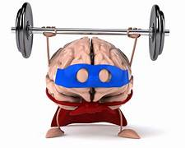
Exercise and the Brain
Jeffrey E. Hansen, Ph.D.
Center for Connected Living, LLC

Slide 2

Exercise and the Brain
The human brain is an exceedingly complex organ, and while we don't fully understand it, it is what we have to use to understand and interact with the world around us. Research is showing that there is a very powerful connection between the nervous system and movement. Exercise has been shown to facilitate the growth of new neurons, paving the way for greater intelligence. For more on this topic, I recommend John Ratey, excellent book, Spark
Please click the link below to watch this motivational talk on the value of exercise as presented by Brain Power and Movement on which the following slides are adapted:
https://www.youtube.com/watch?v=DsVzKCk066g&ab_channel=WhatI%27veLearned

Slide 3
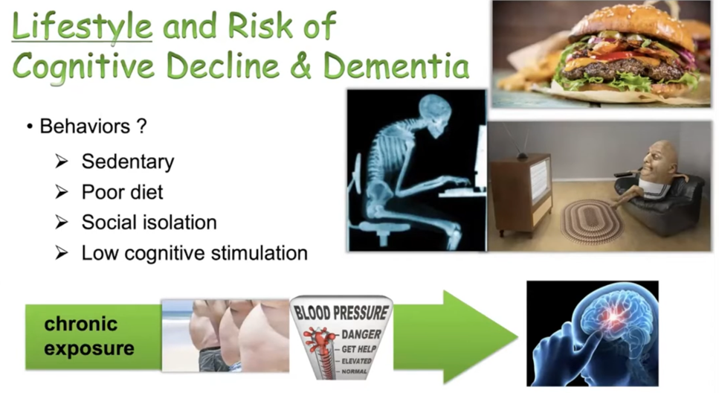
A sedentary, isolated, under-stimulated, poorly fed lifestyle kills you and this is sadly the norm for America today.

Slide 4
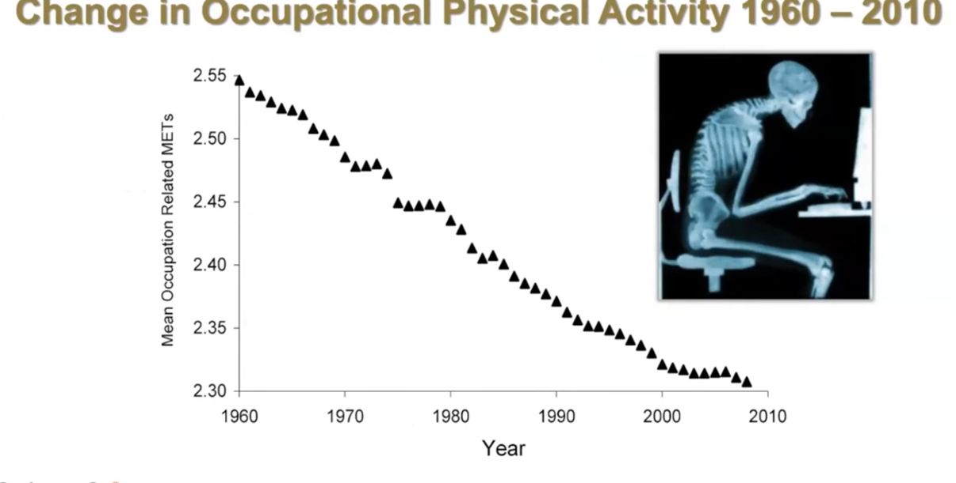

Since 1960 we have become more like sloths.

Slide 5
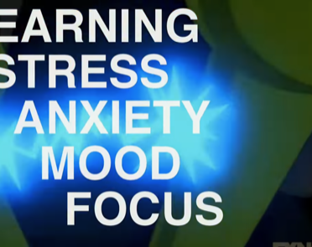
More than just helping one lose weight, exercise improves these functions markedly

Slide 6
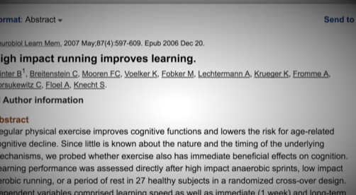
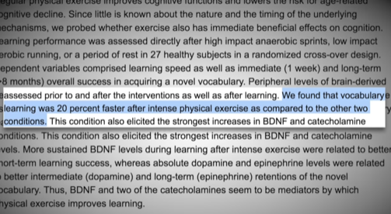
Studies show that learning is markedly improved

Slide 7
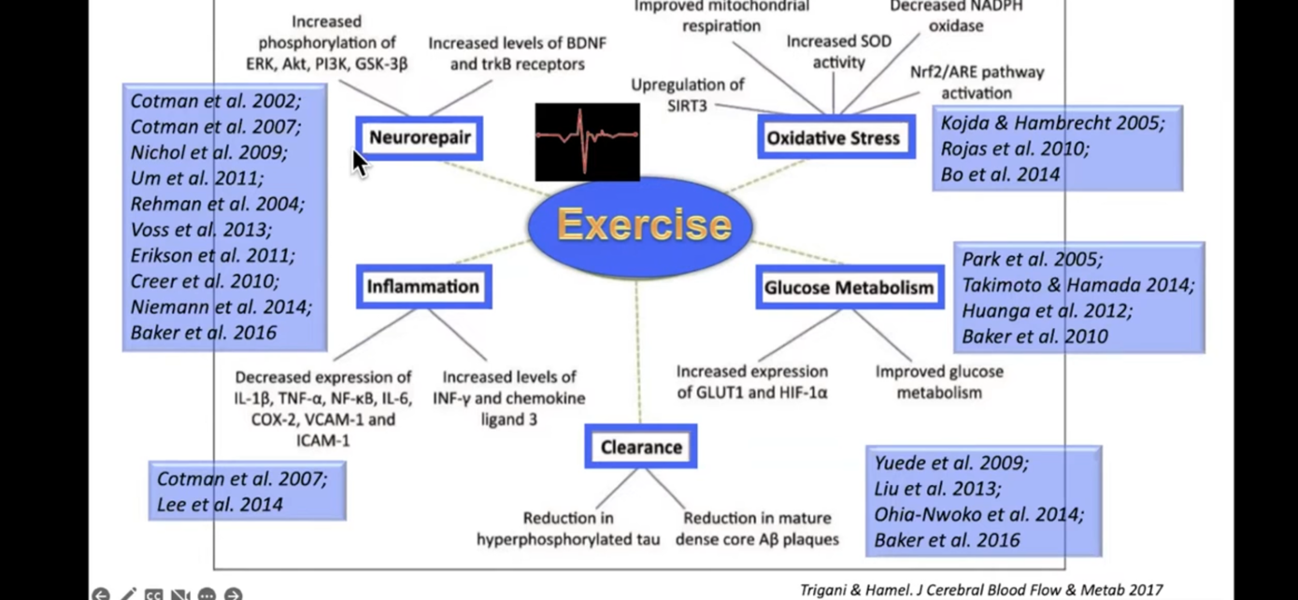
A summary of the research on the benefits of exercise on the body and brain.

Slide 8
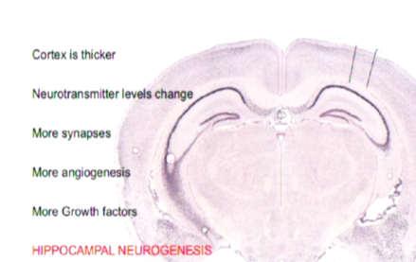
Brain Changes Due to Exercise
Most important, exercise causes significant neurogenesis in the hippocampus which is responsible for memory and newly discovered creativity .

Slide 9
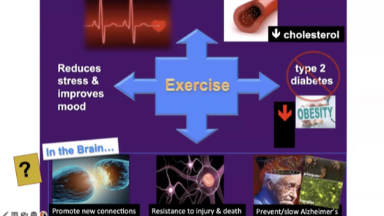
The wonders of Exercise
001543

Slide 10
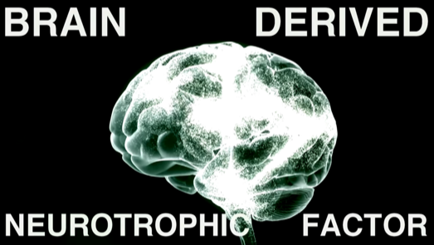
Exercise increases Brain Derived Neurotropic Factor (BDNF)

Slide 11
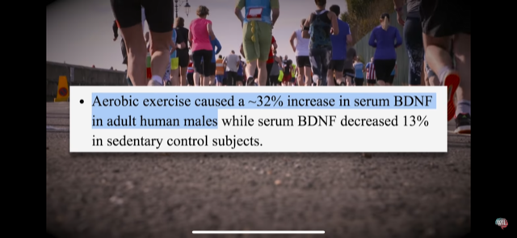
BDNF and Exercise

Slide 12
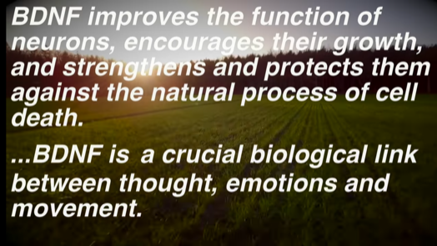
BDNF is good stuff!

Slide 13
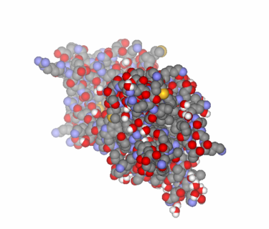
Brain Derived Neurotropic Factor (BDNF)
Brain-derived neurotrophic factor (BDNF) plays an important role in neuronal survival and growth, serves as a neurotransmitter modulator, and participates in neuronal plasticity, which is essential for learning and memory.
BDNF was first isolated from a pig brain in 1982 by Yves-Alain Barde and Hans Thoenen.
BDNF acts on certain neurons of the central nervous system and the peripheral nervous system expressing TrkB, helping to support survival of existing neurons, and encouraging growth and differentiation of new neurons and synapses.
In the brain BDNF is active in the hippocampus, cortex, and basal forebrain—areas vital to learning, memory, and higher thinking. BDNF is also expressed in the retina, kidneys, prostate, motor neurons, and skeletal muscle, and is also found in saliva.
BDNF itself is important for long-term memory.^{[17]} Although the vast majority of neurons in the mammalian brain are formed prenatally, parts of the adult brain retain the ability to grow new neurons from neural stem cells in a process known as neurogenesis. Neurotrophins are proteins that help to stimulate and control neurogenesis, BDNF being one of the most active.

Slide 14
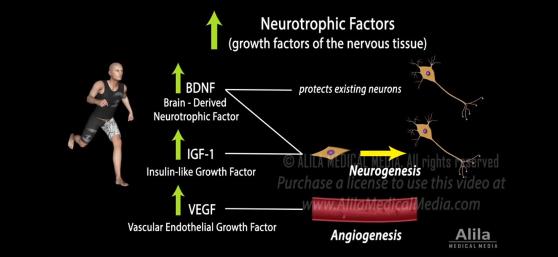
Exercise enhances three main neurotropic factors

Slide 15
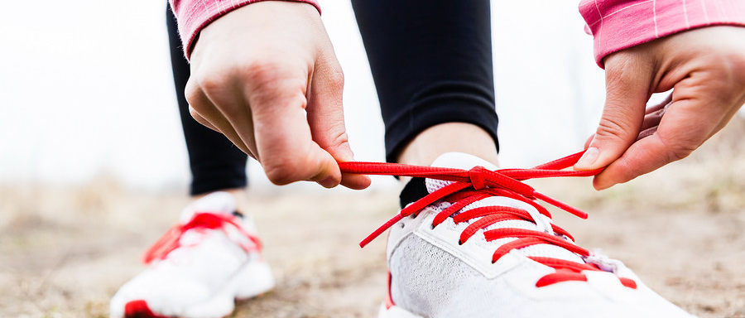

Movement grows the brain and sedentary behavior shrinks it. Koala bears used to have bigger brains but when they settled on eucalyptus leaves as their diet, they could just hang in a tree all day, eat, and not move much. As a result, their brain size has gotten smaller. So, the take-home is that a body that moves promotes a healthier brain.

Slide 16
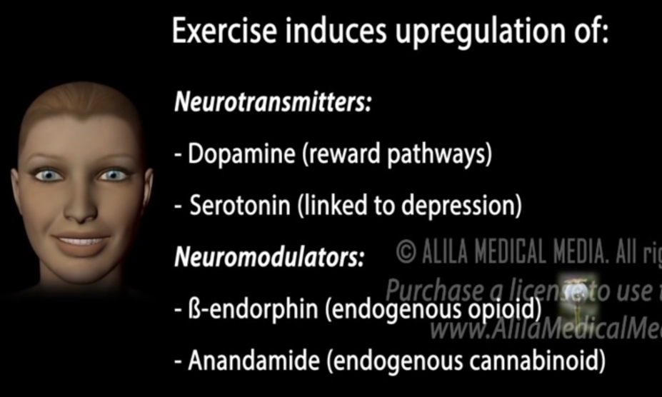
Exercise increases the big three neurotransmitters implicated in mood and feelings of well-being

Slide 17

Exercise and the Brain Research
In a study done at the University of British Columbia, researchers found that regular aerobic exercise, the kind that gets your heart and your sweat glands pumping, appears to boost the size of the hippocampus, the brain area involved in verbal memory and learning. Resistance training, balance and muscle toning exercises did not have the same results.
The finding comes at a critical time. Researchers say one new case of dementia is detected every four seconds globally. They estimate that by the year 2050, more than 115 million people will have dementia worldwide.
Exercise helps memory and thinking through both direct and indirect means.
The benefits of exercise come directly from its ability to reduce insulin resistance, reduce inflammation, and stimulate the release of growth factors (BDMF) chemicals in the brain that affect the health of brain cells, the growth of new blood vessels in the brain, and even the abundance and survival of new brain cells.

Slide 18

Cortisol and health – good for us when we need to be on guard but very bad when it hangs around in or bodies for too long.

Slide 19
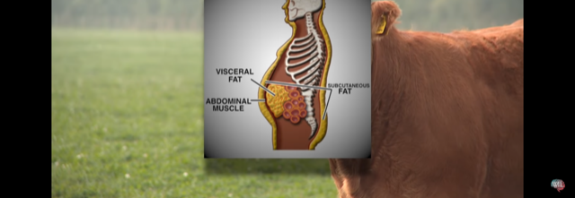
Too much cortisol for too long, cause metabolic syndrome and makes us fat. We gain weight even when we eat little because it makes the brain think that we are in danger, and we need to conserve energy in the form of fat.

Slide 20
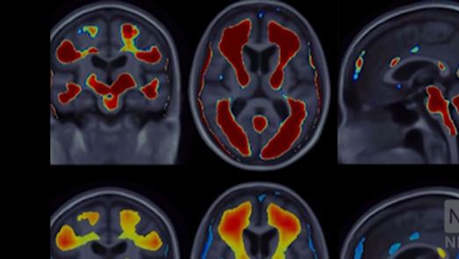
Cortisol makes the brain less efficient as it shuts down the prefrontal cortex and activates the limbic system, most notably the amygdala.

Slide 21
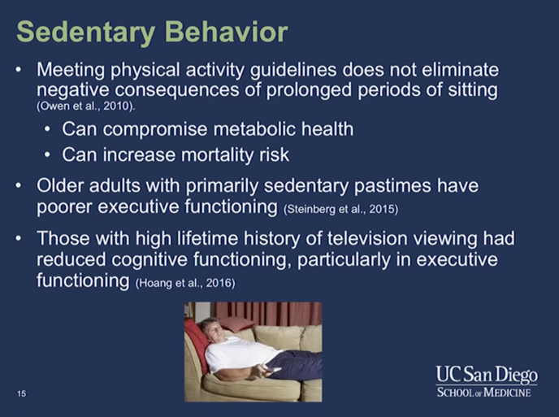
Sedentary behavior is not a good thing!

Slide 22
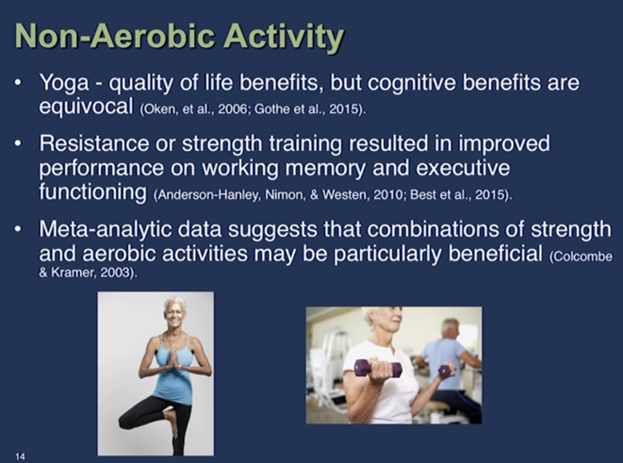
What combination of exercise is best?

Slide 23
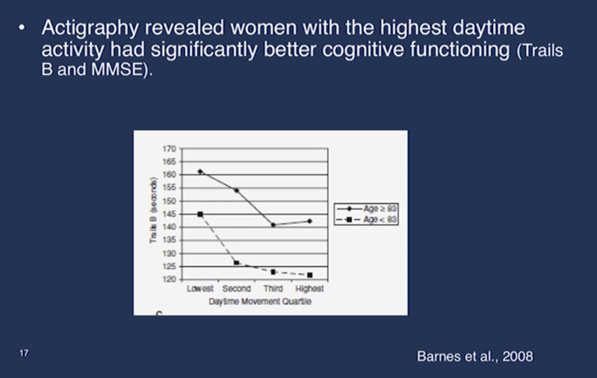
Any type of movement can help, especially in women.

Slide 24
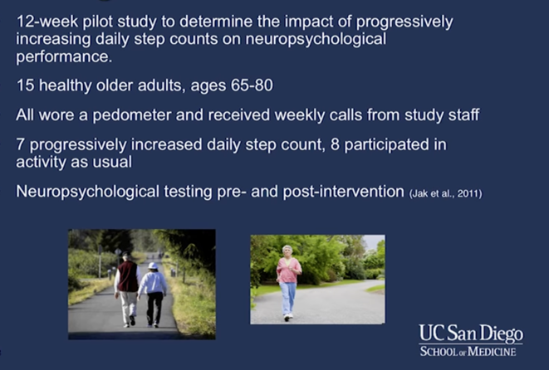
The benefits of walking

Slide 25
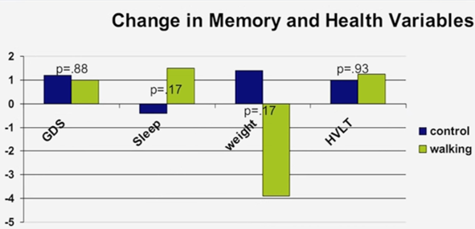
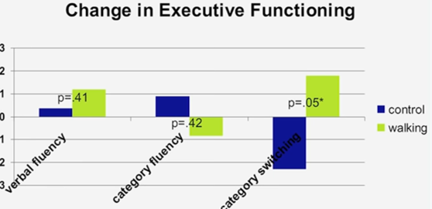
Walking and executive functioning, sleep, weight.

Slide 26
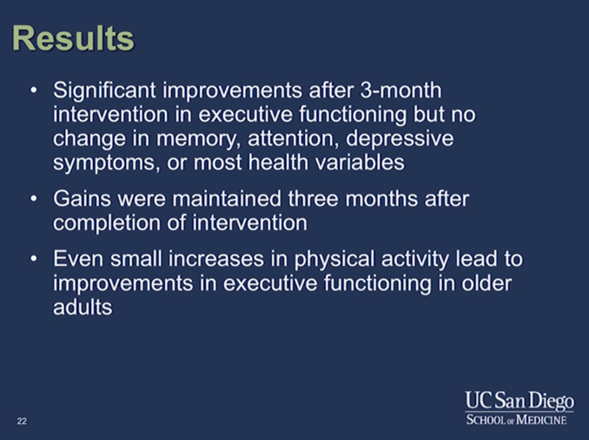
Walking benefits – in summary

Slide 27
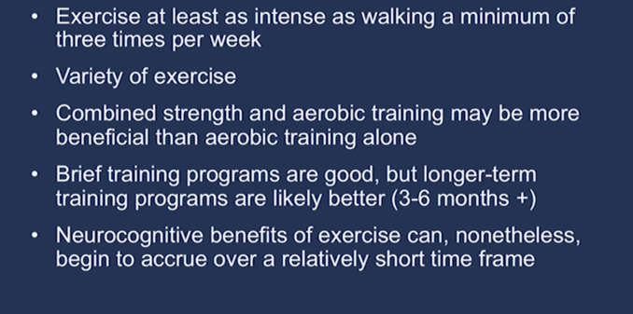
How much and what kind of exercise?

Slide 29
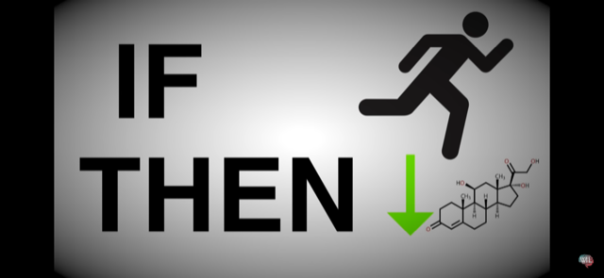
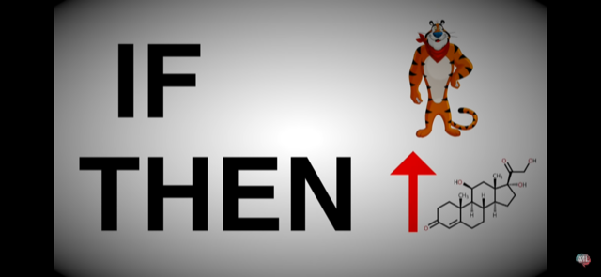
Danger increases cortisol and exercise decreases it.

Slide 30

How much and what kind of exercise is best?
Aerobic is best and 30 to 45 minutes 3-4 times per week.

