Slide 1
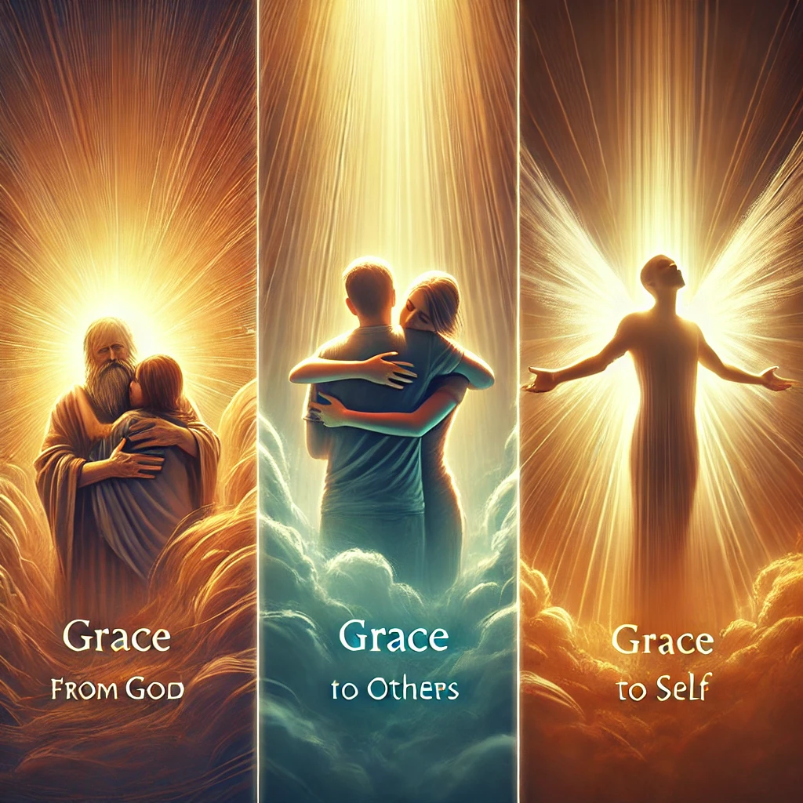
Grace in the Healing Process of Self-Care in Addiction
Jeffrey E. Hansen, Ph.D.
Clinical Director, Holdfast Recovery
Hebrews 4:16 (NIV):
"Let us then approach God's throne of grace with confidence, so that we may receive mercy and find grace to help us in our time of need."

Slide 2

What Grace Looks Like in Recovery
✔ Allowing room for mistakes – Recovery is not linear. Relapse is not failure but a learning moment.
✔ Practicing self-compassion – You are still loved, valuable, and capable of change.
✔ Letting go of perfectionism – Healing is about progress, not perfection.
✔ Accepting help – Grace allows us to seek support instead of isolating.
✔ Anchoring in faith – God's love and forgiveness empower healing and restoration.

Slide 3

Grace in the Healing Process of Self-Care in Addiction
Grace bridges shame and healing, struggle and transformation. It allows individuals to accept themselves as imperfect yet worthy of healing, moving forward with compassion and faith.
2 Corinthians 12:9 (NIV)
"But he said to me, ‘My grace is sufficient for you, for my power is made perfect in weakness.’ Therefore, I will boast all the more gladly about my weaknesses, so that Christ’s power may rest on me.“
This verse reminds us that grace is not about perfection but about God's transformative power in our struggles.

Slide 4

Grace Transforms Self-Care
Grace shifts self-care from an obligation to an act of self-love. It nourishes the body, mind, and spirit—not because one has 'earned' it, but because they are already worthy of healing. Once full, we can extend it to others
1 John 4:19 (NIV)
"We love because he first loved us.“
This verse reminds us that grace is not something we earn—it is given freely by God. When we embrace His love, we learn to extend that same grace to ourselves in the form of self-care and self-healing and ultimately to others.
Galatians 6:2 (NIV):
"Carry each other’s burdens, and in this way you will fulfill the law of Christ."

Slide 5

Key Takeaway
You are not your past. You are not your worst moment. You are more than your addiction. With grace, the journey of recovery becomes a path of restoration rather than punishment
2 Corinthians 5:17 (NIV)
"Therefore, if anyone is in Christ, the new creation has come: The old has gone, the new is here!“
This verse reminds us that we are not defined by our past. Through grace, we are made new, and recovery is a journey of restoration, not condemnation. Would you like another option?

