Slide 1

The Role of the Hypothalamus-Pituitary Adrenal Axis in Stress Response and Implications for PTSD
CPY 7101
Ken Safley
19 APR 2022
Notes:
Good afternoon, today we’ll dive into a little about how the human body responds to stress, and specifically the role of the Hypothalamus- Pituitary Adrenal Axis, or HPA Axis for short

Slide 2
CPY 7101
Agenda
Definitions
General Adaptation Syndrome
Sympathetic Adrenal Medullar Axis
Hypothalamus-Pituitary Adrenal Axis
HPA Axis Abnormalities Associated with PTSD
Neurobiological Factors Associated with HPA Axis Variation
Clinical Applications
Questions
Cultural Considerations
Notes:
I’ll start with some pertinent definitions, and then move on to the General Adaptation Syndrome, which together will give us 10,000 ft view of the overall framework of stress response that we’ll be using today. Then we’ll move on to the SAM and HPA Axes, talk about some variations in the HPA Axis specifically associated with PTSD, neurobiological factors which are associated with the variation, and cultural factors. Finally, we’ll discuss the clinical applications of this information.

Slide 3
CPY 7101
Definitions
Stress: “A nonspecific response of the body to any demand made upon it’’ Godoy et al., 2018, p. 2
Posttraumatic Stress Disorder (PTSD): A mental health condition that's triggered by a traumatic stressor with symptoms such as flashbacks, nightmares, anxiety, and uncontrollable thoughts about the event Mayo, 2022
Physical Stressors: Disturbances in physiological status (tissue insult, infection, etc.)
Psychological Stressors: Stimuli which threatens the present state of the organism, usually experienced as anticipatory to a physical stressor
Notes:
The key thing I’d like to note here is that stress falls into two categories: Physical and Psychological. Physical stress is more of what we typically think of as injury or disease, in that the physiological resources are being stressed in order to return to homeostasis. Psychological stressors on the other hand are more of what people tend to think of as stress, and typically involves being in an anticipatory state, an example being to be stressed of what might happen in the future.
And, as I’m sure most of you are aware, PTSD is a condition which can result from excessive exposure to stress.
Stress, Physical Stressor, and Psychological Stressor definitions from Godoy et al., 2018

Slide 4
CPY 7101
General Adaptation Syndrome Selye, 1936
Alarm Phase
Resistance Phase
Exhaustion Phase
Notes:
So, moving to that 10,000 ft view, back in 1936 Dr. Hans Seyle first proposed GAS to describe a constellation of physiological process which an organism mounts when confronted with a critical situation. Dr. Seyle considered this “to represent a generalised effort of the organism to adapt itself to new conditions” (Selye, 1936, p. 2), and thus he termed it the General Adaptation Syndrome. He further compared it to other general defense reactions, for example inflammation. Despite the model’s imprecision, it is still considered a useful framework in describing the body’s response to stress. It occurs in the three phases that you see here.

Slide 5
CPY 7101
The Acute Stress Response
Organism appraises a stimuli as a threat
Sympathetic Adreno Medullar Axis
Hypothalamus-Pituitary Adrenal Axis
Notes:
Consistent with the GAS framework, whenever a person perceives a given stimuli as a threat, or stressor, their body activates two distinct but complementary systems to mount a defense: the Sympathetic Adreno Medullar (SAM) Axis, and the Hypothalamus-pituitary Adrenal Axis

Slide 6
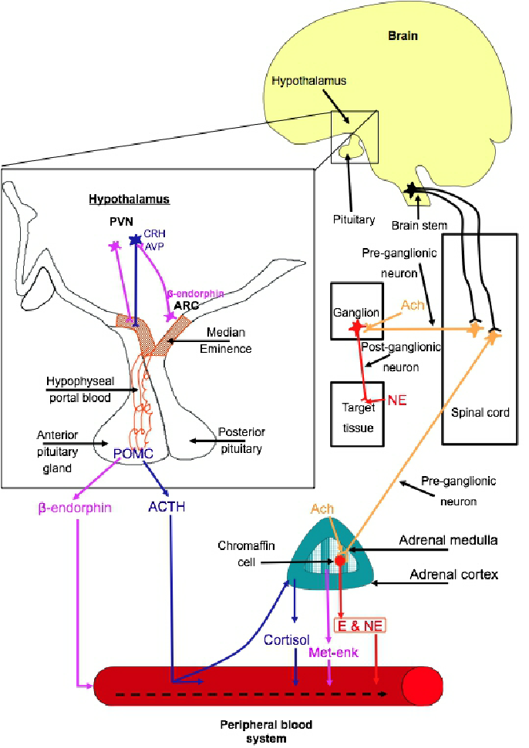
CPY 7101
Sympathetic Adrenal Medullary (SAM)
Axis
Turner et al., 2012
Notes:
The SAM Axis, highlighted here, is the instantaneous, rapid response system.

Slide 7
CPY 7101
Sympathetic Adrenal Medullary (SAM)
Axis
Turner et al., 2012
Notes:
As the name implies, it is a function of the sympathetic nervous system and is mediated by catecholamines, primarily epinephrin and norepinephrine. Since this system depends on neurotransmitters to communicate to end-organ tissues, it is both very quick to respond and is relatively short-lasting.

Slide 8
CPY 7101
Hypothalamus-
Pituitary
Adrenal (HPA)
Axis
Turner et al., 2012
Notes:
This SAM axis complements the HPA axis, highlighted here.

Slide 9
CPY 7101
Hypothalamus-
Pituitary
Adrenal (HPA)
Axis
Turner et al., 2012
Notes:
The HPA Axis picks up where the SAM Axis leaves off, using slower, longer lasting hormones to mediate the stress response.
Hypothalamic-Pituitary Adrenal (HPA) Axis normal operation
Hypothalamus releases Corticotropin-releasing Factor (CRF)
CRF binds to receptors on the anterior pituitary gland which then releases adrenocorticotropic hormone (ACTH)
ACTH acts on the adrenal cortex and stimulates the release of cortisol
Cortisol is distributed via the bloodstream and regulates the body’s stress response (adaptive and maladaptive, situation-dependent)
Releases alarm chemicals (epinephrine and norepinephrine)
glucose release from liver
suppress inflammation
increase blood pressure
counteracts insulin to increase blood sugar
manipulates circadian rhythm to increase alertness
Once cortisol builds to a certain concentration in the blood stream, cortisol exerts negative feedback on the hypothalamus in binding to glucocorticoid receptors, which shuts off production of CRF. This negative feedback system is very influential in maintaining normal cortisol levels in the bloodstream.
A system not shown here but which also exerts influence on the HPA is the Oxytocin system. Evidence that the Oxytocin System complements the HPA Axis, acting as an inhibitory influence on ACTH release and subsequent Cortisol production (Dabrowska, 2011)
With sustained HPA axis activation, the body habituates to high cortisol levels and the negative feedback “shut-off” becomes desensitized, leading to excessive and persistent build-up of cortisol. The axis also desensitizes as we age.

Slide 10

CPY 7101
HPA Axis Abnormalities Associated with PTSD
Glucocorticoid Receptors (up to 3x more than MDD) Yehuda, 2001
Cortisol Levels in many PTSD Patients Godoy et al., 2018
The dexamethasone suppression test (DST) elicits HPA axis negative feedback
Notes:
The interesting thing is, that certain forms of PTSD are associated with apparent malfunction of the HPA axis, specifically the negative feedback loop. For example:
Testing of PTSD patients have revealed up to 3x more glucocorticoid receptors than normal (in contrast to MDD) (Yehuda, 2001)
Similarly, bloodserum tests have demonstrated much lower cortisol levels than predicted, particularly for individuals who are therozed to be in a perpetual state of heightened activation. (in contrast to MDD) (Godoy et al., 2018)
There is a test we can utilize to directly assess the negative feedback sensitivity called the dexamethasone suppression test (DST). In this test, dexamethasone, which is a steroid which mimics the effects of cortisol, is administered to the patient to measure the body’s response. A weak HPA axis response is where the body’s cortisol levels remain roughly unchanged, and strong response will see cortisol levels drop. In research, the DST has demonstrated the capability to differentiate between combat veterans with and without PTSD based on HPA responsivity alone.
So the indicators of increased Glucocorticoid receptors, low cortisol levels, and an excessively strong HPA response to dexamethasone together appear to indicate an excessively sensitive negative feedback loop which suppresses normal HPA axis response (Suris, 2010)

Slide 11
CPY 7101
Neurobiological Predictors Associated with HPA Axis Variation
Post trauma hypocortisolism Jayan et al., 2021
Variations in the NC3R1 (glucocorticoid receptor gene) and FKBP5 (steroid receptor chaperone) Sheerin et al., 2020
FKBP5 demethylation in abused children Parade et al., 2017
Bloodserum oxytocin levels and oxytocin receptors (OXTR) Hoffman et al., 2021
Notes:
What might cause the apparent malfunctions discussed previously? Research has identified several factors which appear to be involved.
Neurobiological factors which are associated with HPA axis malfunction in PTSD patients
Post trauma hypocortisolism in bloodserum tests is predictive of dysphoria and more severe PTSD symptoms (Trauma patients from an ED; Jayan et al., 2021)
Variations in the NC3R1 (glucocorticoid receptor gene) and FKBP5 (steroid receptor chaperone) genes are associated with HPA axis disruption and subsequent PTSD susceptibility (Meta-analysis; Sheerin et al., 2020)
FKBP5 demethylation observed in children exposed to both maltreatment and high contextual stress. Interestingly, use of social services reversed these effects (increased methylation), but only among children with the CC allele (perhaps greater sensitivity to environmental effects, both good and bad) (Parade et al., 2017)
Bloodserum oxytocin levels and oxytocin receptors (OXTR) differentiated between hyporesponsive HPA axis PTSD and healthy controls, and OXTR discriminated between hyporesponsive HPA axis and responsive HPA axis subtypes of PTSD (Female PTSD patients in Germany; Hoffman et al., 2021).

Slide 12
CPY 7101
PTSD
Chronic Stress Cascade
Suppressed Stress Response
Clinical Applications
Notes:
Given these findings, I have several hypotheses which I would be interested to investigate in the future:
H1: A subtype (and probably more than the two here) of PTSD is characterized by hypocortisolism, a higher-than-normal concentration of glucocorticoid receptors in the hypothalamus, and an excessive response to DST which will differ from the subtype brought on by chronic stress exposure.
H2: Treatment for the suppressed HPA axis subtype will be more effective with paired-glucocorticoid administration
H3: Individuals may suffer from either or both forms of PTSD
Hyper-activated HPA axis as compared to Hypo-activated (suppressed)

Slide 13
CPY 7101
Cultural Considerations
Hyperactive HPA
Low SES
Marginalized identities
Suppressed HPA
Victims of assault
Sexual violence
DV
Child abuse
Employment history
Combat veterans
Natural disasters
Refugees
Child abuse
Notes:
Knowing there are may be multiple subtypes of PTSD allows us as clinicians to tailor our treatment to our clients in the way that is most helpful for them. So, things to keep in mind are that people who are likely to be more at-risk of chronic HPA activation due to environmental circumstance may include patients from a low SES, those with one or more marginalized identities, victims of extended verbal, emotional, physical, or sexual abuse such as those coming from domestic violence or with a history of child abuse, or those with a history of stressful employment such as physicians, nurses, first-responders or military. Alternatively, patients who are risk of developing PTSD due to a suppressed HPA stress response may not respond well to traditional PE therapy, may present with specific, identifiable stressors. Histories of these patients will likely include exposure to a specific traumatic event that involves violence or fear of death. Demographic variables which might make someone at-risk for experiencing such a traumatic event may include victims of assault or sexual violence, refugees, combat veterans, or natural disaster survivors. Specifically mentioned earlier are the effects of child-abuse on the methylation of the FKBP5 gene which appear to predispose someone to a suppressed HPA axis.

Slide 14
CPY 7101
Clinical Applications
The effect of stress doses of hydrocortisone during septic shock on posttraumatic stress disorder in survivors (Schelling et al., 2001)
Glucocorticoid-induced reduction of traumatic memories: Implications for the treatment of PTSD (de Quervain, 2007)
Effects of exogenous glucocorticoid on combat-related PTSD symptoms (Suris et al., 2010)
Facilitating fear-based memory extinction with dexamethasone: A randomized controlled trial in male veterans with combat-related PTSD (Suris et al., 2017)
A randomized, double-blind, placebo-controlled trial of hydrocortisone augmentation of prolonged exposure for PTSD in U.S. combat veterans (Lehrner et al., 2021)
Notes:
Consistent with this hypothesis, a number of studies have demonstrated positive effects of glucocorticoid administration to alleviate the symptoms of patients diagnosed with PTSD. A synthetic version of cortisol, hydrocortisone, is usually the glucocorticoid administered. The effects are usually short-term, suggesting that additional glucocorticoids do not correct the underlying HPA Axis deficiency, but they do “trick” the system into working properly, sometimes long-enough for the patient to respond positively to PE therapy. Important to note that not every study demonstrates this benefit for every PTSD patient, again suggesting multiple subtypes of PTSD which respond differently to interventions based on the underlying physiology.
Populations studied: combat veterans, women with PTSD or ED

Slide 15
CPY 7101
Questions?
Notes:
And that concludes my extremely brief attempt to highlight the role of the HPA axis in stress response, does any have any questions?

Slide 16
CPY 7101
References
De Quervain, D. J. (2007). Glucocorticoid-induced reduction of traumatic memories: Implications for the treatment of PTSD. Progress in Brain Research, 239-247. https://doi.org/10.1016/s0079-6123(07)67017-4
De Quervain, D., Wolf, O. T., & Roozendaal, B. (2019). Glucocorticoid-induced enhancement of extinction—from animal models to clinical trials. Psychopharmacology, 236(1), 183-199. https://doi.org/10.1007/s00213-018-5116-0
Godoy, L. D., Rossignoli, M. T., Delfino-Pereira, P., Garcia-Cairasco, N., & De Lima Umeoka, E. H. (2018). A comprehensive overview on stress neurobiology: Basic concepts and clinical implications. Frontiers in Behavioral Neuroscience, 12. https://doi.org/10.3389/fnbeh.2018.00127
Hofmann, J., Huber, C., Novak, B., Schreckenbach, M., Schubert, C. F., Touma, C., Rutten, B. P., & Schmidt, U. (2021). Oxytocin receptor is a potential biomarker of the hyporesponsive HPA axis subtype of PTSD and might be modulated by HPA axis reactivity traits in humans and mice. Psychoneuroendocrinology, 129, 105242. https://doi.org/10.1016/j.psyneuen.2021.105242
Jayan, D., DeRoon-Cassini, T. A., Sauber, G., Hillard, C. J., & Fitzgerald, J. M. (2022). A cluster analytic approach to examining the role of cortisol in the development of post-traumatic stress and dysphoria in adult traumatic injury survivors. Psychoneuroendocrinology, 135, 105450. https://doi.org/10.1016/j.psyneuen.2021.105450
Lehrner, A., Hildebrandt, T., Bierer, L. M., Flory, J. D., Bader, H. N., Makotkine, I., & Yehuda, R. (2021). A randomized, double-blind, placebo-controlled trial of hydrocortisone augmentation of prolonged exposure for PTSD in U.S. combat veterans. Behaviour Research and Therapy, 144, 103924. https://doi.org/10.1016/j.brat.2021.103924

Slide 17
CPY 7101
References
Li, Y., Hassett, A. L., & Seng, J. S. (2019). Exploring the mutual regulation between oxytocin and cortisol as a marker of resilience. Archives of Psychiatric Nursing, 33(2), 164-173. https://doi.org/10.1016/j.apnu.2018.11.008
Mayo Clinic. (2018, July 6). Post-traumatic stress disorder (PTSD) - symptoms and causes. Retrieved April 14, 2022, from https://www.mayoclinic.org/diseases-conditions/post-traumatic-stress-disorder/symptoms-causes/syc-20355967
Parade, S. H., Parent, J., Rabemananjara, K., Seifer, R., Marsit, C. J., Yang, B., Zhang, H., & Tyrka, A. R. (2017). Change in FK506 binding protein 5 (FKBP5) methylation over time among preschoolers with adversity. Development and Psychopathology, 29(5), 1627-1634. https://doi.org/10.1017/s0954579417001286
Schelling, G., Briegel, J., Roozendaal, B., Stoll, C., Rothenhäusler, H., & Kapfhammer, H. (2001). The effect of stress doses of hydrocortisone during septic shock on posttraumatic stress disorder in survivors. Biological Psychiatry, 50(12), 978-985. https://doi.org/10.1016/s0006-3223(01)01270-7
Selye, H. (1936). A syndrome produced by diverse nocuous agents. Nature, 138(3479), 32. https://doi.org/10.1038/138032a0
Selye, H. (1950). Stress and the general adaptation syndrome. BMJ, 1(4667), 1383-1392. https://doi.org/10.1136/bmj.1.4667.1383
Sheerin, C. M., Lind, M. J., Bountress, K. E., Marraccini, M. E., Amstadter, A. B., Bacanu, S., & Nugent, N. R. (2020). Meta‐analysis of associations between hypothalamic‐pituitary‐Adrenal Axis genes and risk of posttraumatic stress disorder. Journal of Traumatic Stress, 33(5), 688-698. https://doi.org/10.1002/jts.22484

Slide 18
CPY 7101
References
Suris, A., North, C., Aidenoff, B., Powell, C., & Greene, R. (2010). Effects of exogenous glucocorticoid on combat-related PTSD symptoms. Ann Clin Psychiatry, 22(4), 274–279.
Surís, A., Holliday, R., Adinoff, B., Holder, N., & North, C. S. (2017). Facilitating fear-based memory extinction with Dexamethasone: A randomized controlled trial in male veterans with combat-related PTSD. Psychiatry, 80(4), 399-410. https://doi.org/10.1080/00332747.2017.1286892
Turner, A., Keating, C., & Tilbrook, A. (2012). Sex differences and the role of sex steroids in sympatho-adrenal medullary system and hypothalamo-pituitary adrenal axis responses to stress. In S. M. Kahn (Ed.), Sex steroids (pp. 117-136). IntechOpen.
Yehuda, R. (2001). Biology of Posttraumatic Stress Disorder. The Journal of clinical psychiatry, 62(17), 41-46.
Yehuda, R., Pratchett, L. C., Elmes, M. W., Lehrner, A., Daskalakis, N. P., Koch, E., Makotkine, I., Flory, J. D., & Bierer, L. M. (2014). Glucocorticoid-related predictors and correlates of post-traumatic stress disorder treatment response in combat veterans. Interface Focus, 4(5), 20140048. https://doi.org/10.1098/rsfs.2014.0048

