Slide 1


Early Attachment
Jeffrey E. Hansen, Ph.D.
Center for Connected Living, LLC
“In particular, it is the experience of loving and being loved that most closely predicts how we react to the hardships of life; human attachments are the ultimate source of resilience.
― Jonah Lehrer, A Book About Love
“The views expressed are those of the author and do not reflect the official policy of the Department of the Army, the Department of Defense, or the U.S. Government.”

Slide 2
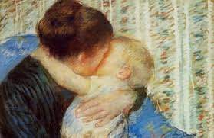
Early Attachment
Attachment is a really big deal and has lifelong implications for all of us. Safe and secure attachment are absolutely necessary for developing healthy and secure relationships, emotional health, and the ability to regulate our emotions.
Two early pioneers in this field, Dr. John Bowlby (1969) and Dr. Mary Ainsworth (1973) carved the way to our understanding of attachment and child development theory.
They defined attachment as a deep and enduring emotional bond that leads to connections between us across time and space.
This attachment is not always mutual and can travel in only one direction. For example, a child can attach to a parent, but the parent does not always attach to the child or vice versa (Kain & Terrell, 2018).

Slide 3

Attachment – Dr. John Bowlby
By way of background on Dr. Bowlby, in an interview with Dr. Milton Stenn , Bowlby shared that his career started off in the medical direction. He noted that he was following in his surgeon father's footsteps. His father was a well-known surgeon in London and Bowlby explained that his father encouraged him to study medicine at Cambridge.
Bowlby ended up following his father's suggestion but was not terribly interested in anatomy and natural sciences. However, during his time at Trinity College, he became particularly interested in developmental psychology which led him to give up medicine by his third year. When Bowlby left medicine, he accepted a teaching opportunity at a school called Priory Gates for six months where he worked with maladjusted children.
Bowlby stated that the experience at Priory Gates was extremely important to his career in research as he learned that the problems of today should be understood and dealt with at a developmental level (Kanter, 2007).

Slide 4
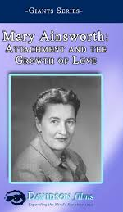
Attachment – Dr. Mary Ainsworth
Bowlby was not the only act in town as he collaborated extensively with Dr. Mary Ainsworth.
Mary was born in Glendale Ohio. When she was 15, she read William McDougall's book, Character and the Conduct of Life, which inspired her to pursue psychology.
While she was teaching at John Hopkins, Mary began working on creating a means to measure attachments between mothers and their children.
It was this that led her to develop her famous "Strange Situation" assessment, in which a researcher observes a child's reactions after a mother briefly leaves her child alone in an unfamiliar room.
The child’s reaction after the separation and upon the mother's return, revealed important information about attachment. Based on her observations and research,
Mary determined that there were three main styles of attachment: secure, anxious-avoidant, and anxious-resistant. Since these initial findings, her work has spawned numerous studies into the nature of attachment and the different attachment styles that exist between children and their caregivers (VeryWellMind, 2019)

Slide 5
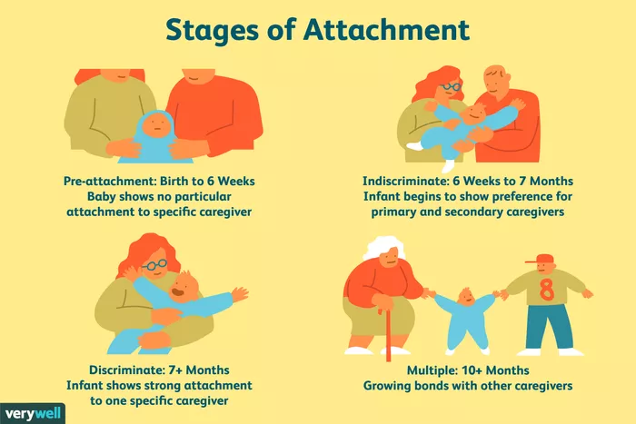
Four Phases of Attachment
Rudolph Schaffer and Peggy Emerson (1964) analyzed the number of attachment relationships that infants form in a longitudinal study with 60 infants.
In their study, infants were observed every four weeks during the first year of life, and then once again at 18 months.
Schaffer and Emerson determined that four distinct phases of attachment emerged: ﻿
Illustration by JR Bee (VeryWellMind, 2019

Slide 6

Four Phases of Attachment
Rudolph Schaffer and Peggy Emerson (1964)
Pre-attachment stage: From birth to three months, infants do not show any particular attachment to a specific caregiver. The infant's signals, such as crying and fussing, naturally attract the attention of the caregiver and the baby's positive responses encourage the caregiver to remain close” (Schaffer & Emerson, 1964).
Indiscriminate attachment: From around six weeks of age to seven months, infants begin to show preferences for primary and secondary caregivers. During this phase, infants begin to develop a feeling of trust that the caregiver will respond to their needs. While they will still accept care from other people, they become better at distinguishing between familiar and unfamiliar people as they approach seven months of age. They also respond more positively to the primary caregiver” (Schaffer & Emerson, 1964).
Discriminate attachment: At this point, from about seven to eleven months of age, infants show a strong attachment and preference for one specific individual. They will protest when separated from the primary attachment figure (separation anxiety) and begin to display anxiety around strangers (stranger anxiety)” (Schaffer & Emerson, 1964).
Multiple attachments: After approximately nine months of age, children begin to form strong emotional bonds with other caregivers beyond the primary attachment figure. This often includes the father, older siblings, and grandparents” (Schaffer & Emerson, 1964).

Slide 7
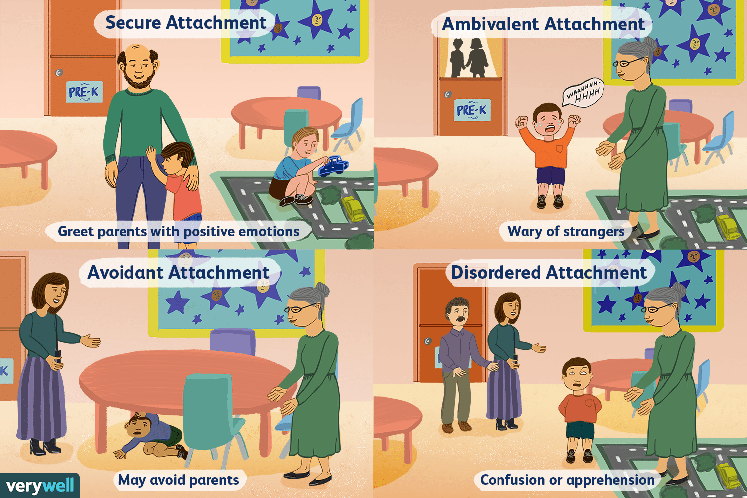
Attachment Styles
As nicely summarized by Lyons-Ruth (1996), the basic the attachment styles culminating from John Bowlby’s and Mary Ainsworth’s research and the fourth by Drs. Mary Main’s and Judith Solomon’s (Main & Solomon, 1986) work include:
Secure
Avoidant
Ambivalent
Disordered

Slide 8

Attachment Styles
Explained
Secure attachment: Secure attachment is marked by distress when separated from caregivers and joy when the caregiver returns. Remember, these children feel secure and are able to depend on their adult caregivers. When the adult leaves, the child may be upset but he or she feels assured that the parent or caregiver will return. When frightened, securely attached children will seek comfort from caregivers. These children know their parent or caregiver will provide comfort and reassurance, so they are comfortable seeking them out in times of need” (Lyons-Ruth, 1996).
Ambivalent attachment: Ambivalently attached children usually don't appear too distressed by the separation, and, upon reunion, actively avoid seeking contact with their parent, sometimes turning their attention to play objects on the laboratory floor. This attachment style is considered relatively uncommon, affecting an estimated 7 percent to 15 percent of U.S. children. Ambivalent attachment maybe a result of poor parental availability. These children cannot depend on their mother (or caregiver) to be there when the child is in need” (Lyons-Ruth, 1996).
Avoidant attachment: Children with an avoidant attachment tend to avoid parents or caregivers. When offered a choice, these children will show no preference between a caregiver and a complete stranger. Research has suggested that this attachment style might be a result of abusive or neglectful caregivers. Children who are punished for relying on a caregiver will learn to avoid seeking help in the future” (Lyons-Ruth, 1996).
Disorganized attachment: Children with a disorganized attachment often display a confusing mix of behavior and may seem disoriented, dazed, or confused. Children may both avoid or resist the parent. Some researchers believe that the lack of a clear attachment pattern is likely linked to inconsistent behavior from caregivers. In such cases, parents may serve as both a source of comfort and a source of fear, leading to disorganized behavior” (Lyons-Ruth, 1996).

Slide 9
Attachment Style Percentages
Mary Ainsworth and her colleagues reported in 1978 that studies on the three initial attachment classifications revealed:
  70 percent of American infants have been classified as secure
  20 percent as avoidant-insecure
  10 percent as resistant-insecure (Ainsworth et al., 1978).
Kain and Terrell (2018) warn that there are worrying declines in secure attachment and that in more recent research populations, the percentages of secure attachment have declined by 10 percent (Andreassen et al., 2007).

Slide 10

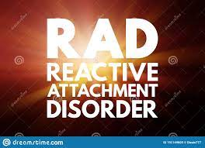
DSM 5 TR disorders resulting from poor attachment
This and the following 4 slides are adapted from Dr. Dawn-Elise Snipes excellent presentation on attachments disorders.
Click below to listen to her full presentation: https://www.youtube.com/watch?v=nqF125Q7b1M&ab_channel=DocSnipes

Slide 11

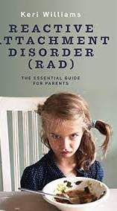


Reactive Attachment Disorder (RAD)

Slide 12
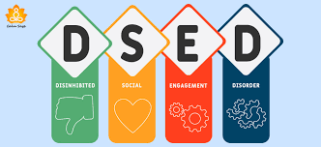
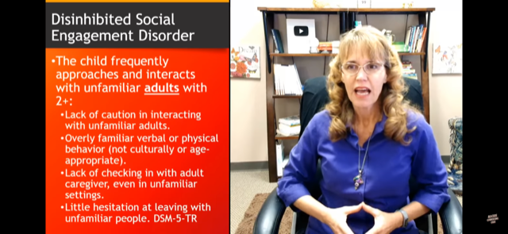
Disinhibited Social Engagement Disorder

Slide 13
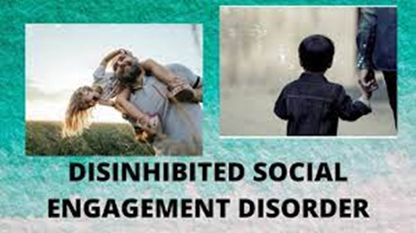
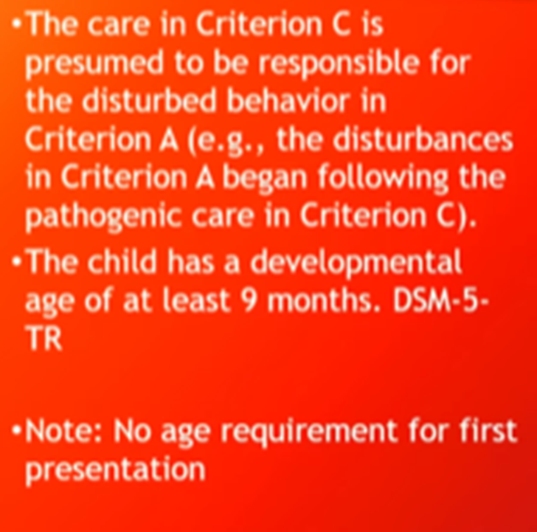
Disinhibited Social Engagement Disorder

Slide 14

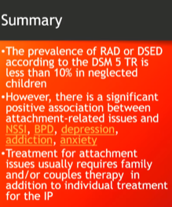
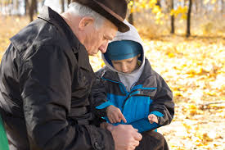
RAD and DSED Differential Diagnosis and Prevalence

Slide 15
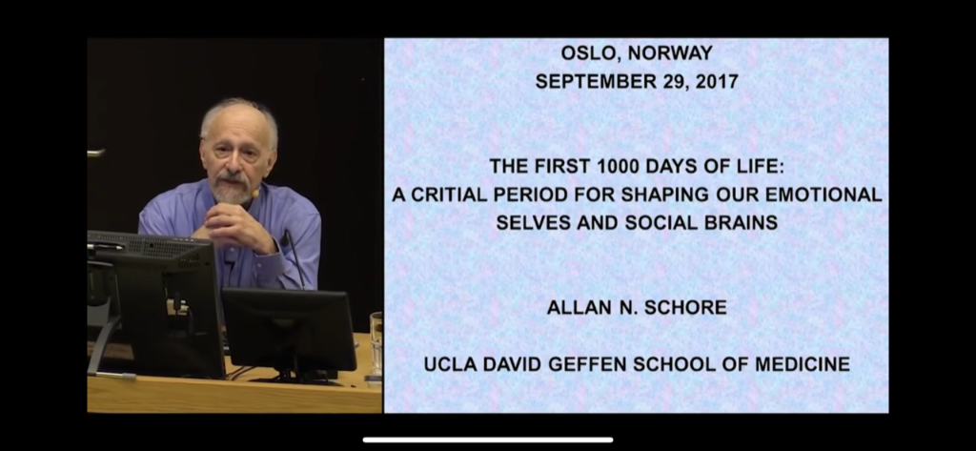
The following slides are adapted from Dr. Allan Schore’s superlative lecture in 2017 in Oslo Norway.
Please click here to hear Dr. Schore’s full lecture: https://www.youtube.com/watch?v=lY7XOu0yi-E&ab_channel=RuneFardal

Slide 16

About Dr. Schore
Dr. Allan Schore is on the clinical faculty of the Department of Psychiatry and Biobehavioral Sciences and UCLA David Geffen School of Medicine. He is author of six seminal volumes, Affect Regulation and the Origin of the Self, Affect Dysregulation and Disorders of the Self, Affect Regulation and the Repair of the Self, The Science of the Art of Psychotherapy, Right Brain Psychotherapy, and The Development of the Unconscious Mind as well as numerous articles and chapters. His Regulation Theory, grounded in developmental neuroscience and developmental psychoanalysis, focuses on the origin, psychopathogenesis, and psychotherapeutic treatment of the early forming subjective implicit self.
His contributions appear in multiple disciplines, including developmental neuroscience, psychiatry, psychoanalysis, developmental psychology, attachment theory, trauma studies, behavioral biology, clinical psychology, and clinical social work. His groundbreaking integration of neuroscience with attachment theory has led to his description as “the American Bowlby,” with emotional development as “the world’s leading authority on how our right hemisphere regulates emotion and processes our sense of self,” and with psychoanalysis as “the world’s leading expert in neuropsychoanalysis.” The American Psychoanalytic Association has described Dr. Schore as “a monumental figure in psychoanalytic and neuropsychoanalytic studies.” He has been inducted into Sigma Xi, The Scientific Research Honor Society. For a detailed list of his books and articles, please visit the Publications page.

Slide 17

“All human achievement is built on the shoulders of giants, and just as John Bowlby and Allan Schore have stood on ‘giant’s shoulders’, so future generations of scientists will in turn be standing on their shoulders. In his books he has integrated a vast array of scientific advances and organized it in an overarching way that deserves the deepest acknowledgement and gratitude.” – Sir Richard Bowlby, 2017

Slide 18
In the words of
Dr. Schore:
“We’re also looking at the more understanding that we have now about normal development and normal attachments, secure attachments, we’re also looking at the other side of that. The other side, of course, would be the insecure attachments. And the most unfortunate early human beginnings, of course, would be in cases of neglect and abuse.
Just for the record, neglect and abuse are found in the histories of individuals who are severely depressed — severely depressed, clinical depressions. And also, the ones who go on to suicide. And that includes, incidentally, all of the major personality disorders in which suicide is very high, like borderline personality disorders.
So here you have a situation – instead of the caregiver being able to attune and to read the baby’s states and to form this non-verbal bond of emotional communication back and forth and to regulate these states, you have a more unfortunate circumstance whereby either the caregiver is either too intrusive and is driving the baby into extremely hyper-aroused states, which the baby can’t regulate, or hypo-aroused states. Maybe, perhaps, abuse more towards hyper-arousal and neglect more to towards hypo-arousal.”

Slide 19

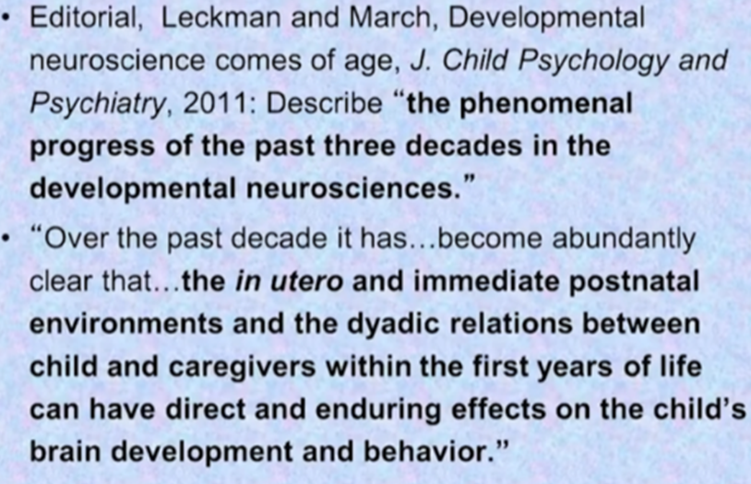
Developmental trauma starts in utero

Slide 20
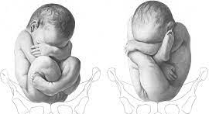
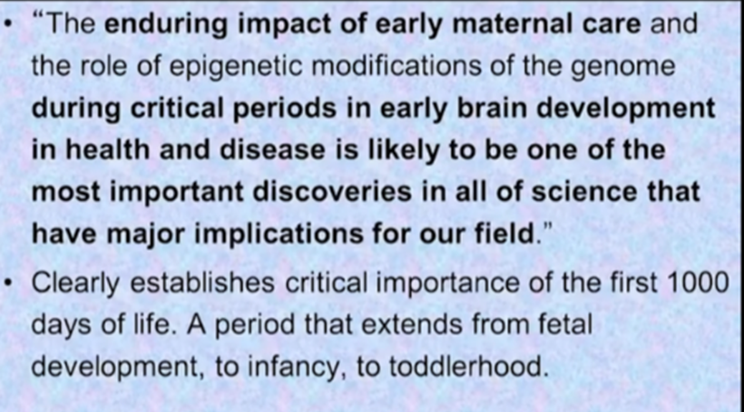
The first 1000 days are critical for the development of the child and any trauma during this time is particularly devastating

Slide 21
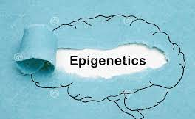
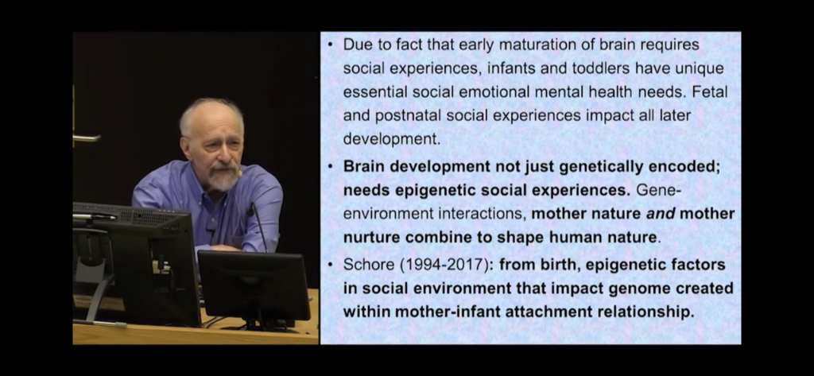
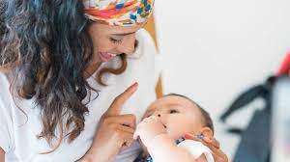
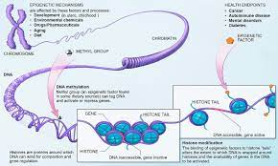
Epigenetic and social experiences have great impact on early development

Slide 22
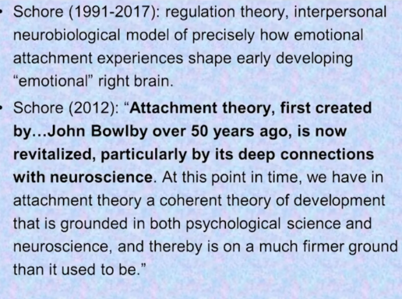
Dr. Allan Schore on attachment

Slide 23

Dr. Schore cites Bowlby often

Slide 24
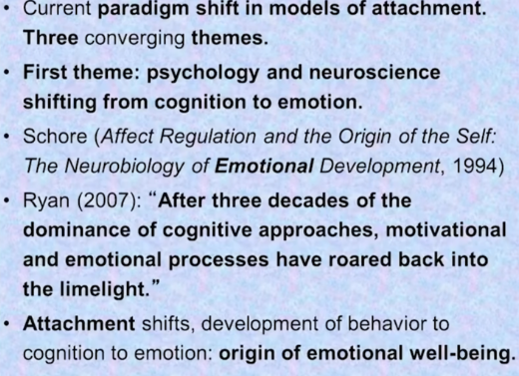
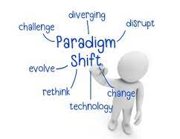
Three current paradigm shifts in models of attachment
First shift: Cognition to Emotion

Slide 25
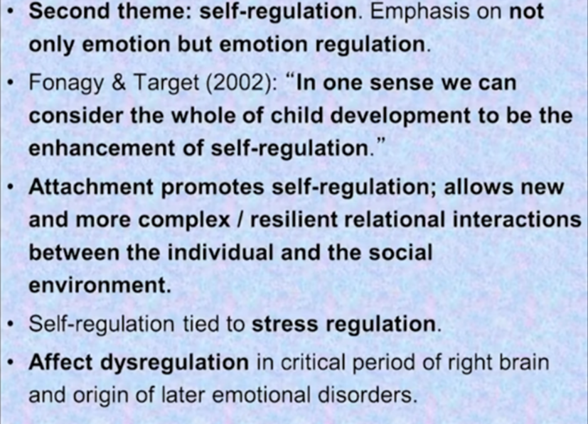
Three current paradigm shifts in models of attachment
Second shift: Emotion includes emotion regulation

Slide 26
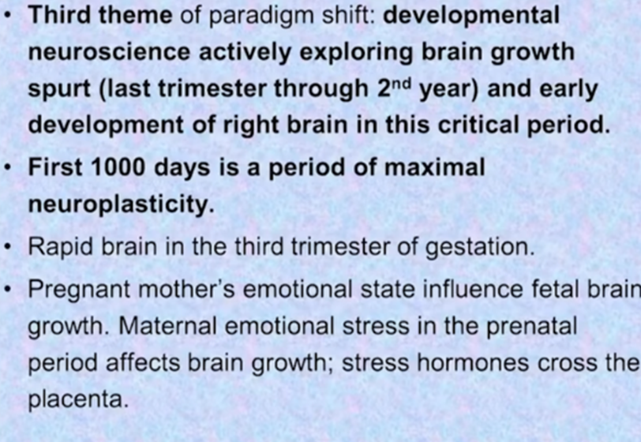
Three current paradigm shifts in models of attachment
Third shift: Usher in developmental neuroscience

Slide 27
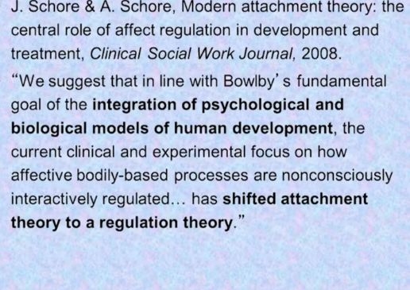
Dr. Allan Schore on attachment as a means to self-regulation.

Slide 28
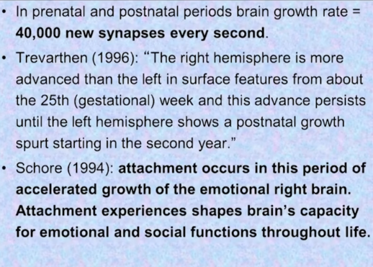
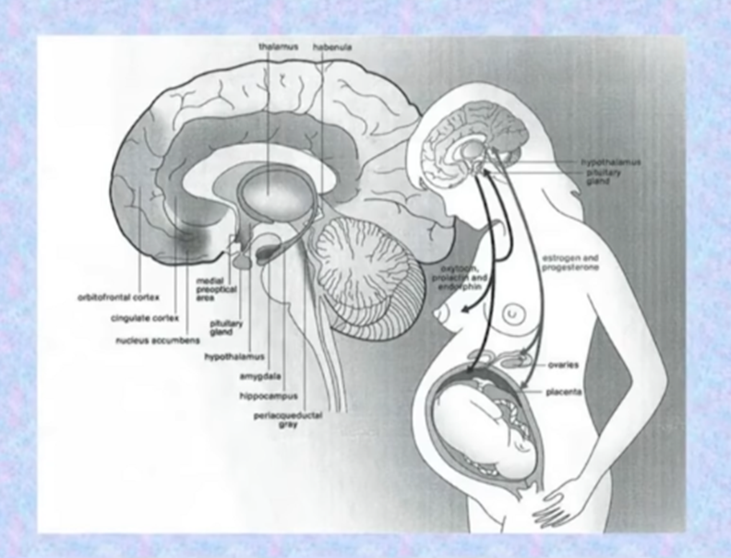
Massive brain growth in the prenatal and postnatal periods – especially the right hemisphere

Slide 29
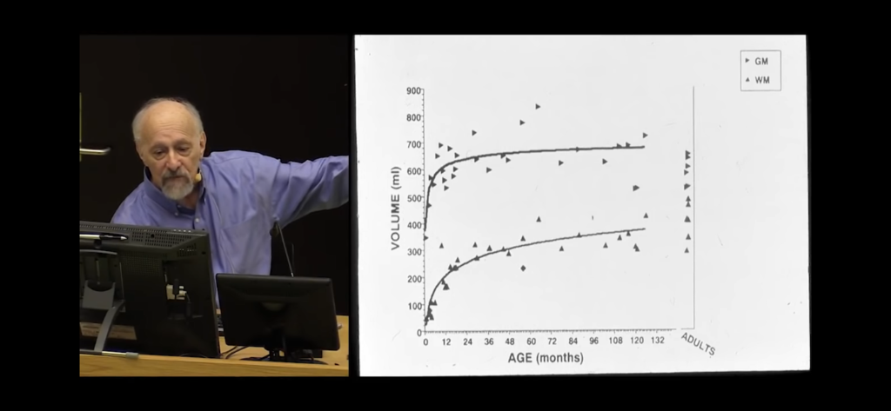
White and gray matter growth rates

Slide 30

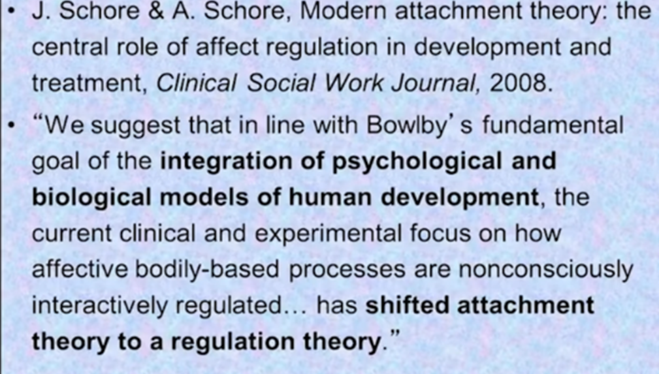
Attachment theory has now become regulation theory

Slide 31
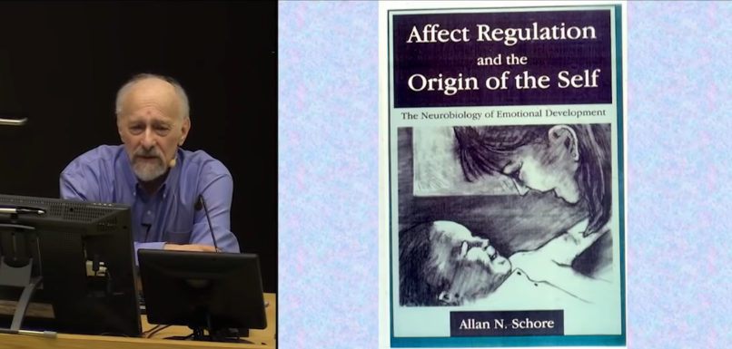
Dr. Schore’s seminal book – Affect Regulation and the Origin of the Self

Slide 32
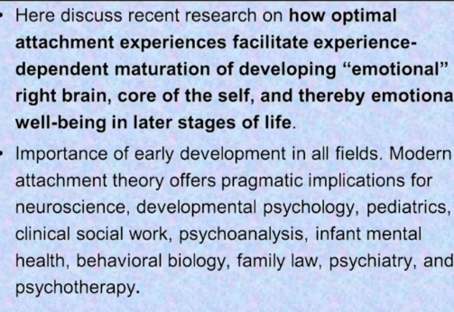


Attachment Theory has a wide reach affecting many fields

Slide 33
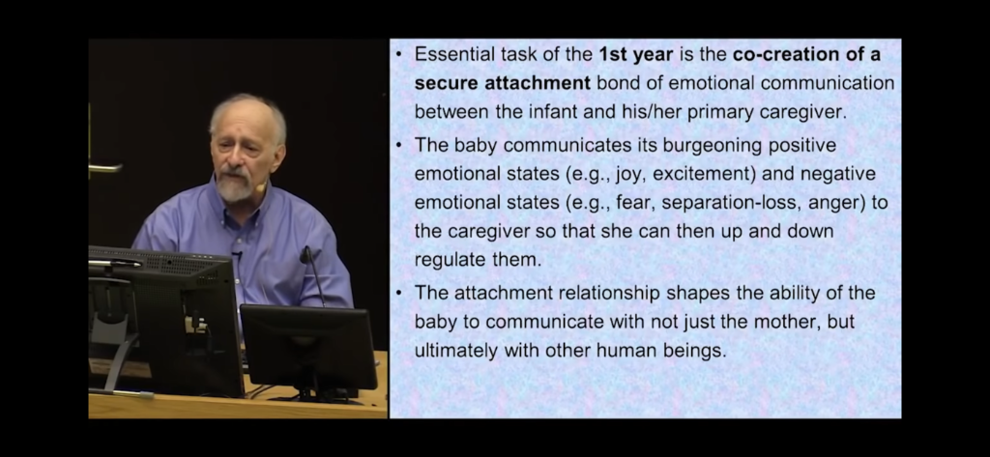
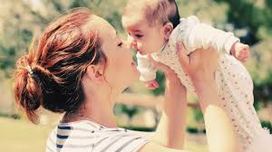
The essential task of the first year is the co-creation of secure attachment with primary caregiver

Slide 34
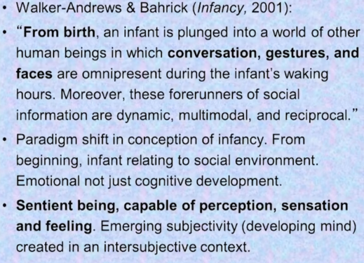

The child’s development is not just cognitive but is emotional

Slide 35
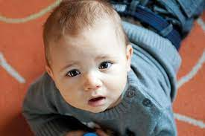
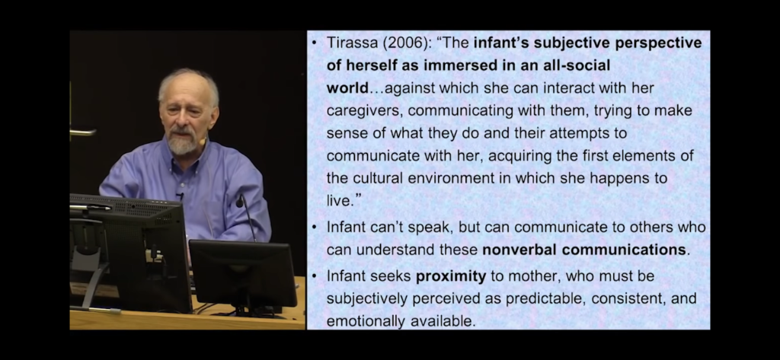
Early communication is nonverbal

Slide 36
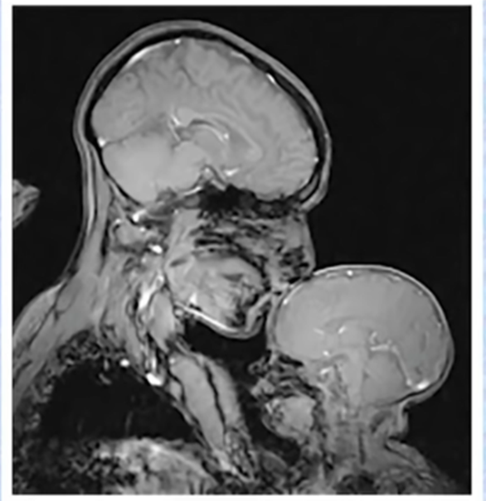
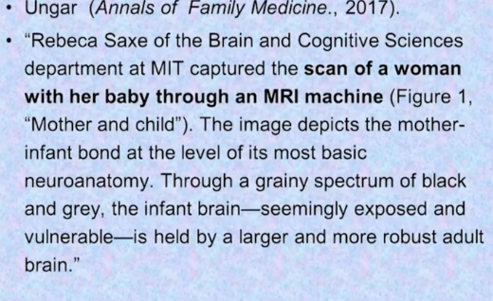
Neuroanatomy of mother-infant bond

Slide 37
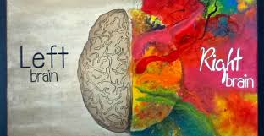
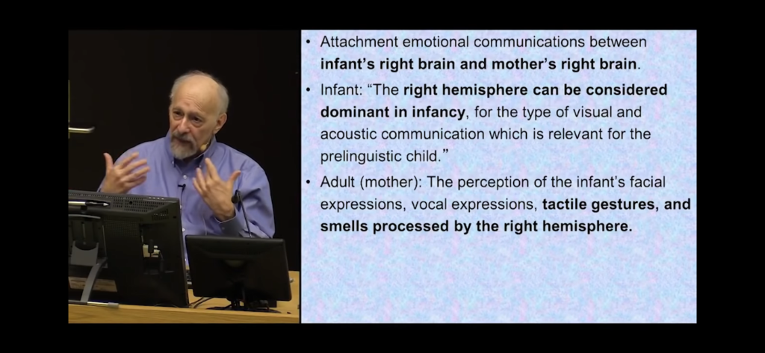
Right brain is dominant in infancy

Slide 38
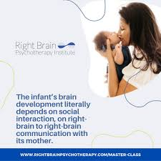
Right to right brain communication between mother and infant is dominant early on

Slide 39
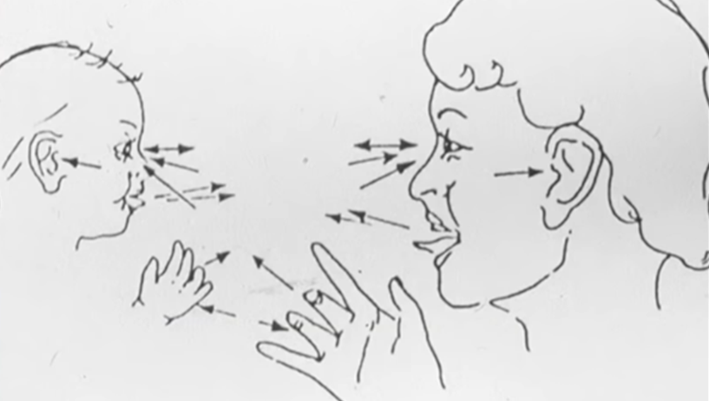
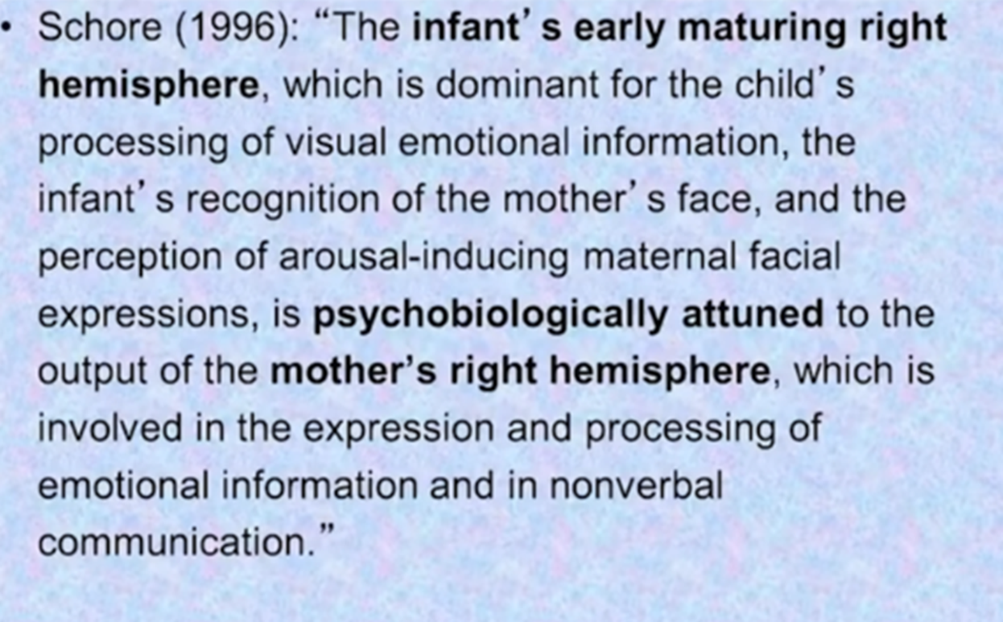
Right to right brain communication between mother and infant is dominant early on

Slide 40
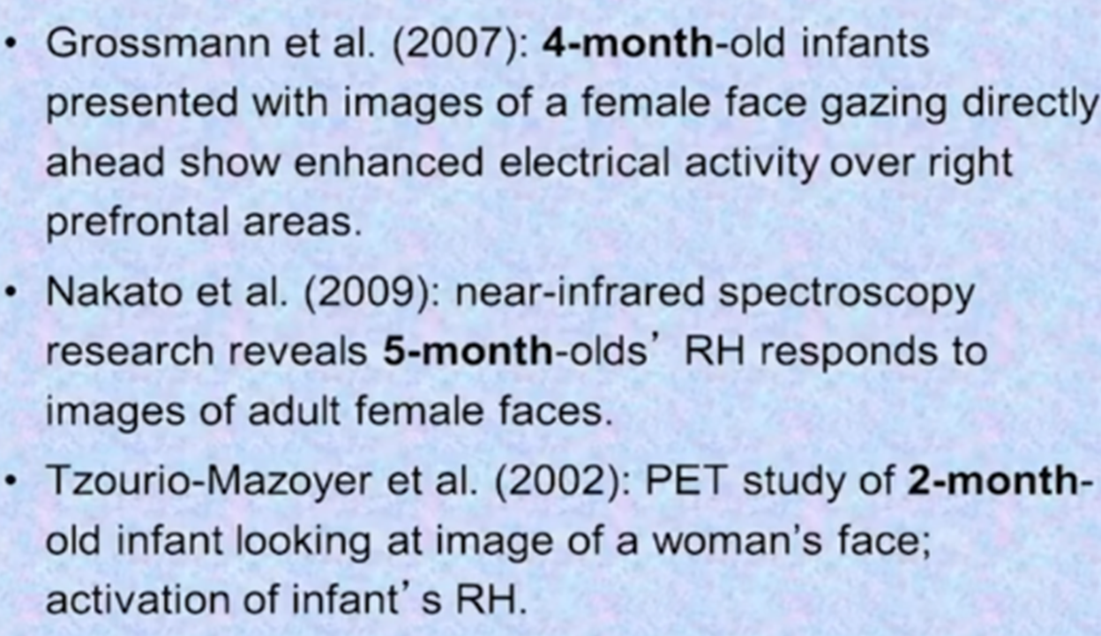


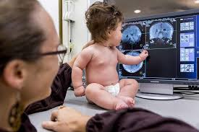
Right hemisphere (RH) visual-facial communications (that baby knows he’s got it going on!)

Slide 41
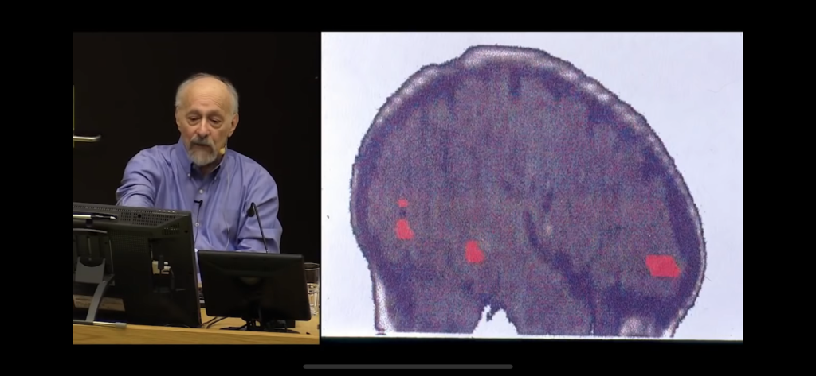

Slide 42
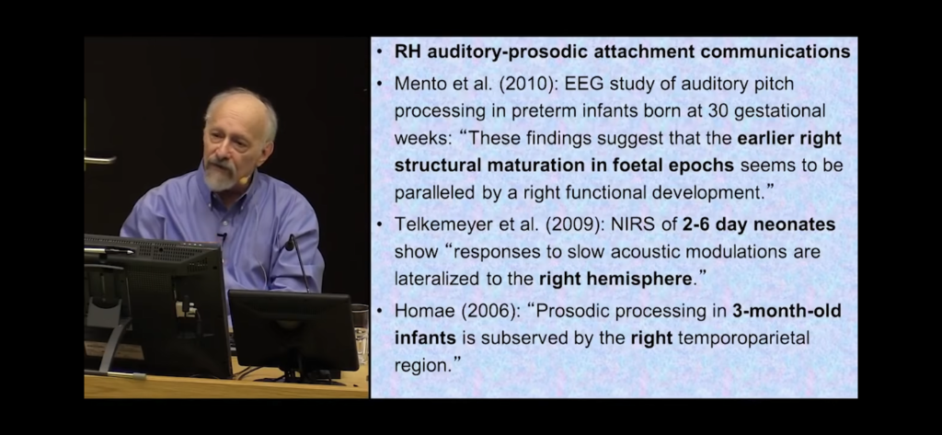
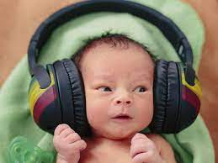

Right hemisphere auditory-prosodic attachment (you just gotta loves those babies!)

Slide 43
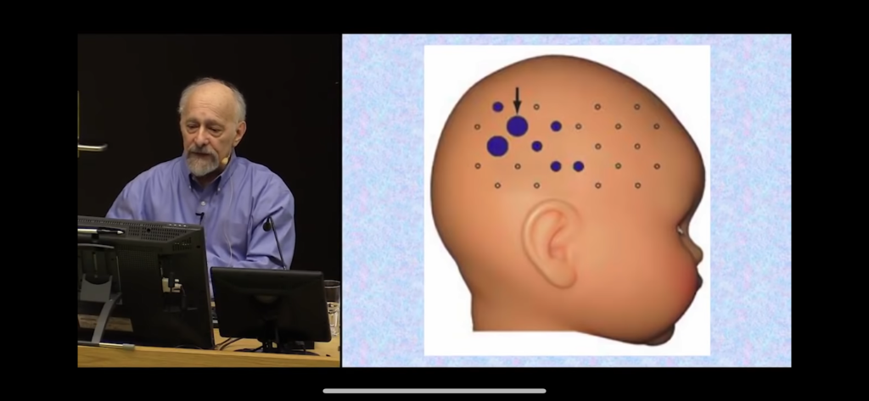

Slide 44



Right hemisphere tactile-gestural attachment communications

Slide 45


The power of attunement

Slide 46

Dr. Schore’s all-time favorite slide depicting mother-infant attunement

Slide 47



There are frequent moments of misattunement

Slide 48



Good enough attunement – it doesn’t have to be perfect - just good enough

Slide 49


Early developing right brain circuits are shaped by attachment experiences

Slide 50



Mother’s right frontal areas activate to match both her infant’s joy and/or distress

Slide 51


Slide 52



Positive and negative affects activate different brain circuits

Slide 53


Small does of shame in the socialization process

Slide 54

Mild shame helps to shift from too high arousal to lower arousal state

Slide 55


Right brain growth continues through the second year of life

Slide 56


Symbolic play allows the toddler to play with ideas and generate fantasies

Slide 57


Dads enter the building at about 2 ½ years of age

Slide 58



Fathers' involvement impacts the growth of the toddler’s left brain

Slide 59



Full body, rough-and-tumble play offered by dads is a good thing. So, mom, let them loose!

Slide 60



Mom and dad make a great team – mom with right brain and dad with left brain development

Slide 61

Attachment
Takeaways
Studies reveal that Interactions during the first three years of life can affect cognitive development and will impact physical, emotional, and mental health of children as they age and develop (Colmer et al., 2011).
Typically, a parent’s emotional response will serve as a template for helping their child learn about emotion. As parents model appropriate emotion regulation through conversations or actions, children learn to control/regulate their emotions.
On the other hand, insecurely attached children may learn to mask their emotional distress or exaggerate them in order to gain the parent’s attention; therefore, making up for a parent who is not consistently responsive (Laible, 2010).
This type of maladaptive behavior has devastating consequences, resulting in poor social skills, emotional dysregulation, depression, anxiety, peer exclusion, social rejection, and/or low self-esteem (Lewis et al, 2015; Newman, 2017).
So, it behooves any of us who are young parents to ensure that we are spending lots and lots of time with our infants and children in healthy, safe, and connected ways, particularly early in life to develop secure attachment so they will be able to have joy, fulfilling relationships, and emotional stability.

