Slide 1
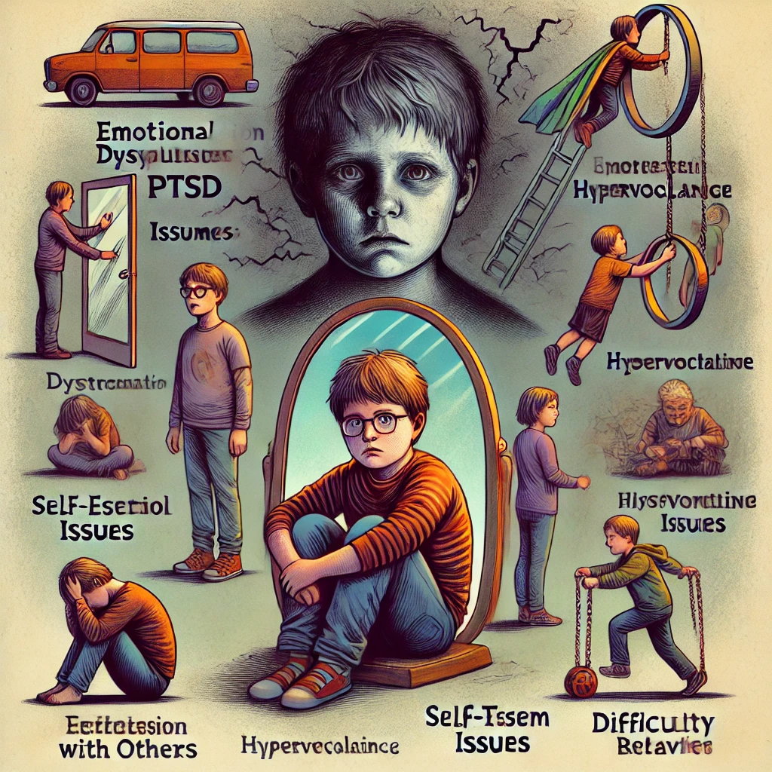
Consequences of Complex or Developmental Trauma
Adapted from Tim Fletcher https://youtu.be/fRu2PHWBAdk?si=b3VWsebK6La4d1pV
Jeffrey E. Hansen, Ph.D.
Clinical Director, Holdfast Recovery
Founder and Director NeuroFaith

Slide 2
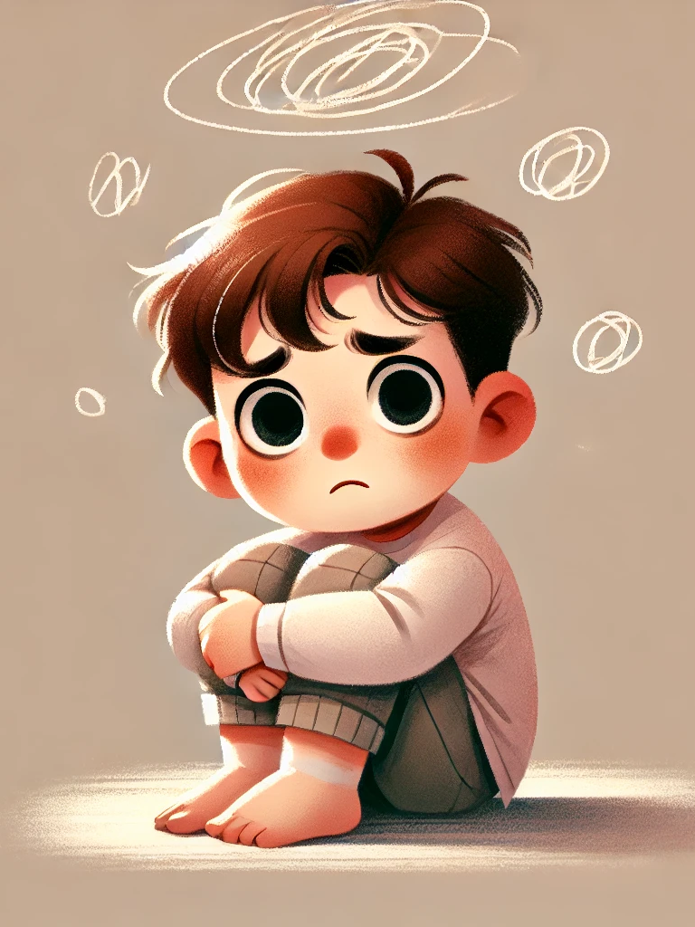
Consequences of Developmental Trauma
The sad part about Complex Trauma is that the child did not choose these adaptations because they wanted to be a bad child; they did it to survive.
They did it because they didn’t know of anything else to do – they didn’t have any other tools available.

Slide 3
Children do not choose trauma. Their survival adaptations are not a reflection of moral failing, but a means of survival.
📖 Isaiah 41:10 – 'So do not fear, for I am with you; do not be dismayed, for I am your God. I will strengthen you and help you; I will uphold you with my righteous right hand.'

Slide 4
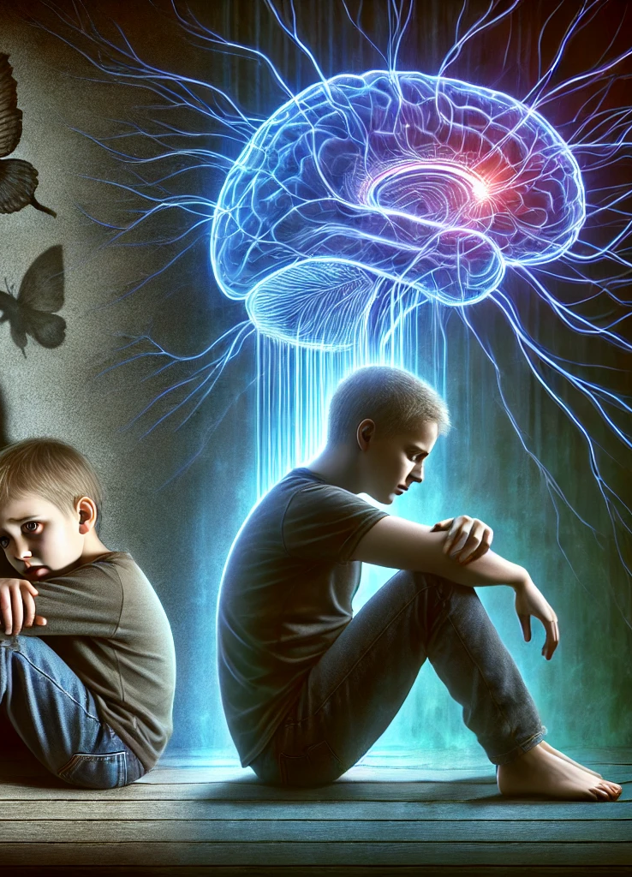
Consequences of Trauma
The child must choose adaptations to survive.
The fault is not theirs for initially choosing to survive.
However, they are now responsible for whether or not they continue to do something that they know is hurting others when it is no longer necessary for survival.
They are now at fault if they continue.

Slide 5
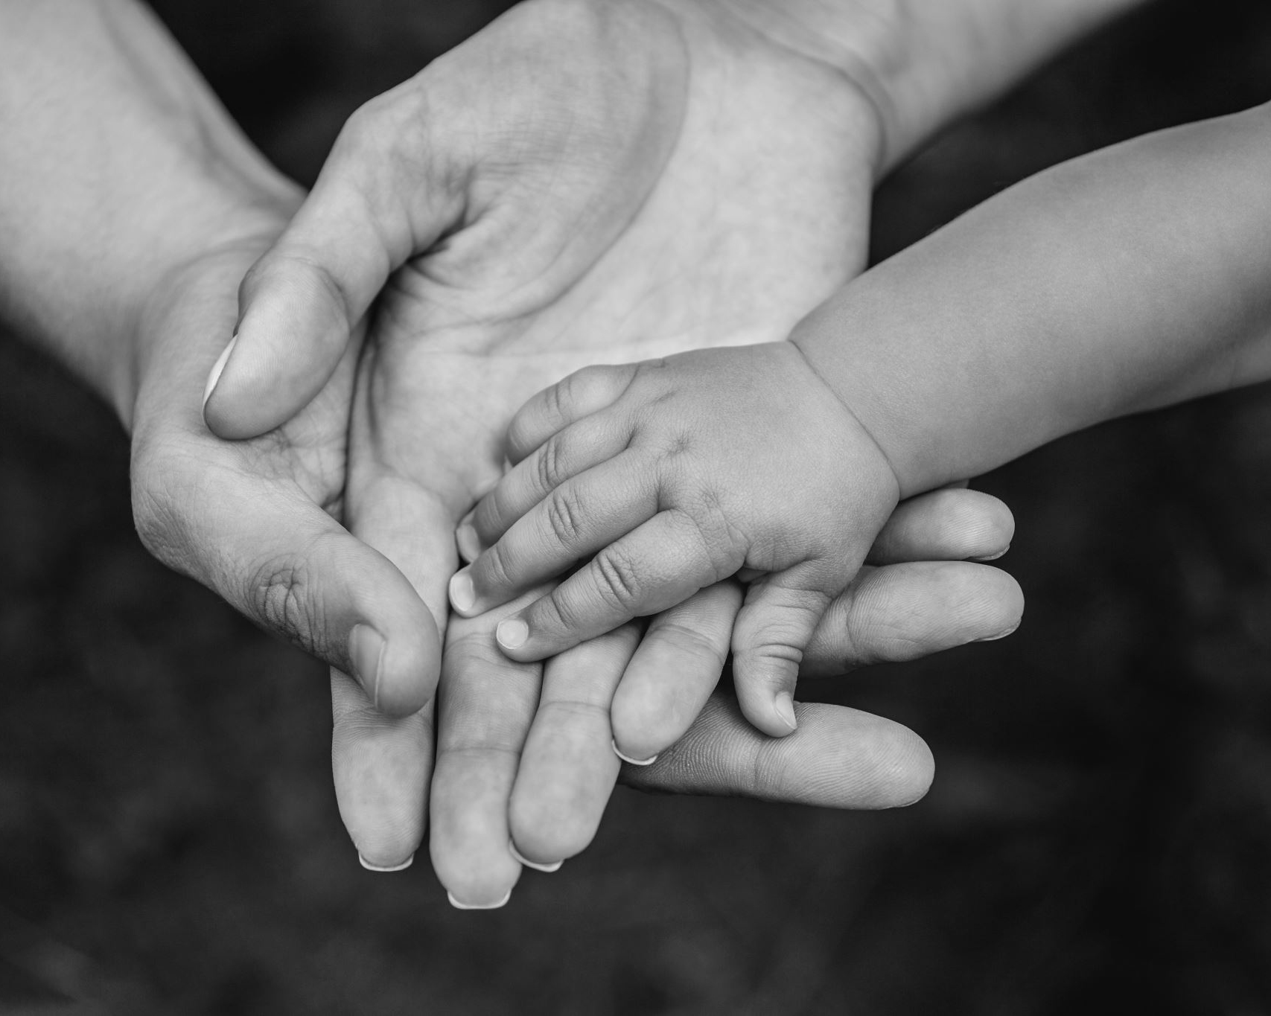
The child is not responsible for what was forced upon them, but they are responsible for their future choices.
📖 Ezekiel 18:20 – 'The child will not share the guilt of the parent, nor will the parent share the guilt of the child. The righteousness of the righteous will be credited to them, and the wickedness of the wicked will be charged against them.'

Slide 6
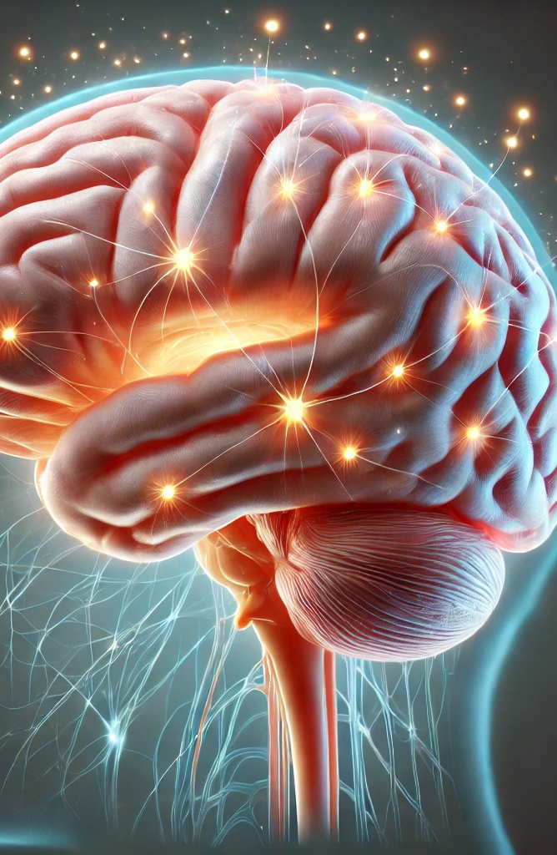
Limbic Brain Running the Show
The limbic brain will always choose actions that result in instant gratification. It does not think in terms of long-term consequences.
Complex Trauma (ongoing fear) keeps a person in their limbic brain.
It is essential that a person learns to recognize when they are in their limbic brain and shift to their cortex to avoid bad decisions and regrets.

Slide 7

Consequences shape behavior through reinforcement, for better or worse.
📖 Galatians 6:7 – 'Do not be deceived: God cannot be mocked. A man reaps what he sows.'

Slide 8
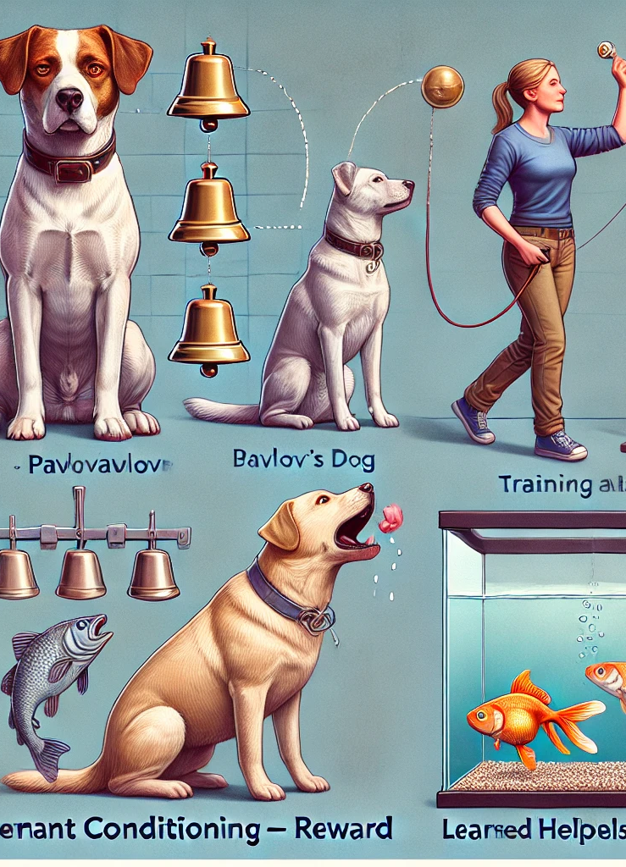
The Power of Consequences
Consequences train the brain and shape behavior/habits:
  Pavlov’s dog
  Training animals – reward
  Glass in fish tank
In Complex Trauma, mis-training occurs:
  Authenticity = rejection
  Validation (my value) comes from my body
  Hope always results in disappointment

Slide 9
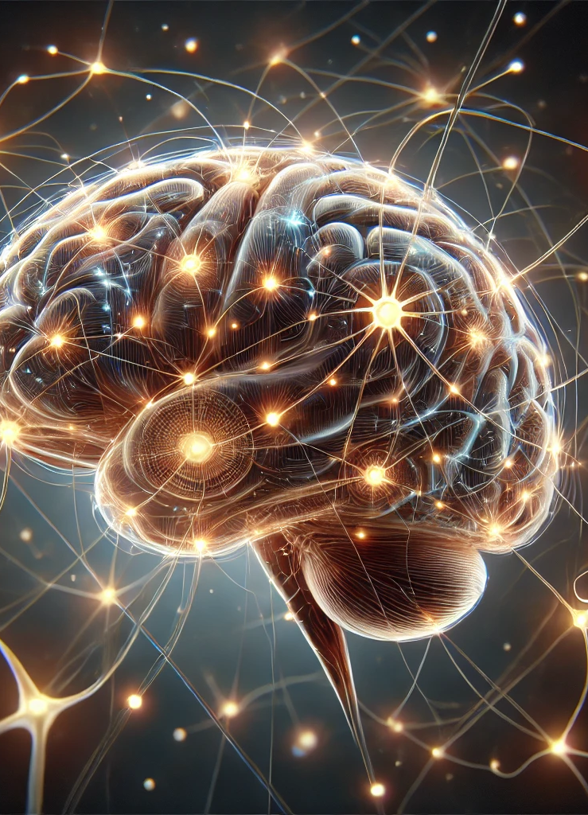
Brain Circuit Reinforcement
Building a brain circuit requires repetition. Once reinforced, it becomes part of our subconscious brain.
In Complex Trauma, survival-based circuits are reinforced thousands of times, making them difficult to break.
A strong gravitational pull makes it hard to resist actions tied to these circuits.

Slide 10
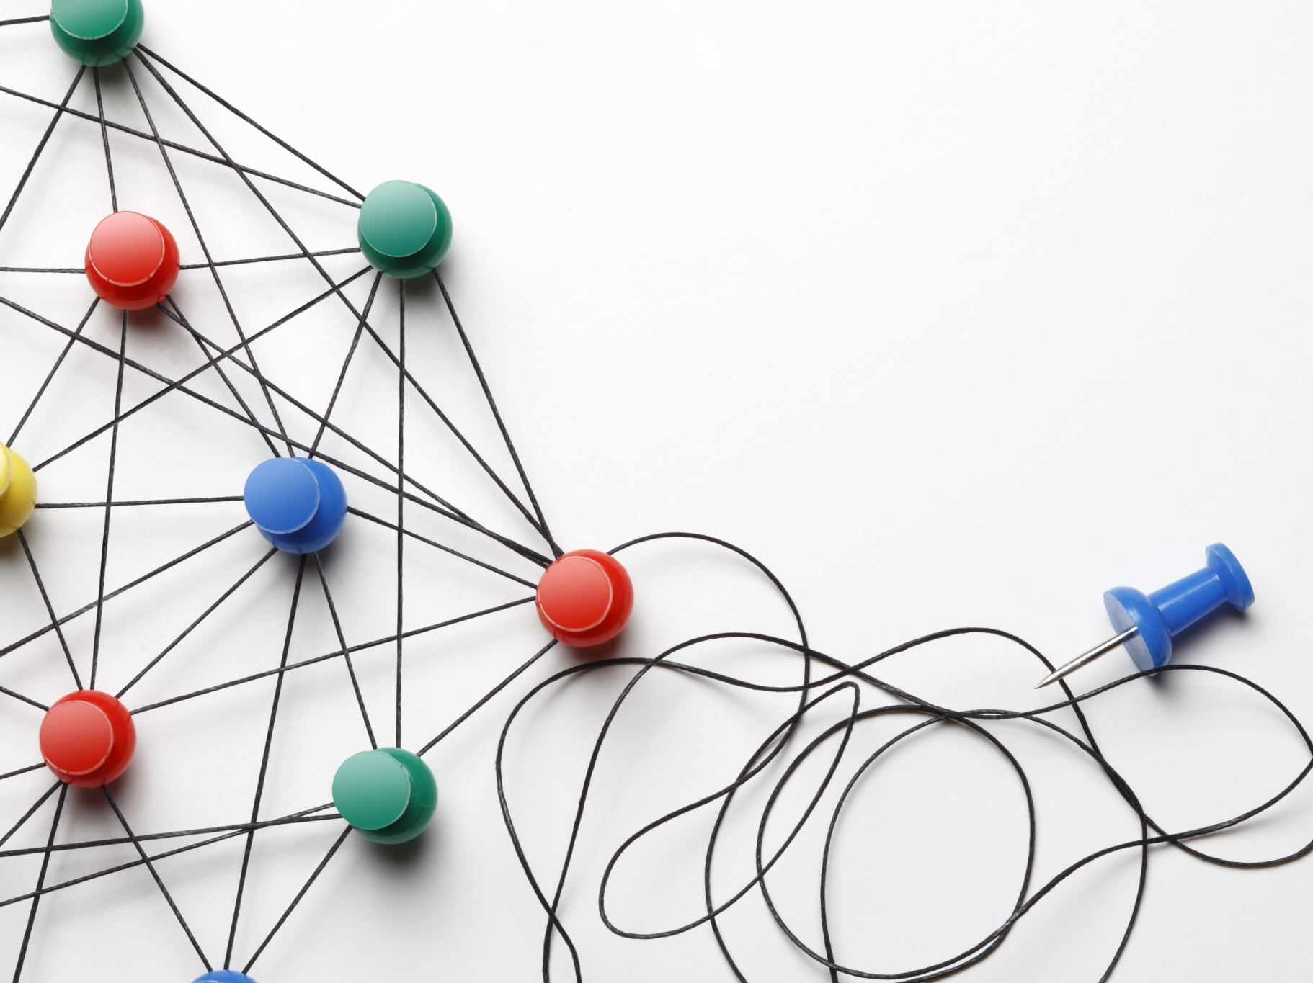
Survival-based circuits are reinforced over time, making them difficult to break.
📖 Romans 12:2 – 'Do not conform to the pattern of this world, but be transformed by the renewing of your mind.'

Slide 11
Dopamine and Trauma
Dopamine creates pleasure, not just from actions, but from memories. For example, a crack addict gets a rush from thinking about using.
The reward is tied to survival-based memories.
However, if the brain is operating on bad information, it may reinforce harmful behaviors with dopamine hits, leading to long-term consequences.

Slide 12
Dopamine reinforces survival-based behaviors, often leading to addiction.
📖 Proverbs 14:12 – 'There is a way that appears to be right, but in the end it leads to death.'

Slide 13
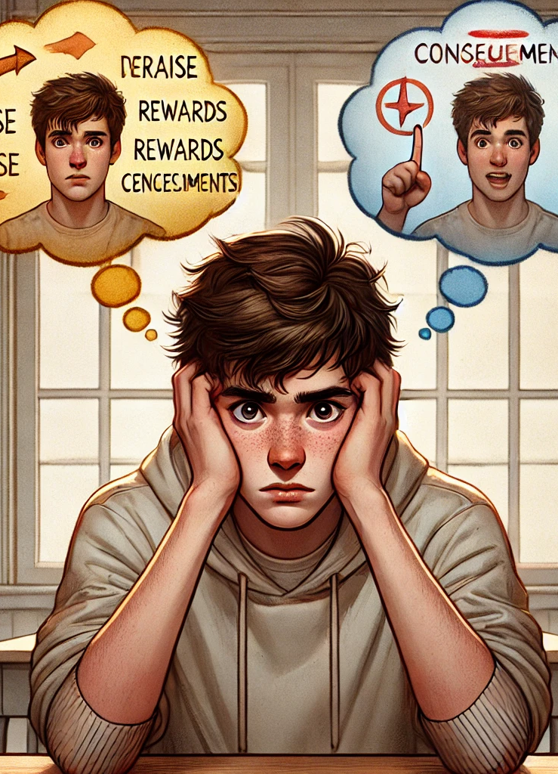
Inconsistent Consequences
Positive, then negative
Inconsistent positive creates false hope and fantasy—similar to gambling addiction
In Complex Trauma, if a child was occasionally rewarded for humor, responsibility, athleticism, or got away with lying/stealing, their brain will keep seeking those outcomes.

Slide 14
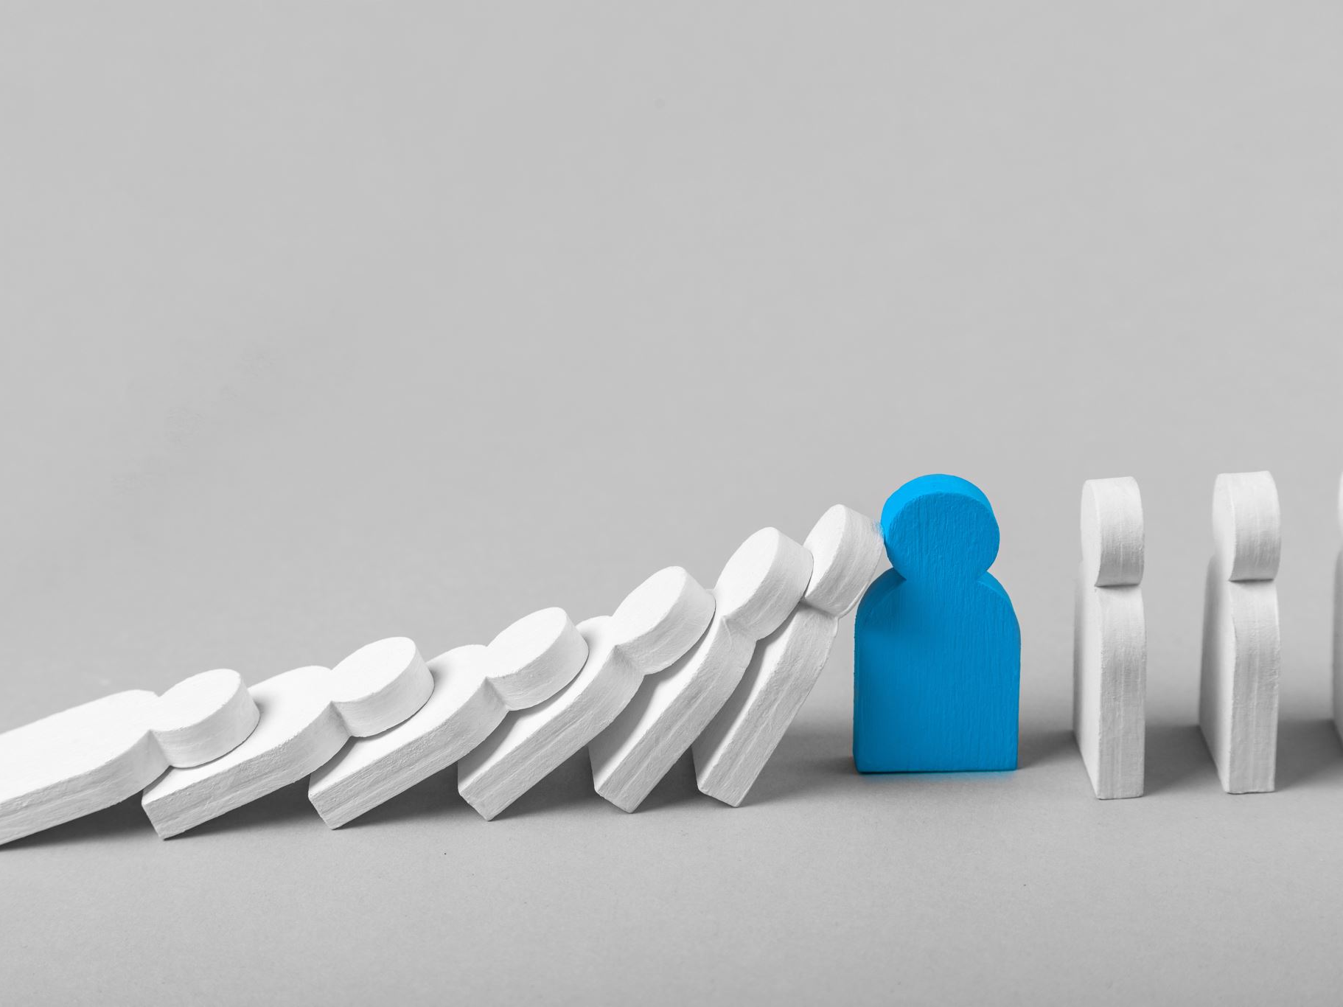
Unpredictable reinforcement creates instability and poor decision-making patterns.
📖 James 1:8 – 'Such a person is double-minded and unstable in all they do.'

Slide 15

Unfair Consequences - Injustice
No reward for good behavior, punishment for things they didn’t do, or overly harsh consequences
This can harden a child to consequences—'If life isn’t fair, who cares?'
Short-term pleasure becomes more appealing.

Slide 16
When consequences feel unjust, it can harden a child's heart.
📖 Ecclesiastes 7:7 – 'Extortion turns a wise person into a fool, and a bribe corrupts the heart.'

Slide 17

Parents Who Spoil a Child
Parents remove all negative consequences and call it love.
The child learns they can avoid consequences.
As adults, they may disregard rules, believing they don’t apply to them.

Slide 18
Overprotecting children from consequences fosters entitlement.
📖 Proverbs 13:24 – 'Whoever spares the rod hates their children, but the one who loves their children is careful to discipline them.'

Slide 19
Delayed Natural Consequences
The full consequences of actions often don’t appear for 20-30 years.
They unfold gradually, making them easy to ignore at first.
This leads to continued poor choices because the negatives aren’t immediately apparent.

Slide 20
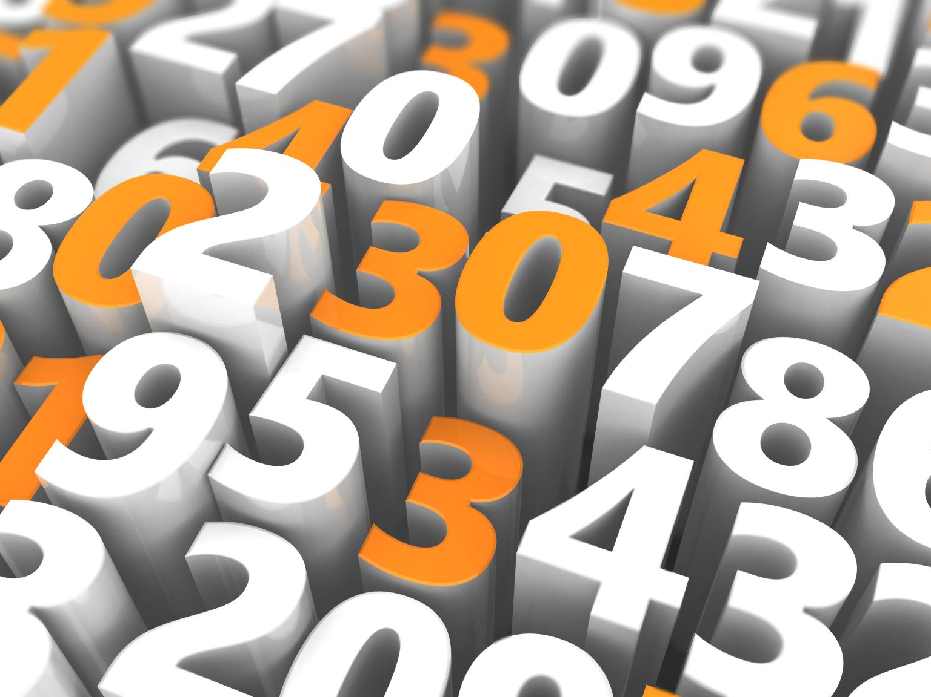
Many consequences unfold gradually over time, often taking decades to manifest.
📖 Numbers 32:23 – 'But if you fail to do this, you will be sinning against the Lord; and you may be sure that your sin will find you out.'

Slide 21
Cognitive Bias in Consequences
Positive benefits often outweigh negatives for years.
We rationalize/minimize negatives and blame others for failures.
Fantasy thinking can deny or ignore potential negative consequences.

Slide 22
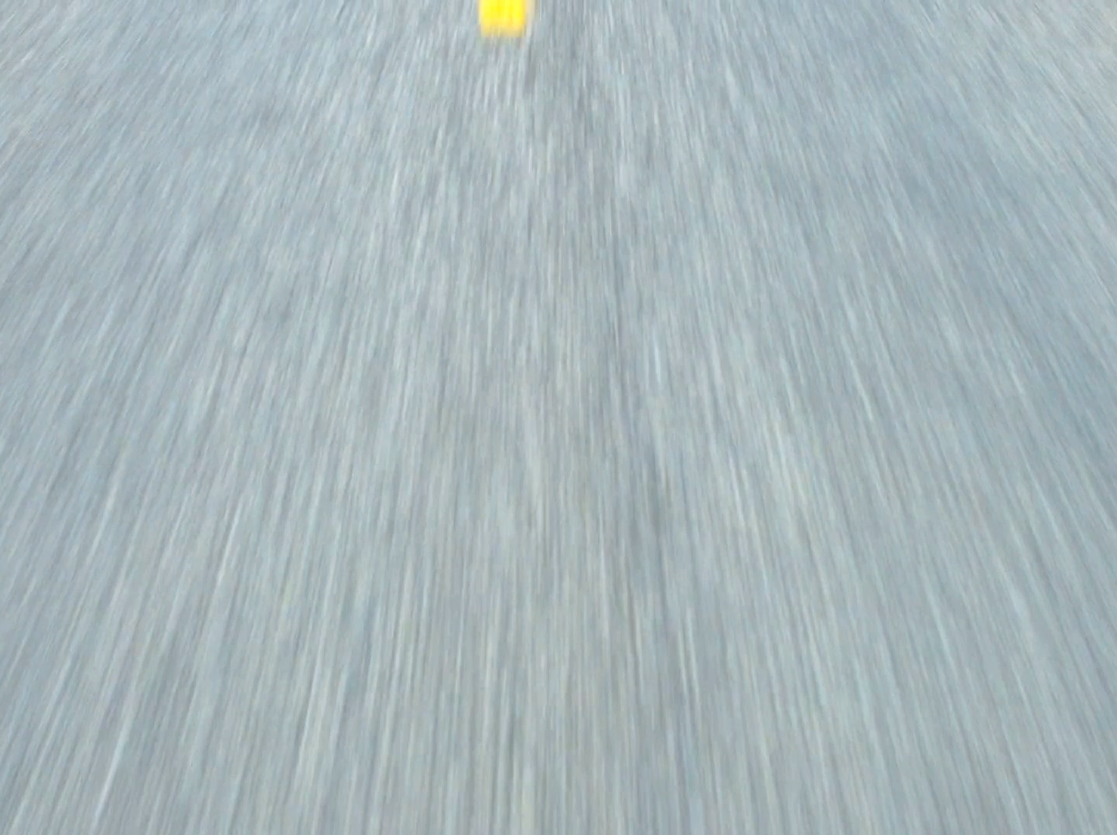
Cognitive bias takes us down a wrong path in life
Proverbs 14:12 (NIV)
'There is a way that appears to be right, but in the end it leads to death.'

Slide 23
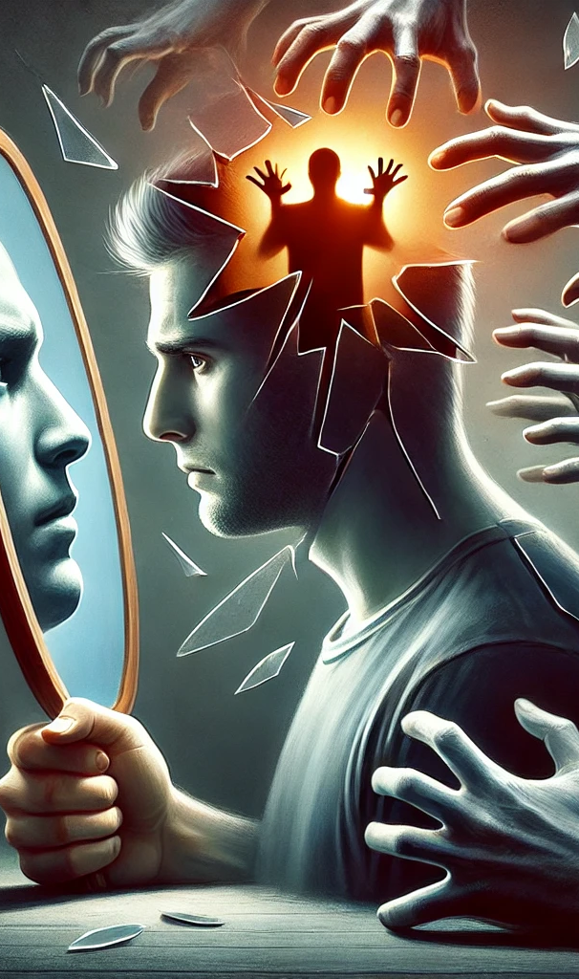
Summary: Cognitive Trauma Consequences
🧠 Trauma distorts perception, leading to cognitive biases and avoidance.
💔 Shame and false beliefs drive addiction, self-sabotage, and relational struggles.
⚡ Healing requires recognizing these biases, reframing negative self-perception, and embracing truth, faith, and self-compassion.

