Slide 1
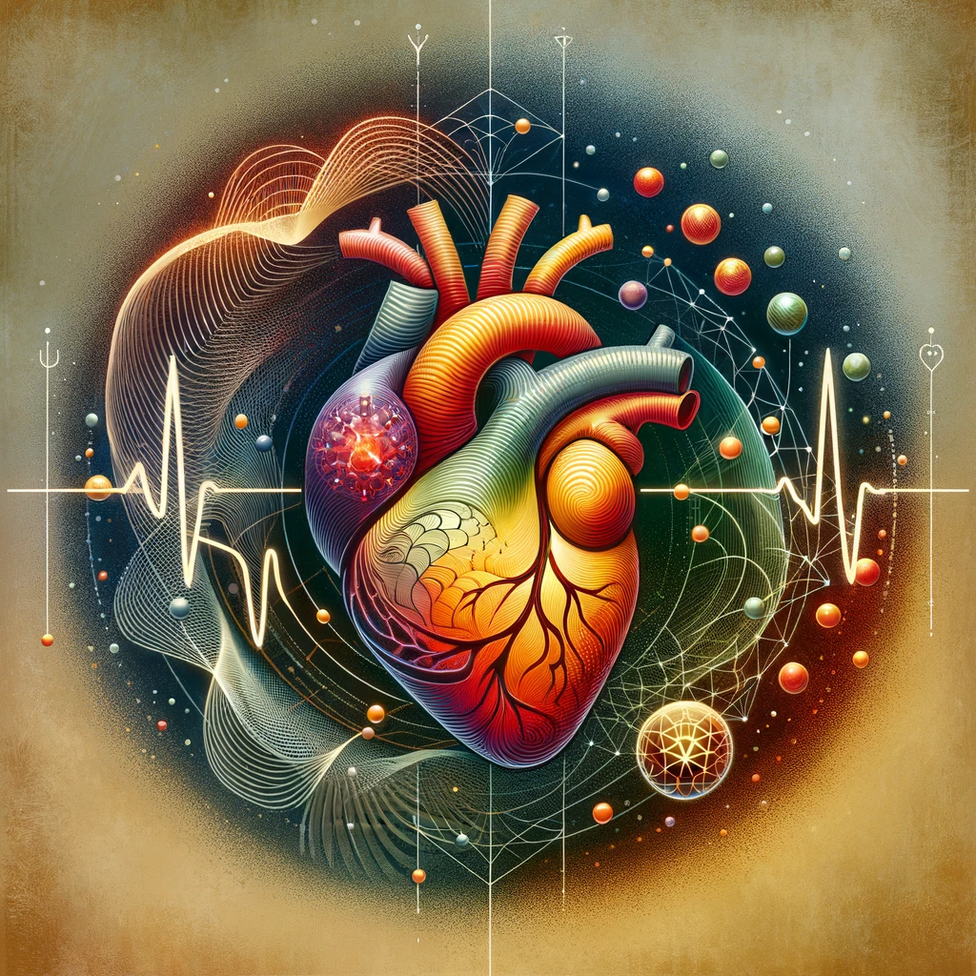
Jeffrey E. Hansen, Ph.D.
Center for Connected Living, LLC
Slides were compiled by Dr. Hansen but have been largely adapted from HeartMath members and friends, Rollin McCraty, Howard Martin, Deborah Rozman, Doc Childre, Gregg Braden, Bruce Lipton, and Joe Dispenza.
Please visit: https://www.heartmath.com/
Heartfelt Living

Slide 2

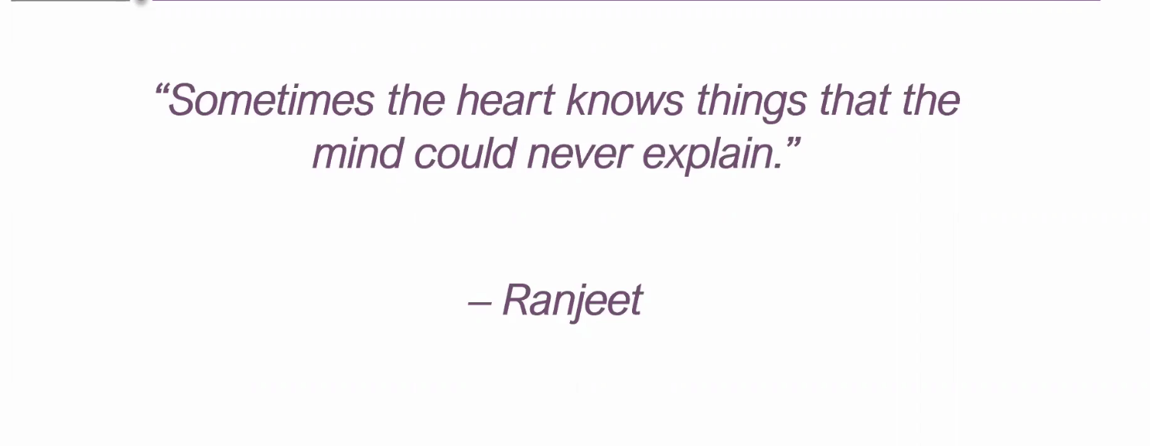

Slide 3
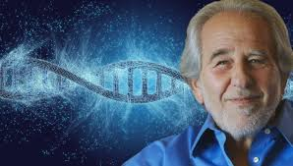
Debate of the Ages - Energy vs Matter
Cell biologist and medical school professor, Bruce Lipton, Ph.D., brilliantly describes how early thinkers and philosophers have influenced science and the current state of medicine. The following 10 slides are largely based on his work.
Click here for his full lecture.
https://www.youtube.com/watch?v=82ShSNuru6c&ab_channel=vekmehelofkirr

Slide 4
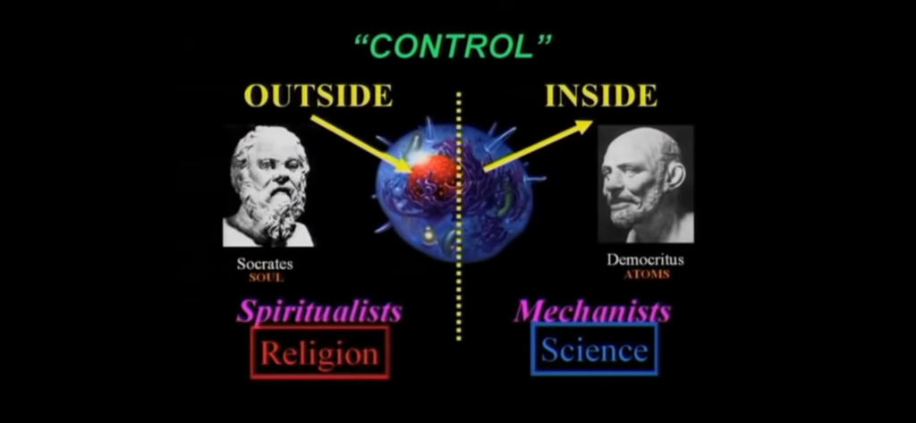
Debate of the ages – Energy vs Matter
Dr. Bruce Lipton highlights the long-held question of whether we are all particle or are we both particle and spiritual/energy – a debate going back as far as Socrates and Democritus. Additionally, the question of whether control is merely within or is it from without as well?

Slide 5
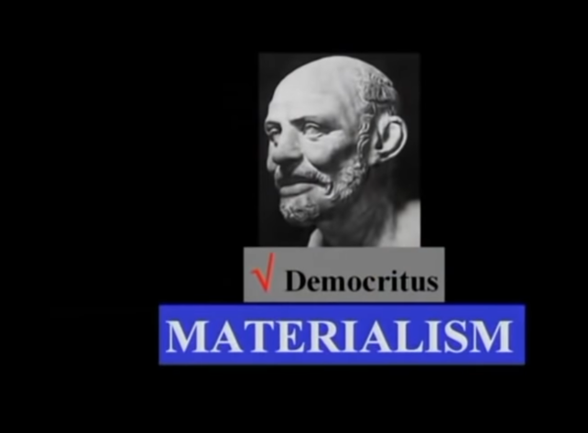
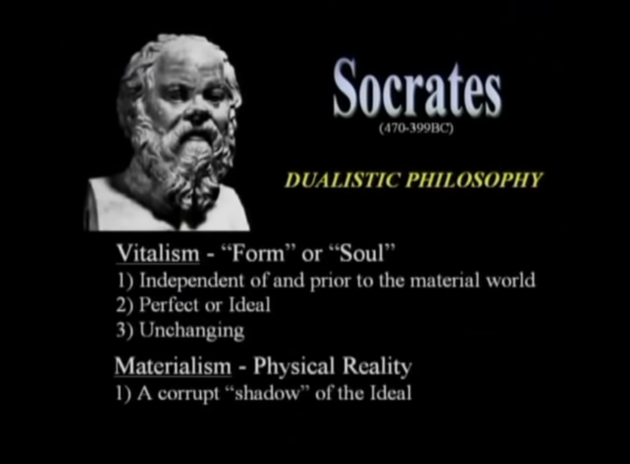
Debate of the Ages - Energy vs Matter
These assumptions have far-reaching consequences for how we experience life and impact on fundamental approaches to medicine and psychology
https://www.heartmath.com/

Slide 6
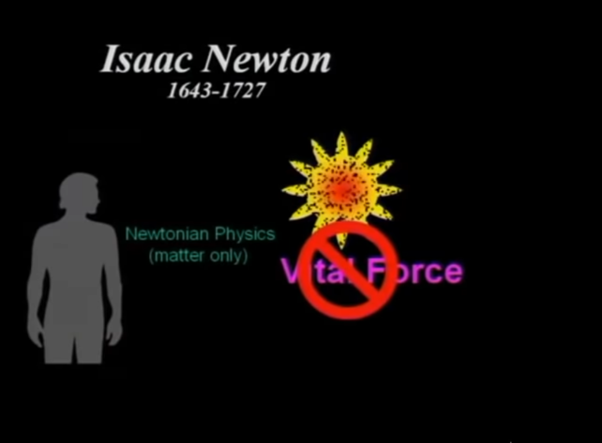
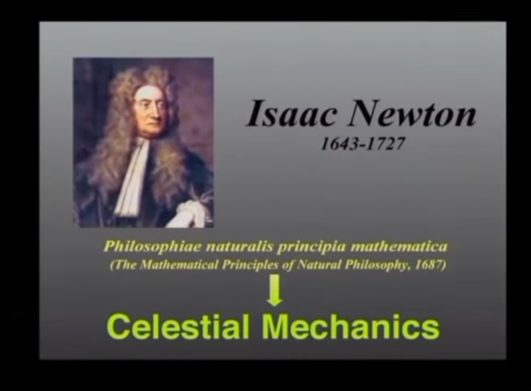
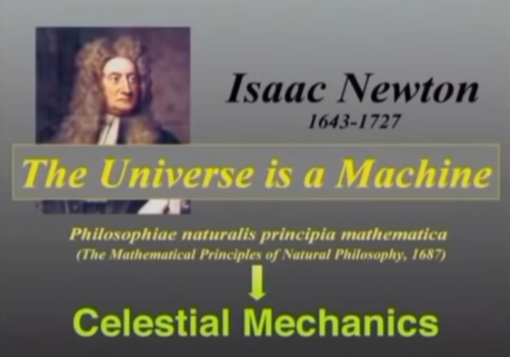
Debate of the Ages - Energy vs Matter
Centuries later, Isaac Newton, following in the footprint of Democritus developed calculus to explain the physical universe in terms of matter. Science and medicine have largely followed this model. Newton invented calculus to explain his model.

Slide 7
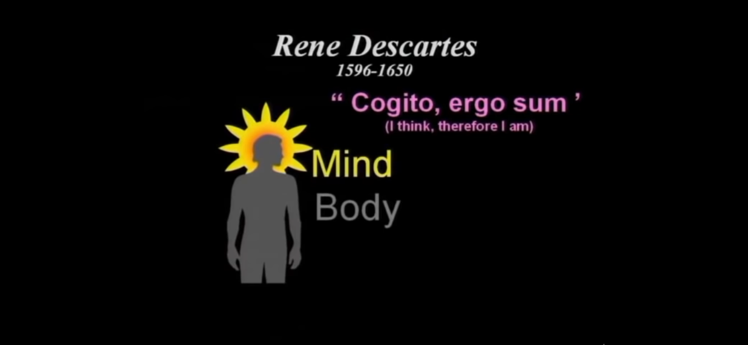
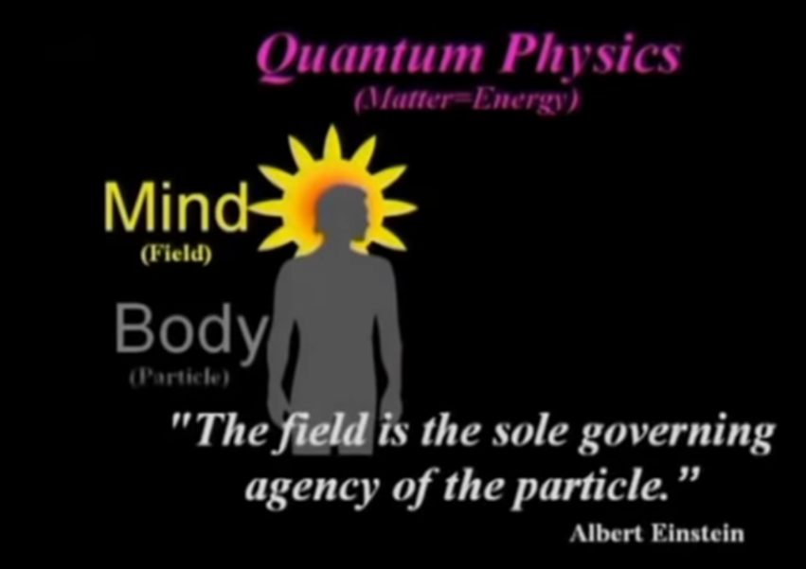
Debate of the Ages – Energy vs Matter
Rene Descartes, on the other hand, following in the steps of Socrates, upheld that both mind and body are essential, the former being within and outside of the body – energy/wave. Descartes formulated the modern version of the mind–body problem. In metaphysics, he provided arguments for the existence of God, to show that the essence of matter is extension, and that the essence of mind is thought. This opens the door to quantum mechanics which is needed to describe the behavior of energy. We can define energy as organized information.

Slide 8
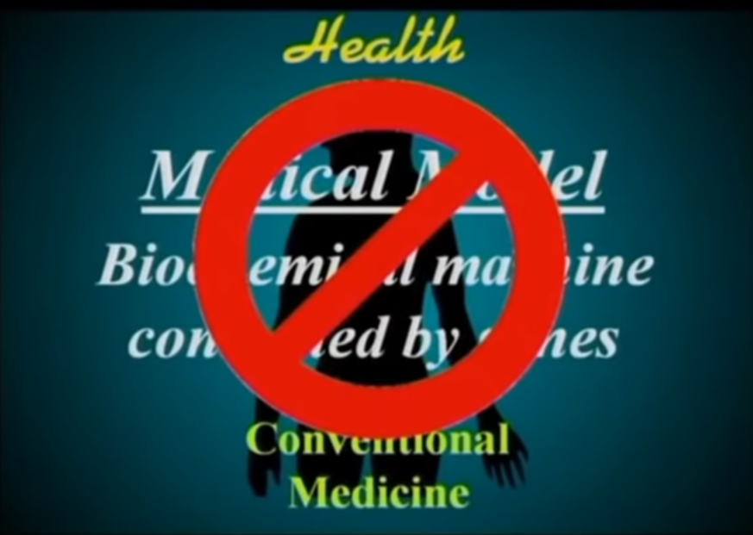
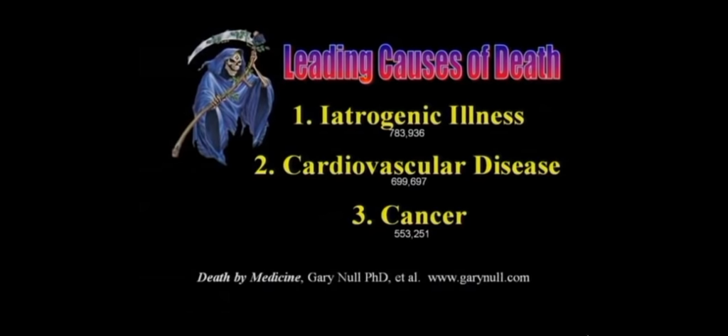
Current Medical Model
The current Newtonian-based medical model is brilliant when it comes to such things as mechanical surgeries, excising cancers, etc., but falls short on many fronts. Sadly, as reported by Dr. Bruce Lipton, cellular biologist and medical school professor and Stanford research scholar, iatrogenic (illness caused by medical examination or treatment) is the number one cause of death in the US, ahead of cancer and cardiovascular disease.

Slide 9
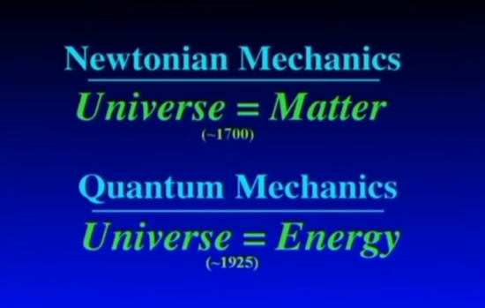
Debate of the Ages - Energy vs Matter
Newtonian Mechanics can only describe the behavior of matter which would be great if that that were all that there was, but science is proving that Socrates and Descartes were correct, energy must be added to the equation to describe the magnificent complexity of life. Newtonian Mechanics fails to predict, for example, the complex shapes of proteins which are the building blocks of the body, on the other hand, Quantum Mechanics does this beautifully.

Slide 10
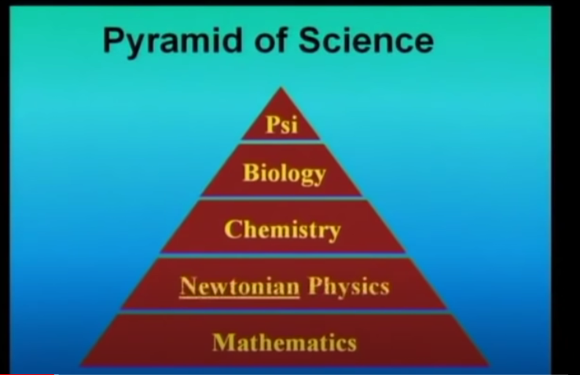
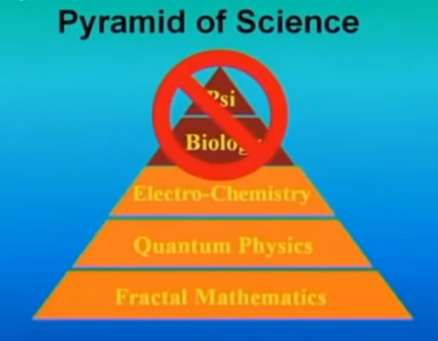
Debate of the Ages – Energy vs Matter
So, we see that each theory (Newtonian vs Quantum) has implications for many science disciplines. If any one step in the pyramid changes, all disciplines above it must change to accommodate the change. Newtonian physics on the left side has stifled disciplines above it. Quantum physics has brought great changes to electro-chemistry and biology and psychology are only beginning to incorporate them

Slide 11
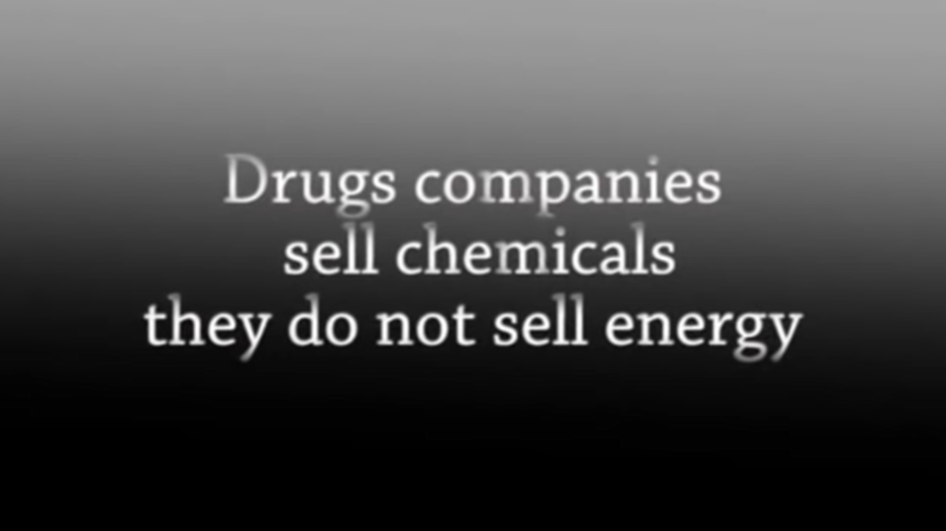

Slide 12
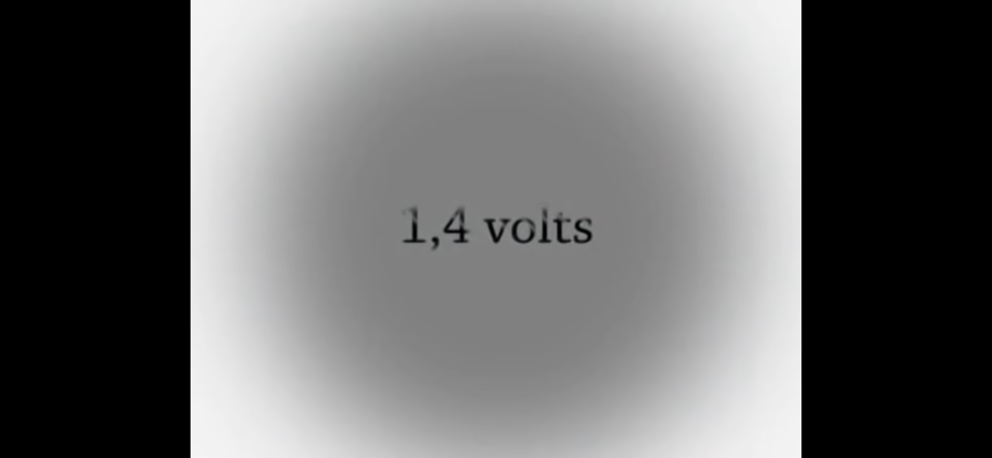
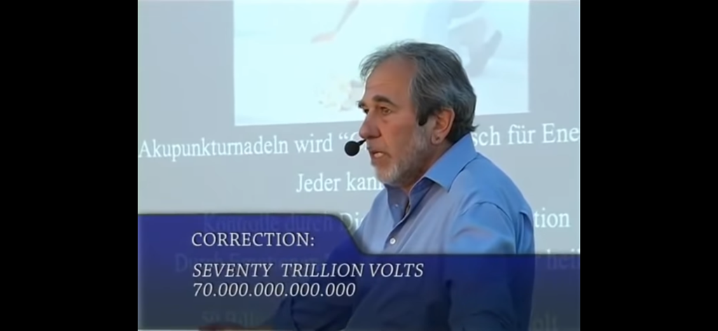
The Power of the Cell
Dr. Lipton asserts that each cell has a capacity of 1.4 volts and given that our bodies are comprised of approximately 50 trillion cells, we carry within us a potential of 70 trillions volts. This energy has immense potential he adds to change us.

Slide 13

Now that we can appreciate that perhaps old models no longer serve us well, we can open ourselves to the need for new ways of healing. For more than 25 years, HeartMath Institute has been researching the heart-brain connection and learning how the heart influences our perceptions, emotions, intuition and health.
HeartMath helps you tap into the power and intelligence of your heart – your heart’s intuition – which awakens you to the best version of yourself. It borrows heavily from quantum theory and an exciting new field of medicine, neurocardiology.
HeartMath helps you tap into the power and intelligence of your heart – your heart’s intuition – which awakens you to the best version of yourself.
For more information on HeartMath, click: https://youtu.be/3Vh9qEblTOE

Slide 14

Our incredible heart:
Beats 101,000 times a day
Circulates an astonishing 1,900 gallons of blood
Through 60,000 miles of blood vessels, arteries, and capillaries (Braden, 2015).

Slide 15
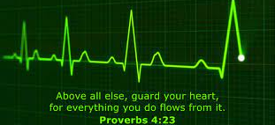
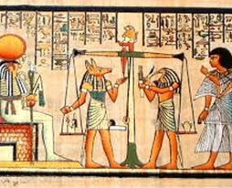
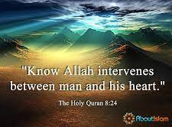
The Heart Wisdom of the Ancients
Click here to listen to the amazing Gregg Braden: https://www.youtube.com/watch?v=3KEv-oQe0jI&ab_channel=GreggBradenOfficial k: https://youtu.be/Hir6I-RfOiY

Slide 16
If you were to ask what the most important organ in the body, most would say the brain?
Braden notes that from Leonardo da Vinci’s day, 500 years ago, until the late 1990s, people throughout the Western-educated world held that the brain is the “conductor” leading the symphony of functions that enable us to stay alive.
This belief that the brain is the control center for the body, emotions, and memories has been so fully and universally accepted and deeply engrained in our collective psyches and taken for granted until now.
Braden asserts that while it is certainly true that the brain’s functions include processes such as perception and motor skills, information processing; and provides triggers for sleep, hunger, desire for sex, and the strength of our immune system, there is more to the story (Braden, 2015).

Slide 17
As some may know, religious and mystery traditions have universally held that the heart has been regarded as a path to deep wisdom in life (Braden 2015b).
In the Bible, for example, the heart is mentioned 826 times in 59 of 66 books. The Bible reveals that our heart isn’t a separate part of our being. Instead, our heart is a composition of all three components of our soul - our mind, emotion, and will plus the most important part of our spirit, our conscience (Bibles for America, 2021). Solomon wrote in Proverbs 4:23, "Keep your heart with all diligence; for out of it spring the issues of life." The Bible posits that what is in your heart will direct your life (Back to the Bible, 2019).
The Quran similarly notes that our heart is a source of wisdom and guidance and mentions the human heart 132 times. Of the Qur’anic statements, some describe this sentient organ as having the capacity of being a center of reasoning, intentions, and decision-making. Consequently, human hearts can either be healthy or diseased. (Janat Al Quran, 2017).
The Egyptians likewise believed that the heart, rather than the brain, was the source of human wisdom, as well as emotions, memory, the soul and the personality itself. Physiology and disease were all connected in concept to the heart, and it was through the heart that God spoke, giving ancient Egyptian’s knowledge of God and God's will. As such, the heart was considered the most important of the body's organs (Dunn, 2021).

Slide 18
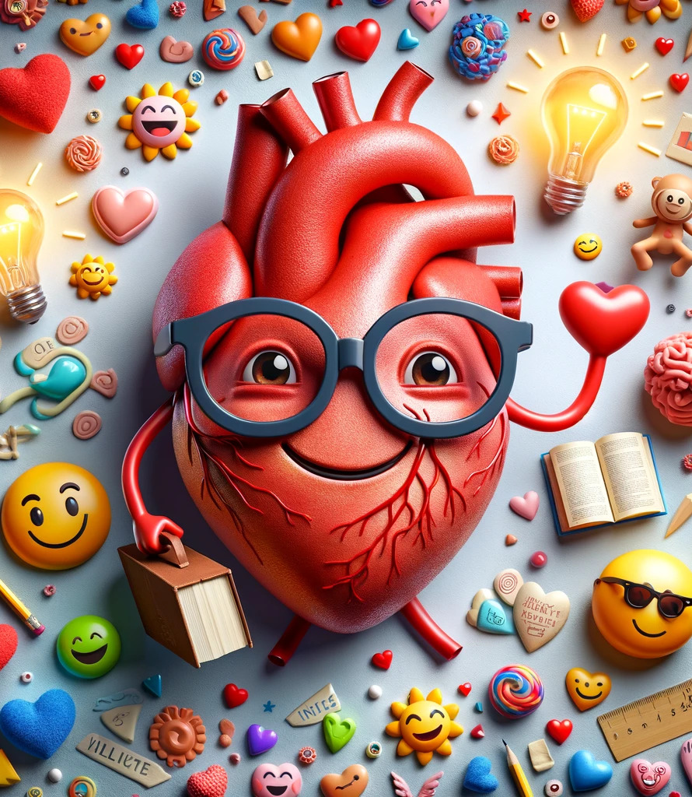
What – Heart Intelligence?
Dr. Armour, MD, PhD., at the University of Montreal in 1991, discovered that the heart has its own "little brain" or "intrinsic cardiac nervous system" (cited in Braden, 2015).
This "heart brain" is composed of approximately 40,000 neurons, called sensory neurites that are similar to neurons in the brain, meaning that the heart has its own nervous system.
In addition, the heart communicates with the brain in many methods: neurologically, biochemically, biophysically, and energetically.
The vagus nerve, which is 80% afferent, carries information from the heart and other internal organs to the brain.
Signals from the "heart brain" redirect to the medulla, hypothalamus, thalamus, and amygdala and the cerebral cortex (Braden, 2015a, 2015b).

Slide 19
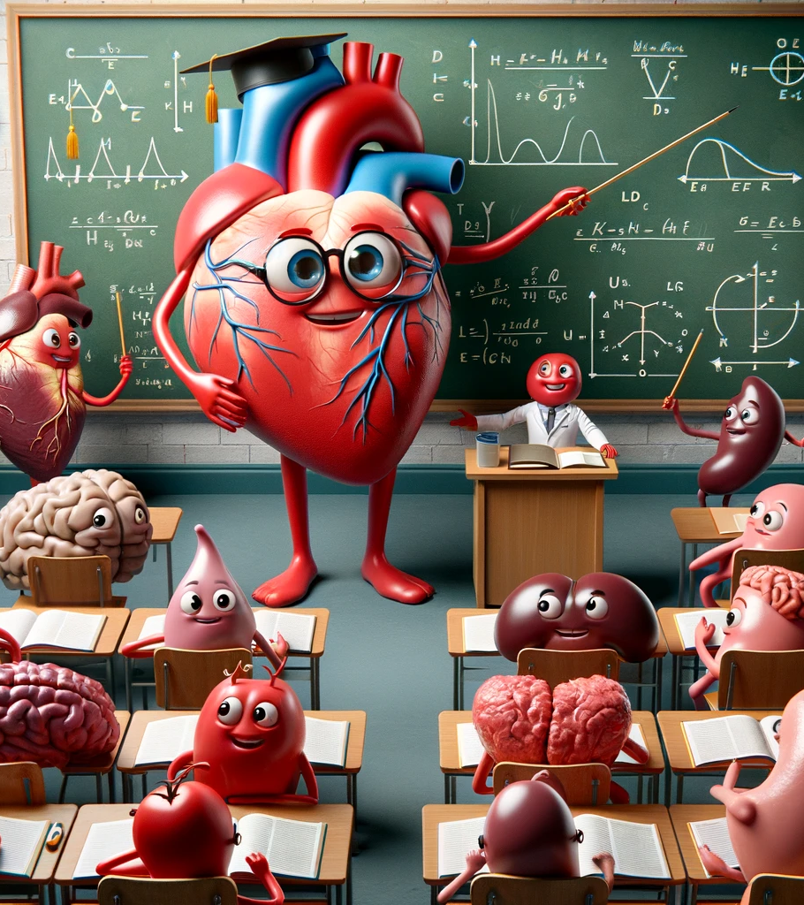
What – Heart Intelligence?
Braden notes that a key role of the heart brain is to detect changes in the body such as hormone levels and other chemicals and to communicate this information to the brain so it can meet our needs accordingly.
The heart brain achieves this by converting the language of the body, chemistry, to the electrical language of the nervous system so it makes sense to the brain.
For example, the heart’s encoded messages to the brain informs it as to when we need adrenalin for danger or when we need less in times of safety so the immune system can be turned on (Braden, 2015a, 2015b).

Slide 20
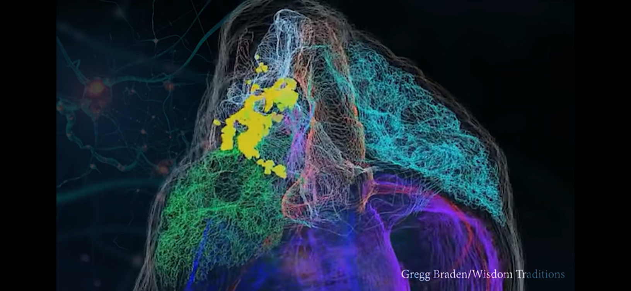
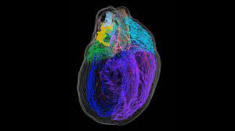
Imaging showing the sensory neurites (in yellow) which comprise the Little Brain of the heart
The heart’s “little brain”
can:
Act independently of the cranial brain to think, learn, and remember.
Act in harmony with the brain to give us the benefit of a single and potent network shared by both the heart and the brain (Braden, 2015).

Slide 21
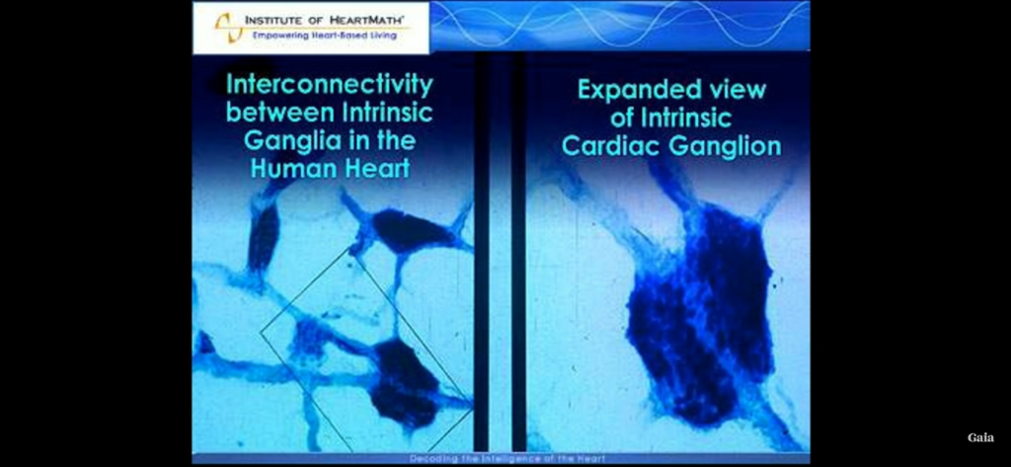
Imaging showing the interconnectivity of sensory neurites in the heart (neural networks)

Slide 22
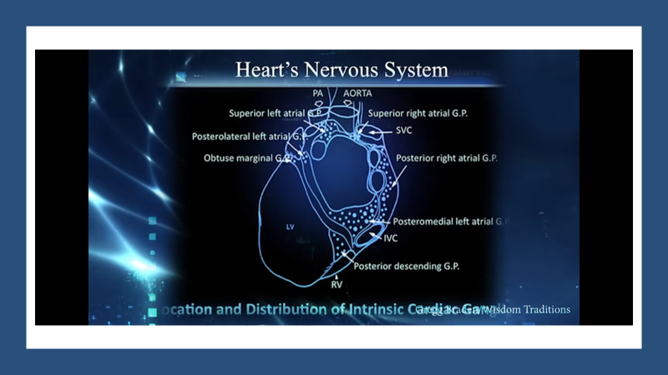

Slide 23
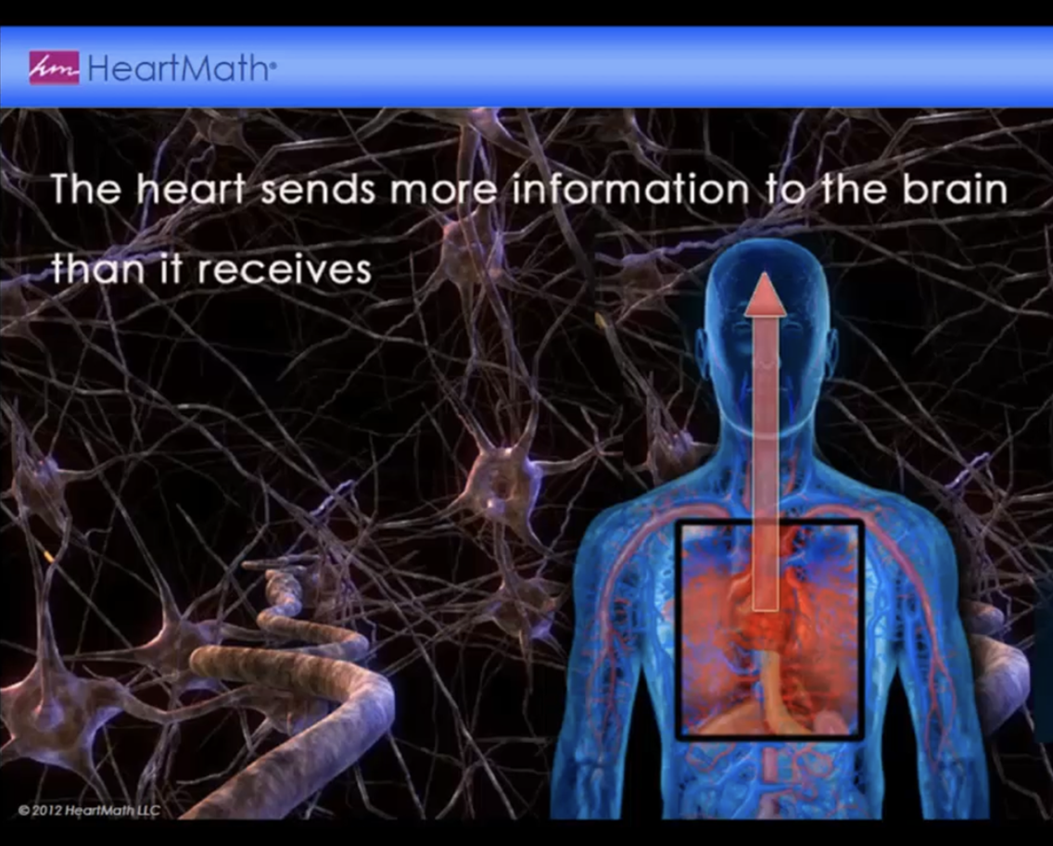
Heart-Brain Communication
80 % of the information flow is from heart to brain (afferent) whereas only 20% of the information flow from brain to heart(efferent)

Slide 24
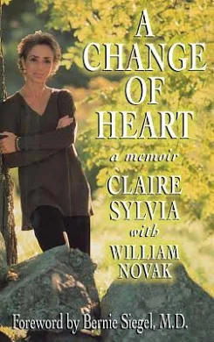
Stories of the Heart:
Clare Sylva, a professional dancer, in 1998 received the heart and lungs of a young man, Tim, who died in a motorcycle accident.
Not long after the transplant, she began to crave new foods such as chicken nuggets and green peppers and was specifically drawn to KFC to satisfy her cravings.
She was able to eventually visit the parents of this young man and discovered that Tim precisely loved the same kinds of foods that she was now craving.
Clare had acquired her cravings through the phenomenon of memory transference which has become an area of serious study and eventual acceptance.
Please click below for Dr. Braden‘s enticing discussion:
https://youtu.be/Hir6I-RfOiY

Slide 25
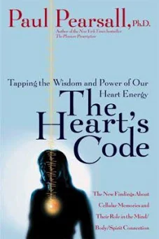
Stories of the Heart
In 1999, Dr. Paul Pearsall, a neuropsychologist, in The Heart’s Code wrote about an 8-year-old little girl who received a heart from a 10-year-old girl.
Almost immediately after the surgery, she started having vivid nightmares of being chased, attacked, and murdered.
Her mother arranged a consultation with a psychiatrist who after several sessions concluded that she was witnessing actual physical incidents.
They decided to call the police who used the detailed descriptions of the murder (the time, the weapon, the place, the clothes he wore, and what the little girl he killed had said to him) given by the little girl to find and convict the man in question.
Please click below for Dr. Braden‘s enticing discussion:
https://youtu.be/Hir6I-RfOiY

Slide 26
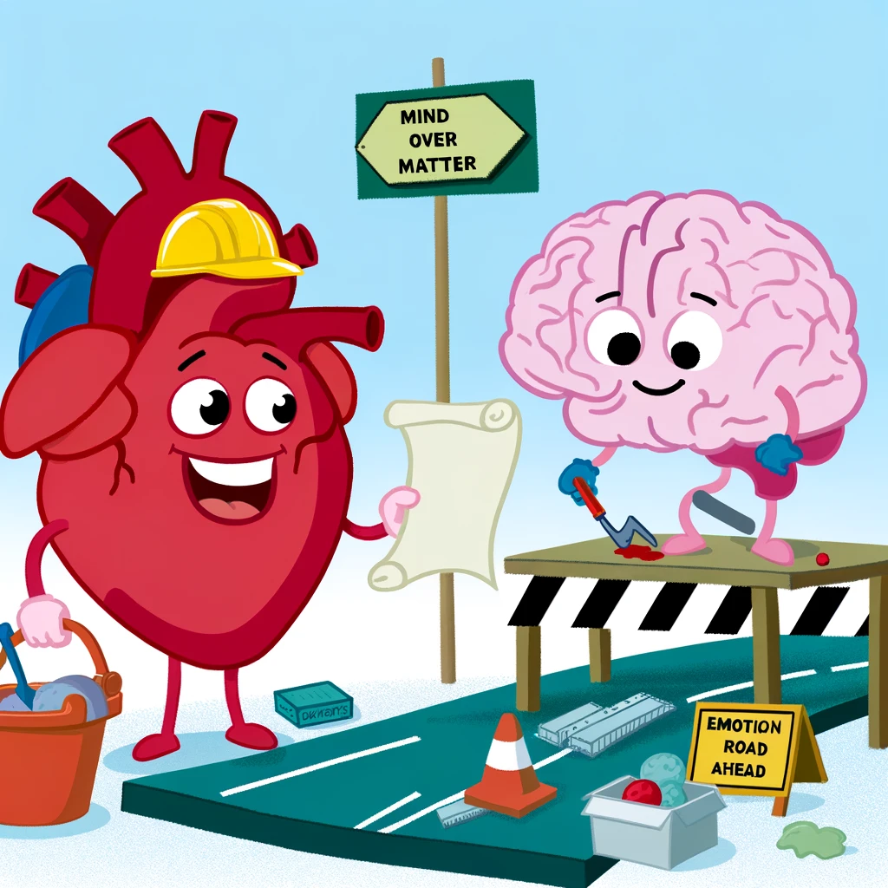
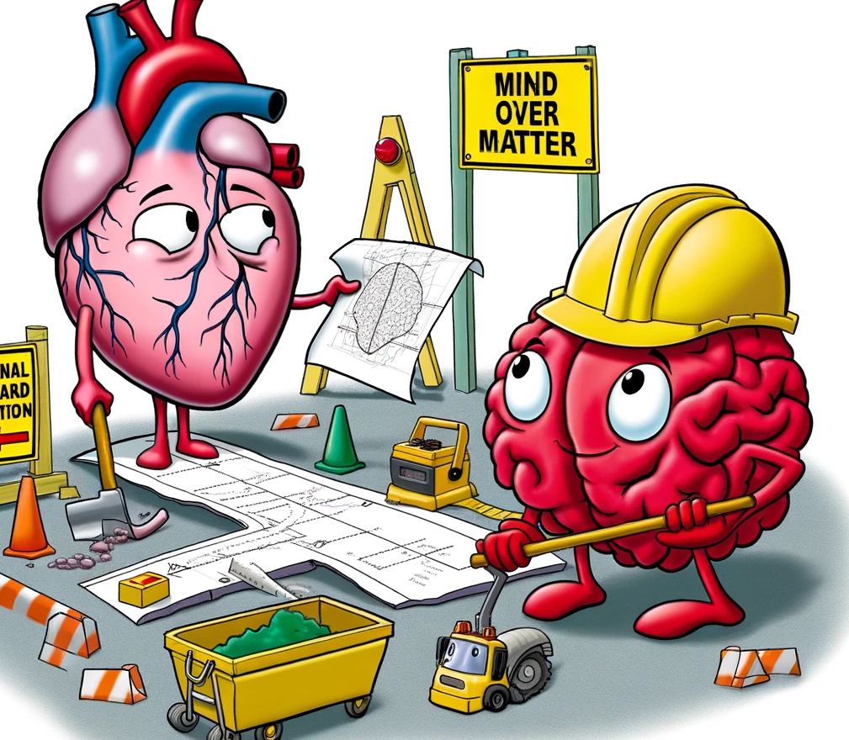
Brain and heart working together
Gregg Braden notes that the discovery of the “little brain” in the heart, and the now-verified evidence that the heart has a certain capacity to think and remember, has led the way to amazing possibilities regarding the hidden power of the heart and what this can men to our lives.
For 150-plus years we were led to believe that the heart and the brain were separate in an either-or manner. Scientists and analytical thinkers believed that the brain was the key while musicians, artists, and intuitive thinkers felt that it was the heart.
The evidence now suggests that it is the heart and the brain working harmoniously together that is fundamental (Braden, 2015a, 2015b).

Slide 27
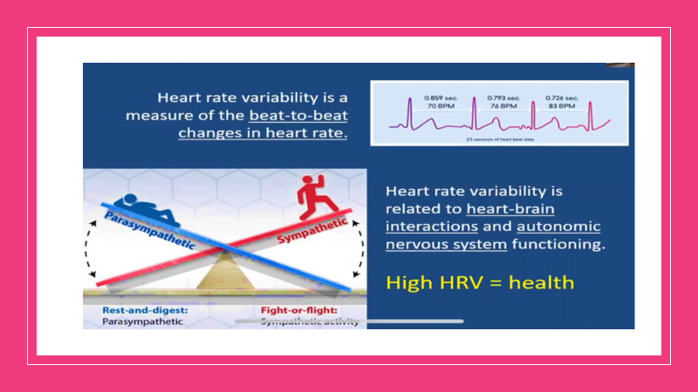
Heart Rate Variability (HRV)
https://www.heartmath.com/science/
Psychophysiologist, Dr. Rollin McCraty, director of research at the HeartMath Institute, and professor at Florida Atlantic University, notes that the heart at rest was once thought to operate much like a metronome, faithfully beating out a regular, steady rhythm.
Scientists and physicians now know, however, that this is far from the case. Rather than being monotonously regular, the rhythm of a healthy heart, even under resting conditions, is surprisingly irregular, with the time interval between consecutive heartbeats constantly changing. This naturally occurring beat-to-beat variation in heart rate is called heart rate variability (HRV).
Heart rate variability is a measure of the beat-to-beat changes in heart rate. Above right graph shows three heartbeats recorded on an electrocardiogram (ECG). Note that variation in the time interval between consecutive heartbeats, giving a different heart rate for each int heartbeat interval.

Slide 28
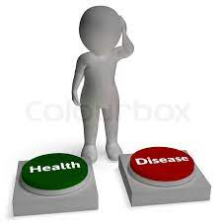
Heart Rate Variability and Your Health
According the HeartMath Institute, scientists and physicians consider heart rate variability (HRV) to be an important indicator of health and fitness. As a marker of physiological resilience and behavioral flexibility, it reflects our ability to adapt effectively to stress and environmental demands. A simple analogy helps to illustrate this point: just as the shifting stance of a tennis player about to receive a serve may facilitate swift adaptation, in healthy individuals the heart remains similarly responsive and resilient, primed and ready to react when needed.
Many factors affect the activity of the autonomic nervous system (ANS), and therefore influence HRV. These include our breathing patterns, physical exercise, and even our thoughts.
Research at the HeartMath Institute has shown that one of the most powerful factors that affect our heart’s changing rhythm is our feelings and emotions. When our varying heart rate is plotted over time, the overall shape of the waveform produced is called the heart rhythm pattern.
  Please see: https://www.heartmath.com/science/

Slide 29
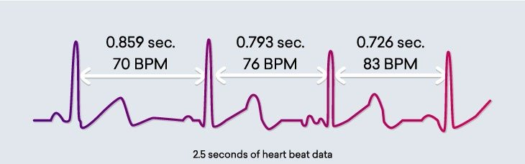
Heart Rate Variability and Your Health
Dr. McCraty asserts that the normal variability in heart rate is due to the synergistic action of the two branches of the autonomic nervous system (ANS)—the part of the nervous system that regulates most of the body’s internal functions. The sympathetic nerves act to accelerate heart rate, while the parasympathetic (vagus) nerves slow it down. The sympathetic and parasympathetic branches of the ANS are continually interacting to maintain cardiovascular activity in its optimal range and to permit appropriate reactions to changing external and internal conditions. The analysis of HRV therefore serves as a dynamic window into the function and balance of the autonomic nervous system.
The moment-to-moment variations in heart rate are generally overlooked when average heart rate is measured (for example, when your doctor takes your pulse over a certain period of time and calculates that your heart is beating at, say, 70 beats per minute). However, the emWave and Inner Balance technologies allows you to observe your heart’s changing rhythms in real time. Using your pulse data, it provides a picture of your HRV—plotting the natural increases and decreases in your heart rate occurring on a continual basis.
https://www.heartmath.com/science/

Slide 30
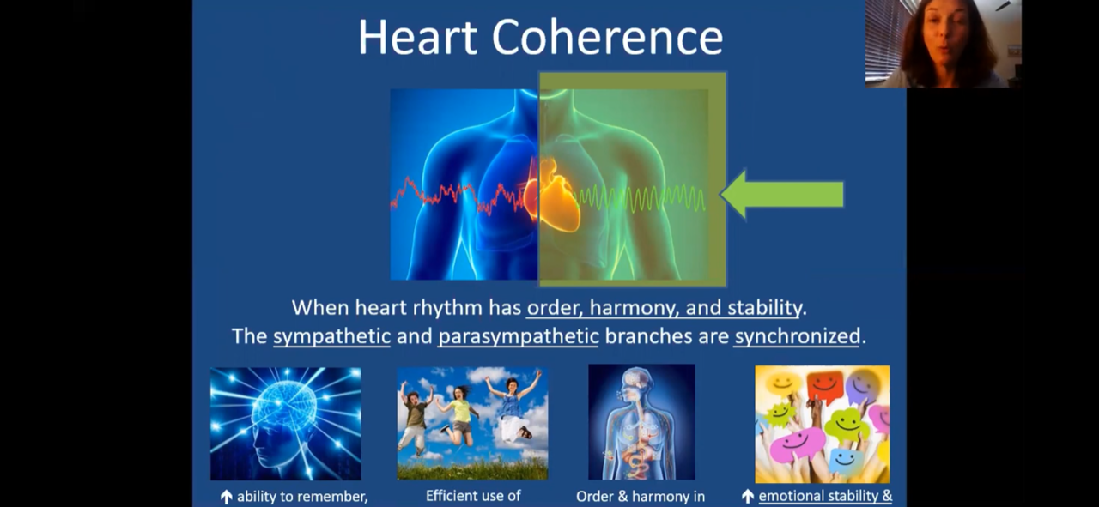

Slide 31
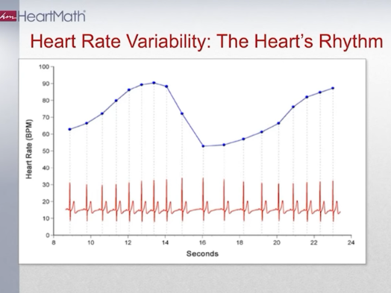
Heart Rate Variability and Your Health
These graphs show examples of real-time heart rate variability patterns (heart rhythms) recorded from individuals experiencing different emotions
The bottom red part of the graph is simply the EEG reading of each pulse. Note that the intervals between the beats change with time. The upper blue graph reflects the collection of these intervals across time. This is the beginning of a sign wave that is read from people in a coherent heart state reflecting positive emotions.
Click: https://youtu.be/3Vh9qEblTOE

Slide 32
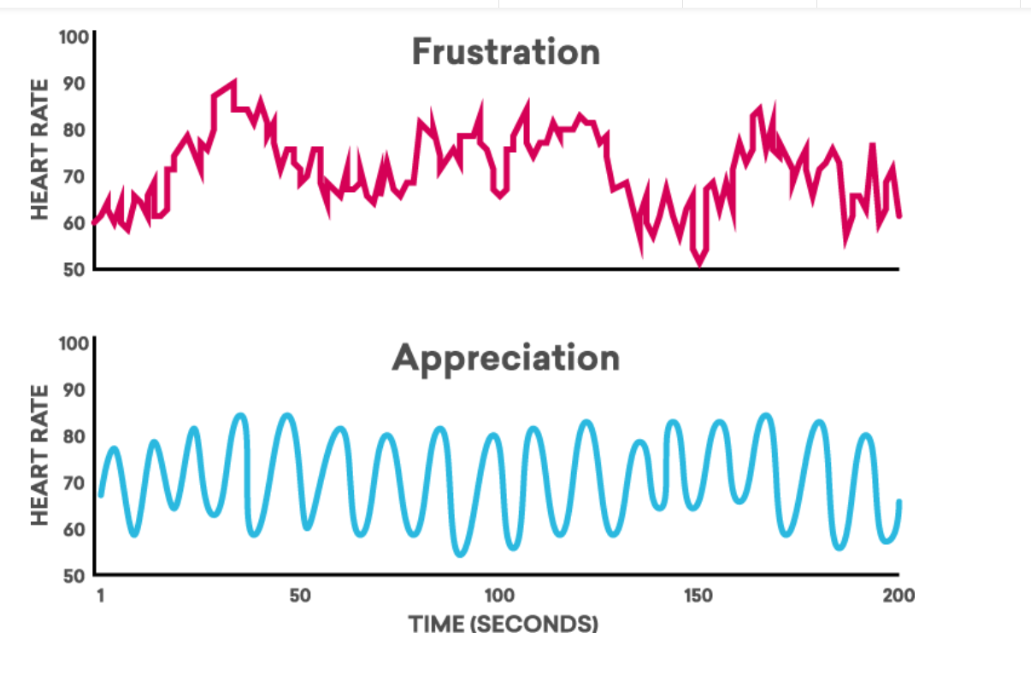
Heart Rate Variability and Your Health
The incoherent heart rhythm pattern shown in the top graph taken on a man who was asked to think about a stressful time in his life. The pattern characterized by its irregular, jagged waveform, is typical of stress and negative emotions such as anger, frustration, and anxiety.
The bottom graph shows an example of the coherent heart rhythm pattern taken on the same man who was taught a HeartMath relaxation technique. This pattern is typically observed when an individual is experiencing a sustained positive emotion, such as appreciation, compassion, or love. The coherent pattern is characterized by its regular, sine-wave-like waveform. It is interesting to note that the overall amount of heart rate variability is actually the same in the two recordings; however, the patterns of the HRV waveforms are clearly different.
Click: https://youtu.be/3Vh9qEblTOE

Slide 33
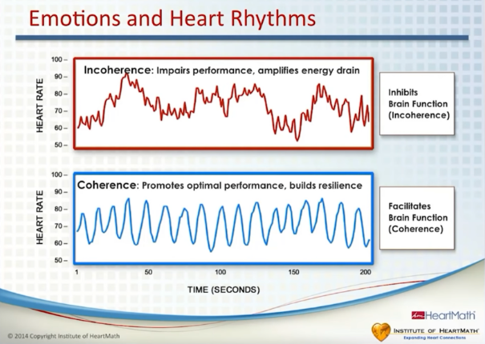
Heart Rate Variability and Your Health
To elaborate on the previous slide, research from HeartMath reveals that heart incoherence inhibits brain function and detrimentally impacts on health while heart coherence enhances brain function and overall health.
Click: https://youtu.be/3Vh9qEblTOE

Slide 34
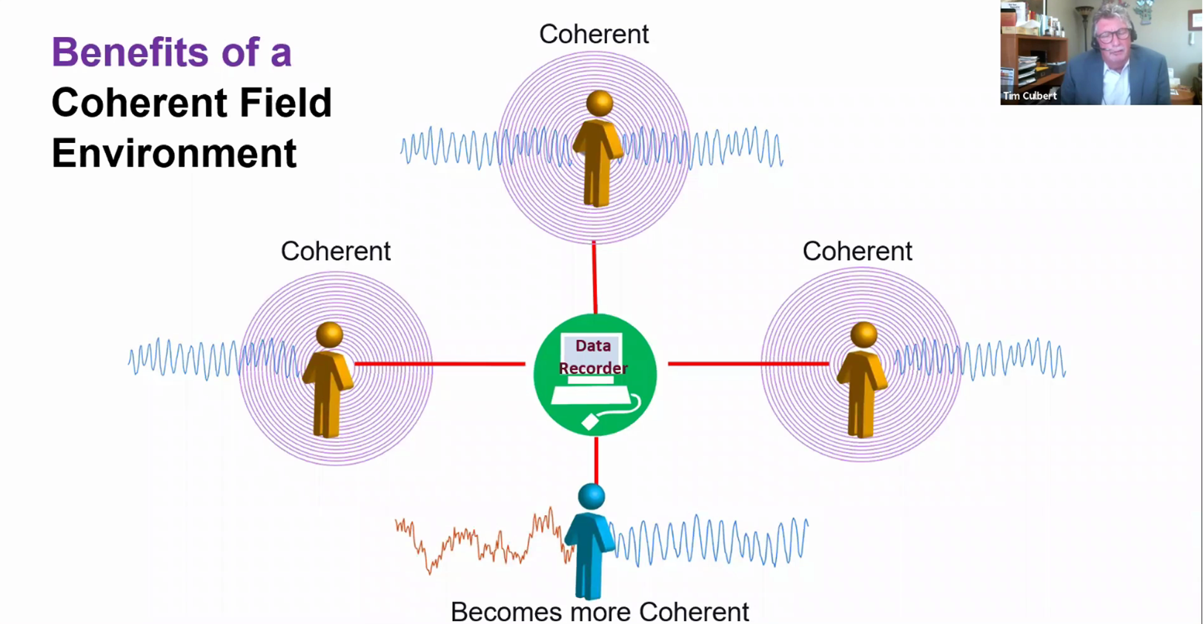
Heart to Heart Impact on Others
McCraty in his excellent YouTube video: https://www.youtube.com/watch?v=MO3SGkI3B-I&ab_channel=QuantumUniversity
cites a doctoral dissertation study that demonstrated to powerful impact that coherent heart states of one individual or individuals can have on another.
In this study three people were trained two weeks prior on how to attain a relaxed coherent heartrate variability state. The fourth person was not trained and was simply asked to go sit with the three that were trained while they were playing a game of cards. They were all wired for cardiac monitoring.
Within in a very short period, the fourth person’s heartrate variability state became relaxed and matched the other three. This study design was replicated 10 times with the same results.

Slide 35
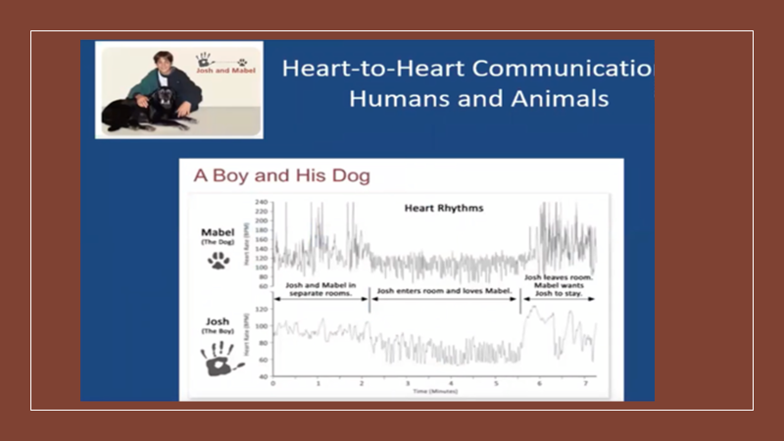
A Boy and his Dog
Research at HeartMath has found that a type of heart-rhythm synchronization can occur in interactions between people and their pets. A lot of pet lovers can appreciate the results of an experiment
HMI Director of Research Dr. Rollin McCraty conducted with his then 15-year-old son, Josh, and the boy’s dog, Mabel. He used electrocardiogram monitors to record heart-rhythm data when the pair were together and apart. The institute also has found that a type of heart-rhythm synchronization can occur in interactions between people and their pets.
Pet lovers can appreciate that we are truly connected to fido in a “heart-felt” way.

Slide 36

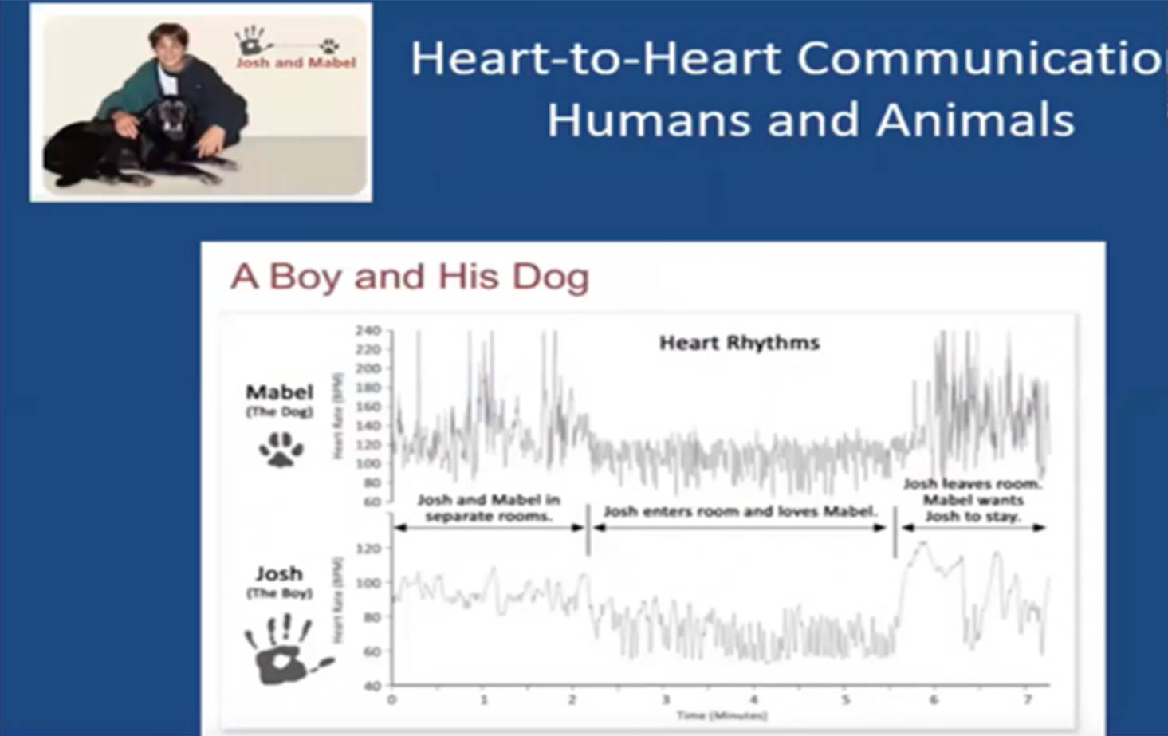
A Boy and his Dog
The top of the graph shows the dog’s (Mabel) heart rhythm shift when the boy (Josh, shown in the lower part of the graph) entered the room, sat down and proceeded to consciously experience feelings of love towards Mabel.
When Josh consciously felt feelings of love and care towards his pet, his heart rhythms became more coherent, and this change appears to have influenced Mabel’s heart rhythms, which then also became more coherent. There was no physical contact between the dog and boy (Childre et al.,2016).

Slide 37
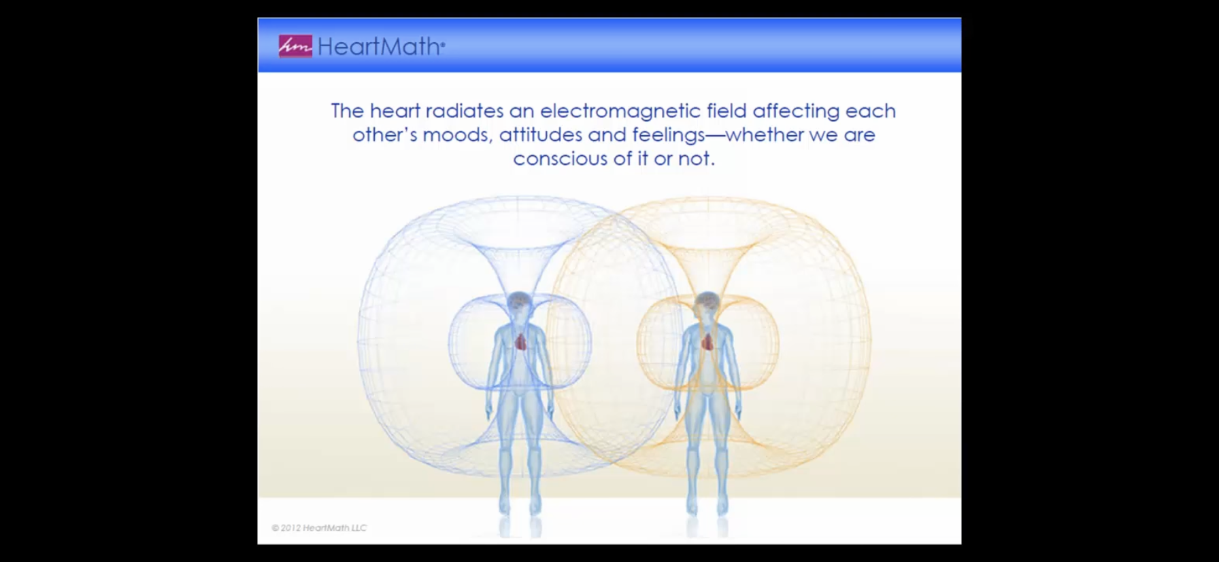

Slide 38

Heart-to-Heart
HeartMath asserts that our heart states can impact on others and most important, those we love.

Slide 39
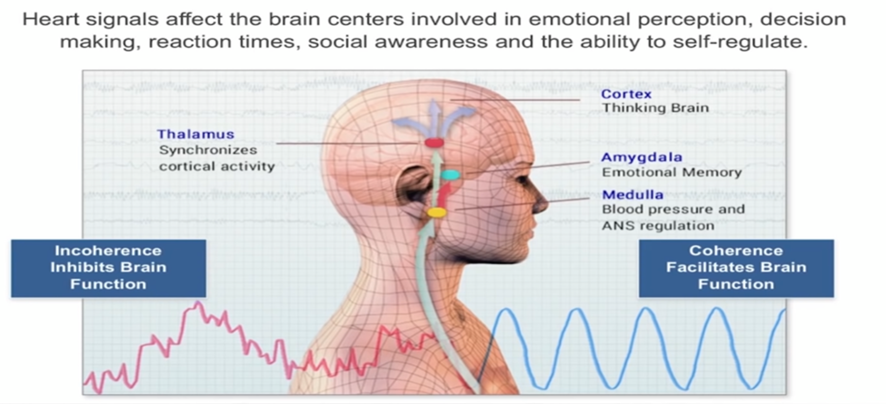
Heart-to-Brain
Dr. McCraty notes that the heart communicates to the brain in four main ways: (1) nerves connecting the heart to the brain, particularly the vagus nerve, (2) hormones, (3) blood pressure shifts, and (4) electromatic waves.
When the heart is coherent, it sends messages to the brain that, likewise, promote brain coherence which allow the brain to be more integrated and efficient and, to the contrary, an incoherent heart inhibits cortical function.
Click: https://youtu.be/3Vh9qEblTOE

Slide 40
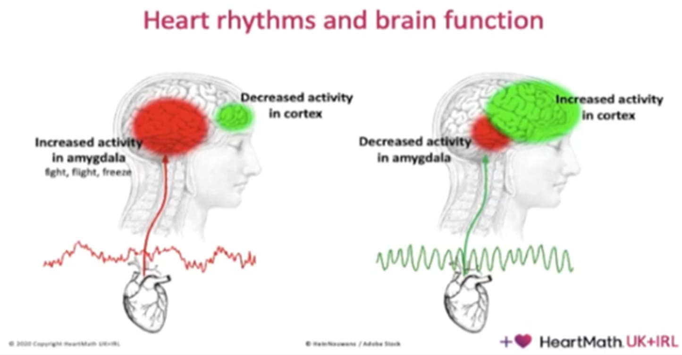
The left slide nicely shows that when the heart is in a negative emotional state and, hence, incoherent, it sends signals to the brain that increase the activity of the amygdala (which tends to focus on negative emotion) to become very active and the prefrontal cortex (which we need of good decision-making) to attenuate.
On the other hand, when the heart is in a positive emotional state of love, appreciation and gratitude, and hence, coherent, it sends signals to the brain that quiet down the amygdala and increase the activity of the prefrontal cortex.

Slide 41
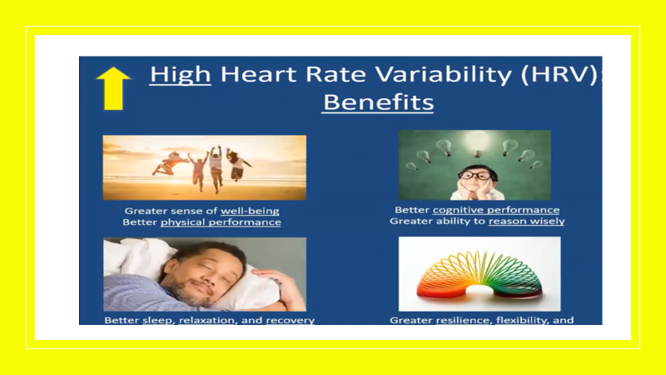
Benefits of High Heartrate Variability (HRV)

Slide 42
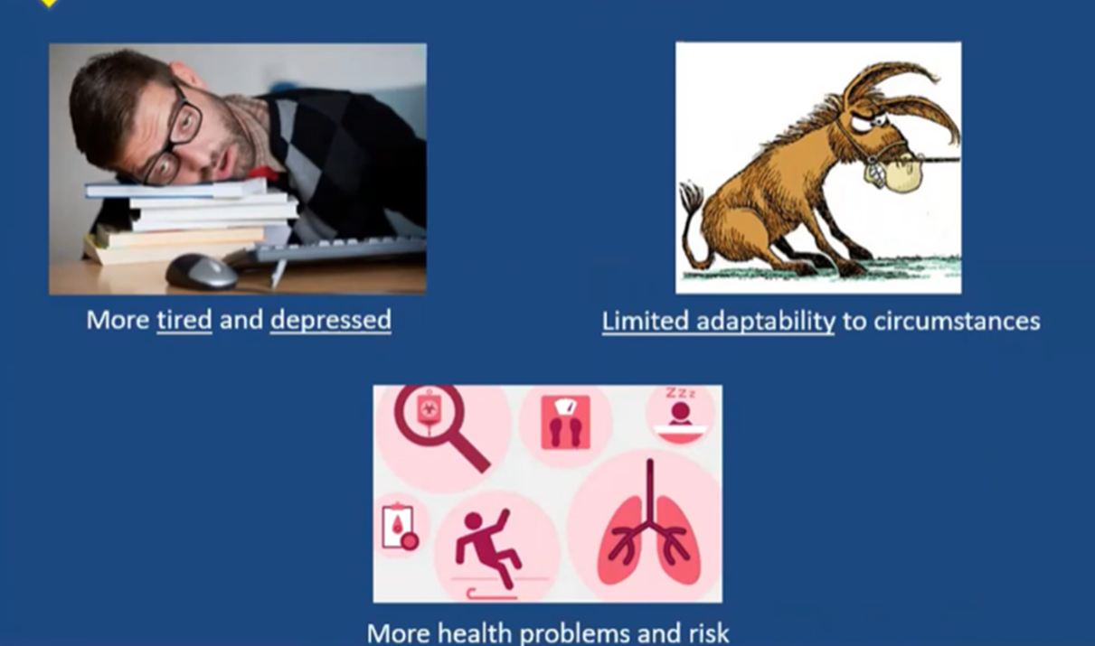
Labilities of Low Heartrate Variability (HRV)

Slide 43
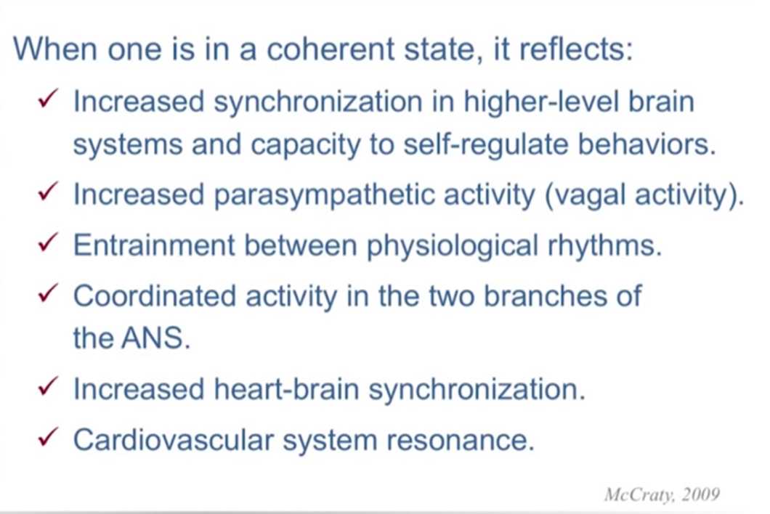
Heart Coherence Benefits

Slide 44
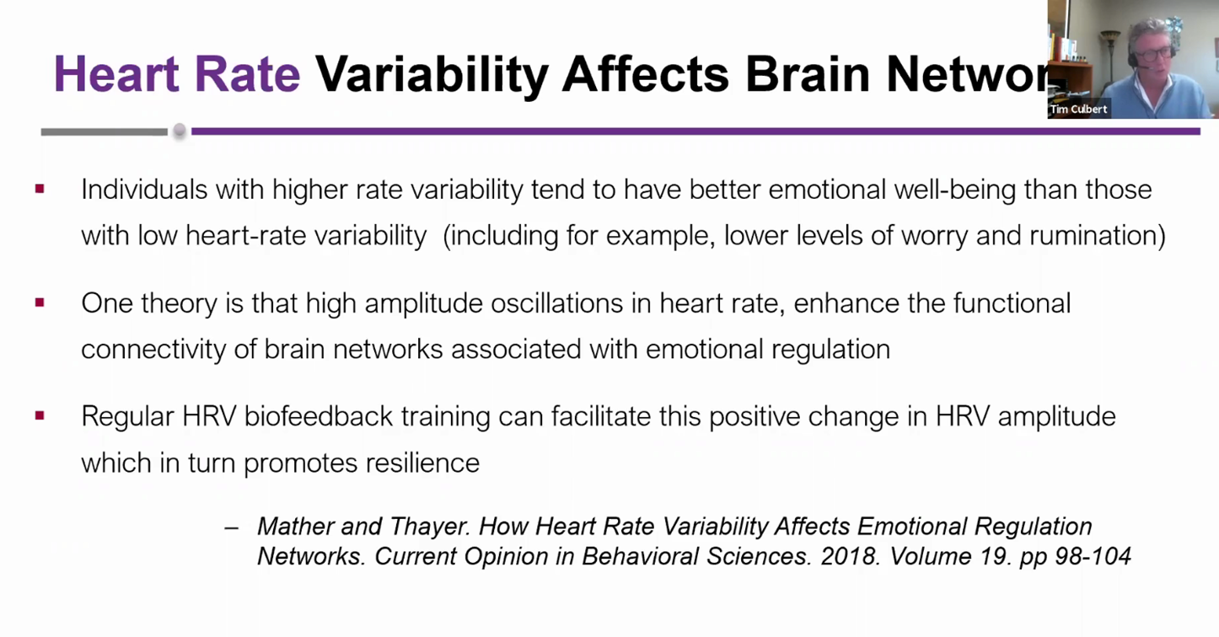
Heart Coherence Benefits on Brain Networks

Slide 45

Studies Showing Benefits of Coherence on Brain Function

Slide 46

Studies Showing Benefits of Heart Coherence on Health

Slide 47

Low HRV and Mental Health

Slide 48

Clinical Applications of HRV

Slide 49

Applications
HeartMath has developed simple and practical ways to benefit from the breakthroughs in understating the neuroscience of Heart Rate Variability as it relates to sound mental and physical health.
The following slides offer five of the main techniques. The value of these techniques is that they are relatively simple and do not take inordinate amounts of time to begin benefiting from them.
Additionally, HeartMath has developed training devices for facilitating learning and application in our daily lives.

Slide 50

HeartMath Self-Regulation Techniques
Researchers at HeartMath have developed five main self-regulation strategies each with its own purpose. These techniques build on one another so it is best to master the top ones before going onto the next.

Slide 51



Heart-Focused Breathing Technique
-for Autonomic Nervous System Deactivation/establishing calmness
Click here for a demonstration video:
https://www.youtube.com/watch?v=JxNjw3bcfVo&ab_channel=TheWholeMD

Slide 52



Quick Coherence Technique
- for in the moment self-regulation
Click here for an excellent how-to video by Dr. Deborah Rozman:
https://www.youtube.com/watch?v=sKmKKCdnJ4U&ab_channel=HeartMath

Slide 53



Freeze-Frame Technique
- for clarity and decision-making
For decision-making and clarity
It is a one-minute technique that allows a major shift in perception. More than positive thinking, it creates a definitive, heartfelt shift in how we view a situation, an individual or ourselves. Very helpful for establishing clarity and promoting decision-making.

Slide 54

Heart Lock-in Technique
- for establishing a new baseline, build energy, and/or improve relationships
Step 1. Focus your attention in the area of the heart. Imagine your breath is flowing in and out of your heart or chest area, breathing a little slower and deeper than usual.
Step 2. Activate and sustain a regenerative feeling such as love, appreciation, care or compassion.
Step 3. Radiate that renewing feeling to yourself and others.
Gregg Braden’s Excellent Meditation:
https://www.youtube.com/watch?v=SLTlg0B-LsQ

Slide 55



Attitude Breathing Technique
- for increased self-control and attitude shifting
Click here for a demonstration video: https://vimeo.com/241211966

Slide 56


HeartMath HRV Training Devices
HeartMath has developed easy to used and relatively inexpensive biofeedback devices to assist in the application of the neuroscience of HeartMath principles into our daily lives.
Please visit their website for more information on how you might obtain the best device for your needs: https://www.heartmath.com/tech/

Slide 57

In Closing
So, we have come a very long way from traditional medicine based on the philosopher Democritus and scientist Sir Isaac Newton, The Newtonian model is giving way to the Quantum model and with it we are appreciating the impact of the wave/energy of the heart and mind. We owe a great debt to the brilliance and courage of the likes of Gregg Braden, Joe Dispensa, Bruce Lipton, Rollin McCraty, Deborah Rozman, Doc Childre, Howard Martin and countless others on the HeartMath team. They have changed my life for the better and it is my hope that you might, likewise, find the healing benefit that they offer to humanity as a gift.

Slide 58


Slide 59


