Slide 1


Cocaine & Crack
Alayna Collins
Madigan Army Medical Center
October 24, 2023

Slide 2
Table of contents
01
02
03
History
Routes of Administration
Psychological Effects
04
05
06
Medical Uses
Pharmacokinetics
Diversity Factors
Where did it start?
How to use it?
How does it feel?
Can it help?
How does it affect the body?
Social, political, legal, economic, cultural

Slide 3

01
History

Slide 4
Used for centuries!
Andes Mountains – 1300s
Coca plant leaves chewed by the Inca people.
Spain – 1490s
Spaniards colonize South America, attempt to limit Coca Leaf intake

Slide 5
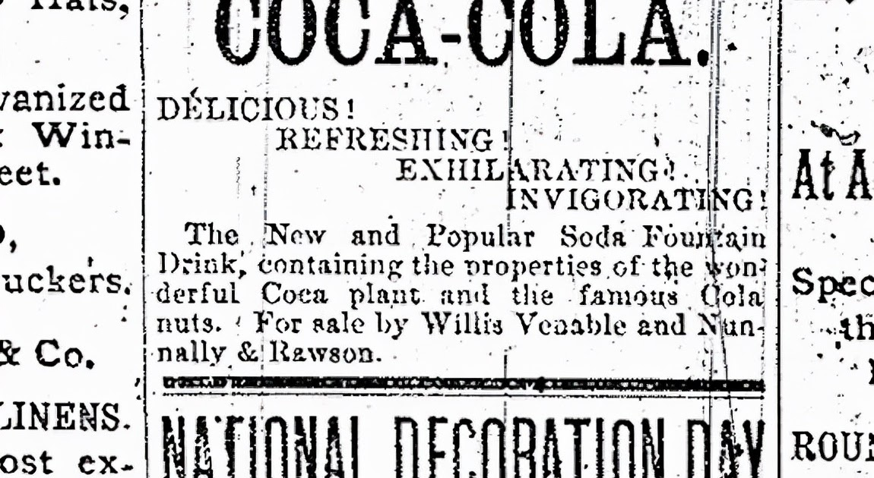
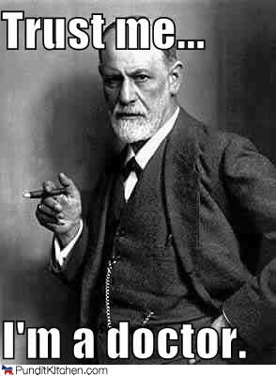
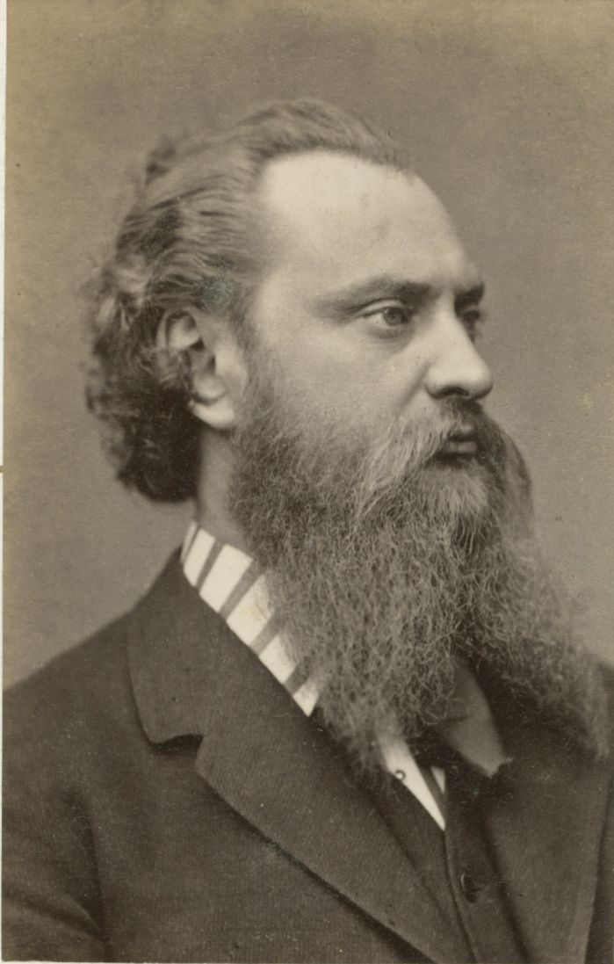

History
Sigmund Freud
John Pemberton
Angelo Mariani
Albert Niemann
1880s
1886
1869
1860
Freud popularized use in Europe. Discovered numbing qualities and shared with his friend, an opthamologist, who started using as a local anesthetic in operations.
Released Coca-Cola, a “tonic” water with cocaine
Created Vin Mariani, wine steeped in coca leaves. VERY popular!
“Purified” cocaine in Europe

Slide 6
History
Harrison Narcotic Act
FDA
Racism…
Tonics
1914
1906
1900s
1900s
Required ingredients to be listed on labels.
Imposed severe restrictions on the amount of cocaine allowed in tonics.
Cocaine goes dormant ….
Fear tactics: Medical field advertised that cocaine made African Americans powerful and uncontrollable.
Tonics containing cocaine and opium were unregulated and BOOMING in sales.

Slide 7
To Be Continued

Slide 8
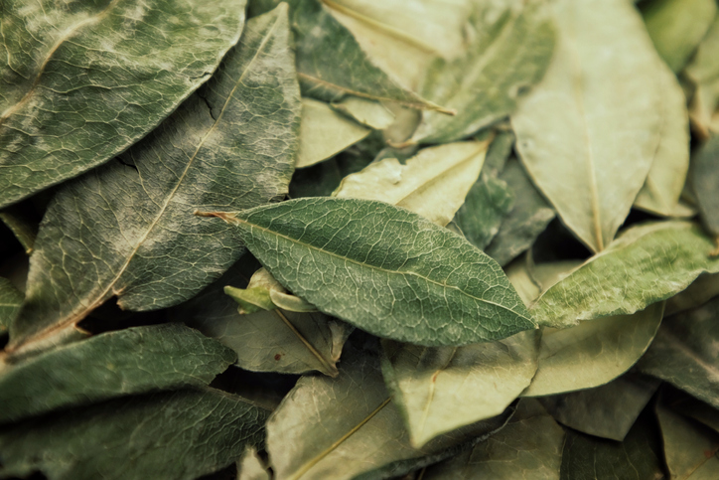
02
Routes of Administration

Slide 9
Routes of Administration
Cocaine (White Powder)
Snorted
Dissolved for injection
Crack Cocaine (solid chunck)
Heated in a pipe, inhaled into the lungs
Prepared from Coca leaves, processed into purified crystals. Cocaine is often diluted 50% with other white powders (corn starch, lactose, talcum powder). Crack is boiled with sodium bicarbonate.

Slide 10
03
Psychological Effects

Slide 11
Psychological Effects
Euphoria & Wellbeing
Talkativeness
Intense Physical Pleasure
Increased Attention
Energy & Alertness
Hostility & Paranoia

Slide 12
04
Medical Uses
Schedule II

Slide 13
Medicines
Local Anesthetic
Others
Similar to coffee and tea
Hunger, stomach upset, pain, sore throat, severe GI issues
Altitude sickness in the Andes
Pain, colic
Melancholia (1860s) and “Young persons afflicted with timidity in society” (1878)
Minor surgeries.
Grinspoon & Bakalar (1981)

Slide 14
05
Pharmacokinetics
(the science behind why cocaine is so addictive!)

Slide 15
Pharmacokinetics
Cocaine
Crack
Coca Leaves
Snorting
Enters mucous membranes
Blood stream
Application to other areas with vascular mucous membranes
~ 30 minutes peak
SLOWEST way of delivering to the body
Injecting
Straight into the blood stream
QUICKEST way of delivering to the body
Inhaling
Vapors enter the body quickly through the lungs
AS QUICK AS injection
Peaks in ~2 minutes
Ingestion
Liver degrades before it reaches circulation

Slide 16
Three Monoamines
Adrenaline
Dopamine
Serotonin
Reuptake
Implicates mood and aggression, sleep, appetite, body temperature
Cocaine increases monoamines in the synapse and blocks reuptake. The body comes to rely on cocaine for stimulation of neurotransmitters…
Norepinephrine and epinephrine. Fight or flight.
Reward and reinforcement center!

Slide 17

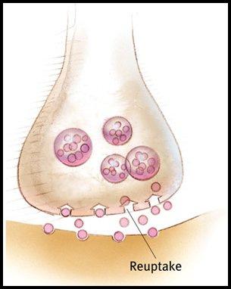
Three Monoamines
Adrenaline
Dopamine
Serotonin
Reuptake
Implicates mood and aggression, sleep, appetite, body temperature
Cocaine increases monoamines in the synapse and blocks reuptake. The body comes to rely on cocaine for stimulation of neurotransmitters…
Norepinephrine and epinephrine. Fight or flight.
Reward and reinforcement center!

Slide 18
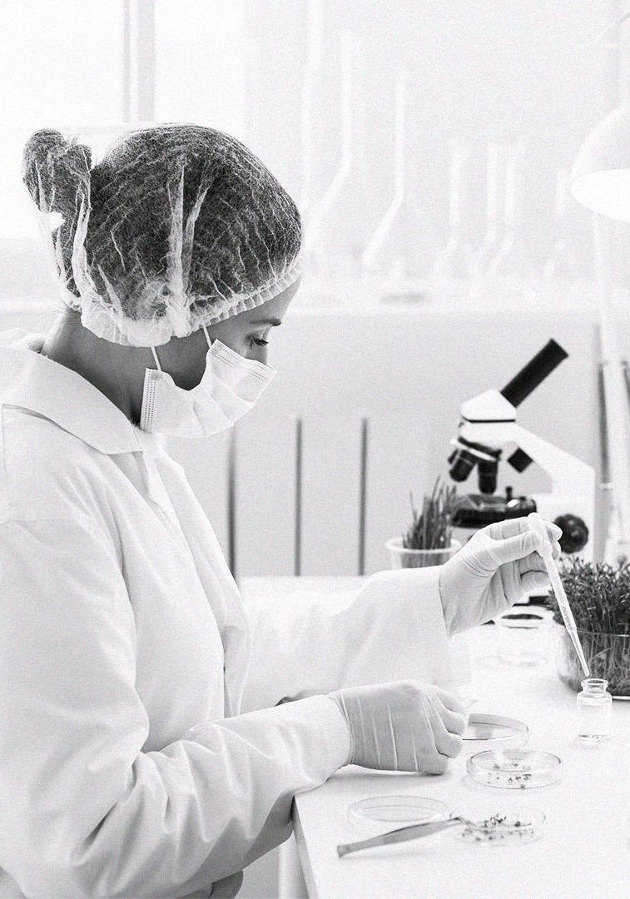
Half Life is 1 Hour!
Usually want another does in 40 minutes.
Creates a quick rush-and-crash cycle.

Slide 19
Tolerance
Develops in a single run
Rapid increase, rapid decrease. Baseline returns after a few days, receptors relatively unaffected
Memory and reward circuits are impacted long-term. Cocaine-associated memories are a primary trigger for relapse. Propranolol and N-acetylcysteine have shown promising results in disruption (Correia et al., 2020)
Withdrawal
Non-life threatening
Exhaustion, sleep, depression (anhedonia), suppression of dopamine during first few days. Temptation to use again is high!
Sympathetic Response
Increased heart rate
Increased blood pressure
Dilation of breathing tubes in the lungs
Psychomotor stimulation
Increased glucose and oxygen to the lungs
Parasympathetic Response
Reduced hunger
No tiredness

Slide 20
06
social, political, legal, economic, cultural

Slide 21
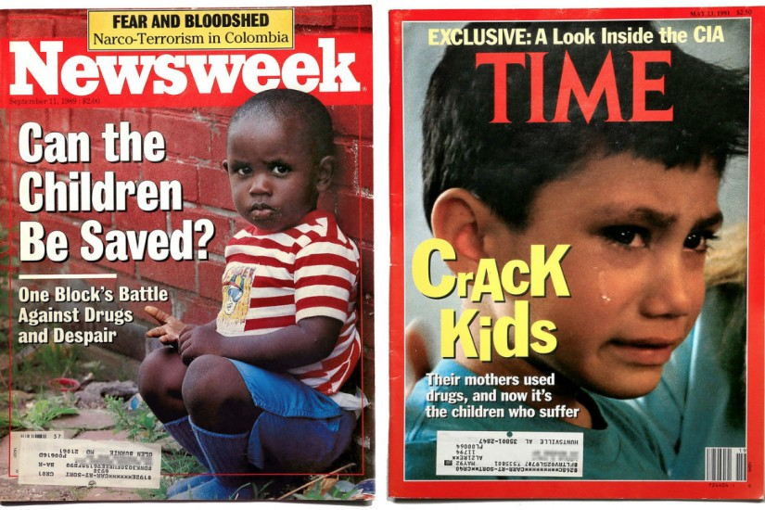
Social
1950’s: Cocaine made a come-back in the US (Das, 1993)
1980s-90s: Crack Babies
Word associations:
1988-89: Crack associated with criminilzation
2016-17: Opioids associated with medicalization (Shachar et al., 2020)
New cocaine users outnumber new meth users 5 to 1 (Kuhn et al., 2019)
1989 1991

Slide 22
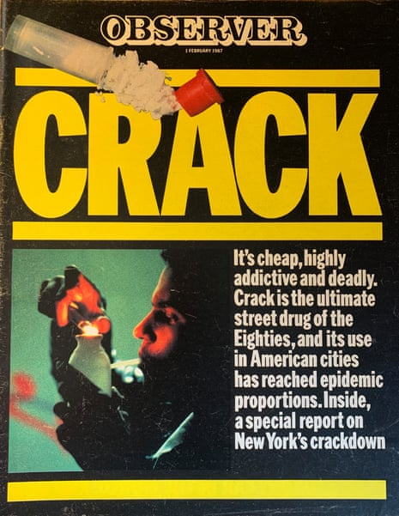
Legal and Political
c
1986 – 5-year sentence for 5 grams of crack v. 500 grams powder cocaine
Reagan’s War on Drugs
  Assigned a felony to drug charges
Usage rates of crack and cocaine highly similar among races
Black people are 6x more likely to be arrested for drug offenses than White people (Kendi, 2017)
Circa 1987

Slide 23
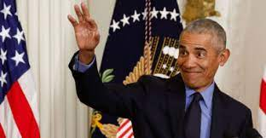
Fair Sentencing Act of 2010
Barack Obama downed the cocaine:crack sentencing ratio from 100:1 to 18:1
Eliminated the mandatory 5-year sentence for first offense crack possession
This can be retroactively applied as of 2011

Slide 24
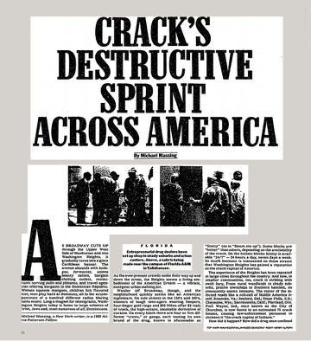
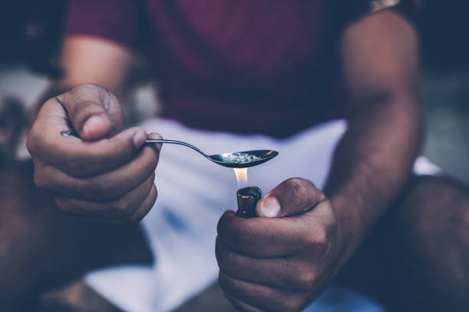
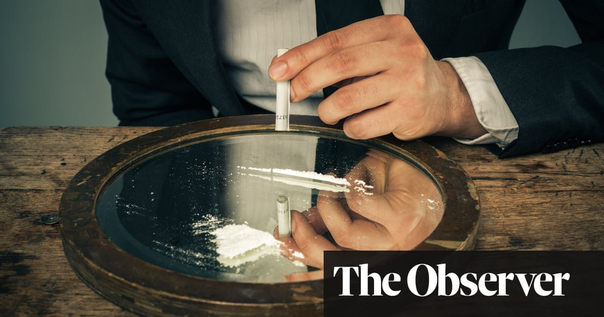
Socioeconomics
2023 search term: cocaine/crack in the media
Cocaine
Rich
White
Party
Crack
Poor
African American
Addiction
Despite cocaine/crack use being similar among races!

Slide 25


