Slide 1
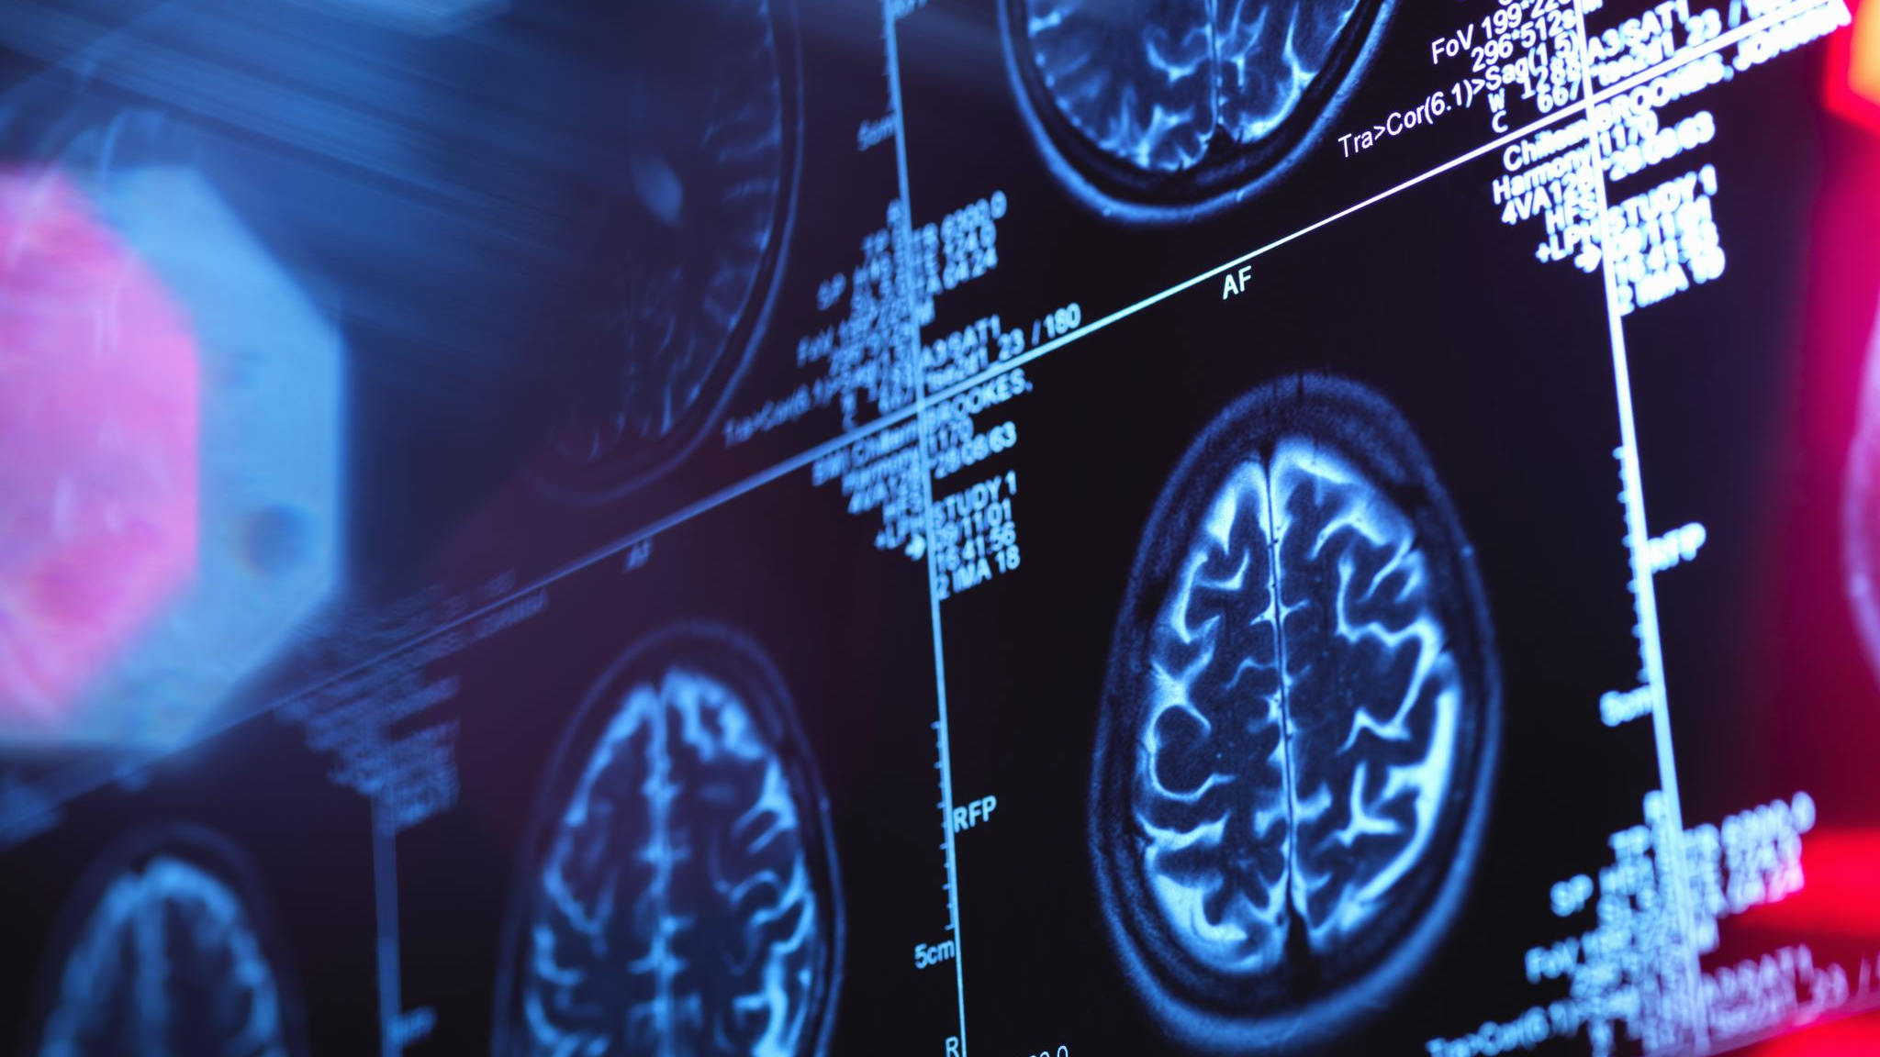
The Neuroscience within Trauma and Addiction
Jeffrey E. Hansen, Ph.D.
Center for Connected Living, LLC

Slide 2

An Addiction Hits Close to Home https://www.youtube.com/watch?v=r26Gvb8RpkU&ab_channel=WafflesXP

Slide 3

Plan for today
Epigenetics
Attachment
Adverse Child Experiences
Polyvagal Theory
Brain changes in trauma and addiction
What to do about it

Slide 4


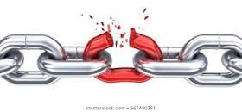
Roots of the word ADDICTION
Adam Slater (2018)
Irresistible
In Rome being “addicted” meant that you had just been sentenced to slavery.
If you owed someone money and couldn’t repay, a judge would sentence you to work as a slave until you could repay the debt.
Addiction later evolved to describe any bond that was difficult to break.

Slide 5
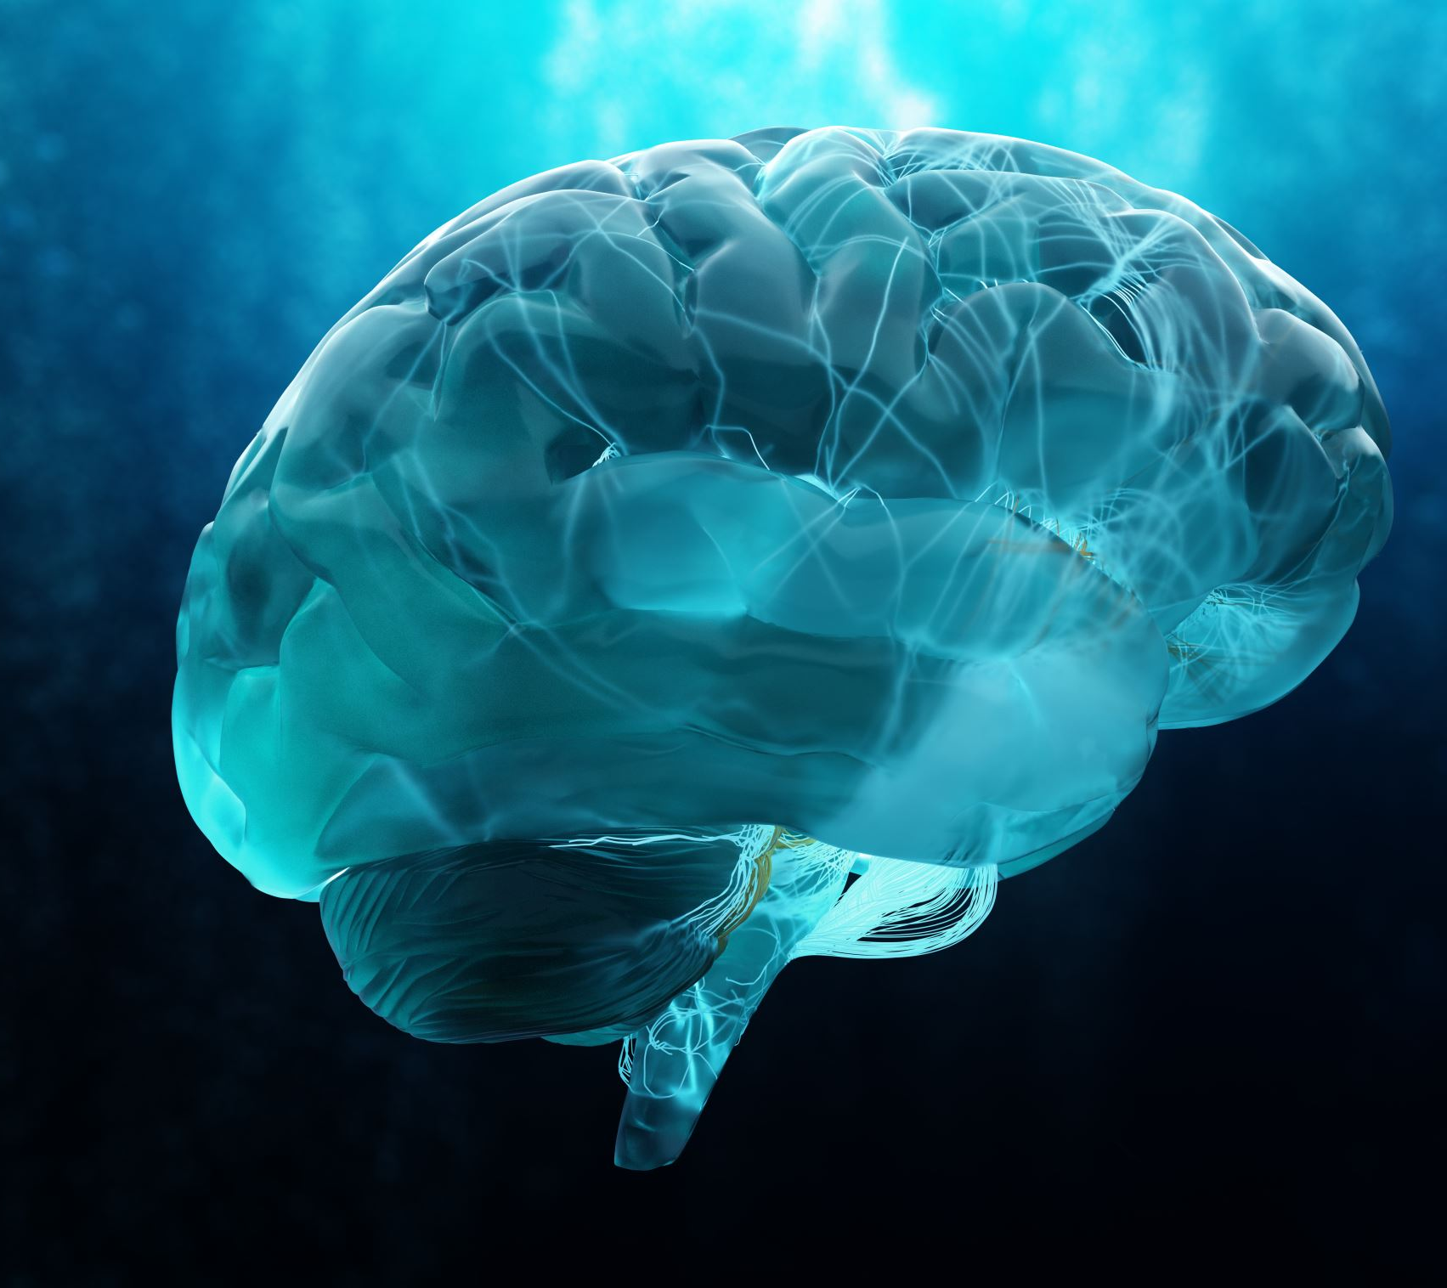
ASAM Definition of Addiction (2011)
Addiction is a treatable, chronic medical disease involving complex interactions among brain circuits, genetics, the environment, and an individual’s life experiences. People with addiction use substances or engage in behaviors that become compulsive and often continue despite harmful consequences.

Slide 6
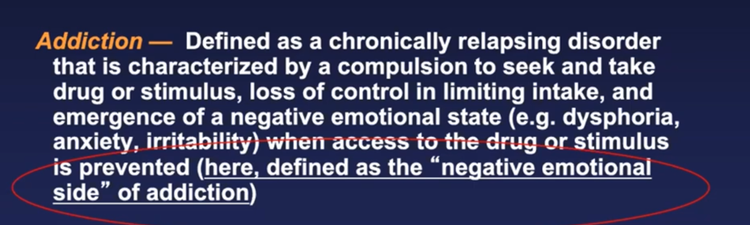
A better definition of addiction per the National Institute of Alcohol Abuse and Alcoholism (NIAAA)

Slide 7
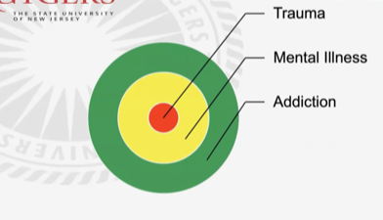

Trauma is almost always at the core of serious addiction which leads way to mental illness and then addiction to mask it.

Slide 8
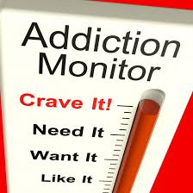

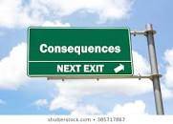
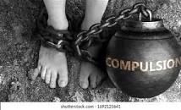
The Four Cs of Addiction
Wilson (2014) notes that all addictions, regardless of their differences, result in an established set of “core brain changes” which, in turn, present as recognized signs, symptoms, and behaviors such as those listed in the Four C’s:
Craving and Preoccupation with obtaining, engaging in or recovering from the use of the substance or behaviors in question.
Loss of Control in using the substance or of engaging in the behavior and noted by increasing frequency or duration, larger amounts or intensity, and/or increasing the risk and behavior in an effort to obtain the desired effect.
Negative Consequences in physical, social, occupational, financial, or psychological areas.
Compulsive in nature

Slide 9


What is a process addiction?
Process addiction, also called behavioral addiction, is characterized by an overwhelming impulse to engage in a certain behavior despite negative consequences.
While involved in the behavior, the individual experiences an elevated mood often followed by a sense of shame or guilt once the behavior ends.

Slide 10

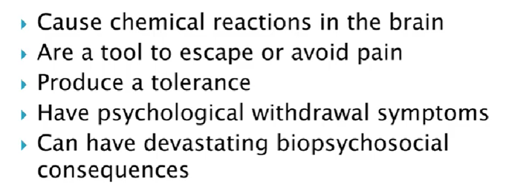
Similarities between Chemical/Substance Addictions and Behavioral Addictions

Slide 11
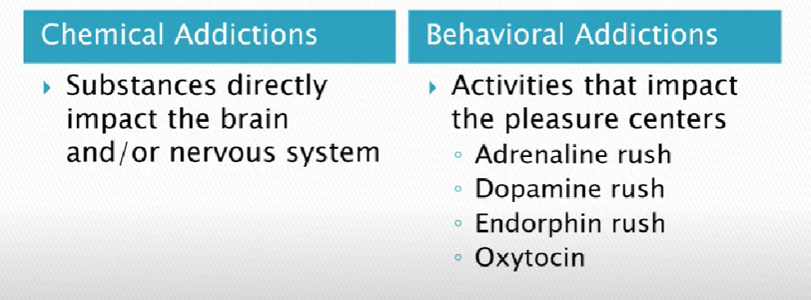
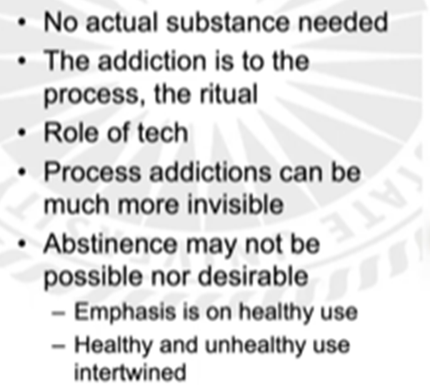
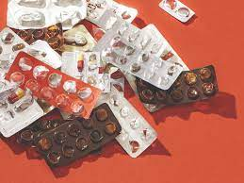
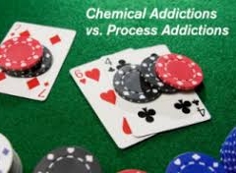
Differences between Chemical/Substance Addictions and Behavioral Addictions

Slide 12
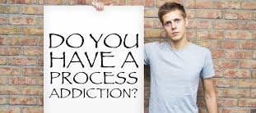
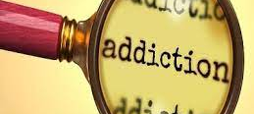
Common Process Addictions
Shopping
Gambling
Sexual activity
Pornography
Eating disorders
Internet use
Exercise
Work
Chaos

Slide 13
Differences between Chemical/Substance Addictions and Behavioral Addictions

Slide 14
Similarities between Chemical/Substance Addictions and Behavioral Addictions

Slide 15
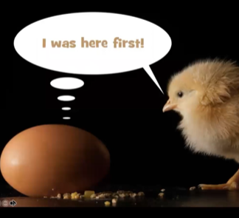
Trauma, Mental Illness, and Addiction. Which comes first?

Slide 16
Trauma is almost always at the core of serious addiction which leads way to mental illness and then addiction to mask it.

Slide 17
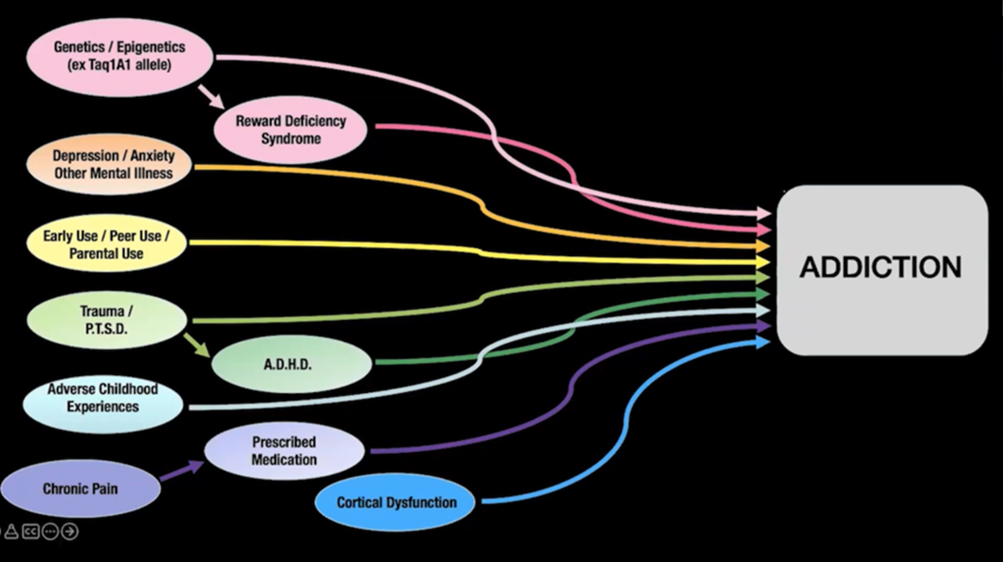
Dr. McCauley’s model encompasses several pathways that can lead to addiction:

Slide 18
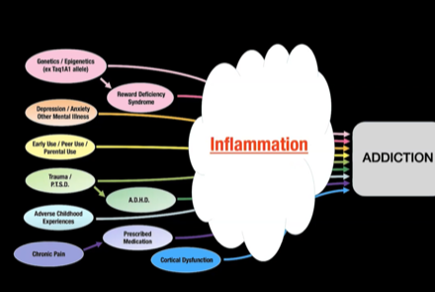
All addiction pathways lead to inflammation in the brain and body

Slide 19
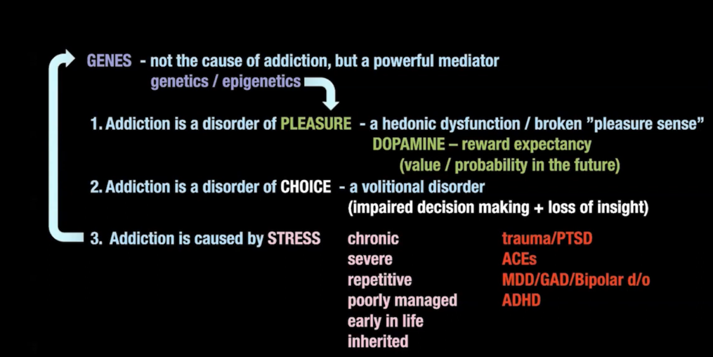
Dr. McCauley’s Integrative Model of Addiction
Disorder of pleasure/hedonic system
Disorder of choice
Caused by stress

Slide 20
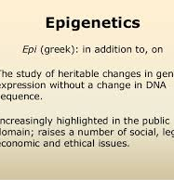
Epigenetics
These are exciting times.
New science is enabling us to better understand what external and internal factors alter us.
Our physical health, our emotional well-being, and our longevity are not only impacted by the hard-wired genetic code we inherit, but our genome is impacted by environmental influences to include as well as the way we live.

Slide 21
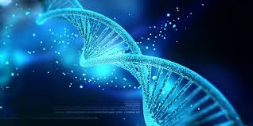
Definition please:
Epigenetics literally means "above" or "on top of" genetics. It refers to external modifications to DNA that turn genes "on" or "off."
These modifications do not change the DNA sequence, but instead, they affect how cells "read" genes. A very exciting trend in epigenetic research involves investigating the process by which our genetic tendencies are altered or influenced in their expression by outside exposure or stimuli.
These epigenetic changes can last through multiple cell divisions for the duration of the cell’s life but what is particularly compelling is that these changes may persist for multiple generations within our family line (Kain & Terrell, 2018).

Slide 22
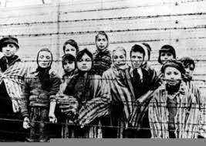
Trauma’s Impact on Epigenetics
Early trauma, for example, is one of the factors that can cause epigenetic changes and these changes can be passed on to the next generation and beyond.
Researchers have come to appreciate that the horrors of the Holocaust did not only impact those who suffered the terror of the concentration camps.
As one would expect, the survivors of the Holocaust often suffered from PTSD, but this did not stop there.
Their children were more likely themselves to develop PTSD and other mood and anxiety disorders, whether or not they were exposed to traumatic events in their own lives (Yehunda et al. 1998).
Barbed Wire Clipart. The Holocaust ...clker.com

Slide 23
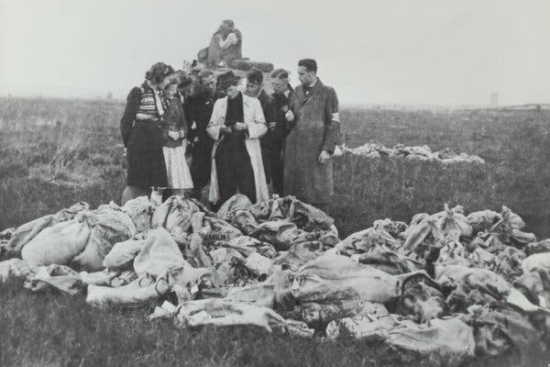
Dutch Famine in World War II
Another sad example of the impact of trauma on subsequent generations is the Dutch Famine in World War II. In September 1944, trains in the Netherlands ground to a halt. Dutch railway workers were hoping that a strike could stop the transport of Nazi troops and help the advancing Allied forces.
Sadly, the Allied campaign failed, and the Nazis punished the Netherlands by blocking food supplies, plunging much of the country into famine. By the time the Netherlands was liberated in May 1945, more than 20,000 people died of starvation.
Pregnant women, it turns out, were uniquely vulnerable, and the children they gave birth to were influenced by famine throughout their lives.
When these children became adults, they ended up heavier than average. In middle age, they had higher levels of triglycerides and LDL cholesterol and they experienced higher rates of obesity, diabetes, and schizophrenia.
Food rations that were dropped into the Netherlands in 1945.Credit...Dutch National Archive

Slide 24
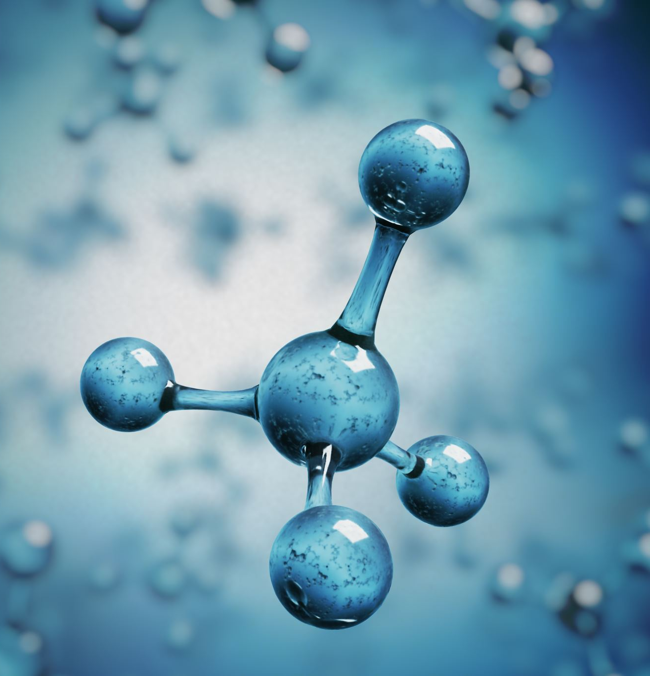
For the science nerds among us:
There are three primary mechanisms through which epigenetic changes in gene expression occur. But first a biology refresher:
DNA from humans is made up of approximately 3 billion nucleotide bases.
There are four fundamental types of these bases that comprise DNA: Adenine, Cytosine, Guanine, and Thymine, commonly abbreviated as A, C, G, and T, respectively.
The sequence, or the order, of the bases is what determines our life instructions.
There are about 20,000 genes in total. Genes are specific sequences of bases (parts of DNA) that provide unique and tailored instructions on how to make important proteins
Proteins are large and very complex molecules that play many critical roles in the body and do most of the work in cells. Proteins are required for the structure, function, and regulation of the body’s tissues and organs and are made up of hundreds and thousands of smaller units called amino acids.
The sequence of amino acids is what determines each protein’s unique 3-dimensional structure and its specific function. Proteins can be described according to their very large range of functions in the body to include antibody, enzyme, messenger, and structural component.

Slide 25

Epigenetic Changes –
The Big Three
With that brief biology refresher out of the way, we can explore the three most well-known and best understood of several mechanisms through which epigenetic changes in gene expression occur.
As noted earlier, although a person's complement of genes or sequence of genes remains essentially the same from birth onward, except for the occurrence of mutations that can change the function of genes.
Different environmental exposures during development, diet, stress, emotional problems, etc., throughout a person's life chemically modify DNA and the proteins bound to it. In addition, individual's histones, or the proteins around which DNA winds when it is compacted into chromosomes, carry different chemical tags which are also influenced by environmental events.
These tags are thought to alter the extent to which DNA is wrapped around the histones, thereby affecting the availability of genes for activation. (Suitable my Nature, 2014; Fraga et al., 2005).

Slide 26
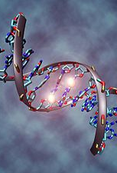
Epigenetic Changes – e The Big Three
DNA methylation:
The first type of epigenetic modification occurs on the DNA strand itself.
This reaction, called DNA methylation, is a biological process by which methyl groups are added to the DNA molecule and thereby changes the activity of a DNA segment without changing the sequence.
When located in a gene promoter, DNA methylation typically acts to repress or block gene transcription, effectively turning that gene off (University of Leicester, 2020),

Slide 27
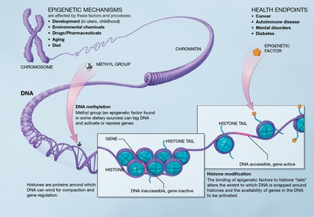
Epigenetic Changes – The Big Three
Histone modifications:
The second two types of modifications involve histones. Histones are the proteins that hold chromosome together. In histone modification, genes are actually wrapped up tightly so the genes cannot be accessed (essentially turned off) or unwrapped so they can be accessed or activated (essentially turned on). There are multiple types of histone modifications which are catalyzed by a number of enzyme families; the most well characterized modifications include acetylation and methylation:
Histone Acetylation is performed by histone acetyltransferases (HATs) which add an acetyl group to lysine amino acids (which are positively charged) in the histone tail which acts to mask the positive charge. This causes loosening of chromatin to promote gene activation (Strahl and Allis, 2000).
Histone Methylation can occur on lysine or arginine amine acids and can occur in mono-, di- or tri-methylation events by histone methyltransferases. This mark does not substantially alter the charge of amino acids and can be associated with both gene activation and inactivation (Laura,2008).

Slide 28

Epigenetics Takeaway
Knowing about epigenetics is both scary and amazing at the same time.
Terrifying in that we know that if we live poorly, paying little attention to how we live, i.e., the impact of poor diet, lack of exercise, living in stress, exposing ourselves to environmental toxins, overreliance on medications, etc., our genome will be altered, resulting in poor physical and/or emotional health and that this effect can be passed on to our progeny for generations to come.
On the other hand, good choices bless us and our future generations. Bearing this in mind, we can appreciate more fully how discussions in the pages ahead about attachment, adverse childhood experiences, Polyvagal Theory, and disconnected living impact us in mind, body, soul, and genome.

Slide 29
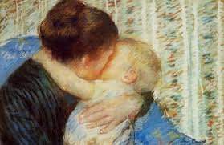
Early Attachment
Attachment is a really big deal and has lifelong implications for all of us. Safe and secure attachment are absolutely necessary for developing healthy and secure development, emotional health, and the ability to regulate our emotions.
Two early pioneers in this field, Dr. John Bowlby (1969) and Dr. Mary Ainsworth (1973) carved the way to our understanding of attachment and child development theory.
They defined attachment as a deep and enduring emotional bond that leads to connections between us across time and space.
This attachment is not always mutual and can travel in only one direction. For example, a child can attach to a parent, but the parent does not always attach to the child or vice versa (Kain & Terrell, 2018).

Slide 30

Attachment – Dr. John Bowlby
In an interview with Dr. Milton Stenn in 1977, Dr. John Bowlby shared that his career started off in the medical direction. He noted that he was following in his surgeon father's footsteps. His father was a well-known surgeon in London and John explained that his father encouraged him to study medicine at Cambridge.
Bowlby ended up following his father's suggestion but was not terribly interested in anatomy and natural sciences. However, during his time at Trinity College, he became particularly interested in developmental psychology which led him to give up medicine by his third year. When John left medicine, he accepted a teaching opportunity at a school called Priory Gates for six months where he worked with maladjusted children.
Bowlby stated that the experience at Priory Gates was extremely important to his career in research as he learned that the problems of today should be understood and dealt with at a developmental level (Kanter, 2007).

Slide 31
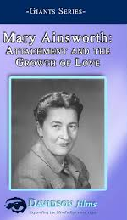
Attachment – Dr. Mary Ainsworth
Bowlby was not the only act in town as he collaborated extensively with Dr. Mary Ainsworth.
Mary was born in Glendale Ohio. When she was 15, she read William McDougall's book, Character and the Conduct of Life, which inspired her to pursue psychology.
While she was teaching at John Hopkins, Mary began working on creating a means to measure attachments between mothers and their children.
It was this that led her to develop her famous "Strange Situation" assessment, in which a researcher observes a child's reactions after a mother briefly leaves her child alone in an unfamiliar room.
The child’s reaction after the separation and upon the mother's return, revealed important information about attachment. Based on her observations and research,
Mary determined that there were three main styles of attachment: secure, anxious-avoidant, and anxious-resistant. Since these initial findings, her work has spawned numerous studies into the nature of attachment and the different attachment styles that exist between children and their caregivers (VeryWellMind, 2019)

Slide 32
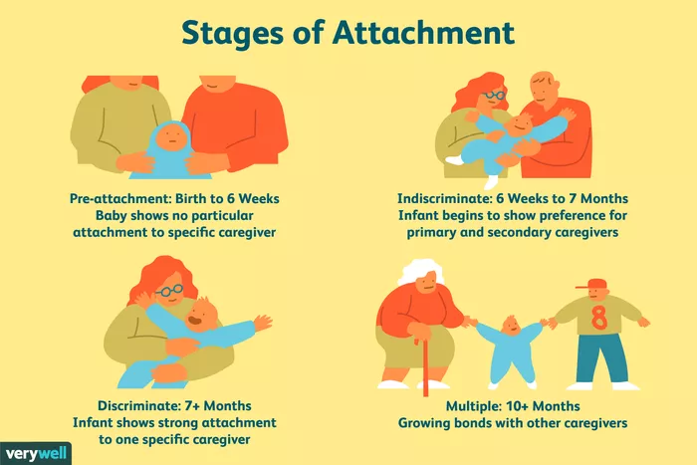
Four Phases of Attachment
Rudolph Schaffer and Peggy Emerson (1964) analyzed the number of attachment relationships that infants form in a longitudinal study with 60 infants.
In their study, infants were observed every four weeks during the first year of life, and then once again at 18 months.
Schaffer and Emerson determined that four distinct phases of attachment emerged: ﻿
Illustration by JR Bee (VeryWellMind, 2019

Slide 33

Four Phases of Attachment
Rudolph Schaffer and Peggy Emerson (1964)
Pre-attachment stage: From birth to three months, infants do not show any particular attachment to a specific caregiver. The infant's signals, such as crying and fussing, naturally attract the attention of the caregiver and the baby's positive responses encourage the caregiver to remain close” (Schaffer & Emerson, 1964).
Indiscriminate attachment: From around six weeks of age to seven months, infants begin to show preferences for primary and secondary caregivers. During this phase, infants begin to develop a feeling of trust that the caregiver will respond to their needs. While they will still accept care from other people, they become better at distinguishing between familiar and unfamiliar people as they approach seven months of age. They also respond more positively to the primary caregiver” (Schaffer & Emerson, 1964).
Discriminate attachment: At this point, from about seven to eleven months of age, infants show a strong attachment and preference for one specific individual. They will protest when separated from the primary attachment figure (separation anxiety) and begin to display anxiety around strangers (stranger anxiety)” (Schaffer & Emerson, 1964).
Multiple attachments: After approximately nine months of age, children begin to form strong emotional bonds with other caregivers beyond the primary attachment figure. This often includes the father, older siblings, and grandparents” (Schaffer & Emerson, 1964).

Slide 34
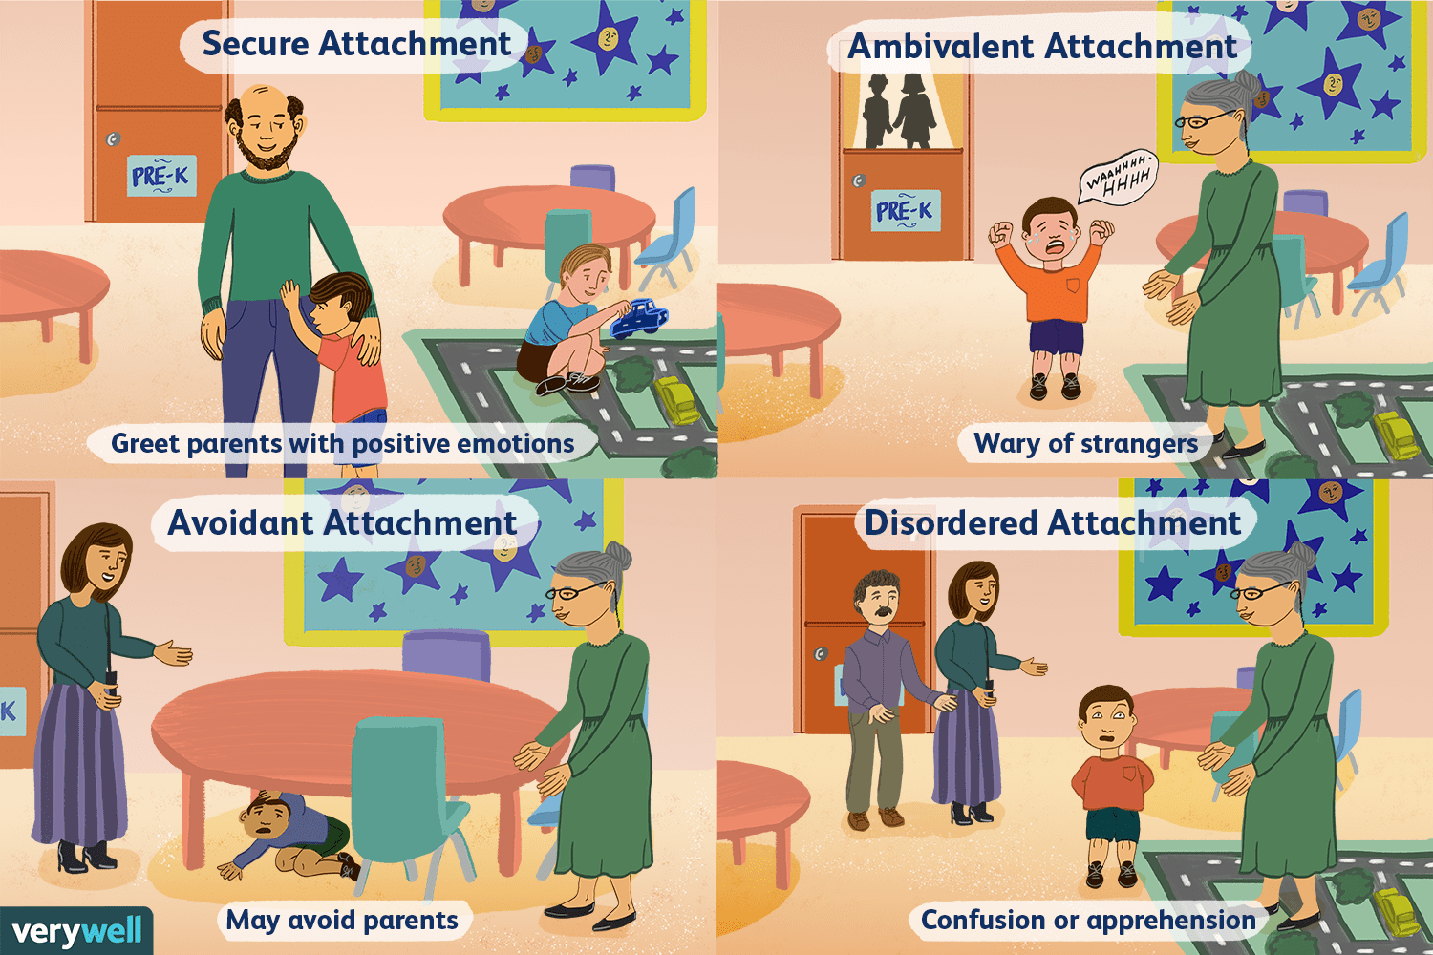
Attachment Styles
As nicely summarized by Lyons-Ruth (1996), the basic the attachment styles culminating from John Bowlby’s and Mary Ainsworth’s research and the fourth by Drs. Mary Main’s and Judith Solomon’s (Main & Solomon, 1986) work include:
Secure
Avoidant
Ambivalent
Disordered

Slide 35

Attachment Styles
Explained
Secure attachment: Secure attachment is marked by distress when separated from caregivers and joy when the caregiver returns. Remember, these children feel secure and are able to depend on their adult caregivers. When the adult leaves, the child may be upset but he or she feels assured that the parent or caregiver will return. When frightened, securely attached children will seek comfort from caregivers. These children know their parent or caregiver will provide comfort and reassurance, so they are comfortable seeking them out in times of need” (Lyons-Ruth, 1996).
Ambivalent attachment: Ambivalently attached children usually don't appear too distressed by the separation, and, upon reunion, actively avoid seeking contact with their parent, sometimes turning their attention to play objects on the laboratory floor. This attachment style is considered relatively uncommon, affecting an estimated 7 percent to 15 percent of U.S. children. Ambivalent attachment maybe a result of poor parental availability. These children cannot depend on their mother (or caregiver) to be there when the child is in need” (Lyons-Ruth, 1996).
Avoidant attachment: Children with an avoidant attachment tend to avoid parents or caregivers. When offered a choice, these children will show no preference between a caregiver and a complete stranger. Research has suggested that this attachment style might be a result of abusive or neglectful caregivers. Children who are punished for relying on a caregiver will learn to avoid seeking help in the future” (Lyons-Ruth, 1996).
Disorganized attachment: Children with a disorganized attachment often display a confusing mix of behavior and may seem disoriented, dazed, or confused. Children may both avoid or resist the parent. Some researchers believe that the lack of a clear attachment pattern is likely linked to inconsistent behavior from caregivers. In such cases, parents may serve as both a source of comfort and a source of fear, leading to disorganized behavior” (Lyons-Ruth, 1996).

Slide 36
Attachment Style Percentages
Mary Ainsworth and her colleagues reported in 1978 that studies on the three initial attachment classifications revealed:
  70 percent of American infants have been classified as secure
  20 percent as avoidant-insecure
  10 percent as resistant-insecure (Ainsworth et al., 1978).
Kain and Terrell (2018) warn that there are worrying declines in secure attachment and that in more recent research populations, the percentages of secure attachment have declined by 10 percent (Andreassen et al., 2007).

Slide 37

Attachment
Takeaways
Studies reveal that Interactions during the first three years of life can affect cognitive development and will impact physical, emotional, and mental health of children as they age and develop (Colmer et al., 2011).
Typically, a parent’s emotional response will serve as a template for helping their child learn about emotion. As parents model appropriate emotion regulation through conversations or actions, children learn to control/regulate their emotions.
On the other hand, insecurely attached children may learn to mask their emotional distress or exaggerate them in order to gain the parent’s attention; therefore, making up for a parent who is not consistently responsive (Laible, 2010).
This type of maladaptive behavior has devastating and potentially consequences resulting in poor social skills, emotional dysregulation, depression, anxiety, peer exclusion, social rejection, and/or low self-esteem (Lewis et al, 2015; Newman, 2017).
So, it behooves any of us who are young parents to ensure that we are spending lots and lots of time with our infants and children in healthy, safe, and connected ways, particularly early in life to develop secure attachment so they will be able to have joy, fulfilling relationships, and emotional stability.

Slide 38
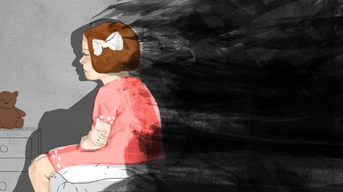
Trauma and Adverse Childhood Experiences
Trauma exposure, particularly child maltreatment (e.g., neglect, emotional, physical and sexual abuse), has been established as one of the main determinants of emotional dysregulation and is also a known risk factor for psychiatric disorders, especially depression and PTSD (McLaughlin et al.,2012; McLaughlin et al., 2013).
Moreover, several prior studies have shown that trauma exposure is clearly associated with profound deficits in emotional regulation across the entire lifespan, including during preschool (Langevin, Hebert, Allard-Dansereau; Bernard-Bonnin, 2016), adolescence (Shields & Cicchetti, 1997; Vettese, Dyer, Li, & Wekerle, 2011) and even adulthood (Briere & Rickards, 2007; Thompson, Hannan, & Miron, 2014; Dunn et al., 2018).
Trauma occurs when we are faced with an experience that overwhelms our ability to process incoming information both at the time of that experience and in future situations (Barta, 2018).
Dr. Michael Barta suffered from trauma himself as a child which led him to addictions that ultimately landed him in jail and almost destroyed his life. In is book, TINSA, he wrote that trauma occurs when our natural defenses are unable to keep us safe from physical, emotional, or mental threats or harm (Barta, 2018).

Slide 39
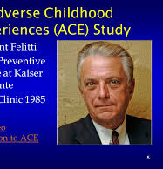
Trauma - Adverse Childhood Experiences
In the mid-1980’s, Dr. Vincent Felitti noticed a puzzling and paradoxical trend in the obesity clinic he was heading.
Specifically, many of his participants who were having the most success in losing weight were dropping out only to gain the weight back. He interviewed the nearly 300 participants and discovered a surprising pattern: almost all of the dropouts had suffered some form of childhood trauma (Kain & Terrell, 2018).
This initial study grew into a major public health study with Dr. Felitti teaming up with Dr. Anda at the Centers for Disease Control (CDC) that continues to this day, involving more than 17,000 individuals.
This research came to be known as the Adverse Childhood Experiences (ACE) Study (Felitti et al., 2014). In this study, people were asked about ten different types of traumatic events that happened to them when they were children to include physical and sexual abuse, family problems, and neglect.

Slide 40
Trauma is almost always at the core of serious addiction which leads way to mental illness and then addiction to mask it.

Slide 41
The Four Cs of Addiction
Wilson (2014) notes that all addictions, regardless of their differences, result in an established set of “core brain changes” which, in turn, present as recognized signs, symptoms, and behaviors such as those listed in the Four C’s:
Craving and Preoccupation with obtaining, engaging in or recovering from the use of the substance or behaviors in question.
Loss of Control in using the substance or of engaging in the behavior and noted by increasing frequency or duration, larger amounts or intensity, and/or increasing the risk and behavior in an effort to obtain the desired effect.
Negative Consequences in physical, social, occupational, financial, or psychological areas.
Compulsive in nature

Slide 42

Trauma - Adverse Childhood Experiences
  The ten reference categories experienced during childhood or adolescence are as below, with their prevalence in parentheses (Felitti and Anda, 2009):
  Abuse
    Emotional – recurrent threats, humiliation (11%)
    Physical - beating, not spanking (28%)
    Contact sexual abuse (28% women, 16% men, 22% overall) •
  Household dysfunction
    Mother treated violently (13%)
    Household member was alcoholic or drug user (27%)
    Household member was imprisoned (6%)
    Household member was chronically depressed, suicidal, mentally ill, or in psychiatric hospital (17%)
    Not raised by both biological parents (23%)
  Neglect
    Physical (10%)
    Emotional (15%)

Slide 43

Trauma - Adverse Childhood Experiences
Somewhat surprising in the Felitti studies was that emotional abuse was more likely to cause depression than any other kind of trauma – even sexual abuse.
This suggests that the kind of treatment children receive from parents is a tremendously powerful predictor of positive outcome and when that trust is broken, devastation surely ensues.

Slide 44

Dr. Michael Barta’s Adverse Childhood Experiences
Barta (2018) in his book, TINSA, defines ACEs a little differently as summarized below:
  Sexual assault or abuse
  Physical assault or abuse
  Psychological or emotional trauma
  Serious accidents, medical procedures, or illnesses
  Manmade or natural disasters
  Witnessing violence to include domestic abuse
  School violence to include bullying
  Traumatic grief or unwanted separation
  Terrorism or war
  Betrayal by others to include relational trauma

Slide 45

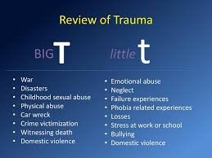
Big T Trauma and Little t Trauma
The experts in the field divide trauma into two categories:
  Big T trauma: Traumas that are associated with horrific single events such as natural disasters, terrorism, and war.
  Little t trauma: Trauma that are smaller in nature such as bullying, neglect, and betrayal.

Slide 46

Big T Trauma and
Little t Trauma
In my personal experience as a pediatric psychologist, far more of my patients have been subjected to “little t” traumas and I agree with Barta that these experiences have a tremendous impact on how children view themselves, their relationships, and their place in the world.
Moreover, the long-term consequences of these traumas are tremendous and often lead to a total inability or impaired ability to access appropriate responses to threatening events and can lead to chronic hyperarousal, intense anxiety, panic, mood instability, poor emotional/behavioral regulation, feelings of powerlessness, helplessness, shame, and even immobility.
Of all traumas, relational (or loss of connection) trauma is particularly devastating.
The implications here are enormous. Specifically, in order to promote safe and healthy emotional regulation, we must be able to pinpoint where in the lifespan people hurt us physically, emotionally, mentally, or spiritually, whether intentionally or accidentally.
If we can resolve our developmental wounds, we can move on and experience a more fulfilling life.

Slide 47




ACE Scores and Outcomes
As Dr. Felitti in a 2009 lecture points out, studies reveal many shocking long-term horrible outcomes when we are exposed to ACEs and this raises exponentially according to how many of them, we have been exposed to.
The results indicate that for every category of traumatic experience we have had as a child, we are dramatically more likely to be depressed as an adult.
If we have ACE scores of , we are:
  260% more likely to have chronic obstructive pulmonary disease than someone with a score of 0
  240% more likely to contract hepatitis, 460% more likely to experience depression
  1,220% more likely to attempt suicide
If we have ACE scores of , we are:
  Five times more likely to become depressed as an adult and if we have had
If we have ACE scores of we are:
  3,100 percent more likely to attempt suicide as an adult (Felitti et al., 2014; Felitti 2004; Felitti and Anda, 2009; Felitti et al., 1998).
Dr. Felitti offered the following graphs which nicely detail the dramatic impact that ACEs have on our society:

Slide 48
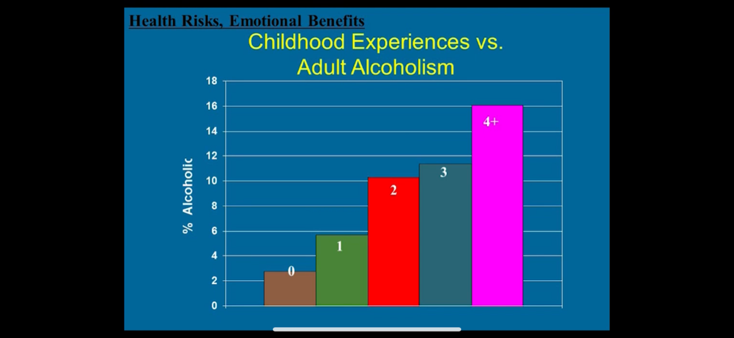
Dr Vincent Felitti (2009) https://www.youtube.com/watch?v=KEFfThbAYnQ (Accessed February 17, 2020)

Slide 49
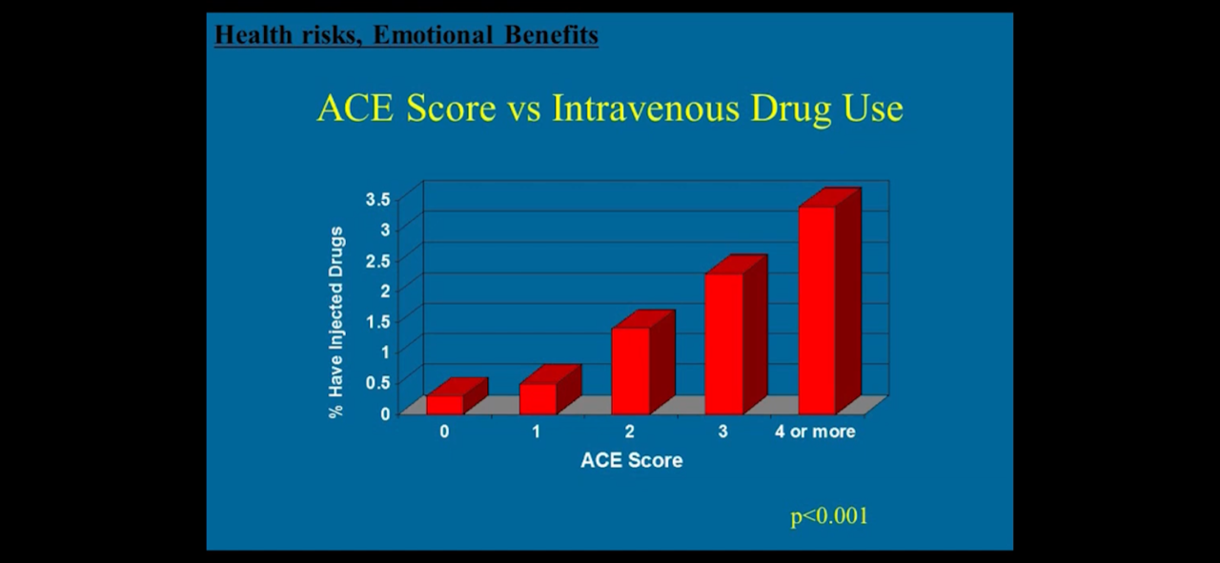
Dr Vincent Felitti (2009) https://www.youtube.com/watch?v=KEFfThbAYnQ (Accessed February 17, 2020)

Slide 50
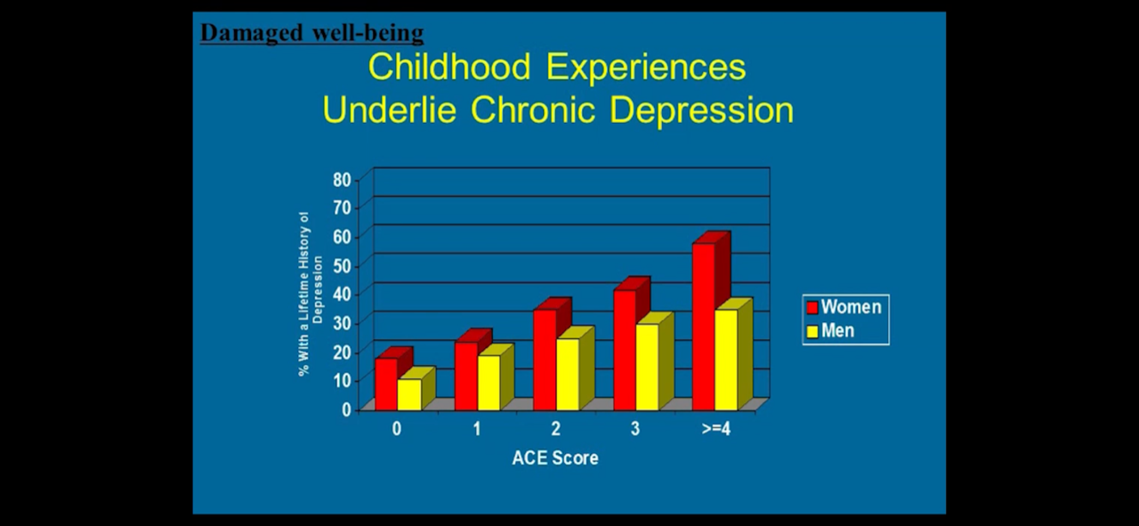
Dr Vincent Felitti (2009) https://www.youtube.com/watch?v=KEFfThbAYnQ (Accessed February 17, 2020)

Slide 51
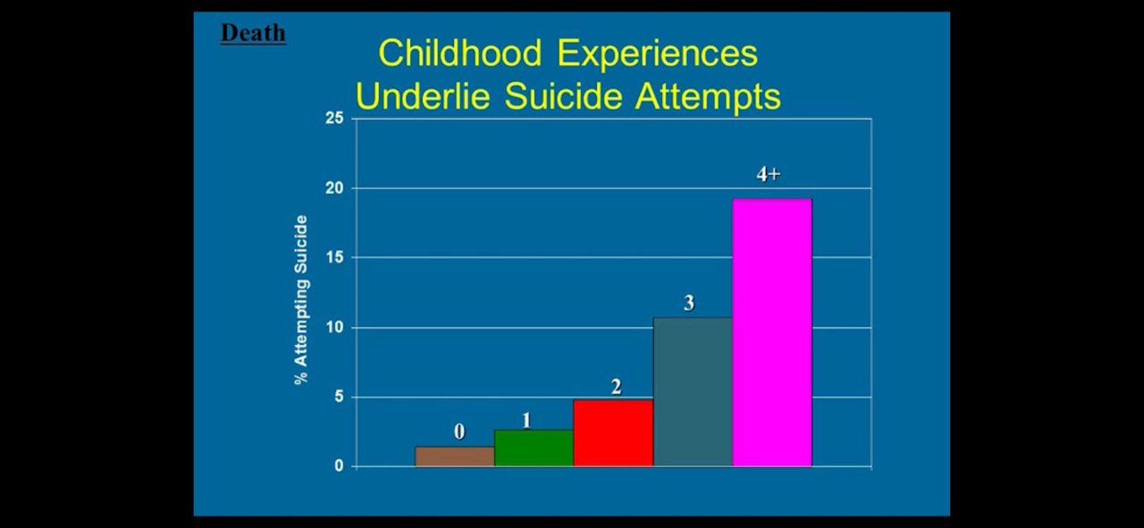
Dr Vincent Felitti (2009) https://www.youtube.com/watch?v=KEFfThbAYnQ (Accessed February 17, 2020)

Slide 52
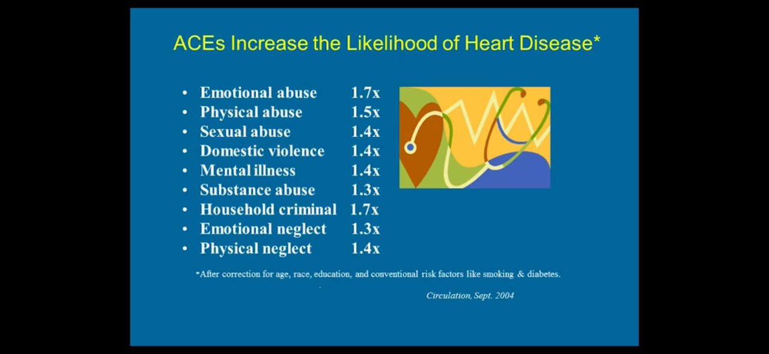
Dr Vincent Felitti (2009) https://www.youtube.com/watch?v=KEFfThbAYnQ (Accessed February 17, 2020)

Slide 53
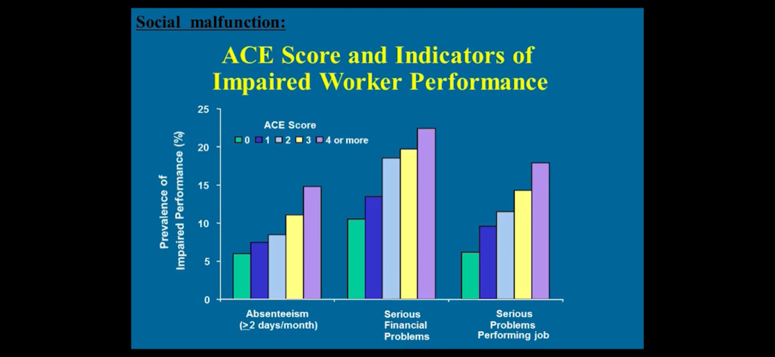
Dr Vincent Felitti (2009) https://www.youtube.com/watch?v=KEFfThbAYnQ (Accessed February 17, 2020)

Slide 54


Special appreciation to Dr. Kevin McCauley and Dr. Georg Koob whose brilliant work inspired important content for this presentation,
Please click the links below to access their brilliant lectures:
Dr. Kevin McCauley
https://www.youtube.com/watch?v=zYphZvRHm6Y&list=PLvpkbo8ssyriex9eUKI6JGaR1UX2NGdtn&ab_channel=KTOO360TV
Dr. Georg Koob:
https://www.youtube.com/watch?v=mGqBN72sSz4&ab_channel=AddictionPolicyForum

Slide 55


A Few Trauma Takeaways to Think About
Most of us will have a least one ACEs in our developmental years, and, if not extreme, this will not necessarily harm us. However, if any one ACE is extreme or if there are too many, we can be marked for problems in life.
It is essential that we do not sweep our traumas under the rug but, rather, deal with them before they deal with us. I admit that I minimized my ACEs and naively prided myself in my ability to manage them. In hindsight, I would now have chosen to seek good therapy earlier in my life by a trauma-informed therapist. This would have improved my capacity to deal with the stressors that eventually unhinged me.
I respectfully and lovingly urge any of us who are raising children to be ever so mindful of the impact of excessive adversity on our children. We parents should not assume that, even though our children appear to be doing well, that they are necessarily internally well if they have been exposed to excessive ACEs.
We do our children right by getting the help to heal the dysfunction in our lives, in our marriages, and/or in our family dynamics and, in so doing, freeing our children from having to pay the price in their own lives and in their progeny for possibly generations to come.

Slide 56
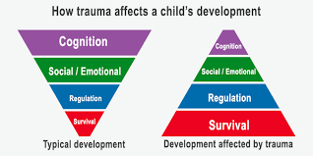
Trauma’s Impact on Social Engagement and Emotional Regulation
My own clinical experience suggests that the most common forms of trauma are due to a lack of attunement or connection with parental or adult figures while growing up.
As Barta (2015) writes, “These deficiencies are not about bad parenting but about a parent’s inability or diminished ability to respond to the child’s emotional needs. Most parents are doing the best they can with the tools they have, but whether deliberately or inadvertently, the traumas of our childhood can have tremendous impact on our lives (Barta, 2018, p. 17)
As trauma expert, Dr. Peter Levine notes in his book, Healing Trauma, “Trauma is much about loss of connection – to ourselves, to our bodies, to our families, to others, and to the world around us. This loss of connection is often hard to recognize because it doesn’t happen all at once. It can happen slowly over time, and we adapt to these subtle changes sometimes without even noticing them.
These are the hidden effects of trauma, the ones most of us keep to ourselves...Our choices become limited as we avoid certain, feelings, people, and situations. The result of a gradual constriction of freedom is the loss of vitality and potential for the fulfilment of our dreams” (Levine, 2008, p. 9).

Slide 57
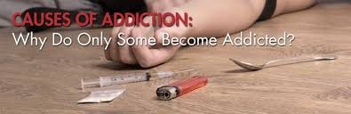
How does the brain become addicted to substances or behaviors?

Slide 58
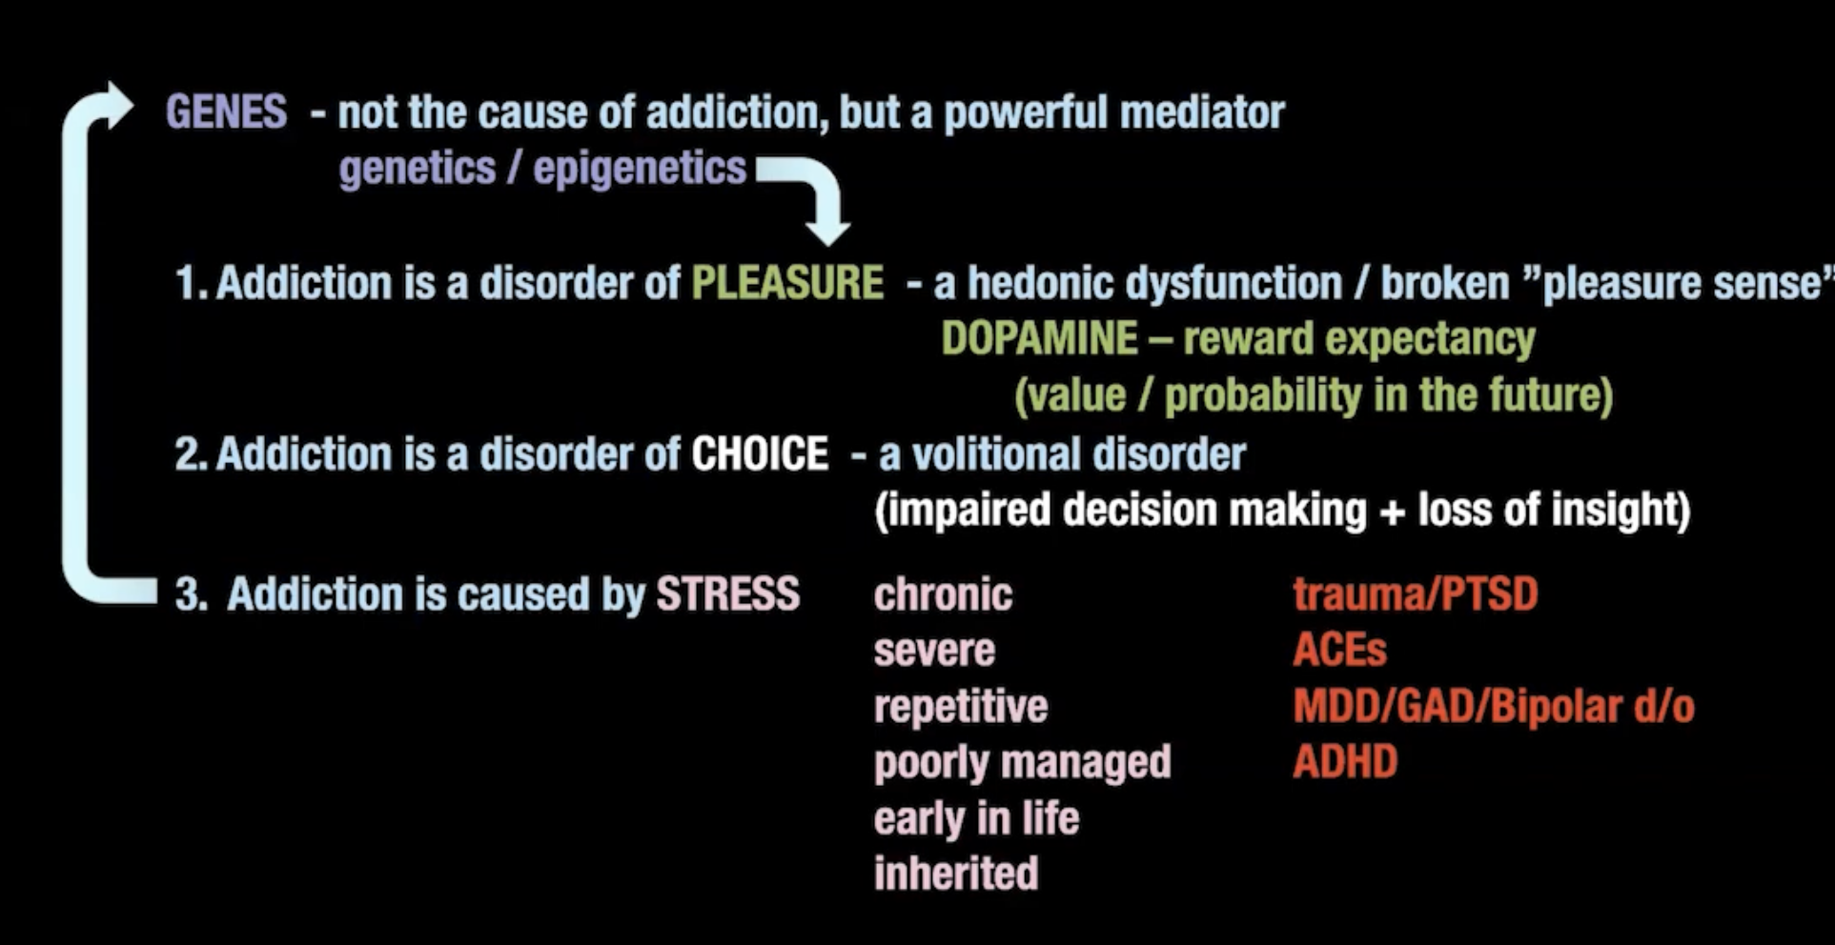
Dr. McCauley’s model is brilliantly integrative

Slide 59
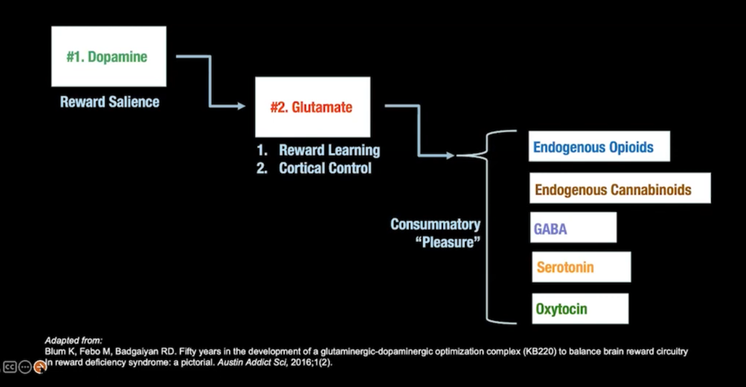
The “Brain Reward Cascade” (Blum)

Slide 60
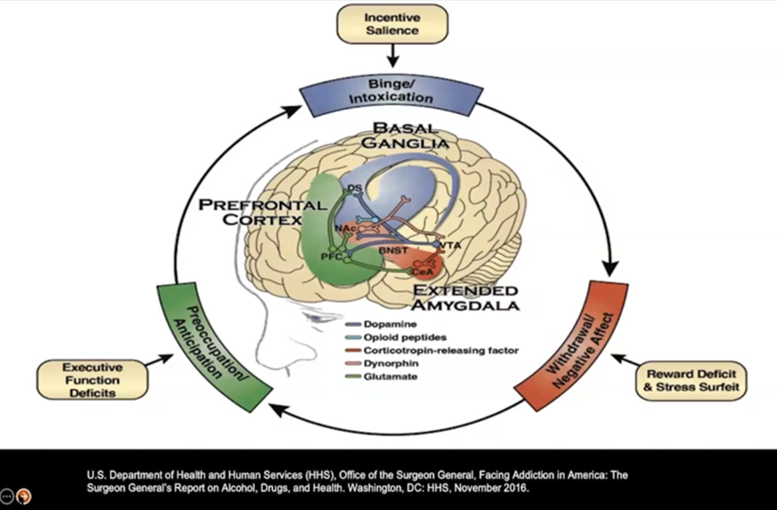
There are three entry points for the addiction process, each involving different regions of the brain.

Slide 61
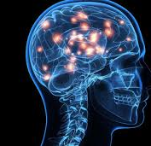
The Neuroscience of Addiction
The Role of Dopamine
  Sensitization
  Desensitization
Hypofrontality – Not a good thing
The Marriage of Triune Brain therapy and Polyvagal Theory

Slide 62
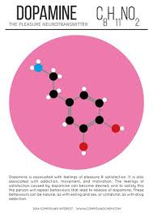
How the Brain Gets Hooked on Substances and Behaviors
As Kardaras(2016) stated in his book, Glow Kids, in order to fully understand addiction, we need to understand the brain’s reward system and the impact of dopamine on that reward pathway.
Specifically, how much dopamine is activated by a substance or behavior is correlated directly with the addictive potential of that substance or behavior.
Dopamine, as many of us know, is the “feel-good” neurotransmitter that is the most critical and important part of the addiction process. Dopamine was discovered in 1958 by Arvid Carlsson and Niles-Ake Hillarp at the National Heart Institute of Sweden.

Slide 63
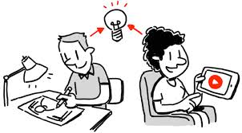
Functions of Dopamine
Dr. Susan Weinschenk (2009) noted that dopamine is created in various parts of the brain and is critical in several brain functions to include:
Thinking
Moving
Sleeping
Mood
Attention
Motivation
Seeking and reward Inspired to watch because of Dopamine

Slide 64
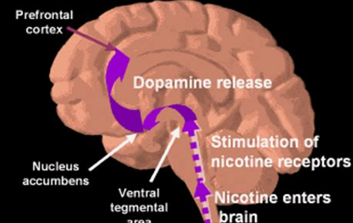
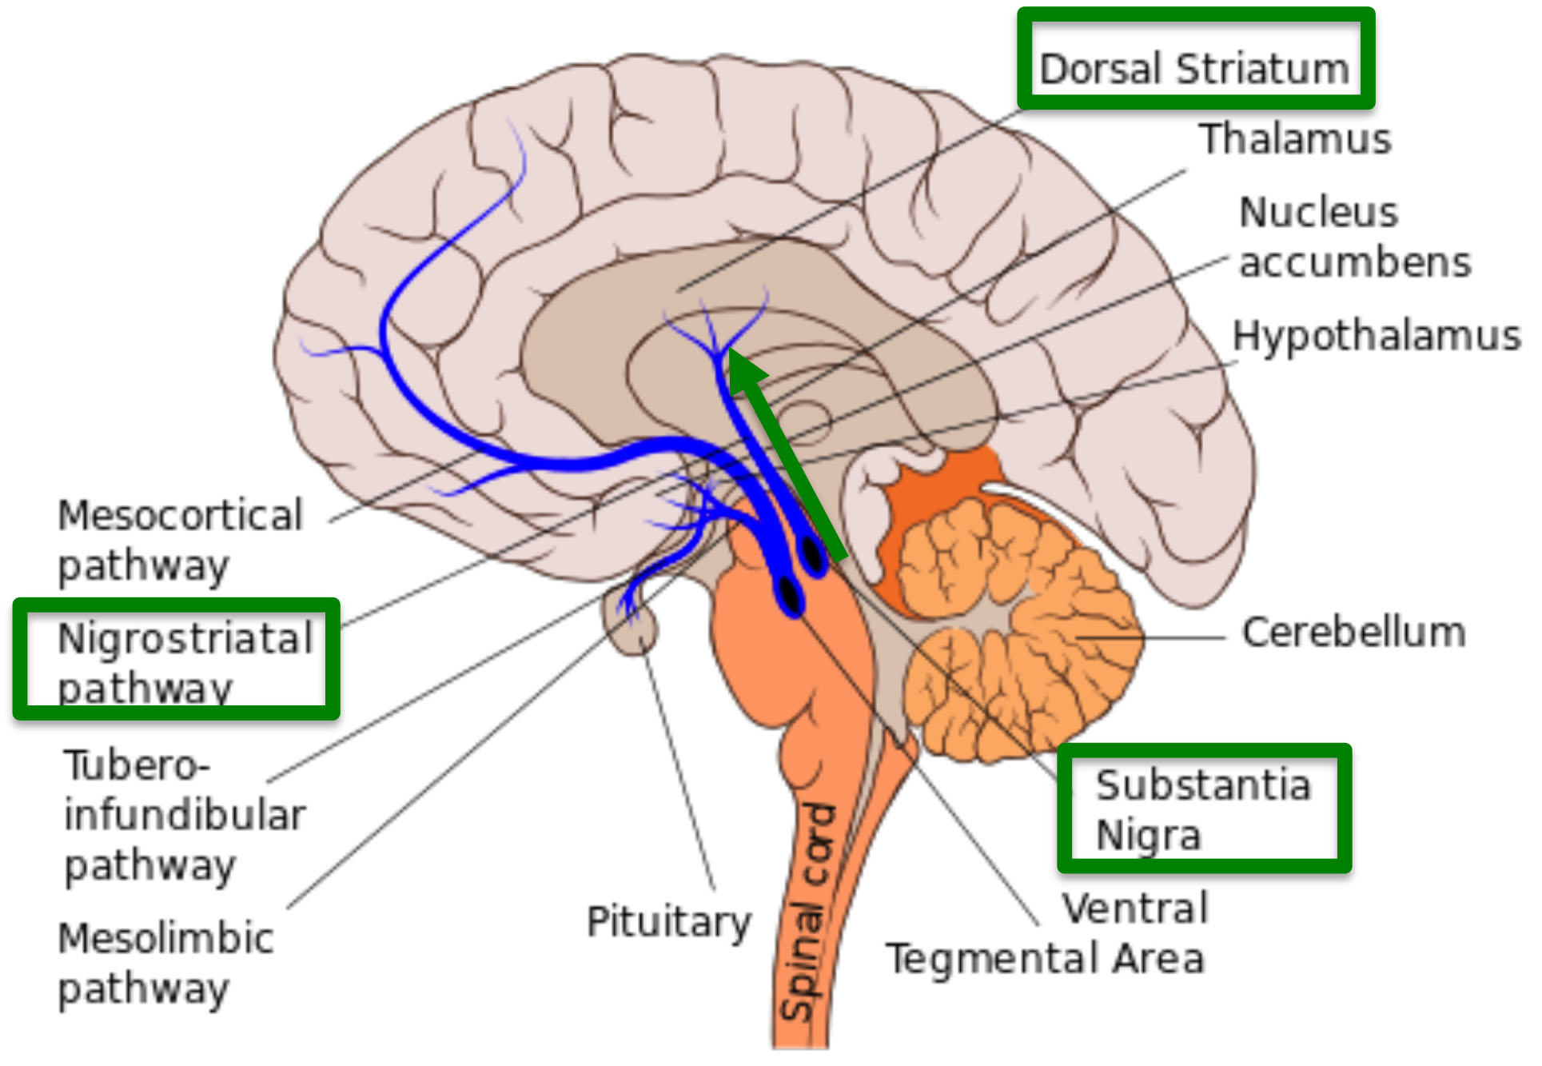
Two Main Dopamine Reward Pathways
Mesocorticolimbic for motivation and reward Nigrostriatal for movement
The Mesocorticolimbic Pathway transports dopamine from the VTA to the nucleus accumbens, amygdala, and prefrontal cortex. The nucleus accumbens is found in the ventral medial portion of the striatum and is believed to play a role in reward, motivation, desire, and even the placebo effect.
The Nigrostriatal Pathway travels from the substantia nigra to the striatum. The nigrostriatal pathway is important for facilitating movement.

Slide 65
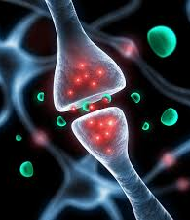
Dopamine is both a neuromodulator and a neurotransmitter
According to Stanford neuroscientist Dr. Andrew Huberman, dopamine is both a neuromodulator and a neurotransmitter. The main difference between neurotransmitter and neuromodulator is that a neurotransmitter is a chemical messenger released by a neuron to affect either one or two post-synaptic neurons or another specific effector organ whereas a neuromodulator is a chemical messenger released by a neuron to affect a group of neurons or effector organs with a specific receptor.
Furthermore, a neurotransmitter directly affects the postsynaptic partner to produce a quick, rapid effect while a neuromodulator indirectly affects the post-synaptic partner, especially through a second messenger to produce a slow but long-lasting effect. Dopamine can be released locally or volumetrically (a large dump). When it is released volumetrically, it affects many neurons. Very concerning, dopamine can ultimately affect gene expression according to Dr. Lieberman.
Click here to listen to Dr. Hubererman’s excellent lecture on dopamine: https://www.youtube.com/watch?v=QmOF0crdyRU&t=2s&ab_channel=AndrewHuberman

Slide 66

More on Dopamine
When an individual performs an action that is satisfying to a need or fulfills a desire, dopamine is released into the nucleus accumbens, a cluster of nerve cells beneath the cerebral hemispheres that are specifically associated with reward and pleasure. This is also known as the brain’s “pleasure center.”
Natural dopaminergic activities, such as eating and sex, usually come after effort and delay and serve a survival function.
These are called the “natural rewards” as contrasted with addictive chemicals/behaviors (which can highjack the same circuity).
Addictive drugs and behaviors, such as gambling and video gaming, actually offer a short-circuit to this process which only ends up flooding the nucleus accumbens with dopamine and does not serve any biological function.

Slide 67

Dopamine vs Endogenous Opioids
Although dopamine has been referred to as the “pleasure molecule,” it is in actuality more about seeking and searching for pleasure, rather than pleasure itself. Dopamine is more involved in drive and motivation to seek.
The “final reward” or what we experience as feelings of pleasure, Wilson (2014) writes, involve the release of endogenous opioids.
You can think of dopamine as “wanting” and opioids as “liking.”
As psychologist Dr. Weinschenk explains, “Dopamine causes us to want, desire, seek out and, search; however, the dopamine system is stronger than the opioid system and we hence seek more than we are as satisfied…” (Weinschenk, 2009).
“Addicts want it more but gradually like it less. Addiction might be
thought of as “wanting gone amok.” (Wilson, 2014).
  Click here to listen to Gary Wilson’s outstanding lecture:
  https://www.youtube.com/watch?v=ZLtSoWrEplM&ab_channel=Reach10

Slide 68

Hierarchy and Dopamine

Slide 69

Similar to humans, monkeys form social hierarchies.

Slide 70

When given access to cocaine, low status monkeys consumed cocaine excessively to the point of addiction whereas high status monkeys barely touched it…

Slide 71

Low status monkeys have fewer D2 dopamine receptors.

Slide 72

Dopamine also is involved in bad and neutral things.

Slide 73

Dopamine is not required for reward

Slide 74

Dr. McCauley’s “Ns” of Domaine

Slide 75


Bought the BMW but still wanting the Ducati Diavel

Slide 76

Dopamine and DeltaFosB “Keep doing it!”
Highly salient activities, in this case addiction, lead to the accumulation of DeltaFosB, a protein that activates the genes involved with addiction. The molecular changes it potentiates are almost identical for both sexual conditioning and chronic drug use. Specifically, DeltaFosB rewires the brain to crave IT whatever IT is.
In a sense, dopamine is like the foreman on a construction site barking orders and DeltaFosB is the worker on the site. Dopamine is yelling, “This activity is really important, and you should do it again and again.”
DeltaFosB is responsible for ensuring that you remember and repeat the activity.
This repeated process produces what is called sensitization which is based
on the principle, “Nerve cells that fire together wire together” as noted by
Canadian researcher Donald Hebb in 1949. Repeated activity strengthens
cell connections.

Slide 77

Dopamine and CREB – “Slow it Down, Silver!”
As the brain recognizes that it needs a rest, it will kick out CREB in an effort to slow things down (Wilson, 2014).
In essence, DeltaFosB acts like the gas pedal and CREB functions as the brakes.
CREB specifically inhibits dopamine and endogenous opioids in an effort to take the joy out of the binging/addictive behavior or substance so that you can give it a rest.
This numbed pleasure response that is induced by CREB is often
identified as desensitization which leads to tolerance - the need of
increasingly higher doses to achieve the same effect. Tolerance is a
key factor in addiction.

Slide 78


Dopaminergic Downregulation at the Synaptic Level

Slide 79
So, we see that chronic overstimulation can lead to two opposite effects:
Increased dopamine activity (wanting/seeking it more) –
sensitization via DeltaFosB
01
Decreased dopamine and opioid activity (liking it/enjoying it less) – desensitization via CREB
02

Slide 80

What Cranks Us Up?
Summary of dopamine increases:
Food – 150% increase
Nicotine – 200% increase
Snorting cocaine – 350% increase
Sexual intimacy – 250% increase
Pornography – 250% increases and stays elevated for longer – even when compared to cocaine

Slide 81



The next few slides are from groundbreaking work of Dr. Anna Lembke and Dr. Daniel Lieberman and give us additional insights into how dopamine impacts the addiction process.

Slide 82

Pleasure and Pain Nicely in Balance
According to Stanford Psychiatrist, Dr. Anna Lembke, dopamine which acts on pleasure neurocircuits, and pain are related and help create a homeostatic balance in the brain and body.
The following slides are based on Anna Lembke(2021) Dopamine Nation book.
Click here to watch her excellent YouTube video:
https://www.youtube.com/watch?v=5Pu82wZRZwo&ab_channel=AndreaSamadi

Slide 83


As we actively seek pleasure, pain gremlins begin to jump on the teeter totter to try to restore homeostasis balance.
Anna Lembke (2021) https://www.youtube.com/watch?v=5Pu82wZRZwo&ab_channel=AndreaSamadi

Slide 84


Slide 85

Pain circuits activate in order to move toward homeostasis or balance
Anna Lembke, 2021, https://www.youtube.com/watch?v=5Pu82wZRZwo&ab_channel=AndreaSamadi

Slide 86


Pleasure and pain out of balance
Anna Lembke (2021) https://www.youtube.com/watch?v=5Pu82wZRZwo&ab_channel=AndreaSamadi

Slide 87


Dr. Lembke recommends a 30-day dopamine fast in order to rebalance the dopaminergic circuits in the brain.
Anna Lembke (2021)

Slide 88

The following slides are taken largely from Dr. Lieberman's excellent book, The Molecule of More
The Molecule of More
Click here to listen to Dr. Lieberman:
https://www.youtube.com/watch?v=TjKCzYYkKN4&ab_channel=Valuetainment
Click here to listen to animated video on Molecule of More:
https://www.youtube.com/watch?v=sPpY_nePtV8&ab_channel=Instaread

Slide 89

The brain has up chemicals and down chemicals
The up chemical dopamine drives us to seek new things

Slide 90

The Down Chemicals – designed for the here and now

Slide 91

Reward Prediction Error
When the expected becomes unexpected which increases dopamine dramatically and compels us to continue seeking the new thing. This can become addicting.

Slide 92

Dopamine drops when the unexpected becomes expected.

Slide 93

We can then possibly decide to end the cycle.

Slide 94

Here & Now Circuits allow us to back off the future pursuit and enjoy the present and all that it offers – relationships, peace, connection

Slide 95

Addiction neurochemical #2 Glutamate

Slide 96

Glutamate leads to hyper-memorization of drug cues and leads to relapse.

Slide 97

Glutamate spillover and overlearning

Slide 98

Glial Cells
Glial cells comprise about 33 – 66% of the brain and once thought to be of minor significance are hugely important to brain health and specifically, to the health of neurons.

Slide 99

Astrocyte Glial Cells

Slide 100

Microglia

Slide 101

Microglia are damaged by excessive glutamate.

Slide 102

Addiction neurochemical #3: Glutamate
Glutamate is an excitatory neurotransmitter with several types of receptors found throughout the central nervous system, and its metabolism is important to maintaining optimal levels within the extracellular space. As such, it is important to memory, cognition, and mood regulation.

Slide 103

The activation of CRF₁ receptors by CRF in the hypothalamus initiates the hypothalamic–pituitary–adrenal (HPA) axis, ultimately resulting in the release of glucocorticoids (cortisol in primates and corticosterone in rodents) from the adrenal cortex.

Slide 104

The Stress Homeostatic Response

Slide 105

Allostasis
Stress hormone, cortisol is released to counter excessive dopamine in in effort to attain homeostasis. But a new set point is made.

Slide 106


The initial response of pleasure (A-process) leads to a homeostatic process of stress or pain (B-process).

Slide 107

This slide depicts how the allostatic response creates new set points for pleasure and pain.

Slide 108

To summarize: The process of addiction involves
1. Excessive and errant survival salience via dopamine.
2. Hyper-memorization of the addictive substance or behavior.
3. Over-use which creates stress via cortisol (HPA activation).

Slide 109

The Marriage of Triune Brain Theory and Polyvagal Theory
The greatest thing then, in all education, is to make our nervous system our ally as opposed to our enemy
- William James

Slide 110

The Marriage of Triune Brain Theory and Polyvagal Theory
In the last 10 years new and exciting neuroscience has emerged that helps us map out our physical, emotional, and cognitive responses to the world around us and provides us a way through the ensuing tempest within ourselves.
Dr. Barta (2018) proposes a model that demonstrates how the brain and the nervous system work together to fuel emotional dysregulation. In his model which he calls TINSA (Trauma Induced Sexual Addiction), he pairs some of the greatest minds in neurology and psychology to include:
  Dr. Stephen Porges’ Polyvagal Theory
  Dr. Paul Maclean’s Triune Brain Theory.

Slide 111

Triune Brain Theory
MacLean (2009) proposed that there are three distinct formations in our brain which are used in different situations for everyday survival purposes.
These specific structures developed sequentially on top of each other at different times during the evolution of the brain for the purposes of giving the organism the ability to survive during that period of time.
Even though the brain became more advanced and adaptive, the older more primitive structures of the brain still play an especially important role in thought, process, and behavior.
(For my Christian friends who might worry about this model contradicting sensitivities about creationism – not to worry. As explained by Dr. Andy Doan, M.D. Ph.D., ophthalmology surgeon and neuroscience researcher, and paraphrased by me, “God is very efficient, and He included in our more developed brain substructures that He already designed for lower life forms/animals. No need to re-do what was already perfect and efficient”).

Slide 112

Triune Brain Theory
The Reptilian Brain (or Reptilian Complex):
As the name suggests, this is the most primitive brain and it developed about 500 million years ago in fish and later reptiles.
Its roles include sensation, instinctual reaction, breathing, temperature regulation. TINSA hypothesizes that the reptilian complex promotes certain survival functions as well, most specifically, immobilization or freeze.
We often see lizards, for example, freeze in the face of danger such as a lunch-starved predator in an instinctive reaction that can be life-saving (sadly for the lizard, it doesn’t always work, and he sometimes ends up being a snack anyway).

Slide 113

Triune Brain Theory
The Mammalian Brain (or Limbic System):
Later, about 150 million years ago, the limbic system first appeared in small animals.
This system developed as critters were able to move more freely about as they were now equipped with extremities.
As such, it often became necessary to either fight off or flee from would-be predators. In addition, the capacity to have memory and emotions developed.
This enabled the animal to control the body’s response to danger and to remember that danger as well as the ability to be vigilant and scan the surrounding environment for potential dangers. Like critters, we often revert to this neurological system when we act instinctively.

Slide 114

Triune Brain Theory
The Frontal Lobe (or Neocortex):
According to Maclean (1990), the frontal lobes came on board only about 2 or 3 million years ago.
As in the reptilian brain and the limbic system, the purpose of this brain formation is to react to and protect us from danger.
Unlike our more primitive neighbors, this system reacts consciously. Very importantly, there was a need to develop a system that made possible more “civilized” responses to threats and at the same time one that offered the possibility to connect to others for safety.
Therefore, the frontal lobe allows us to access a new way of surviving based on socialization. This makes it possible for us to use analysis, logic and decision-making, and this is what specifically separates us from other lower-ordered animals that rely on instincts alone for survival

Slide 115

Triune Brain Theory – To Bring it Home
To bring it home, on topside we have the cortical brain consisting of the frontal lobe which is the most recently developed portion of the brain, i.e., the conscious, thinking brain.
At the bottom, we have our subcortical, unconscious brain, which is made up of the reptilian and limbic complexes and is directed largely by raw instinct and emotions which often results in immediate knee-jerk reactions that happen in a split second.
Barta (2018) informs us that, in the best of worlds, we try to lead with our frontal lobe and remain socially engaged if something threatening confronts us and in order think our way out of it, smile, and/or stay calm.
But in times of intense stress or in situations that remind us of past trauma, this survival mechanism is quickly overrun by earlier, more primitive survival strategies of our mammalian/limbic brain and our reptilian brain structures.
As such, when our neocortex fails us, the limbic system takes command and we are then rapidly sent into our fight-or-flight response and if this does not work and we cannot run away or fight our way out of it, the most primitive line of defense is deployed and we simply freeze, become immobilized, or completely collapse. This hijacking process can occur whether the threat is real or merely perceived (Barta, 2018).

Slide 116
Polyvagal Theory
Made simple

Slide 117

Polyvagal Theory
The Autonomic Nervous System
Dr. Steve Porges
The autonomic nervous system is our personal surveillance system.
In an effort to keep us out of danger, it is always on guard; asking the question, “Is this safe?” Its dedicated goal is to protect us by sensing safety and risk.
It achieves this by listening moment by moment to what is happening in and around our bodies and in the connections, we have to others (Dana, 2018).
This listening happens far below awareness and far away from our conscious control.
Dr. Porges, understanding that this is not awareness that comes with perception which is conscious, coined the term neuroception to describe the way our autonomic nervous system scans for cues of safety, danger, and life threat, without involving the thinking parts of our brain or the unconscious parts of the brain (Porges, 2017).

Slide 118
Polyvagal Theory
The Autonomic Nervous System
Briefly stated, our response to threat will move us toward one of three defensive responses. Two of which keep us in perpetual defense and one of which moves us toward health and restoration.
Sympathetic Division: Prepares the body for stressful or emergency situations – fight or flight. The sympathetic nervous system originates in spinal nerves (nerves that arise from the spinal cord) and is our system of mobilization. The sympathetic nerves are found in the middle of our backs in the thoracic and lumbar regions of the spinal cord. There are two mobilization systems in our sympathetic nervous system.
  Sympathetic Adrenal Medullary (SAM): The SAM system is activated very quickly, within 100 milliseconds and brings up a burst adrenaline for a fast response to a stressor. SAM activation triggers a short-term and rapid response to a stressor which is followed by a return to regulation (Dana, 2018).
  Hypothalamic-Pituitary-Adrenal (HPA) Axis: The HPA axis takes over when the quick, adrenaline surge of energy of the SAM does not resolve the distress. The HPA releases cortisol (AKA stress hormone). This release takes longer and is much slower in taking effect, requiring minutes to take effect rather than seconds (Dana, 2018).

Slide 119

Polyvagal Theory
Sympathetic Division
The sympathetic division increases heart rate and the force of heart contractions and widens (dilates) the airways to make breathing easier.
It causes the body to release stored energy.
Muscular strength is increased. This division also causes palms to sweat, pupils to dilate, and hair to stand on end.
It slows body processes that are less important in emergencies, such as digestion and urination (Merck Manual).
When we are in this physical state, we can feel emotions such as fear and/or rage and, if extremely activated, absolute terror (Rothschild, 2017).

Slide 120

Polyvagal Theory
Parasympathetic Division
The parasympathetic division conserves and restores calm/homeostasis. It slows the heart rate and decreases blood pressure. It stimulates the digestive tract to process food and eliminate wastes. Energy from food is processed and used to restore and build tissues (Merck Manual).
Dr. Porges discovered that the parasympathetic division of the Autonomic Nervous System consists of two branches which lead to two different responses.
The main nerve in the parasympathetic nervous system is the 10th cranial nerve, aka vagus nerve, which is the largest of the 12 cranial nerves and has huge implications for our well-being and health.
The name vagus comes from the Latin word vagary which means wanderer, and this nerve is definitely a vagabond.
The vagus travels downward from the brainstem to the heart and stomach and then back upward to the face and its connection with other cranial nerves.
This amazing wandering nerve is a mixed nerve which communicates bidirectionally between the body and the brain. 80% percent of its fibers are sensory (afferent) sending information from the body to the brain, and 20% are motor (efferent), sending action information from the brain to the body (Dana, 2018).

Slide 121


Polyvagal Theory - Parasympathetic Division
The vagus nerve has two very distinct branches: Dorsal vagal nerve and the ventral vagal nerve.
Dorsal Vagal Nerve: Barta (2018) notes that the most primitive form of defense occurs when the dorsal vagal nerve is activated.
  It is not sophisticated in that it is unmyelinated and slow. When activated, the dorsal vagal nerve promotes. shutdown, freeze, and collapse
  An example of this shutdown is when a gazelle, for example, is being stalked by a lion and when trapped with no possible way to flee, drops down and appears to be deader than a doornail.
  This is not a conscious process but is, rather, a very primitive and unconscious one. When we are in this physical state, we can feel emotions such as sadness, depression, grief, shame and/or disgust (Rothschild, 2017).
Ventral Vagal Nerve: Barta (2018) writes that the second response of our parasympathetic nervous system (the first being freeze and collapse as noted above) is responsible for our ability to engage socially and to handle social relationships.
  According to Barta, the social engagement system is controlled by our ventral vagus nerve which is a very smart myelinated nerve with a rapid response time. As such, it allows us to “know” if we are safe enough so we can calm our defenses through a process of “neuroception” which, as noted earlier, is translated as the brain’s ability to sense safety.
  This serves not only bonding needs but allows us to shift out of sympathetic arousal and move into parasympathetic calm or to downshift from activation to calm. When we are in this emotional state, we can feel emotions such as calm, pleasure, love, sexual arousal, and “good” grief (Rothschild, 2017).

Slide 122
Marriage of MacLean’s Triune Brain Theory with Porges’ Polyvagal Theory
Through the marriage of MacLean’s Triune Brain Theory with Porges’ Polyvagal Theory, we can explain how each part of the triune brain is correlated with the three responses of the autonomic nervous system (Barta, 2018).

Slide 123

Polyvagal Theory – The Stream
When we enter into an autonomic state, the information about that state travels up the automatic pathways up to the brain where a story is drafted to make sense of the embodied experience/sensations.
In other words, the physiological state produced by the autonomic nervous system creates a psychological story.
Dana (2020) describes this as a metaphor of a stream where we can imagine the flow of experience. At the river’s source is neuroception and at the river’s mouth is the story. In between lie perception, autonomic state, feelings, and behavior. We are accustomed to entering in the river downstream with feeling and behavior, or story being at the fore.
However, neuroception takes place at the furthest point upstream. We need to make our way back to the starting point, leaving behind the story, behavior, and feelings in order to identify the state and bring perception or awareness to neuroception (Dana, 2020).
This has implications for treatment which we will discussed “downstream” in this paper.

Slide 124

Polyvagal Theory – Autopilot or the Choice of Connection?
So, our neurosystem, left on autopilot will, when we are faced with stress and threat, move us to either:
    (a) Sympathetic fight or flight which equates to extreme anxiety, anger, rage, and or terror or to
    (b) Dorsal vagal shutdown which leads to slowing down, withdrawal, and possibly even depression. If these modes of coping become excessive, we are at risk for potentially using maladaptive strategies such as addictions to quell the pain of negative physical symptoms, associated negative emotions, and/or complete withdrawal and possibly self-destructive behavior.
The best response, of course, is to activate our social engagement system of the ventral vagal pathway of the parasympathetic branch. In this state, our heart rate is regulated, our breath is full, we take in the faces of friends, and we can tune in to conversations and tune out distracting noises.

Slide 125

The chart below adapted by Dr. Rothschild nicely demonstrates the shifting in body sensations, physiological symptoms, and emotions as we move between autonomic states (Rothschild, 2017).
The Autonomic Nervous System Precision Regulation Chart is Available for purchase on Amazon for $8.99 (a very high recommend):
Babette Rothschild (2017) https://www.amazon.com/Autonomic-Nervous-System-Table-Laminated/dp/039371280X/ref=sr_1_15?dchild=1&keywords=deb+dana&qid=1590326813&s=books&sr=1-15

