Slide 1


Our Internal Tempest and the Pathway to Peace
Jeffrey E. Hansen, Ph.D.
Center for Connected Living, LLC
There is a voice that doesn’t use words. Listen
- Rumi
“The views expressed are those of the author and do not reflect the official policy of the Department of the Army, the Department of Defense, or the U.S. Government.”

Slide 2

Let’s set the stage
Tornadoes ravage the land, hurricanes the sea – leaving paths of destruction wherever they go, but nothing compares to the tempest within, the one that tears at the soul and robs one of peace. This is a story of the pain of searing emotional dysregulation, one that does not respect age, gender, race, or station in life. It can start in infancy and, left unmanaged, has the potential for damaging or even destroying your life, and possibly even the lives of those around you. It almost destroyed mine and I will risk sharing some of my story in hopes that it might help you or the ones you care about and love.

Slide 3
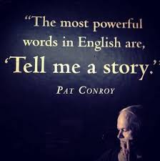
My Story
Many years ago, I went through a totally unexpected storm that clipped me at my knees. Happily, I emerged though the storm in better shape than before, but not without much pain and suffering and a long journey of healing. After I was back in the swing of things, it became important to me to understand more fully what brought me to this breaking point in my life and what specifically I (and the many who supported me) did to navigate through it. This became a personal mission. First, because the long experience was so awful that I wanted to never repeat it (wanted to buy a psychological insurance policy), and second, I desired to help those who might possibly be facing their own similar struggles. So, let’s walk this together

Slide 4

Definition Please
Emotional self-regulation or emotion regulation as defined by Wikipedia “is the ability to respond to the ongoing demands of experience with the range of emotions in a manner that is socially tolerable and sufficiently flexible to permit spontaneous reactions as well as the ability to delay spontaneous reactions as needed.
Emotion regulation is a complex process that involves initiating, inhibiting, or modulating one's state or behavior in a given situation – for example, the subjective experience (feelings), cognitive responses (thoughts), emotion-related physiological responses (heart rate or hormonal activity), and emotion-related behavior (bodily actions or expressions).
Functionally, emotion regulation can also refer to processes such as the tendency to focus one's attention on a task and the ability to suppress inappropriate behavior under instruction. Emotion regulation is a highly significant function in human life” (Wikipedia, 2020a).
As this definition suggests, emotional regulation is a really big deal and involves our thoughts, our bodies, and our feelings

Slide 5

The Course of our Talk
Our story begins in the womb where millions of cells are replicating to begin to make us who we are. Already, the story of our lives and who we might eventually become are in the process of being written. From early infancy, our brain is wiring in 40 thousand synaptic connections per second and neurons in the brain will increase to eventually reach a population of 86 billion.
The health of our mothers during pregnancy, the general health of both of our parents, as well as their parents all impact on the developing fetus and its biology changes epigenetically as a result.
Many things go right but, unfortunately, some things go wrong, as well.
We will explore five areas to help us navigate toward peace
      Epigenetics
      Trauma and Adverse Childhood Experiences
      Early attachment
      The Marriage of Triune Brain Theory and Polyvagal Theory
      Johann Hari’s Model for Connected Living

Slide 6
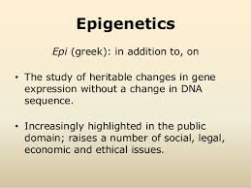
Epigenetics
These are exciting times.
New science is enabling us to better understand what external and internal factors alter us.
Our physical health, our emotional well-being, and our longevity are not only impacted by the hard-wired genetic code we inherit, but our genome is impacted by environmental influences to include as well as the way we live.

Slide 7
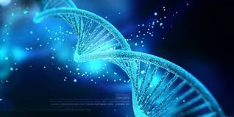
Definition please:
Epigenetics literally means "above" or "on top of" genetics. It refers to external modifications to DNA that turn genes "on" or "off."
These modifications do not change the DNA sequence, but instead, they affect how cells "read" genes. A very exciting trend in epigenetic research involves investigating the process by which our genetic tendencies are altered or influenced in their expression by outside exposure or stimuli.
These epigenetic changes can last through multiple cell divisions for the duration of the cell’s life but what is particularly compelling is that these changes may persist for multiple generations within our family line (Kain & Terrell, 2018).

Slide 8
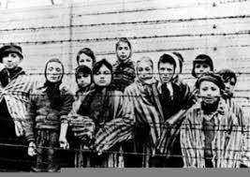
Trauma’s Impact on Epigenetics
Early trauma, for example, is one of the factors that can cause epigenetic changes and these changes can be passed on to the next generation and beyond.
Researchers have come to appreciate that the horrors of the Holocaust did not only impact those who suffered the terror of the concentration camps.
As one would expect, the survivors of the Holocaust often suffered from PTSD, but this did not stop there.
Their children were more likely themselves to develop PTSD and other mood and anxiety disorders, whether or not they were exposed to traumatic events in their own lives (Yehunda et al. 1998).
Barbed Wire Clipart. The Holocaust ...clker.com

Slide 9
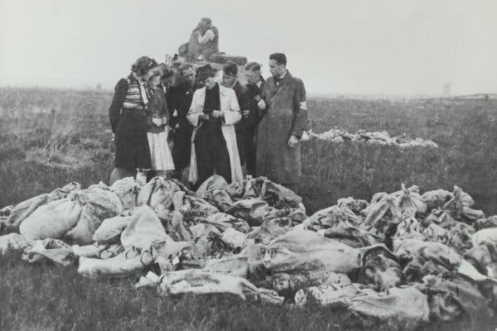
Dutch Famine in World War II
Another sad example of the impact of trauma on subsequent generations is the Dutch Famine in World War II. In September 1944, trains in the Netherlands ground to a halt. Dutch railway workers were hoping that a strike could stop the transport of Nazi troops and help the advancing Allied forces.
Sadly, the Allied campaign failed, and the Nazis punished the Netherlands by blocking food supplies, plunging much of the country into famine. By the time the Netherlands was liberated in May 1945, more than 20,000 people died of starvation.
Pregnant women, it turns out, were uniquely vulnerable, and the children they gave birth to were influenced by famine throughout their lives.
When these children became adults, they ended up heavier than average. In middle age, they had higher levels of triglycerides and LDL cholesterol and they experienced higher rates of obesity, diabetes, and schizophrenia.
Food rations that were dropped into the Netherlands in 1945.Credit...Dutch National Archive

Slide 10

For the science nerds among us:
There are three primary mechanisms through which epigenetic changes in gene expression occur. But first a biology refresher:
DNA from humans is made up of approximately 3 billion nucleotide bases.
There are four fundamental types of these bases that comprise DNA: Adenine, Cytosine, Guanine, and Thymine, commonly abbreviated as A, C, G, and T, respectively.
The sequence, or the order, of the bases is what determines our life instructions.
There are about 20,000 genes in total. Genes are specific sequences of bases (parts of DNA) that provide unique and tailored instructions on how to make important proteins
Proteins are large and very complex molecules that play many critical roles in the body and do most of the work in cells. Proteins are required for the structure, function, and regulation of the body’s tissues and organs and are made up of hundreds and thousands of smaller units called amino acids.
The sequence of amino acids is what determines each protein’s unique 3-dimensional structure and its specific function. Proteins can be described according to their very large range of functions in the body to include: antibody, enzyme, messenger, and structural component.

Slide 11

Epigenetic Changes –
The Big Three
With that brief biology refresher out of the way, we can explore the three most well-known and best understood of several mechanisms through which epigenetic changes in gene expression occur.
As noted earlier, although a person's complement of genes or sequence of genes remains essentially the same from birth onward, except for the occurrence of mutations that can change the function of genes.
Different environmental exposures during development, diet, stress, emotional problems, etc., throughout a person's life chemically modify DNA and the proteins bound to it. In addition, individual's histones, or the proteins around which DNA winds when it is compacted into chromosomes, carry different chemical tags which are also influenced by environmental events.
These tags are thought to alter the extent to which DNA is wrapped around the histones, thereby affecting the availability of genes for activation. (Suitable my Nature, 2014; Fraga et al., 2005).

Slide 12
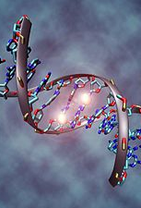
Epigenetic Changes – e The Big Three
DNA methylation:
The first type of epigenetic modification occurs on the DNA strand itself.
This reaction, called DNA methylation, is a biological process by which methyl groups are added to the DNA molecule and thereby changes the activity of a DNA segment without changing the sequence.
When located in a gene promoter, DNA methylation typically acts to repress or block gene transcription, effectively turning that gene off (University of Leicester, 2020),

Slide 13
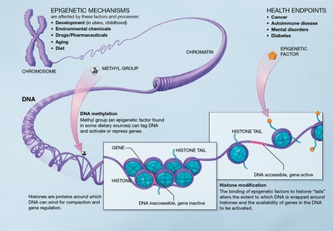
Epigenetic Changes – The Big Three
Histone modifications:
The second two types of modifications involve histones. Histones are the proteins that hold chromosome together. In histone modification, genes are actually wrapped up tightly so the genes cannot be accessed (essentially turned off) or unwrapped so they can be accessed or activated (essentially turned on). There are multiple types of histone modifications which are catalyzed by a number of enzyme families; the most well characterized modifications include acetylation and methylation:
Histone Acetylation is performed by histone acetyltransferases (HATs) which add an acetyl group to lysine amino acids (which are positively charged) in the histone tail which acts to mask the positive charge. This causes loosening of chromatin to promote gene activation (Strahl and Allis, 2000).
Histone Methylation can occur on lysine or arginine amine acids and can occur in mono-, di- or tri-methylation events by histone methyltransferases. This mark does not substantially alter the charge of amino acids and can be associated with both gene activation and inactivation (Laura,2008).

Slide 14

Epigenetics Takeaway
Knowing about epigenetics is both scary and amazing at the same time.
Terrifying in that we know that if we live poorly, paying little attention to how we live, i.e., the impact of poor diet, lack of exercise, living in stress, exposing ourselves to environmental toxins, overreliance on medications, etc., our genome will be altered, resulting in poor physical and/or emotional health and that this effect can be passed on to our progeny for generations to come.
On the other hand, good choices bless us and our future generations. Bearing this in mind, we can appreciate more fully how discussions in the pages ahead about attachment, adverse childhood experiences, Polyvagal Theory, and disconnected living impact us in mind, body, soul, and genome.

Slide 15
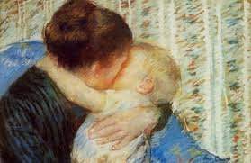
Early Attachment
Attachment is a really big deal and has lifelong implications for all of us. Safe and secure attachment are absolutely necessary for developing healthy and secure development, emotional health, and the ability to regulate our emotions.
Two early pioneers in this field, Dr. John Bowlby (1969) and Dr. Mary Ainsworth (1973) carved the way to our understanding of attachment and child development theory.
They defined attachment as a deep and enduring emotional bond that leads to connections between us across time and space.
This attachment is not always mutual and can travel in only one direction. For example, a child can attach to a parent, but the parent does not always attach to the child or vice versa (Kain & Terrell, 2018).

Slide 16

Attachment – Dr. John Bowlby
In an interview with Dr. Milton Stenn in 1977, Dr. John Bowlby shared that his career started off in the medical direction. He noted that he was following in his surgeon father's footsteps. His father was a well-known surgeon in London and John explained that his father encouraged him to study medicine at Cambridge.
Bowlby ended up following his father's suggestion but was not terribly interested in anatomy and natural sciences. However, during his time at Trinity College, he became particularly interested in developmental psychology which led him to give up medicine by his third year. When John left medicine, he accepted a teaching opportunity at a school called Priory Gates for six months where he worked with maladjusted children.
Bowlby stated that the experience at Priory Gates was extremely important to his career in research as he learned that the problems of today should be understood and dealt with at a developmental level (Kanter, 2007).

Slide 17
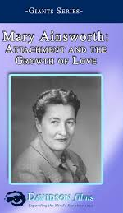
Attachment – Dr. Mary Ainsworth
Bowlby was not the only act in town as he collaborated extensively with Dr. Mary Ainsworth.
Mary was born in Glendale Ohio. When she was 15, she read William McDougall's book, Character and the Conduct of Life, which inspired her to pursue psychology.
While she was teaching at John Hopkins, Mary began working on creating a means to measure attachments between mothers and their children.
It was this that led her to develop her famous "Strange Situation" assessment, in which a researcher observes a child's reactions after a mother briefly leaves her child alone in an unfamiliar room.
The child’s reaction after the separation and upon the mother's return, revealed important information about attachment. Based on her observations and research,
Mary determined that there were three main styles of attachment: secure, anxious-avoidant, and anxious-resistant. Since these initial findings, her work has spawned numerous studies into the nature of attachment and the different attachment styles that exist between children and their caregivers (VeryWellMind, 2019)

Slide 18
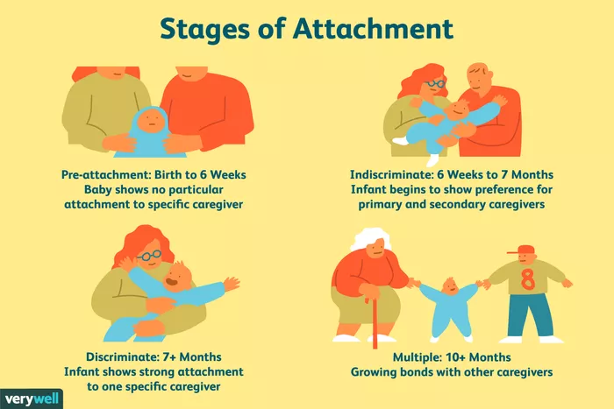
Four Phases of Attachment
Rudolph Schaffer and Peggy Emerson (1964) analyzed the number of attachment relationships that infants form in a longitudinal study with 60 infants.
In their study, infants were observed every four weeks during the first year of life, and then once again at 18 months.
Schaffer and Emerson determined that four distinct phases of attachment emerged: ﻿
Illustration by JR Bee (VeryWellMind, 2019

Slide 19

Four Phases of Attachment
Rudolph Schaffer and Peggy Emerson (1964)
Pre-attachment stage: From birth to three months, infants do not show any particular attachment to a specific caregiver. The infant's signals, such as crying and fussing, naturally attract the attention of the caregiver and the baby's positive responses encourage the caregiver to remain close” (Schaffer & Emerson, 1964).
Indiscriminate attachment: From around six weeks of age to seven months, infants begin to show preferences for primary and secondary caregivers. During this phase, infants begin to develop a feeling of trust that the caregiver will respond to their needs. While they will still accept care from other people, they become better at distinguishing between familiar and unfamiliar people as they approach seven months of age. They also respond more positively to the primary caregiver” (Schaffer & Emerson, 1964).
Discriminate attachment: At this point, from about seven to eleven months of age, infants show a strong attachment and preference for one specific individual. They will protest when separated from the primary attachment figure (separation anxiety) and begin to display anxiety around strangers (stranger anxiety)” (Schaffer & Emerson, 1964).
Multiple attachments: After approximately nine months of age, children begin to form strong emotional bonds with other caregivers beyond the primary attachment figure. This often includes the father, older siblings, and grandparents” (Schaffer & Emerson, 1964).

Slide 20
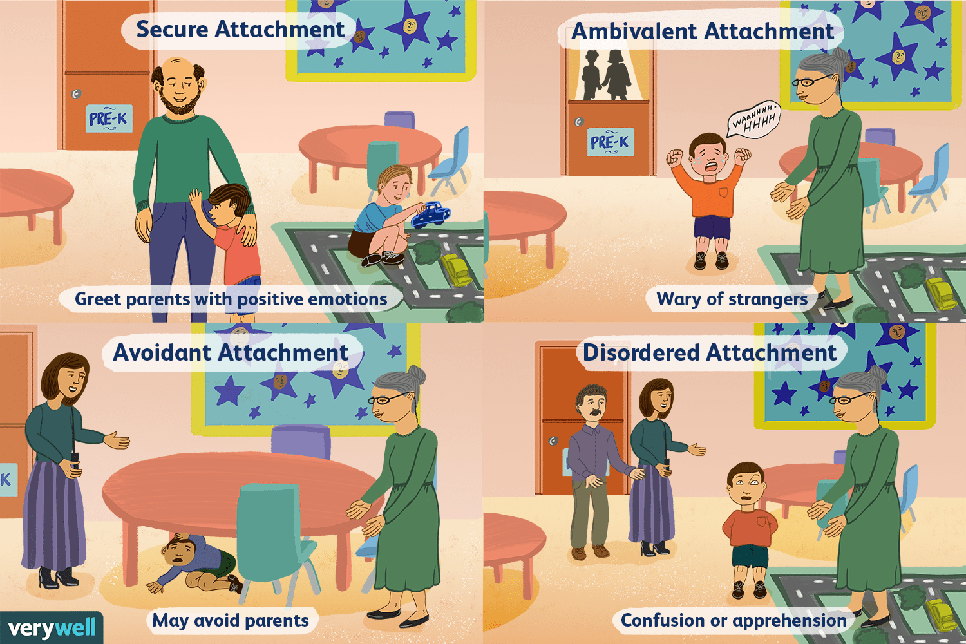
Attachment Styles
As nicely summarized by Lyons-Ruth (1996), the basic the attachment styles culminating from John Bowlby’s and Mary Ainsworth’s research and the fourth by Drs. Mary Main’s and Judith Solomon’s (Main & Solomon, 1986) work include:
Secure
Avoidant
Ambivalent
Disordered

Slide 21

Attachment Styles
Explained
Secure attachment: Secure attachment is marked by distress when separated from caregivers and joy when the caregiver returns. Remember, these children feel secure and are able to depend on their adult caregivers. When the adult leaves, the child may be upset but he or she feels assured that the parent or caregiver will return. When frightened, securely attached children will seek comfort from caregivers. These children know their parent or caregiver will provide comfort and reassurance, so they are comfortable seeking them out in times of need” (Lyons-Ruth, 1996).
Ambivalent attachment: Ambivalently attached children usually don't appear too distressed by the separation, and, upon reunion, actively avoid seeking contact with their parent, sometimes turning their attention to play objects on the laboratory floor. This attachment style is considered relatively uncommon, affecting an estimated 7 percent to 15 percent of U.S. children. Ambivalent attachment maybe a result of poor parental availability. These children cannot depend on their mother (or caregiver) to be there when the child is in need” (Lyons-Ruth, 1996).
Avoidant attachment: Children with an avoidant attachment tend to avoid parents or caregivers. When offered a choice, these children will show no preference between a caregiver and a complete stranger. Research has suggested that this attachment style might be a result of abusive or neglectful caregivers. Children who are punished for relying on a caregiver will learn to avoid seeking help in the future” (Lyons-Ruth, 1996).
Disorganized attachment: Children with a disorganized attachment often display a confusing mix of behavior and may seem disoriented, dazed, or confused. Children may both avoid or resist the parent. Some researchers believe that the lack of a clear attachment pattern is likely linked to inconsistent behavior from caregivers. In such cases, parents may serve as both a source of comfort and a source of fear, leading to disorganized behavior” (Lyons-Ruth, 1996).

Slide 22
Attachment Style Percentages
Mary Ainsworth and her colleagues reported in 1978 that studies on the three initial attachment classifications revealed:
  70 percent of American infants have been classified as secure
  20 percent as avoidant-insecure
  10 percent as resistant-insecure (Ainsworth et al., 1978).
Kain and Terrell (2018) warn that there are worrying declines in secure attachment and that in more recent research populations, the percentages of secure attachment have declined by 10 percent (Andreassen et al., 2007).

Slide 23

Attachment
Takeaways
Studies reveal that Interactions during the first three years of life can affect cognitive development and will impact physical, emotional, and mental health of children as they age and develop (Colmer et al., 2011).
Typically, a parent’s emotional response will serve as a template for helping their child learn about emotion. As parents model appropriate emotion regulation through conversations or actions, children learn to control/regulate their emotions.
On the other hand, insecurely attached children may learn to mask their emotional distress or exaggerate them in order to gain the parent’s attention; therefore, making up for a parent who is not consistently responsive (Laible, 2010).
This type of maladaptive behavior has devastating and potentially consequences resulting in poor social skills, emotional dysregulation, depression, anxiety, peer exclusion, social rejection, and/or low self-esteem (Lewis et al, 2015; Newman, 2017).
So, it behooves any of us who are young parents to ensure that we are spending lots and lots of time with our infants and children in healthy, safe, and connected ways, particularly early in life to develop secure attachment so they will be able to have joy, fulfilling relationships, and emotional stability.

Slide 24
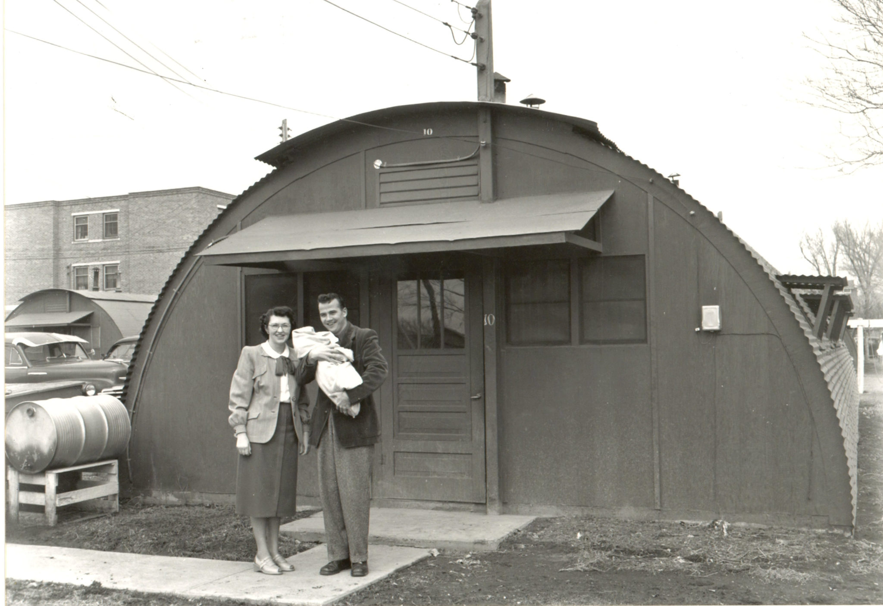
Personal Note from Jeff:
Overall, I believe that my attachment was relatively secure, so good job, mom. However, there were a few things worth mentioning. At that time, my father was in veterinary school at Colorado State University in Fort Collins, Colorado. My father, a very driven and competitive man who worked harder than most any of his peers to become the number-one ranked graduate in his class. As such, he was often extremely stressed, at times angry, and at times dismissive of my mother. This led mom to have to “go it alone” as the parent of my two-year-older brother, Ken, and my twin brother, Gregg (yes, double trouble). We were, like most graduate level college families, dirt poor and we lived in what is called a Quonset Hut which was basically a tin can cut in half (the roofs of some of them were known to sometimes get torn off in the intense storms that Colorado offers).
In this physical and emotional climate, my mother was, understandably, extremely stressed. Our ability to fully, securely, and individually connect and attach was appreciably challenged to no fault of my mother, as she did the very best that she could. On the other hand, my older brother enjoyed the first two years of his life living in the secure and safe context of grandparents and our favorite uncle, as he and my parents were living and working on the family ranch prior to my father’s entrance into graduate school. As such, his attachment was better, and this offered him some advantage that served him well when he later endured the physical and emotional abuse that followed.

Slide 25
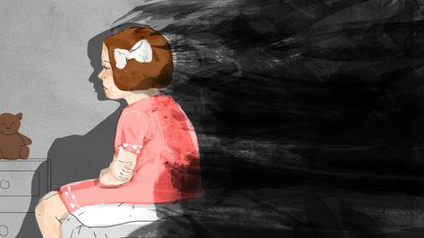
Trauma and Adverse Childhood Experiences
Trauma exposure, particularly child maltreatment (e.g., neglect, emotional, physical and sexual abuse), has been established as one of the main determinants of emotional dysregulation and is also a known risk factor for psychiatric disorders, especially depression and PTSD (McLaughlin et al.,2012; McLaughlin et al., 2013).
Moreover, several prior studies have shown that trauma exposure is clearly associated with profound deficits in emotional regulation across the entire lifespan, including during preschool (Langevin, Hebert, Allard-Dansereau; Bernard-Bonnin, 2016), adolescence (Shields & Cicchetti, 1997; Vettese, Dyer, Li, & Wekerle, 2011) and even adulthood (Briere & Rickards, 2007; Thompson, Hannan, & Miron, 2014; Dunn et al., 2018).
Trauma occurs when we are faced with an experience that overwhelms our ability to process incoming information both at the time of that experience and in future situations (Barta, 2018).
Dr. Michael Barta suffered from trauma himself as a child which led him to addictions that ultimately landed him in jail and almost destroyed his life. In is book, TINSA, he wrote that trauma occurs when our natural defenses are unable to keep us safe from physical, emotional, or mental threats or harm (Barta, 2018).

Slide 26
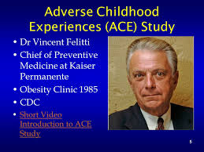
Trauma - Adverse Childhood Experiences
In the mid-1980’s, Dr. Vincent Felitti noticed a puzzling and paradoxical trend in the obesity clinic he was heading.
Specifically, many of his participants who were having the most success in losing weight were dropping out only to gain the weight back. He interviewed the nearly 300 participants and discovered a surprising pattern: almost all of the dropouts had suffered some form of childhood trauma (Kain & Terrell, 2018).
This initial study grew into a major public health study with Dr. Felitti teaming up with Dr. Anda at the Centers for Disease Control (CDC) that continues to this day, involving more than 17,000 individuals.
This research came to be known as the Adverse Childhood Experiences (ACE) Study (Felitti et al., 2014). In this study, people were asked about ten different types of traumatic events that happened to them when they were children to include physical and sexual abuse, family problems, and neglect.

Slide 27

Trauma - Adverse Childhood Experiences
  The ten reference categories experienced during childhood or adolescence are as below, with their prevalence in parentheses (Felitti and Anda, 2009):
  Abuse
    Emotional – recurrent threats, humiliation (11%)
    Physical - beating, not spanking (28%)
    Contact sexual abuse (28% women, 16% men, 22% overall) •
  Household dysfunction
    Mother treated violently (13%)
    Household member was alcoholic or drug user (27%)
    Household member was imprisoned (6%)
    Household member was chronically depressed, suicidal, mentally ill, or in psychiatric hospital (17%)
    Not raised by both biological parents (23%)
  Neglect
    Physical (10%)
    Emotional (15%)

Slide 28

Trauma - Adverse Childhood Experiences
Somewhat surprising in the Felitti studies was that emotional abuse was more likely to cause depression than any other kind of trauma – even sexual abuse.
This suggests that the kind of treatment children receive from parents is a tremendously powerful predictor of positive outcome and when that trust is broken, devastation surely ensues.

Slide 29

Dr. Michael Barta’s Adverse Childhood Experiences
Barta (2018) in his book, TINSA, defines ACEs a little differently as summarized below:
  Sexual assault or abuse
  Physical assault or abuse
  Psychological or emotional trauma
  Serious accidents, medical procedures, or illnesses
  Manmade or natural disasters
  Witnessing violence to include domestic abuse
  School violence to include bullying
  Traumatic grief or unwanted separation
  Terrorism or war
  Betrayal by others to include relational trauma

Slide 30

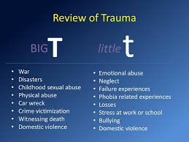
Big T Trauma and Little t Trauma
The experts in the field divide trauma into two categories:
  Big T trauma: Traumas that are associated with horrific single events such as natural disasters, terrorism, and war.
  Little t trauma: Trauma that are smaller in nature such as bullying, neglect, and betrayal.

Slide 31
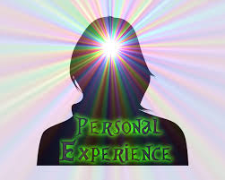
Big T Trauma and
Little t Trauma
In my personal experience as a pediatric psychologist, far more of my patients have been subjected to “little t” traumas and I agree with Barta that these experiences have a tremendous impact on how children view themselves, their relationships, and their place in the world.
Moreover, the long-term consequences of these traumas are tremendous and often lead to a total inability or impaired ability to access appropriate responses to threatening events and can lead to chronic hyperarousal, intense anxiety, panic, mood instability, poor emotional/behavioral regulation, feelings of powerlessness, helplessness, shame, and even immobility.
Of all traumas, relational (or loss of connection) trauma is particularly devastating.
The implications here are enormous. Specifically, in order to promote safe and healthy emotional regulation, we must be able to pinpoint where in the lifespan people hurt us physically, emotionally, mentally, or spiritually, whether intentionally or accidentally.
If we can resolve our developmental wounds, we can move on and experience a more fulfilling life.

Slide 32
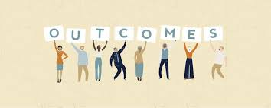



ACE Scores and Outcomes
As Dr. Felitti in a 2009 lecture points out, studies reveal many shocking long-term horrible outcomes when we are exposed to ACEs and this raises exponentially according to how many of them we have been exposed to.
The results indicate that for every category of traumatic experience we have had as a child, we are dramatically more likely to be depressed as an adult.
If we have ACE scores of , we are:
  260% more likely to have chronic obstructive pulmonary disease than someone with a score of 0
  240% more likely to contract hepatitis, 460% more likely to experience depression
  1,220% more likely to attempt suicide
If we have ACE scores of , we are:
  Five times more likely to become depressed as an adult and if we have had
If we have ACE scores of we are:
  3,100 percent more likely to attempt suicide as an adult (Felitti et al., 2014; Felitti 2004; Felitti and Anda, 2009; Felitti et al., 1998).
Dr. Felitti offered the following graphs which nicely detail the dramatic impact that ACEs have on our society:

Slide 33
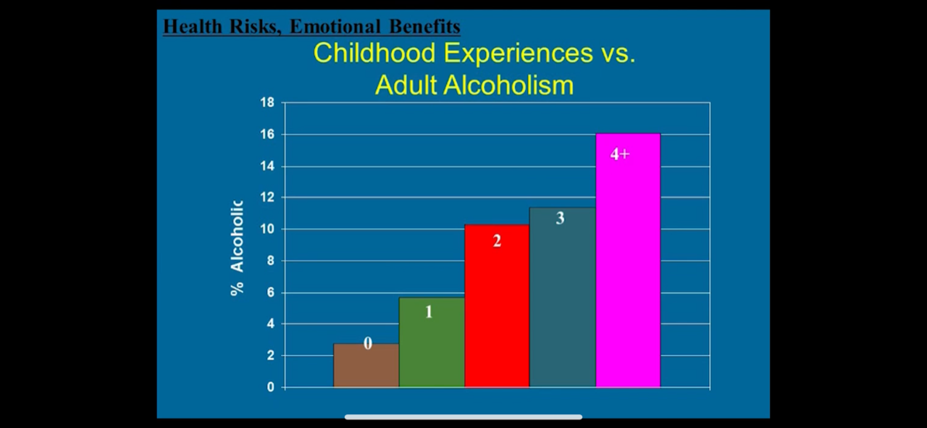
Dr Vincent Felitti (2009) https://www.youtube.com/watch?v=KEFfThbAYnQ (Accessed February 17, 2020)

Slide 34
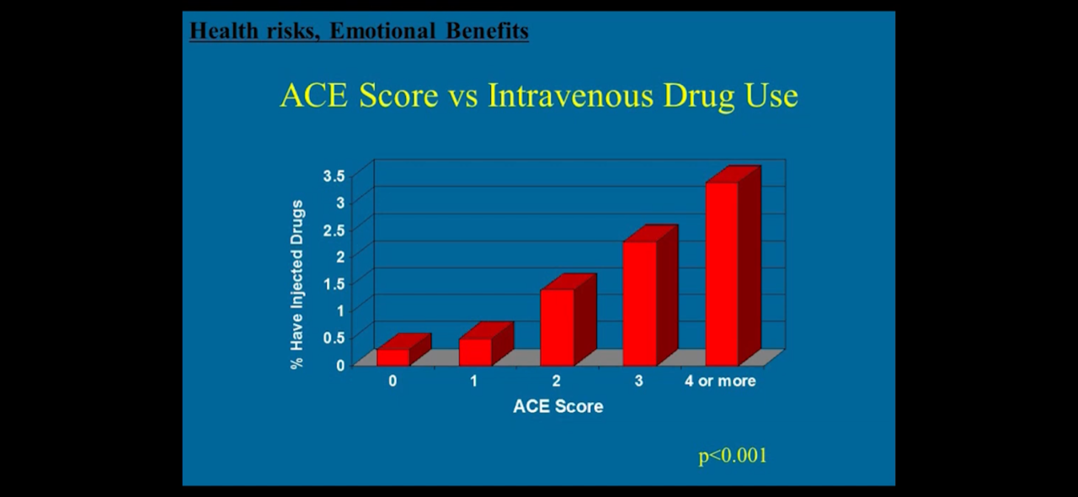
Dr Vincent Felitti (2009) https://www.youtube.com/watch?v=KEFfThbAYnQ (Accessed February 17, 2020)

Slide 35
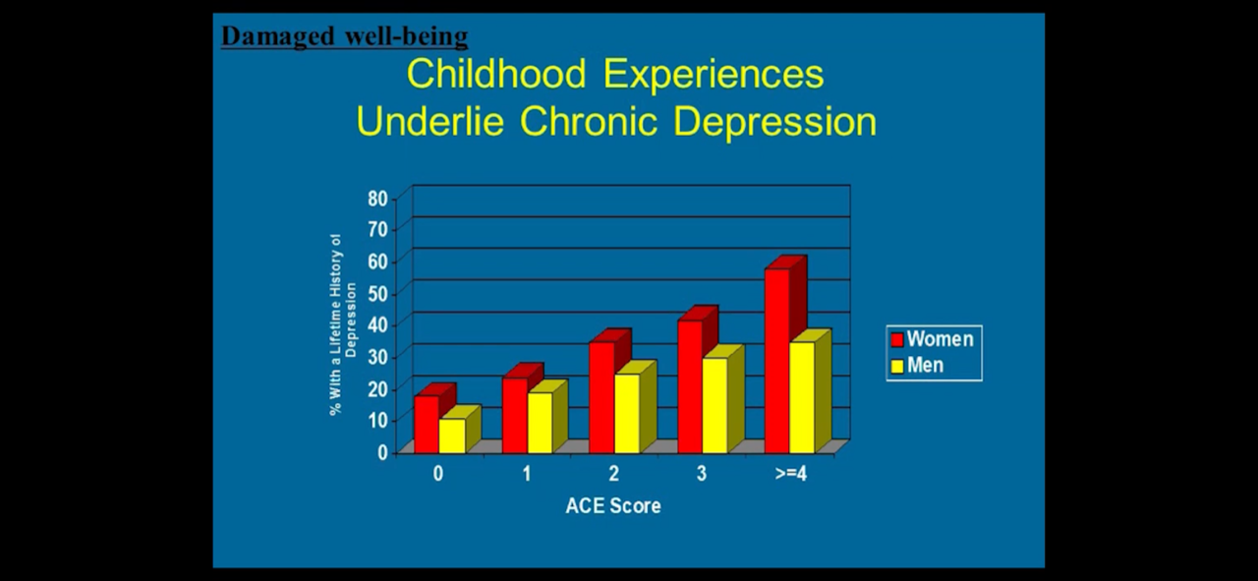
Dr Vincent Felitti (2009) https://www.youtube.com/watch?v=KEFfThbAYnQ (Accessed February 17, 2020)

Slide 36
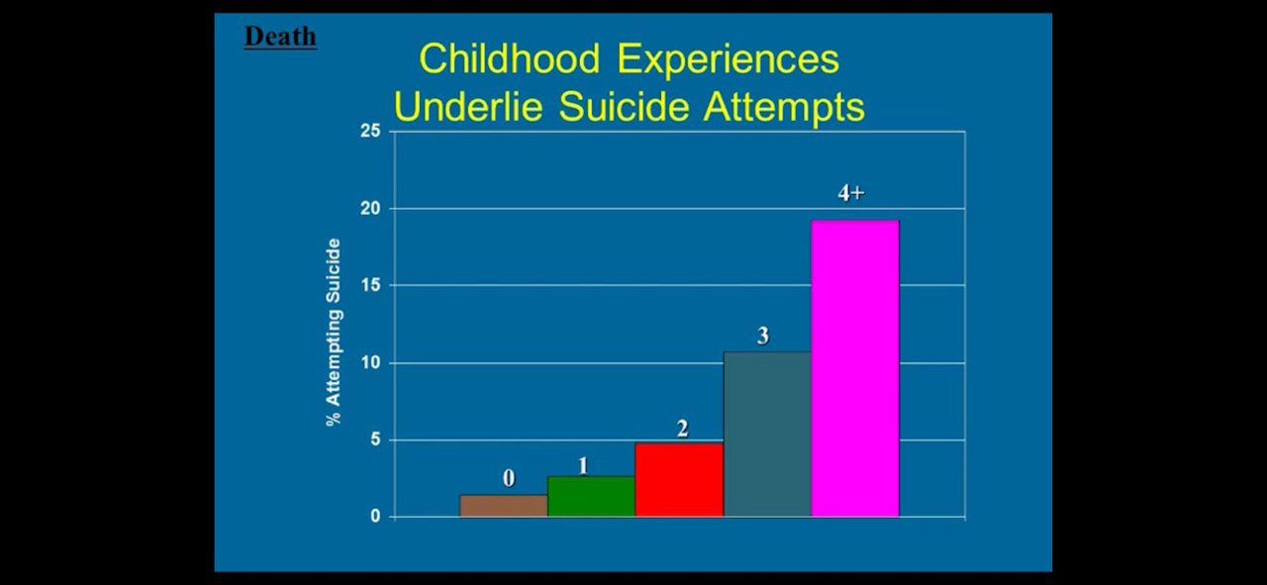
Dr Vincent Felitti (2009) https://www.youtube.com/watch?v=KEFfThbAYnQ (Accessed February 17, 2020)

Slide 37
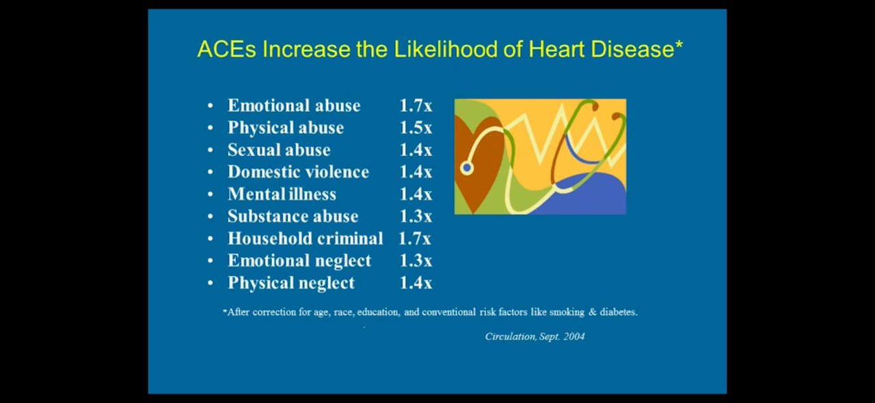
Dr Vincent Felitti (2009) https://www.youtube.com/watch?v=KEFfThbAYnQ (Accessed February 17, 2020)

Slide 38
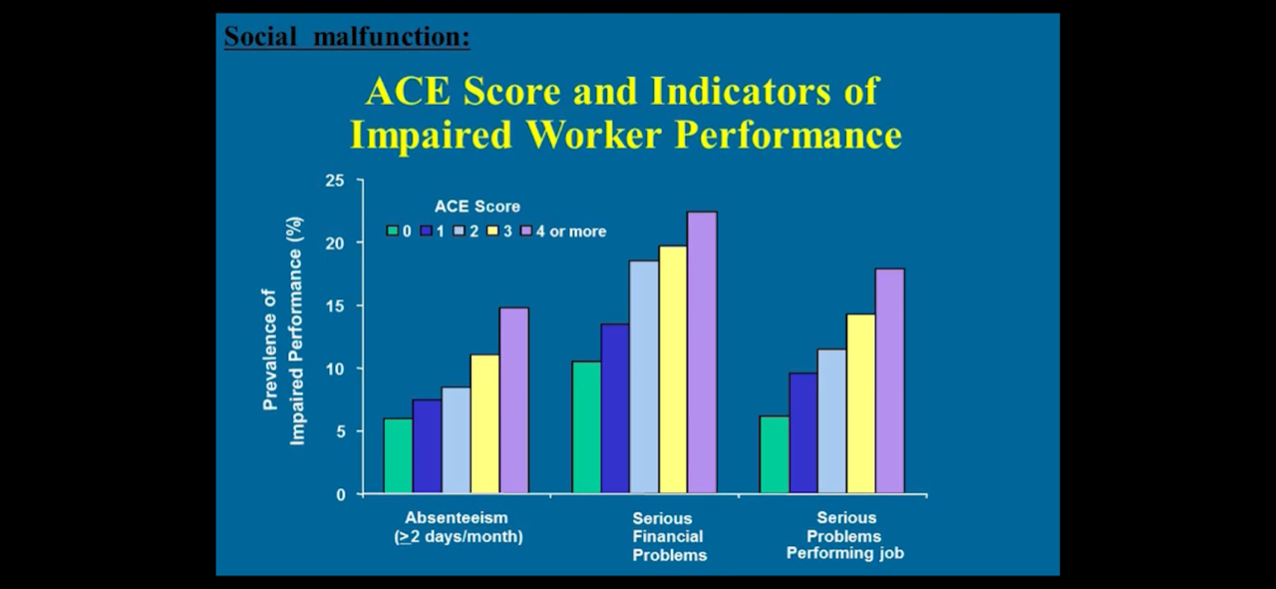
Dr Vincent Felitti (2009) https://www.youtube.com/watch?v=KEFfThbAYnQ (Accessed February 17, 2020)

Slide 39
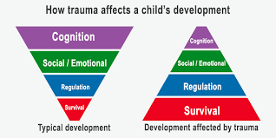
Trauma’s Impact on Social Engagement and Emotional Regulation
My own clinical experience suggests that the most common forms of trauma are due to a lack of attunement or connection with parental or adult figures while growing up.
As Barta (2015) writes, “These deficiencies are not about bad parenting but about a parent’s inability or diminished ability to respond to the child’s emotional needs. Most parents are doing the best they can with the tools they have, but whether deliberately or inadvertently, the traumas of our childhood can have tremendous impact on our lives (Barta, 2018, p. 17)
As trauma expert, Dr. Peter Levine notes in his book, Healing Trauma, “Trauma is much about loss of connection – to ourselves, to our bodies, to our families, to others, and to the world around us. This loss of connection is often hard to recognize because it doesn’t happen all at once. It can happen slowly over time, and we adapt to these subtle changes sometimes without even noticing them.
These are the hidden effects of trauma, the ones most of us keep to ourselves...Our choices become limited as we avoid certain, feelings, people, and situations. The result of a gradual constriction of freedom is the loss of vitality and potential for the fulfilment of our dreams” (Levine, 2008, p. 9).

Slide 40
Trauma’s Impact on Social Engagement and Emotional Regulation – con’t
Most important to normal development is “social engagement” which is the ability to know, understand, regulate, and express emotions in the present moment. Even though everyone is born with a social engagement system (i.e., a neurological system that promotes human connection), we know that early trauma can disrupt its normal development.
Anda et al (2018) note, “Early adverse experiences may disrupt the ability to form long-term attachments in adulthood. The unsuccessful search for attachment my lead to sexual relations with multiple partners with resultant promiscuity and other issues related to sexuality” (e.g., pornography addiction, emphasis mine).
As a result of adverse developmental trauma, the ensuing loss of connection with our inner self, our bodies, others, and the world around us, we are predisposed to engage in addictive behaviors to relieve the emotional dysregulation that torments us.

Slide 41

The ACEs Quiz
You might want to take a moment and take the ACE quiz yourself to see where you fall.
For each “yes” answer, add 1. The total number at the end is your cumulative number of ACEs.
Before your 18th birthday:
Did a parent or other adult in the household often or very often… Swear at you, insult you, put you down, or humiliate you? or Act in a way that made you afraid that you might be physically hurt?
Did a parent or other adult in the household often or very often… Push, grab, slap, or throw something at you? or Ever hit you so hard that you had marks or were injured?
Did an adult or person at least 5 years older than you ever… Touch or fondle you or have you touch their body in a sexual way? or Attempt or actually have oral, anal, or vaginal intercourse with you?
Did you often or very often feel that … No one in your family loved you or thought you were important or special? or Your family didn’t look out for each other, feel close to each other, or support each other?
Did you often or very often feel that … You didn’t have enough to eat, had to wear dirty clothes, and had no one to protect you? or Your parents were too drunk or high to take care of you or take you to the doctor if you needed it?
Were your parents ever separated or divorced?
Was your mother or stepmother:
Often or very often pushed, grabbed, slapped, or had something thrown at her? or Sometimes, often, or very often kicked, bitten, hit with a fist, or hit with something hard? or Ever repeatedly hit over at least a few minutes or threatened with a gun or knife?
Did you live with anyone who was a problem drinker or alcoholic, or who used street drugs?
Was a household member depressed or mentally ill, or did a household member attempt suicide
Did a household member go to prison?
Total ACE score: ______
Source: NPR, ACEsTooHigh.com. This ACEs Quiz is a variation on the questions asked in the original ACEs study conducted by CDC researchers. (cited in Shonkoff, 2015).

Slide 42

A Personal Note from Jeff:
My ACE score comes to a five and I also dealt with developmental trauma not fully captured by the ACE quiz to include my father’s repeated and failed marriages, his occasional invalidation of my feelings and emotions (sometimes punishing me for what he perceived as unnecessary sadness), his abuse against my older brother, and his intermittent expressions to others of anger and at times, rage (e.g., fist fights when in a jealous rage, threatening to kill a bouncer who threw him out of a bar when he was intoxicated, chasing a man with a hand gun of whom he felt jealous, reckless driving when intoxicated, and road rage resulting in serious car accident of another). My father was at heart level a good man but, sadly, was terribly abused by his own father who was previously even more savagely abused by his father. Although less abusive than the men before him, my carried the generational curse. He made admirable efforts to eventually tame his internal demons and that I greatly respect; but they could not be quelled completely. He was an accomplished veterinarian and was an extraordinarily successful entrepreneur, but the magnitude of his pain tarnished his private life and impacted greatly on our family.
Although I followed my father’s wonderful example of a hard work ethic and his dedication to the service of others, the price of his instability left its mark on me. I was able to quell the outward rage and abuse that plagued my father, but instead absorbed an internal terror that was problematic throughout my childhood even though on surface level I appeared to be highly functional and successful, earning top grades, enjoying great social relationships, and eventually earning advanced degrees. I was, nonetheless, internally very insecure, and anxious, and at times, periodically depressed in my childhood and early adult years. This came to a head, when midway through life, I was hit with a series of stressors that my weakened emotional constitution, due early trauma, could not handle. My wife had just recovered from cancer, my daughter was being evaluated for what was thought to be lymphoma, my Marine son was dodging IEDs in Iraq, a client of mine was making threats to destroy my career (normally I would have shrugged this off, as my clinical performance in this case was flawless), and the financial crisis of 2008 hit and, holding considerable real estate properties which plummeted in worth, we were brought to the brink of bankruptcy.
After weeks with little to no sleep, I came to a point of complete emotional collapse with intrusive and unwanted ideation that there was no hope, no way out, and suicide became alarmingly attractive. Never one to take the “check out option,” I asked my three business partners and colleagues to have me psychiatrically admitted where I stayed for three days. This is where my journey to healing began. More on this later.

Slide 43

A Few Trauma Takeaways to Think About
Most of us will have a least one ACEs in our developmental years, and, if not extreme, this will not necessarily harm us. However, if any one ACE is extreme or if there are too many, we can be marked for problems in life.
It is essential that we do not sweep our traumas under the rug but, rather, deal with them before they deal with us. I admit that I minimized my ACEs and naively prided myself in my ability to manage them. In hindsight, I would now have chosen to seek good therapy earlier in my life by a trauma-informed therapist. This would have improved my capacity to deal with the stressors that eventually unhinged me.
I respectfully and lovingly urge any of us who are raising children to be ever so mindful of the impact of excessive adversity on our children. We parents should not assume that, even though our children appear to be doing well, that they are necessarily internally well if they have been exposed to excessive ACEs.
We do our children right by getting the help to heal the dysfunction in our lives, in our marriages, and/or in our family dynamics and, in so doing, freeing our children from having to pay the price in their own lives and in their progeny for possibly generations to come.

Slide 44

The Marriage of Triune Brain Theory and Polyvagal Theory
The greatest thing then, in all education, is to make our nervous system our ally as opposed to our enemy
- William James

Slide 45

The Marriage of Triune Brain Theory and Polyvagal Theory
In the last 10 years new and exciting neuroscience has emerged that helps us map out our physical, emotional, and cognitive responses to the world around us and provides us a way through the ensuing tempest within ourselves.
Dr. Barta (2018) proposes a model that demonstrates how the brain and the nervous system work together to fuel emotional dysregulation. In his model which he calls TINSA (Trauma Induced Sexual Addiction), he pairs some of the greatest minds in neurology and psychology to include:
  Dr. Stephen Porges’ Polyvagal Theory
  Dr. Paul Maclean’s Triune Brain Theory.

Slide 46
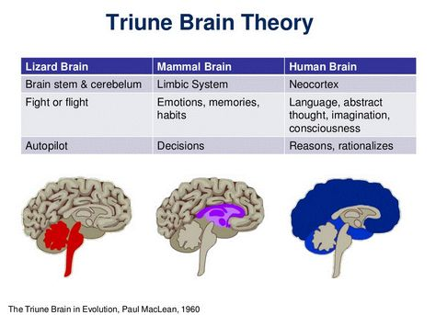
Triune Brain Theory
MacLean (2009) proposed that there are three distinct formations in our brain which are used in different situations for everyday survival purposes.
These specific structures developed sequentially on top of each other at different times during the evolution of the brain for the purposes of giving the organism the ability to survive during that period of time.
Even though the brain became more advanced and adaptive, the older more primitive structures of the brain still play an especially important role in thought, process, and behavior.
(For my Christian friends who might worry about this model contradicting sensitivities about creationism – not to worry. As explained by Dr. Andy Doan, M.D. Ph.D., ophthalmology surgeon and neuroscience researcher, and paraphrased by me, “God is very efficient, and He included in our more developed brain substructures that He already designed for lower life forms/animals. No need to re-do what was already perfect and efficient”).

Slide 47
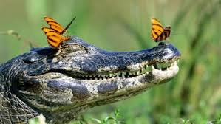
Triune Brain Theory
The Reptilian Brain (or Reptilian Complex):
As the name suggests, this is the most primitive brain and it developed about 500 million years ago in fish and later reptiles.
Its roles include sensation, instinctual reaction, breathing, temperature regulation. TINSA hypothesizes that the reptilian complex promotes certain survival functions as well, most specifically, immobilization or freeze.
We often see lizards, for example, freeze in the face of danger such as a lunch-starved predator in an instinctive reaction that can be life-saving (sadly for the lizard, it doesn’t always work, and he sometimes ends up being a snack anyway).

Slide 48
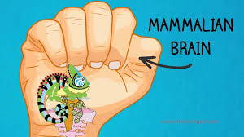
Triune Brain Theory
The Mammalian Brain (or Limbic System):
Later, about 150 million years ago, the limbic system first appeared in small animals.
This system developed as critters were able to move more freely about as they were now equipped with extremities.
As such, it often became necessary to either fight off or flee from would-be predators. In addition, the capacity to have memory and emotions developed.
This enabled the animal to control the body’s response to danger and to remember that danger as well as the ability to be vigilant and scan the surrounding environment for potential dangers. Like critters, we often revert to this neurological system when we act instinctively.

Slide 49
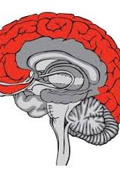
Triune Brain Theory
The Frontal Lobe (or Neocortex):
According to Maclean (1990), the frontal lobes came on board only about 2 or 3 million years ago.
As in the reptilian brain and the limbic system, the purpose of this brain formation is to react to and protect us from danger.
Unlike our more primitive neighbors, this system reacts consciously. Very importantly, there was a need to develop a system that made possible more “civilized” responses to threats and at the same time one that offered the possibility to connect to others for safety.
Therefore, the frontal lobe allows us to access a new way of surviving based on socialization. This makes it possible for us to use analysis, logic and decision-making, and this is what specifically separates us from other lower-ordered animals that rely on instincts alone for survival

Slide 50
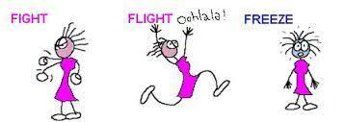
Triune Brain Theory – To Bring it Home
To bring it home, on topside we have the cortical brain consisting of the frontal lobe which is the most recently developed portion of the brain, i.e., the conscious, thinking brain.
At the bottom, we have our subcortical, unconscious brain, which is made up of the reptilian and limbic complexes and is directed largely by raw instinct and emotions which often results in immediate knee-jerk reactions that happen in a split second.
Barta (2018) informs us that, in the best of worlds, we try to lead with our frontal lobe and remain socially engaged if something threatening confronts us and in order think our way out of it, smile, and/or stay calm.
But in times of intense stress or in situations that remind us of past trauma, this survival mechanism is quickly overrun by earlier, more primitive survival strategies of our mammalian/limbic brain and our reptilian brain structures.
As such, when our neocortex fails us, the limbic system takes command and we are then rapidly sent into our fight-or-flight response and if this does not work and we cannot run away or fight our way out of it, the most primitive line of defense is deployed and we simply freeze, become immobilized, or completely collapse. This hijacking process can occur whether the threat is real or merely perceived (Barta, 2018).

Slide 51
Polyvagal Theory

Slide 52
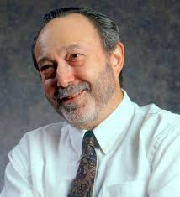
Polyvagal Theory
The Autonomic Nervous System
Dr. Steve Porges
The autonomic nervous system is our personal surveillance system.
In an effort to keep us out of danger, it is always on guard; asking the question, “Is this safe?” Its dedicated goal is to protect us by sensing safety and risk.
It achieves this by listening moment by moment to what is happening in and around our bodies and in the connections we have to others (Dana, 2018).
This listening happens far below awareness and far away from our conscious control.
Dr. Porges, understanding that this is not awareness that comes with perception which is conscious, coined the term neuroception to describe the way our autonomic nervous system scans for cues of safety, danger, and life threat, without involving the thinking parts of our brain or the unconscious parts of the brain (Porges, 2017).

Slide 53
Polyvagal Theory
The Autonomic Nervous System
Briefly stated, our response to threat will move us toward one of three defensive responses. Two of which keep us in perpetual defense and one of which moves us toward health and restoration.
Sympathetic Division: Prepares the body for stressful or emergency situations – fight or flight. The sympathetic nervous system originates in spinal nerves (nerves that arise from the spinal cord) and is our system of mobilization. The sympathetic nerves are found in the middle of our backs in the thoracic and lumbar regions of the spinal cord. There are two mobilization systems in our sympathetic nervous system.
  Sympathetic Adrenal Medullary (SAM): The SAM system is activated very quickly, within 100 milliseconds and brings up a burst adrenaline for a fast response to a stressor. SAM activation triggers a short-term and rapid response to a stressor which is followed by a return to regulation (Dana, 2018).
  Hypothalamic-Pituitary-Adrenal (HPA) Axis: The HPA axis takes over when the quick, adrenaline surge of energy of the SAM does not resolve the distress. The HPA releases cortisol (AKA stress hormone). This release takes longer and is much slower in taking effect, requiring minutes to take effect rather than seconds (Dana, 2018).

Slide 54

Polyvagal Theory
Sympathetic Division
The sympathetic division increases heart rate and the force of heart contractions and widens (dilates) the airways to make breathing easier.
It causes the body to release stored energy.
Muscular strength is increased. This division also causes palms to sweat, pupils to dilate, and hair to stand on end.
It slows body processes that are less important in emergencies, such as digestion and urination (Merck Manual).
When we are in this physical state, we can feel emotions such as fear and/or rage and, if extremely activated, absolute terror (Rothschild, 2017).

Slide 55
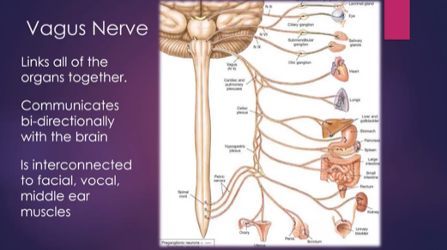
Polyvagal Theory
Parasympathetic Division
The parasympathetic division conserves and restores calm/homeostasis. It slows the heart rate and decreases blood pressure. It stimulates the digestive tract to process food and eliminate wastes. Energy from food is processed and used to restore and build tissues (Merck Manual).
Dr. Porges discovered that the parasympathetic division of the Autonomic Nervous System consists of two branches which lead to two different responses.
The main nerve in the parasympathetic nervous system is the 10th cranial nerve, aka vagus nerve, which is the largest of the 12 cranial nerves and has huge implications for our well-being and health.
The name vagus comes from the Latin word vagary which means wanderer, and this nerve is definitely a vagabond.
The vagus travels downward from the brainstem to the heart and stomach and then back upward to the face and its connection with other cranial nerves.
This amazing wandering nerve is a mixed nerve which communicates bidirectionally between the body and the brain. 80% percent of its fibers are sensory (afferent) sending information from the body to the brain, and 20% are motor (efferent), sending action information from the brain to the body (Dana, 2018).

Slide 56

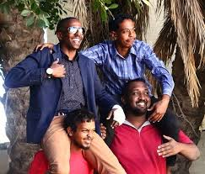
Polyvagal Theory - Parasympathetic Division
The vagus nerve has two very distinct branches: Dorsal vagal nerve and the ventral vagal nerve.
Dorsal Vagal Nerve: Barta (2018) notes that the most primitive form of defense occurs when the dorsal vagal nerve is activated.
  It is not sophisticated in that it is unmyelinated and slow. When activated, the dorsal vagal nerve promotes. shutdown, freeze, and collapse
  An example of this shutdown is when a gazelle, for example, is being stalked by a lion and when trapped with no possible way to flee, drops down and appears to be deader than a doornail.
  This is not a conscious process but is, rather, a very primitive and unconscious one. When we are in this physical state, we can feel emotions such as sadness, depression, grief, shame and/or disgust (Rothschild, 2017).
Ventral Vagal Nerve: Barta (2018) writes that the second response of our parasympathetic nervous system (the first being freeze and collapse as noted above) is responsible for our ability to engage socially and to handle social relationships.
  According to Barta, the social engagement system is controlled by our ventral vagus nerve which is a very smart myelinated nerve with a rapid response time. As such, it allows us to “know” if we are safe enough so we can calm our defenses through a process of “neuroception” which, as noted earlier, is translated as the brain’s ability to sense safety.
  This serves not only bonding needs but allows us to shift out of sympathetic arousal and move into parasympathetic calm or to downshift from activation to calm. When we are in this emotional state, we can feel emotions such as calm, pleasure, love, sexual arousal, and “good” grief (Rothschild, 2017).

Slide 57
Marriage of MacLean’s Triune Brain Theory with Porges’ Polyvagal Theory
Through the marriage of MacLean’s Triune Brain Theory with Porges’ Polyvagal Theory, we can explain how each part of the triune brain is correlated with the three responses of the autonomic nervous system (Barta, 2018).

Slide 58

Polyvagal Theory – The Stream
When we enter into an autonomic state, the information about that state travels up the automatic pathways up to the brain where a story is drafted to make sense of the embodied experience/sensations.
In other words, the physiological state produced by the autonomic nervous system creates a psychological story.
Dana (2020) describes this as a metaphor of a stream where we can imagine the flow of experience. At the river’s source is neuroception and at the river’s mouth is the story. In between lie perception, autonomic state, feelings, and behavior. We are accustomed to entering in the river downstream with feeling and behavior, or story being at the fore.
However, neuroception takes place at the furthest point upstream. We need to make our way back to the starting point, leaving behind the story, behavior, and feelings in order to identify the state and bring perception or awareness to neuroception (Dana, 2020).
This has implications for treatment which we will discussed “downstream” in this paper.

Slide 59

Polyvagal Theory – Autopilot or the Choice of Connection?
So, our neurosystem, left on autopilot will, when we are faced with stress and threat, move us to either:
    (a) Sympathetic fight or flight which equates to extreme anxiety, anger, rage, and or terror or to
    (b) Dorsal vagal shutdown which leads to slowing down, withdrawal, and possibly even depression. If these modes of coping become excessive, we are at risk for potentially using maladaptive strategies such as addictions to quell the pain of negative physical symptoms, associated negative emotions, and/or complete withdrawal and possibly self-destructive behavior.
The best response, of course, is to activate our social engagement system of the ventral vagal pathway of the parasympathetic branch. In this state, our heart rate is regulated, our breath is full, we take in the faces of friends, and we can tune in to conversations and tune out distracting noises.

Slide 60
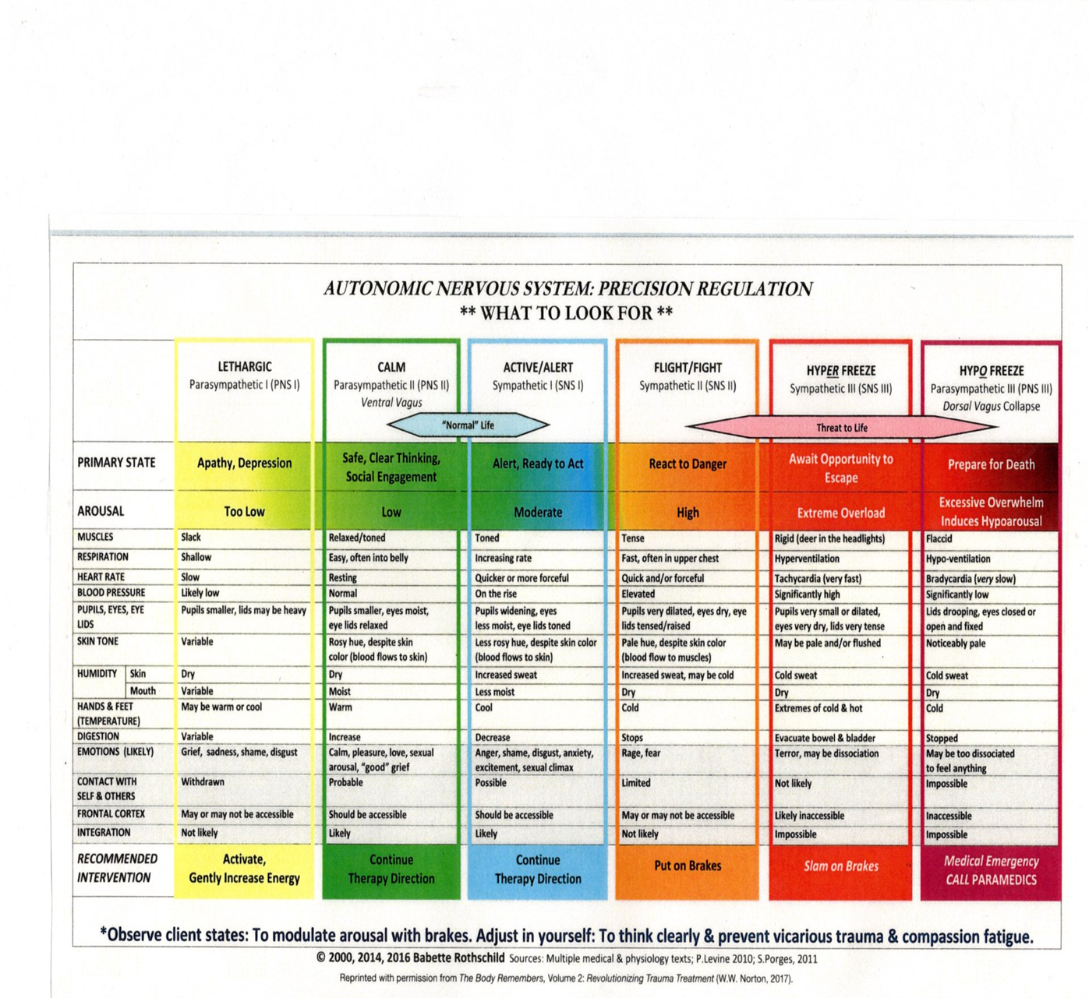
The chart below adapted by Dr. Rothschild nicely demonstrates the shifting in body sensations, physiological symptoms, and emotions as we move between autonomic states (Rothschild, 2017).
The Autonomic Nervous System Precision Regulation Chart is Available for purchase on Amazon for $8.99 (a very high recommend):
Babette Rothschild (2017) https://www.amazon.com/Autonomic-Nervous-System-Table-Laminated/dp/039371280X/ref=sr_1_15?dchild=1&keywords=deb+dana&qid=1590326813&s=books&sr=1-15

Slide 61

Personal note from Jeff:
Looking back at the events described earlier which landed me in the St Peter emergency room on that cold and snowy winter day, I came to see how Polyvagal Theory so accurately mapped out what my body was doing. Sadly, at that time, few professionals, including myself, knew much of anything about this groundbreaking research. Had I known, I believe that I would have greatly mitigated my suffering and would have acted much earlier to heed the warning that my body was trying to give me. Neruorceptively, my life situation was not safe, and my body knew it, but my mind was too busy and cluttered to hear. I had been autonomically overactivated into the orange range and eventually the red zone. My sympathetic adrenal medullary (SAM) and hypothalamic pituitary adrenal axis (HPA) were activated which initially kicked out adrenaline and eventually cortisol in an effort to keep me vigilant and alert in an order to fend off the previously noted threats of my wife’s cancer, my daughter’s suspected cancer diagnosis, my son’s deployment to Fallujah, Iraq, and the impact of the 2008 financial calamity that were weighing on me. In that state, sleep alluded me and it felt as though I was literally crawling out of my skin. My feet burned, I was often tachycardic (heart beating like a hummingbird), and my cognitive processing diminished (there were days that I felt dumber than a rock). Then, after literally weeks of being tortured in a sympathetically activated state, my dorsal vagal nerve took over and I literally hit the floor as my autonomic nervous system protectively shut me down due to the enervation of the dorsal vagal nerve. That, along with the accompanying false and self-destructive negative narrative that my mind had created to give meaning to the events (minds often get it wrong and mine certainly did), paved the way for crushing depression.

Slide 62


Polyvagal Theory and Treatment
Now that we have a new understanding of how our autonomic nervous system works, we can use this knowledge to restore to emotional, psychological, and physical health. Never before has a breakthrough in neuroscience offered such a paradigmatic shift of hope.
Neuroception Perception State Feelings Behavior Story

Slide 63
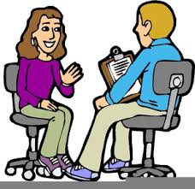
Polyvagal Theory and Treatment
So, the first step in healing is to move our neuroception - what our autonomic nervous system is automatically sensing regarding safety and danger without our awareness to perception to awareness or perception.
We can then appreciate what our physiological state is causing us to feel emotionally and subsequently change the behaviors that we then engage in.
The ensuing story or narrative we give to this process in an effort to make sense of what we are sensing and feeling, if positive and healthy, helps us correct our autonomic state.
On the other hand, if our narrative is false, as it often is (e.g., we often shame and blame ourselves or we catastrophize the situation), then our autonomic state becomes even more activated or shut down and our subsequent emotions become more anxious or depressed, respectively, and we enter into a negative feedback loop, a process that leads to emotional problems/illness and/or physical problems.

Slide 64
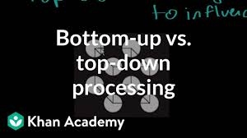
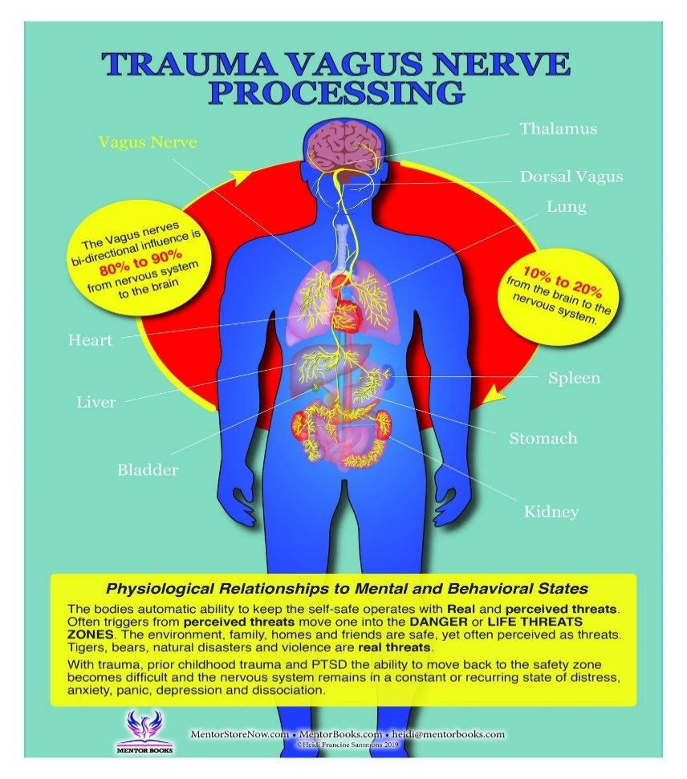
Polyvagal Theory and Treatment
There are two basic approaches to healing: Bottom up and Top Down:
  Bottom up entails working with the body more directly. It is important to appreciate that, as previously noted, 80 percent of the fibers in the vagus nerve are sensory in that they go from the organs to the brain and 20 present are motor in that they travel from the brain to various body organs. (Porges, 2017). This suggests that what our bodies tell us is indeed very important and we must make every effort to listen and heal on that level.
  Top down strategies which involve our thinking and hopefully more rational brain require a certain level of cognitive development and maturity so very young children may not be able to benefit from this approach (e.g., Cognitive Behavioral Therapy aka CBT).

Slide 65
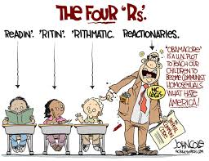
Polyvagal Theory and Treatment
As previously noted by Deb Dana, it is in a ventral vagal state and a neuroception of safety that brings the possibility for connection, curiosity, and change. She nicely presents a polyvagal approach which she calls the four R’s (the first three are bottom up and the last is bottom down (Dana, 2018):

Slide 66
Polyvagal Theory and Treatment
Recognize the Autonomic State
I recommend that we make the Autonomic Nervous System Precision Regulation Chart our companion as we use it to recognize where we, our children, and/or others are on that continuum. In so doing, we become able to make what is implicit (under the table and outside of our awareness) explicit (on the table and in our awareness).
We can use the color codes to describe for ourselves and for others where we and others are with just one neutral and non-judgmental word.
This is particularly helpful for children as well as this helps to give them a physical and emotional language that connect the mind with the body.

Slide 67
Polyvagal Theory and Treatment
Recognize the Autonomic State
If we find ourselves in the Orange Zone to Red Zone, we are overly activated and are prone to experience:
  Rapid heartrate
  Hyperventilation
  Panic attacks
  Inability to focus or follow through
  Distress in relationships
  Emotions of fear, terror, rage, anger
  Possible health consequences to include heart disease, high cholesterol, high blood pressure, weight gain, memory impairment, headaches, chronic neck shoulder and back tension, stomach problems, and increased vulnerability to illness (lower immune response) (Dana, 2018).

Slide 68
Polyvagal Theory and Treatment
Recognize the Autonomic State
If we find ourselves in the Yellow Zone, we are under activated or shutdown and are prone to experience:
  Slow heartrate
  Shallow breathing
  Withdrawal from others
  Emotions of sadness, depression, shame, disgust
  Possible health consequences to include chronic fatigue, fibromyalgia, stomach problems, low blood pressure, type 2 diabetes, and weight gain (Dana, 2018)

Slide 69
Polyvagal Theory and Treatment
Recognize the Autonomic State
If we find ourselves in the Green Zone, we experience safety and connection and we are prone to experience:
Regulated heart rate (vagal brake lowers heartrate by 20 beats per minute)
Breath is full
Feeling regulated
We take in the faces of others
We can “tune in” to conversations and “tune out” distractions
We can see the “big picture”
We can connect with the world and the people in it
Able to reach out to others
Able to play and take time to enjoy life and others
Able to be productive in work
Able to organize and follow-through
Able to heal emotionally and physically
Emotions of happiness, joy, love, peace, calm
Possible health consequences include a healthy heart, regulated blood pressure, a healthy immune system, decreased vulnerability to illness, good digestion, quality sleep, and an overall sense of well-being (Dana, 2018)

Slide 70

Polyvagal Theory and Treatment
Respect the Adaptive Survival Response
One of the beautiful aspects of Polyvagal Theory is that it removes shame from the equation.
Dr. Porges kindly states in reference to clients, “I was going to say that depending on the age of my client, but actually, regardless of age, the first thing to convey to the client that they did not do anything wrong… If we want individuals to feel safe, we don’t accuse them of doing something wrong or bad. We explain to them how their body responded, how their responses are adaptive, how we need to appreciate this adaptive feature and how the client needs to understand that this adaptive feature is flexible and can change in different contexts.”(Porges, 2017, p. 121 - 122).
So, rather than shaming a woman for shutting down in dorsal vagal freeze when being molested or raped which will only fuel her shame, guilt, and emotional pain, we must compassionately inform her that her autonomic nervous system was brilliant and that, in reading the cues, immobilized her in a situation where fighting or fleeing could have possibly cost her her life.
Many a judge have literally ruined survivors of abuse by blaming them for not running or fighting and invalidated their trauma and thus failed to honor their day in court.

Slide 71
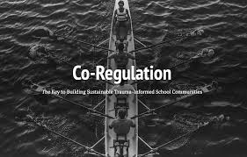
Polyvagal Theory and Treatment
Regulate or Co-regulate in a Ventral Vagal State
Once we recognize that we are dysregulated and we have pinpointed which defensive physiological state we are in and where we are on the emotional regulation continuum (see emotional regulation chart above) i.e., activation or slowing/shutting down, we can take action by using bottom-up self-regulation strategies and co-regulation strategies
As Herman Melville once wrote, “We cannot live for ourselves, a thousand fibers connect us.” Connection is a biological imperative according to Porges (2015).
Our autonomic nervous system longs for connection and it is though our biology that we are wired to connect. It is by means of co-regulation that we connect with others and create a shared sense of safety (Dana, 2020).
As specifically defined by Dr Porges, co-regulation is the mutual regulation of physiological states between individuals. In life, it occurs first between mother and infant but later extends to friends, partners, co-workers, and groups such as families to name a few (Porges, 2017).

Slide 72
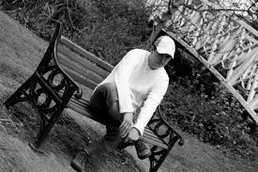
Polyvagal Theory and Treatment
Regulate or Co-regulate in a Ventral Vagal State
We humans are social creatures and “our nature is to recognize, interact, and form relationships” with others (Cacioppo & Cacioppo, 2014, p. 1).
As we know, babies need to connect for survival and positive co-regulation in low birthweight babies, in particular, leads to heart rate, temperature, and breathing stabilization, more organized sleep, rapid improvement in state regulation, and reduced mortality, severe illness, and infection (Jefferies, 2012).
Connection is a wired-in biological necessity and isolation or even the perception of social isolation can, and in most cases, lead to a compromised ability to regulate our autonomic state which diminishes our physical and emotional well-being (Porges & Furman, 2011).
We can all appreciate that when we feel alone, we suffer. In a Ted Talk presentation, Cacioppo (2013) reported a rather shocking meta-analysis study of over 100,000 participants which found increased risks of dying early due to the following:
  Air pollution: 5% increased risk of dying early
  Obesity: 20% risk of dying early
  Alcoholism: 30% risk of dying early
  Loneliness: 45% risk of dying early

Slide 73
Polyvagal Theory and Treatment
Regulate or Co-regulate in a Ventral Vagal State
So, when we recognize that we are suffering and dysregulated it is very helpful and sometimes lifesaving to seek safe others.
Conversely, when we are emotionally regulated ourselves, we can offer our safe regulation to others, be they adults or children. This is a particularly important and essential component to good parenting.
We can gift our safe regulation to ourselves and to others by choosing the following strategies below. Remember, though the process of neuroception, others read our cues of safety just as we read theirs.
Quid pro quo, we receive back what he give and vice versa. We would do well to practice these strategies, so they become automatic whenever we move out of the green zone and want to return.

Slide 74

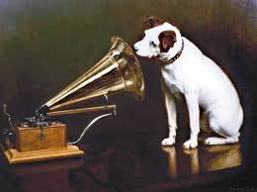
Polyvagal Theory and Treatment
Regulate or Co-regulate in a Ventral Vagal State
Kind eyes: As they say, they eyes are the window of the soul.
Modious voice: Speak with a more melodious voice, full of prosody and life.

Slide 75
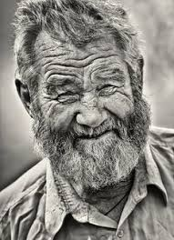
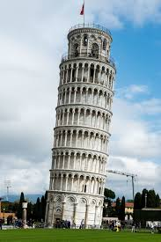
Polyvagal Theory and Treatment
Regulate or Co-regulate in a Ventral Vagal State
Avoid leaning in: Leaning in can be perceived as very threatening. Most of us don’t like it when others enter into are personal space, particularly in western cultures, and the end result is typically defensive activation moving us toward fight or flight or less typically, occasional freeze responses.
Smiling mouth and eyes: Smile not only with your mouth but with your eyes. Whether or not we are aware, our neuroception scans for congruence between the smiling mouth and smiling eyes. Crow’s feet wrinkles are testament to someone who lives a more joyful life. So maybe reconsider that Botox.

Slide 76
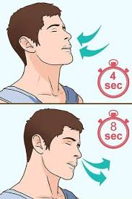

Polyvagal Theory and Treatment
Regulate or Co-regulate in a Ventral Vagal State
Slow and low Breathing: Our lungs are the only internal body organ that we can directly control and proper breathing has a huge impact our health. Breathe slowly with exhalations longer than inhalations – breathing out slowly accentuates relaxation and actually can slow our heart rate by 20 beats per minutes (vagal brake).
\
Heartfelt positive emotions: As we breathe, we should try to bring positive emotions such gratitude, joy, and love, or any positive experience or memory into our heart. The importance of positive emotions in the heart is now supported by the latest neuroscience. The electromagnetic field of the heart can now be measured and extends outward to a distance of about three to five feet as compared to that of the brain which extends only 2 to 4 inches.

Slide 77
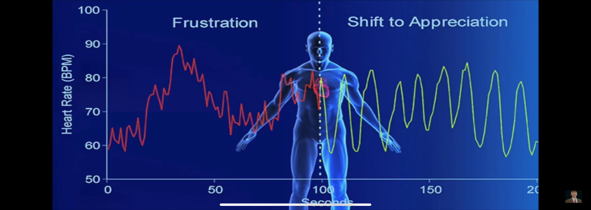
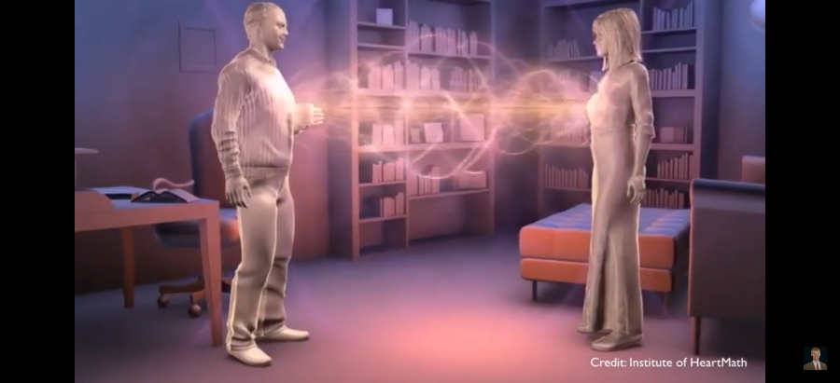
Polyvagal Theory and Treatment
Regulate or Co-regulate in a Ventral Vagal State
Heartfelt positive emotions: When we focus on positive emotions, our heart radiates a nicely coherent wave as compared to a dysregulated wave when our emotions are negative. This has impact on not only our emotional and physical health but the health of others (HeartMath Institute, 2020). Moreover, the heart has over 40,000 cells called sensory neurites which are very similar to the cells in the brain and there is evidence that the heart has a certain capacity for some types of memory as well as a gut level wisdom that guides us (Dispenza & Braden, 2019).
\

Slide 78


Polyvagal Theory and Treatment
Re-story
Now that we or ourselves and our loved ones are in a more regulated state by use of the bottom-up strategies discussed above, we should be more settled and thus, more able to use top-down strategies and correct the narrative or re-story the situation, be it a current event or something in our distant past (Dana, 2018, 2020; Kain, 2018). We humans by nature are meaning-making machines, autonomically pulled to the story (Dana, 2020).
Sadly, our narrative is often negative as there is a bias toward the negative (Hanson & Mendius, 2009). Although this tendency to see the negative in our circumstanes and in ourselves might have a survival advantage in that we will be vigilant for the tiger, expecting him to eat us when we are in the wild, it works against us when there is no threat.
Additionally, victims of shock or acute trauma are particularly vulnerable to creating false narratives about themselves and the world around them (Porges, 2017; Dana, 2018, Kain & Terrell, 2018). In a more regulated state, we are safe to possibly do a Ctrl-Alt-Del on the old story and rewrite a new or revised version that better reflects our past or current autonomic adventure, one that allows us to accept and appreciate the heroic nature of our autonomic nervous system that enabled us to survive though the pain and/or trauma of the past and embrace the beauty and joy of what we now have and the bright future that lies ahead.

Slide 79
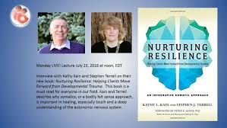
Polyvagal Theory and Treatment
Re-story
As Drs. Kain and Terrell eloquently write, “As our capacity increases, our narratives are likely to change, to include the sense of success at meeting challenges, of developing curiosity, or of a willingness to explore. Eventually, our narratives may also include access to a sense of safety and connection. Rather than I am constantly afraid and unhappy, a client will begin to tell himself a different story: I am stronger than I thought and able to meet challenges with greater balance and success” (Kain & Terrell, 2018, pgs. 101-192).
They add, “At the same time, our somatic narratives will begin to change. We may literally experience changes in our symptoms – decreased inflammation, less pain, fewer migraines. Our illness narratives my alter to include the possibility of being free of pain, free of symptoms that have beleaguered us for most of our lives” Kain & Terrell, 2018, p 192).

Slide 80
Personal note from Jeff:
When I “literally hit the floor” that day and in the days and months that followed, my false narrative continued to plague me. I thought that I was weak, that I was a poor example of a husband, father, and therapist. My once positive and confident self evaporated. The best way to describe it was that I felt like I was an “un-person.” My autonomic nervous system continued to terrorize me, and I was unable to turn it off. My therapists (plural – yes, there were several) who, although were all very skilled, could not fully explain what was happening in my body and brain. This left me feeling hopeless and further fueled the flame of negativity. It wasn’t until I made many changes in my life, to include leaving a lucrative practice that was no longer feeding my soul, ending a particularly toxic relationship with a colleague, embracing new professional challenges that paid less in money but much more for the heart, making new and safer friendships, getting back into motorcycling (the perfect recipe for autonomic regulation), and learning how to make and continue safer relationships, that the sun rose again in my life. As I did these things, my autonomic nervous system eventually settled, and I was then able to create a new narrative. This new narrative fully appreciated the wisdom of my body experience, gave meaning to what I had gone through, and offered hope of a bright and more secure future.

Slide 81

Johann Hari’s Model:
Connected Living
As we look toward solutions for getting our emotions and lives on track, we must have a template for what healthy lifestyles looks like.
One of the most influential books that I have found to address this issue is the groundbreaking book, Lost Connections by Johann Hari (2018). In this book award-winning journalist and critical thinker, Johann Hari, who suffered from depression since he was a child, set out on a three-year journey around the world to seek answers to his own depression.
He talked with psychiatrists, epidemiologists, neurologists, neuroscientists, social scientists, and many other experts in their fields of study around the globe and explored different cultures and how they fared with these issues.
In addition, he conducted a comprehensive review of the literature. He concluded that much of what we have been led to believe about the genesis and treatment of depression and anxiety is off the mark in many ways.
He determined that in many cases depression and anxiety are the result of crucial and growing problems with the way we are living our lives. He discovered that there are nine underlying causes of these problems which are summarized as follows (Hari, 2018):

Slide 82

Johann Hari’s Model for Connected Living
One: Connection to Meaningful Work:
  A lack of control and little connection between effort and reward are highly predictive of depression and suicide in the workplace (Marmot et al., 2002).
  Gallup study found that twice as many people in 2011 to 2012 hated their jobs as love their jobs (Marmot et al., 2002).
  Takeaway: Ensure you are connected to meaningful and fulfilling work both at the workplace and at home. For teens and many young adults, the workplace is school so attention must be given to making this a successful and meaningful endeavor.

Slide 83

Johann Hari’s Model for Connected Living
Two: Connection to Meaningful People:
  Pinker (2015) followed both isolated and highly connected people over nine years and found that isolated people were two to three times more likely to die during lonely periods.
  Cacioppo (2006, 2008, 2010), a neuroscience researcher, studied the impact that loneliness has on health. He and his colleagues determined that loneliness causes cortisol levels to go through the roof.

Slide 84


Johann Hari’s Model for Connected Living
Two: Connection to Meaningful People - continued:
Cacioppo (2013) reported a rather shocking meta-analysis study of over 100,000 participants which found increased risks of dying early due to living with the following:
  Air pollution: 5% increased risk of dying early
  Obesity: 20% risk of dying early
  Alcoholism: 30% risk of dying early
  Loneliness: 45% risk of dying early
Takeaway: Ensure that you are connected with family and good friends in 3D, face-to-face relationships.

Slide 85
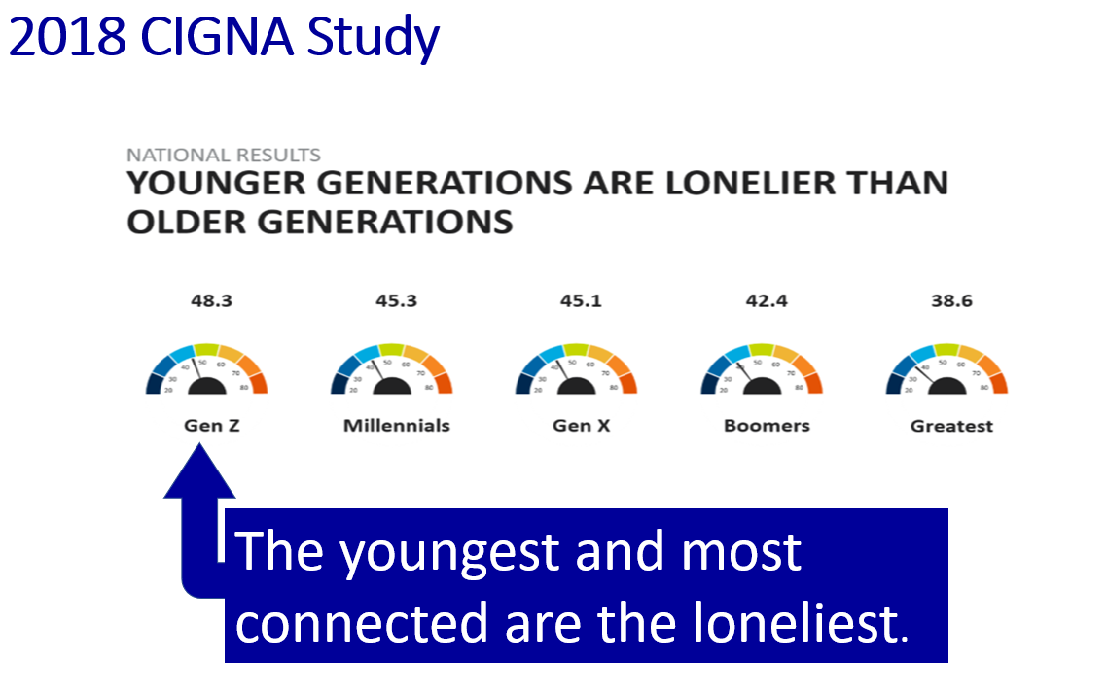
Johann Hari’s Model for Connected Living
Two: Connection to Meaningful People - continued:
Shared with permission – Peter Ryan, CAPT, USN (R)

Slide 86

Johann Hari’s Model for Connected Living
Three – Connection to Meaningful Values:
  Overvaluing money and possessions leads to higher scores of depression (Belk, 1983). Kasser’s (2002) research specifically determined that the more materialistic you are the more likely you are to score higher on measures of depression.
  Takeaway: It is a powerful thing to contemplate your values and what makes you and your family unique. Knowing your values helps build a firm foundation on which to heal.
Four – Disconnection from Childhood Trauma:
    As noted earlier, the Kaiser Study of Adverse Childhood Experiences (ACEs) indicated that for every category of trauma experienced as a child, he/she was dramatically more likely to be depressed as an adult (Felitti et al., 2014; Felitti, 2004).
    Takeaway: Seek a competent trauma therapist to address unresolved childhood trauma less you be tempted to continue consuming pornography or another addiction to self-medicate the pain.

Slide 87

Johann Hari’s Model for Connected Living
Five – Connection to Status and Respect:
  Like our primate cousins, low ranking individuals show changes in the brain, specifically the pituitary and adrenal glands (Sapolsky, 1992; 2002).
  As Twenge (2006) in her book Generation Me astutely pointed out, self-esteem is not based on air, but on mastery and real-world competence.
  Takeaway: Build self-respect and confidence based on competence. This is foundational for resilience and regulated emotions.

Slide 88

Johann Hari’s Model for Connected Living
Six: Connection to the Natural World:
  Bonobos in the wild can become sad or depressed, but there is a limit to how far they will go. In captivity, they become extremely depressed and often self-injure and/or rock compulsively (interview with Isabel Behncke cited in Hari, 2018).
  “Nature Deficit Disorder” - Humans are hard-wired for a genuine nature connection (Louv, 2005).
  Louv (2005) stated that many psychological problems in kids today are related to an erosion of their connection with nature and immersion into the digital world.
  Takeaway: Get yourself outside exercising and/or enjoying the beauty of the outdoors! The colors green and blue actually regulate the nervous system.

Slide 89


Johann Hari’s Model for Connected Living
Seven – Connection to a Hopeful and Secure Future:
  As Native Americans were stripped of their identities, they lost their connection to the future, they became increasingly depressed, and then often resorted to alcohol which often culminated in addiction (Hari, 2018).
  Takeaway: Many of us are in the same boat and have lost sight of a secure future. We need to find a way to foster competence and hope.
Eight – Connection to Faith (emphasis mine):
  Observational studies suggest that people who have regular spiritual practices tend to live longer (Strawbridge et al., 1997).
  Religious commitment may improve stress control by affording better coping mechanisms, richer social support, and the strength of personal values and worldview (Koenig et al., 1997).
  Takeaway: Consider pursuing faith in something beyond yourself – your emotional and physical health might thank you one day.

Slide 90
My Letter to Johann Hari
Johann Hari’s work was profoundly helpful to me as it summarized much of what I did to get my self once again regulated emotionally and back on track, so much so, that I felt compelled to write him a letter of gratitude.
Hi Johann,
I have been wanting to write your for quite some time and on this cold and wet Saturday evening in the Pacific Northwest, I am finally reaching out.
By way of introduction, I am a clinical pediatric psychologist, working at Madigan Army Medical Center, one of the largest Army training hospitals in the US. I also have a small private practice in Olympia, Washington State. But this is not really that relevant. What is relevant and what connects me to you, is that I, too, have struggled with profound depression, so severe, in fact, that it landed me in the psychiatric ward at St. Peter Hospital some twelve years ago after hitting a point of deep depression – precipitated by my wife’s cancer diagnosis, my daughter’s possible lymphoma diagnosis, my son’s deployment to Fallujah, Iraq in 2008, and the loss of my financial stability due to heavy real estate investment losses during the financial collapse and worldwide recession of that time. After my total emotional collapse, I embarked on a long journey of recovery, one that took me almost eight years. Once recovered, I began to do an internal assessment and inventory of the many things I did to bring back wholeness to my life and, by way of a gift, once nearing completion of that inventory, I happened to hear your interview with Georgy Noorey on Coast to Coast radio. I was immediately captivated by your story. I bought your book, Lost Connections, and was nothing short of validated, blessed, moved, intellectually challenged, and deeply touched by your words. You helped lend credence and validation to my struggle and to what it took to save myself and heal. I came to know you as a fellow traveler in the struggle of life. I watched nearly every YouTube and Ted Talk interviews and presentations you gave and came to know you as a sort of friend, if not even a brother, in the life experience we all share.
I am very happy to say that my life is now nothing short of amazing. I left my very lucrative full-time private practice where money ruled, toxic relationships reigned, and fulfillment in service to others diminished. I returned to an Army medical center, perhaps by universal design, the one where I once served when I was on active duty some two and a half decades ago - with half the pay but twice the fulfillment, as I was no longer working for the mighty dollar but was instead dedicated to the service of others. In short, I found my soul.

Slide 91
My Letter to Johann Hari – cont.
My journey to hell and back, the lessons learned, and your book all helped to contribute to my salvation. Johann, I cannot thank you enough – for your humility to share your story, for your brilliance to research the truth, and for your courage to share it. You have helped to enrich and save the lives of many, not the least of which mine.
I have applied your teaching not only to my life, but to the lives of the many severely disturbed and oftentimes emotionally challenged patients which I serve at Madigan and in my private practice. I have developed your multi-point model of connection into a therapy protocol for many of my patients at Madigan Army Medical Center, as well as in my private practice which I have affectionately named, The Center for Connected Living, LLC. In addition, I have a personal interest and passion to help those who are imprisoned by media and pornography addiction, the epidemic plagues of modern culture, and I use your model of connection as one of the key components of recovery for them both in my therapy and in my speaking engagements.
I hope you don’t mind, but I have made considerable reference your work in my papers and PowerPoints which I have developed for my patients at Madigan and in my private practice. Should you ever wish to peruse them, you can find them on my website: jeffreyhansenphd.com. No worries if you choose not to review them but suffice it to say that you are helping to restore emotional lives of many, my friend.
I hope to meet you one day and to have the privilege of shaking your hand. You are the best of humanity and I am honored to count you as one of my literary mentors.
With fond regards,
Jeff

Slide 92

Conclusion
  So, thank you for taking a walk with me. We all struggle with managing and regulating our emotions. It is just part of the human condition. For some lucky few, who have inherited healthy genes and epigenomes, enjoyed the best of secure attachment early in life, experienced few Adverse Child Experiences in childhood, and lived connectedly, emotional regulation comes much easier. But most of us, to some degree, have taken on damage which has impacted on our ability to manage the emotional tempest within us and we are instead managed by it. No matter how bad our lives previous to this moment might have been, we can heal, we can restore our mind, body, and soul. If I can take such a fall from grace and heal to live a life better than I ever could have imagined, so can you. Keep looking up, keep learning, keep persevering. You can do it, connected with all good things.
  Jeff
  P.S. With deep heartfelt thanks to family and friends for walking connectedly with me through the peaks and valleys of life. You know who you are.

Slide 93
Emotional regulation
1 August 2020 Draft – Hansen, J - updated

