Slide 1
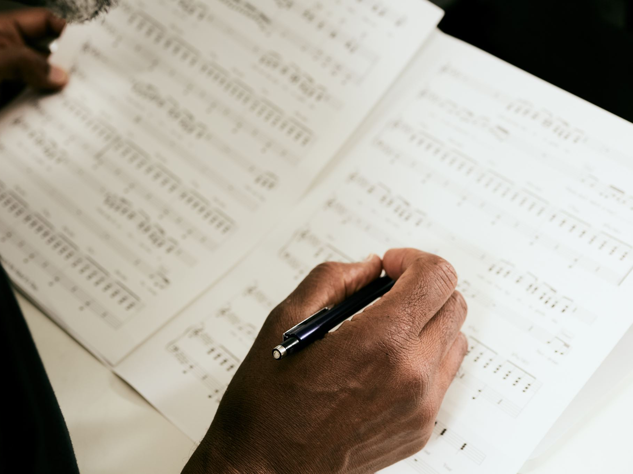
25 Biblical 'I AM' Declarations for 2025
Affirmations of Faith and Identity in Christ
Pastor Earl Heverly
Adapted by Jeffrey E. Hansen, Ph.D.

Slide 2
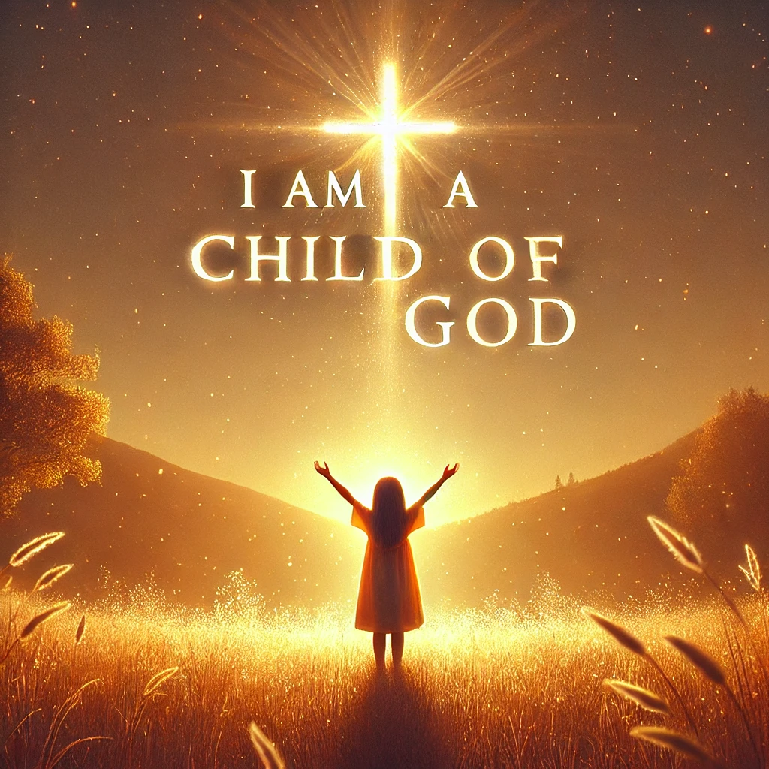
1. I am a child of God.
The Spirit Himself testifies with our spirit that we are God’s children.
Romans 8:16 (NIV)

Slide 3
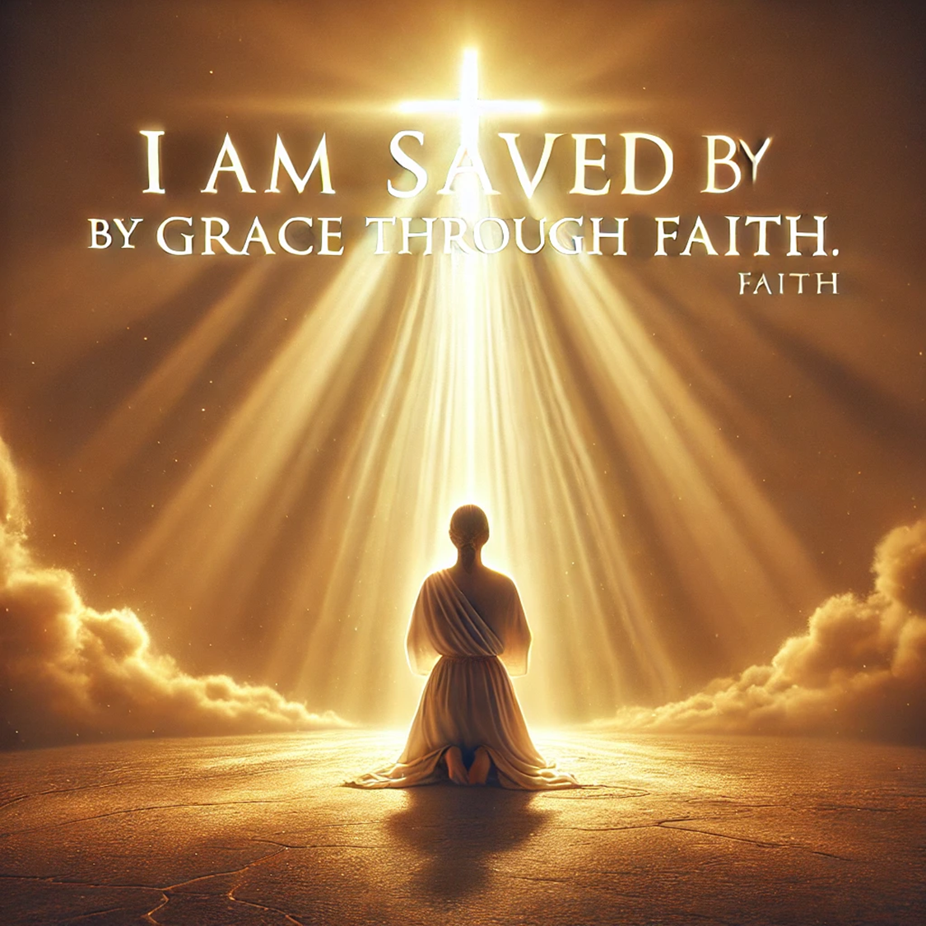
2. I am saved by grace through faith.
For it is by grace you have been saved, through faith—and this not from yourselves, it is the gift of God—not by works, so that no one can boast.
Ephesians 2:8-9 (NIV)

Slide 4
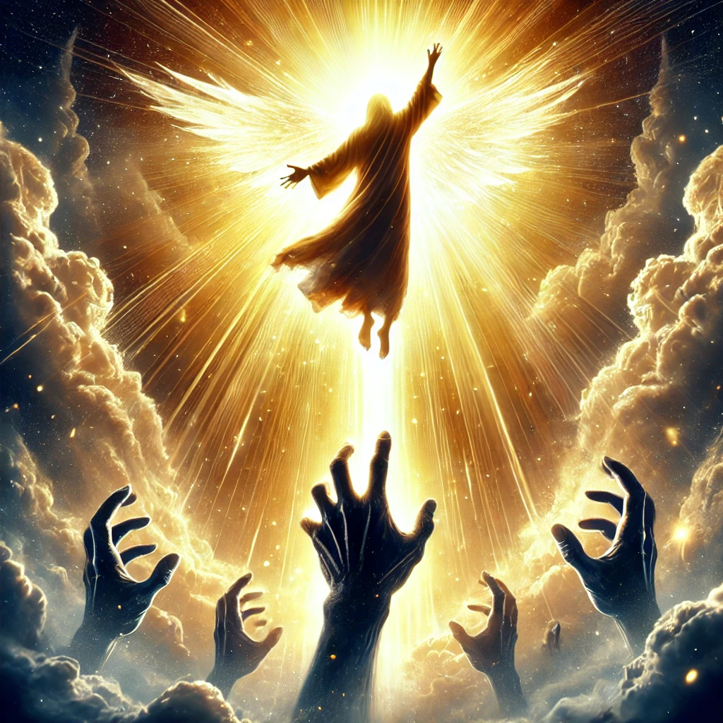
3. I am redeemed from the hand of the adversary.
Let the redeemed of the Lord say this— those He redeemed from the hand of the foe.
Psalm 107:2 (NIV)

Slide 5
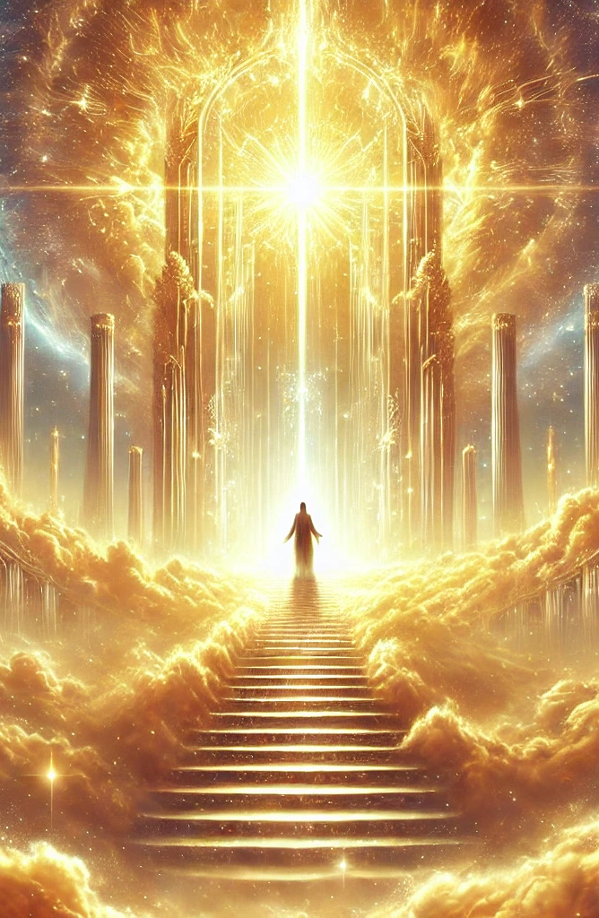
4. I am an heir of eternal life.
And this is what God has testified: He has given us eternal life, and this life is in His Son. Whoever has the Son has life; whoever does not have God’s Son does not have life.
1 John 5:11-12 (NLT)

Slide 6
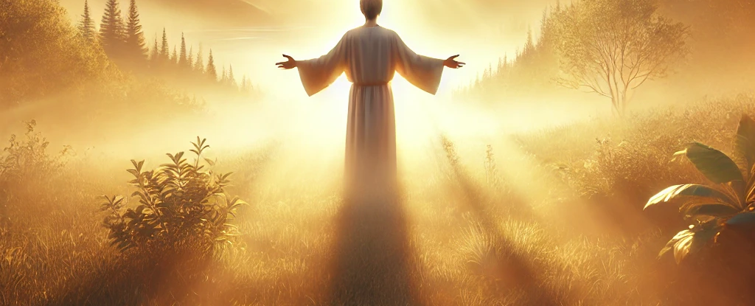
5. I am forgiven.
He is so rich in kindness and grace that He purchased our freedom with the blood of His Son and forgave our sins.
Ephesians 1:7 (NLT)

Slide 7
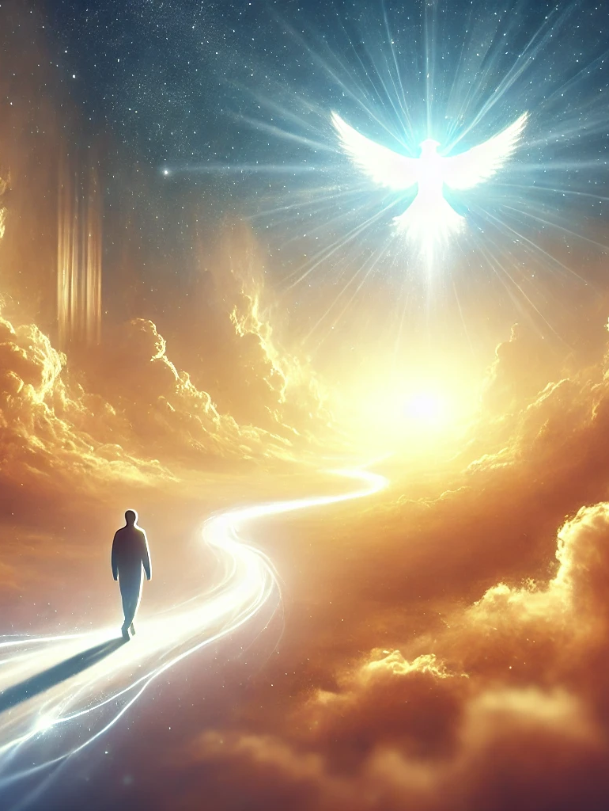
6. I am led by the Spirit.
For you did not receive a spirit that makes you a slave again to fear, but you received the Spirit of sonship. And by Him we cry, 'Abba, Father.' The Spirit Himself testifies with our spirit that we are God’s children.
Romans 8:15-16 (NIV)

Slide 8
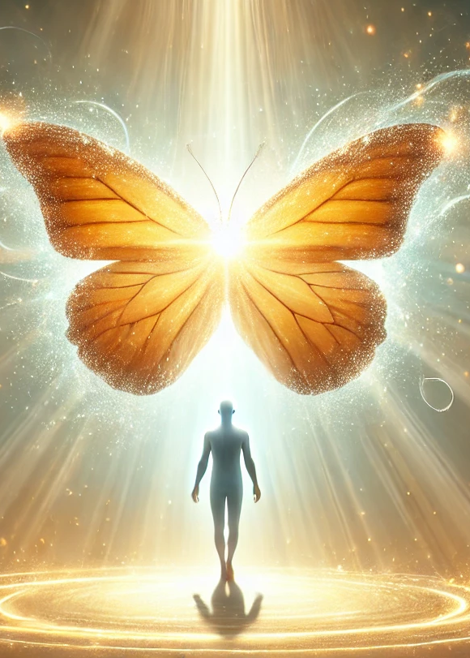
7. I am a new creature, a new creation.
Therefore, if anyone is in Christ, he is a new creation; the old has gone, the new has come!
1 Corinthians 5:17 (NIV)

Slide 9
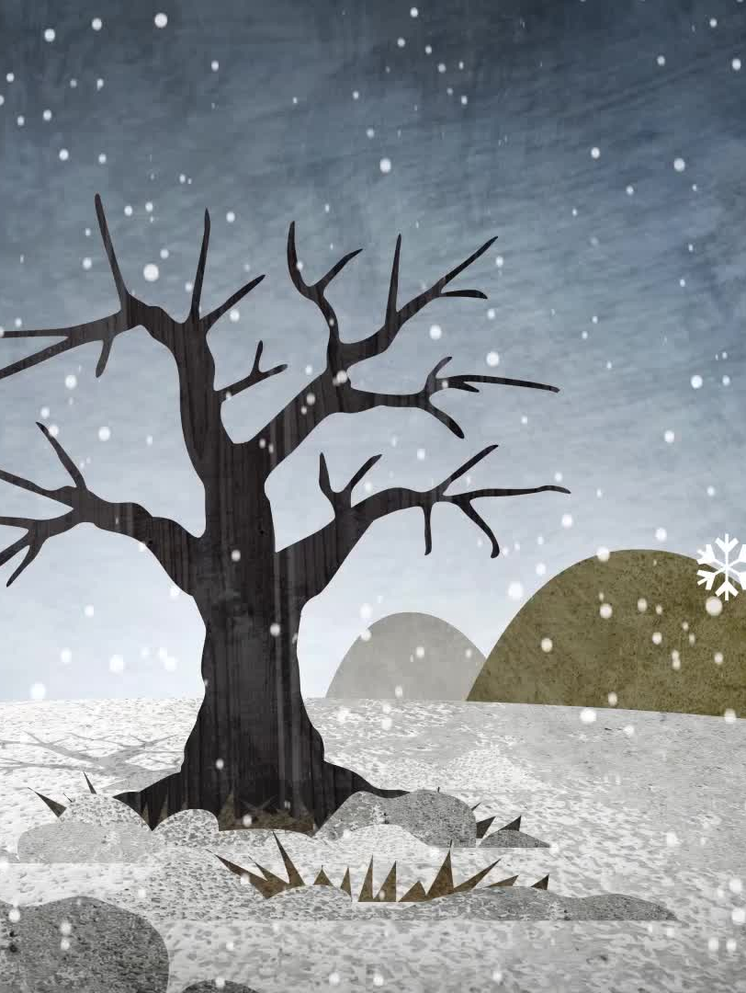
8. I am redeemed from the curse of the law.
Christ redeemed us from the curse of the law by becoming a curse for us, for it is written: 'Cursed is everyone who is hung on a tree.'
Galatians 3:13 (NIV)

Slide 10
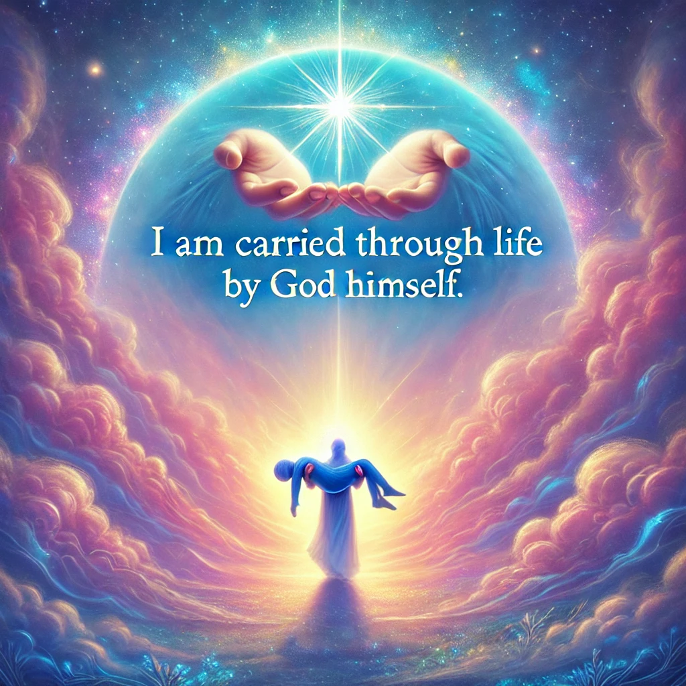
9. I am carried through life by God Himself.
'I will be your God throughout your lifetime— until your hair is white with age. I made you, and I will care for you. I will carry you along and save you.'
Isaiah 46:4 (NLT)

Slide 11
10. I am strong in the LORD and His mighty power.
'By My power I will make My people strong, and by My authority they will go wherever they wish. I, the LORD, have spoken!'
Zechariah 10:12 (NLT)

Slide 12
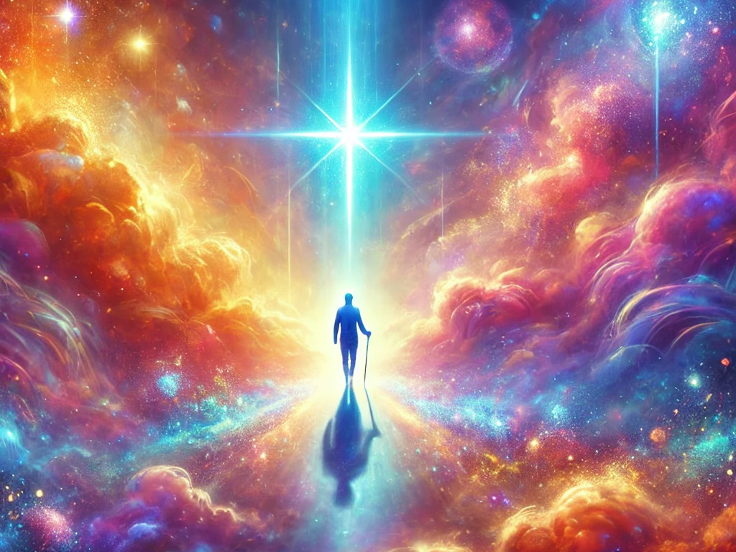
11. I am living by faith and not by sight.
We live by faith and not by sight.
2 Corinthians 5:7 (NIV)

Slide 13

12. I am rescued from the dominion of darkness.
For He has rescued us from the dominion of darkness and brought us into the kingdom of the Son He loves.
Colossians 1:13 (NLT)

Slide 14
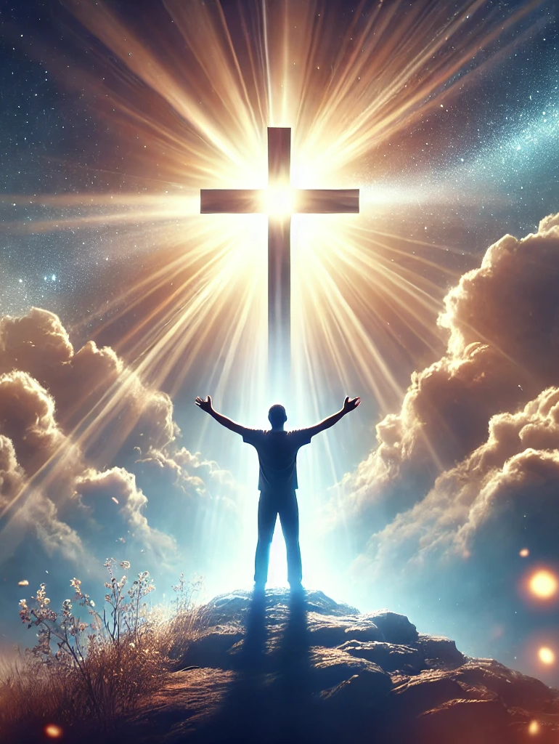
13. I am justified, made right with God.
Since we have now been justified by His blood, how much more shall we be saved from God’s wrath through Him!
Romans 5:9 (NIV)

Slide 15

14. I am an heir of God and a co-heir with Christ.
And since we are His children, we are His heirs. In fact, together with Christ we are heirs of God’s glory. But if we are to share His glory, we must also share His suffering.
Romans 8:17 (NLT)

Slide 16
15. I am blessed with every spiritual blessing.
All praise to God, the Father of our Lord Jesus Christ, who has blessed us with every spiritual blessing in the heavenly realms because we are united with Christ.
Ephesians 1:3 (NLT)

Slide 17
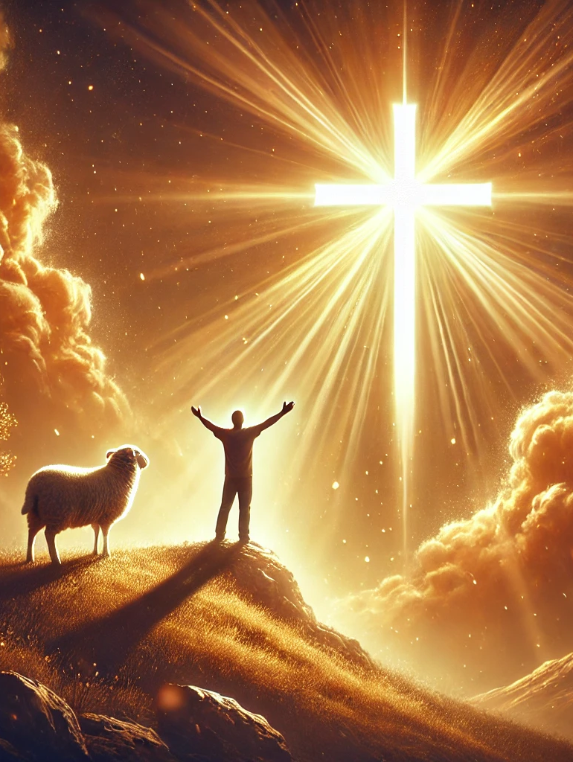
16. I am an overcomer by the blood of the Lamb and the word of my testimony.
And they have defeated him by the blood of the Lamb and by their testimony. And they did not love their lives so much that they were afraid to die.
Revelation 12:11 (NLT)

Slide 18
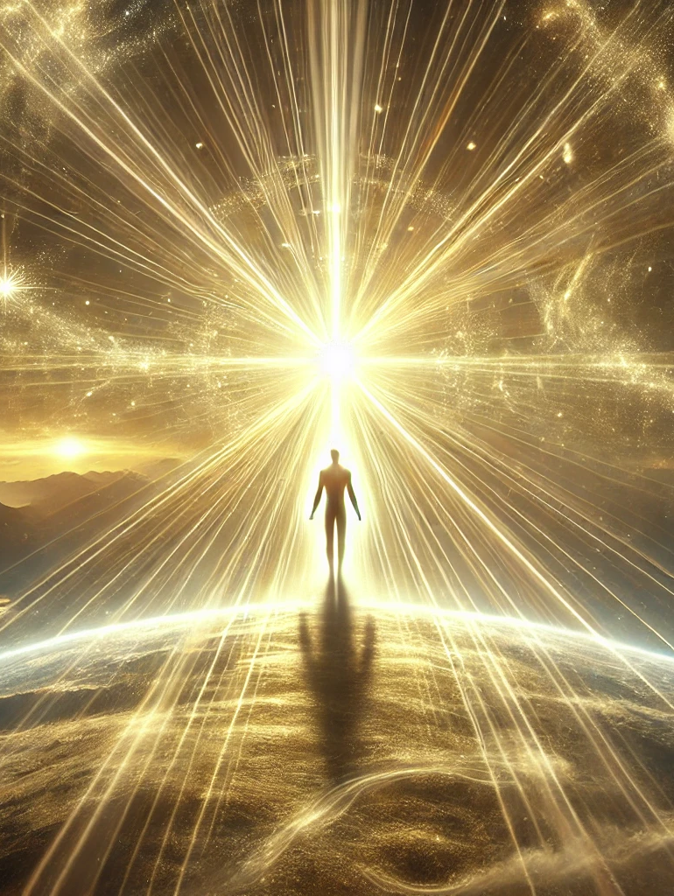
17. I am the light of the world.
'You are the light of the world—like a city on a hilltop that cannot be hidden.'
Matthew 5:14 (NLT)

Slide 19
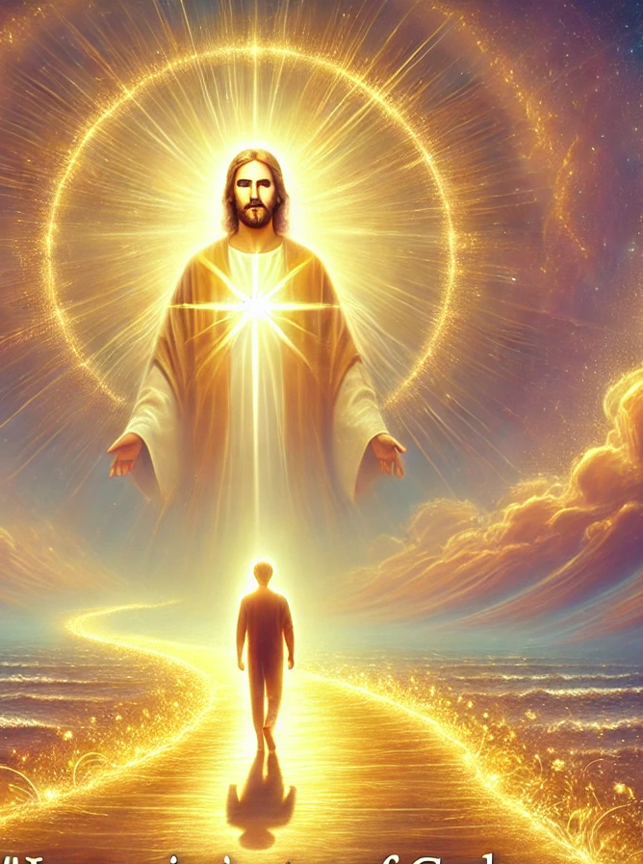
18. I am an imitator of God, as a beloved child, to walk in Jesus’ love.
Be imitators of God, therefore, as dearly loved children and live a life of love.
Ephesians 5:1, 2a (NLT)

Slide 20
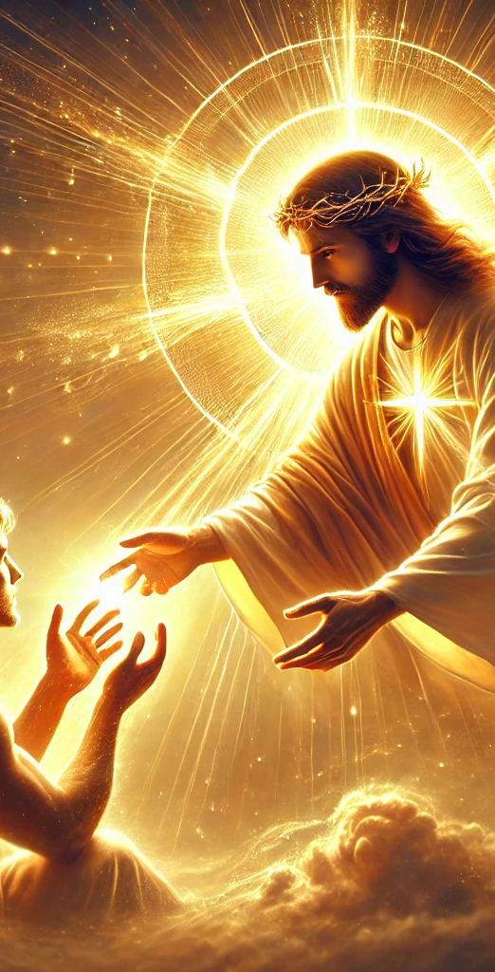
19. I am healed by His wounds.
He personally carried our sins in His body on the cross so that we can be dead to sin and live for what is right. By His wounds you are healed.
1 Peter 2:24 (NLT)

Slide 21
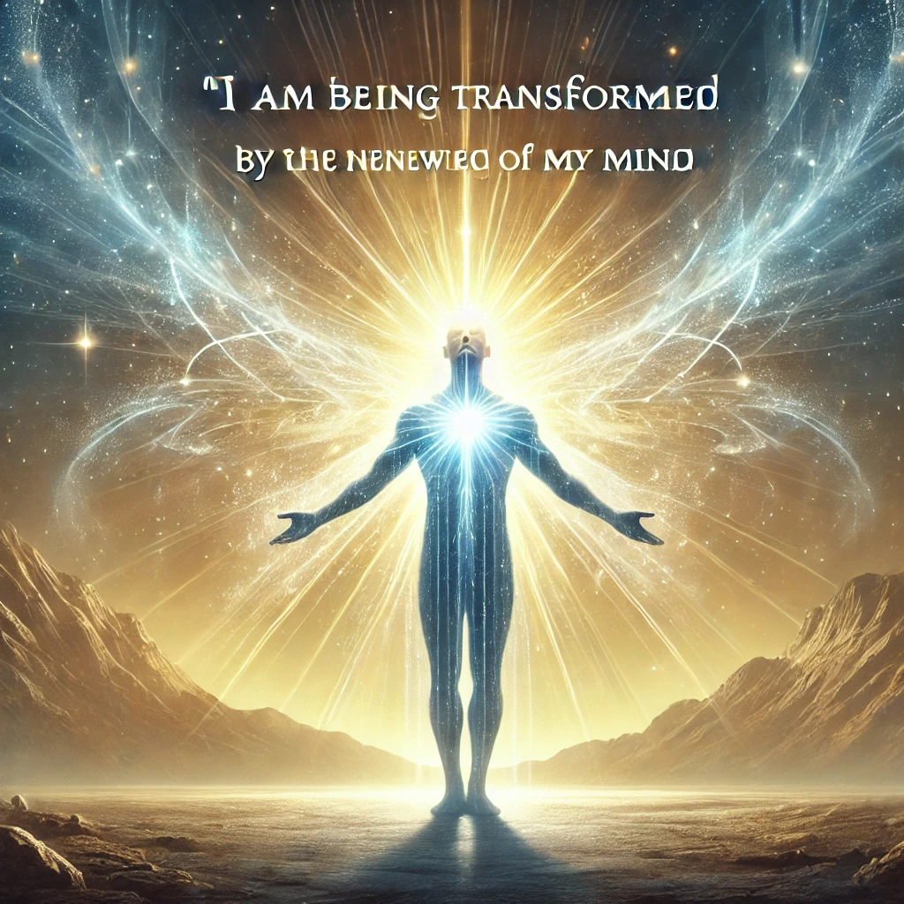
20. I am being transformed by the renewing of my mind.
Do not conform any longer to the pattern of this world but be transformed by the renewing of your mind. Then you will be able to test and approve what God’s will is--His good, pleasing and perfect will.
Romans 12:1-2 (NIV)

Slide 22
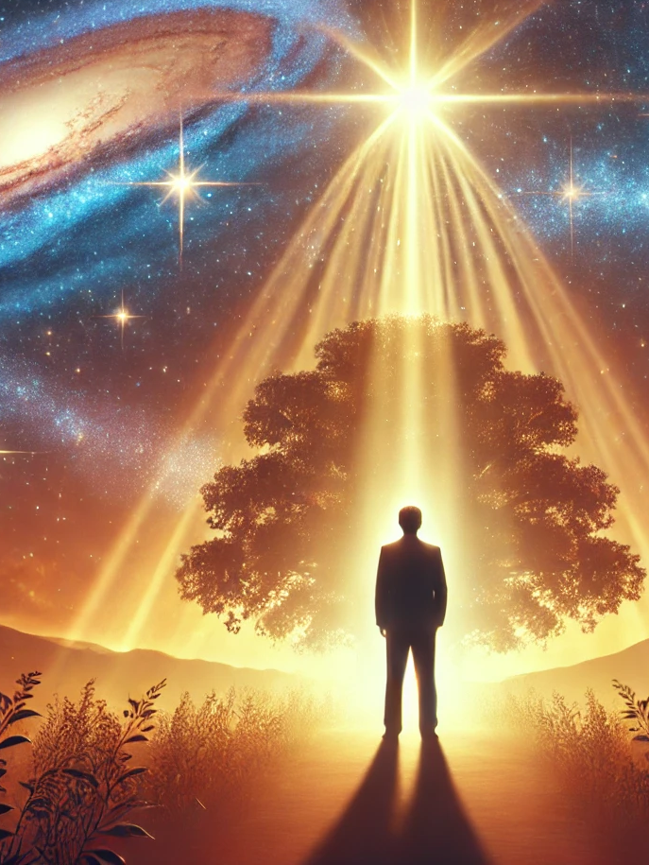
21. I am an heir to the blessings of Abraham.
Through Christ Jesus, God has blessed the Gentiles with the same blessing He promised to Abraham, so that we who are believers might receive the promised Holy Spirit through faith.
Galatians 3:14 (NLT)

Slide 23
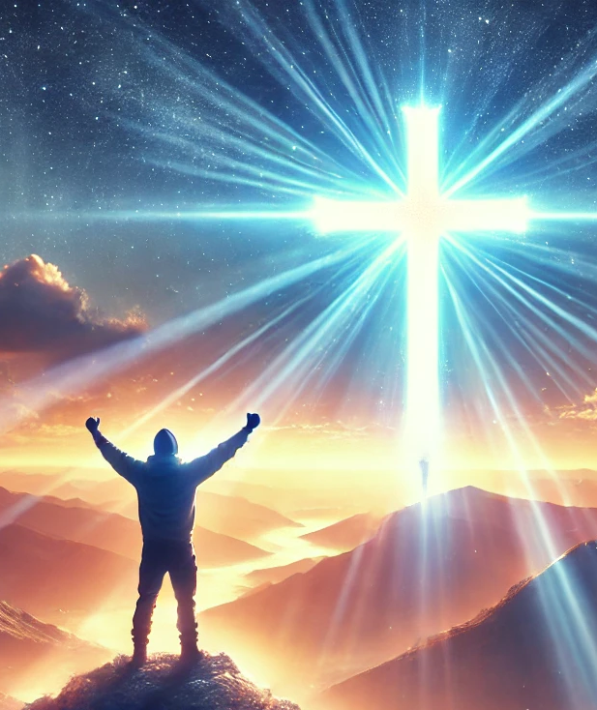
22. I am able to do all things through Christ Who strengthens me.
For I can do everything through Christ, who gives me strength.
Philippians 4:13 (NLT)

Slide 24
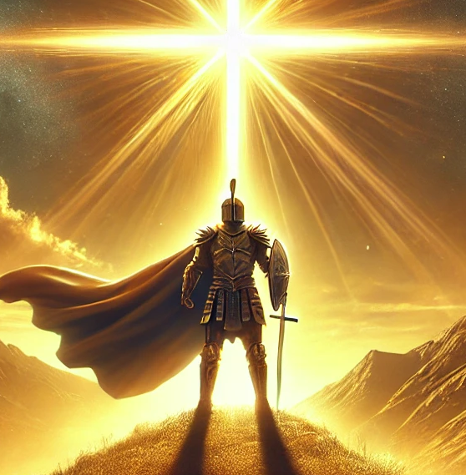
23. I am more than a conqueror.
No, in all these things we are more than conquerors through Him who loved us.
Romans 8:37 (NIV)

Slide 25
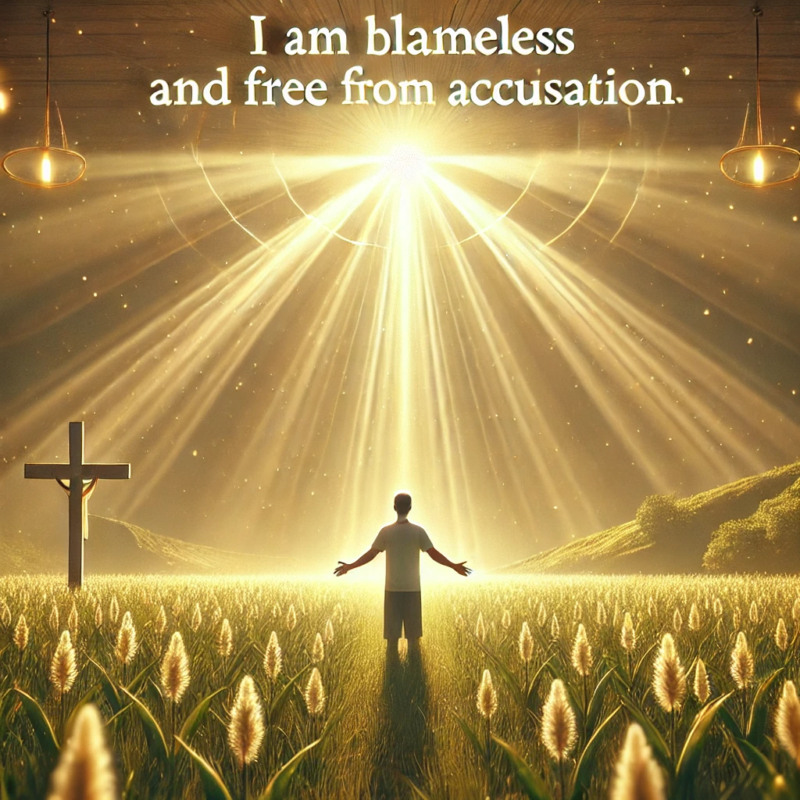
24. I am blameless and free from accusation.
Yet now He has reconciled you to Himself through the death of Christ in His physical body. As a result, He has brought you into His own presence, and you are holy and blameless as you stand before Him without a single fault.
Colossians 1:22 (NLT)

Slide 26
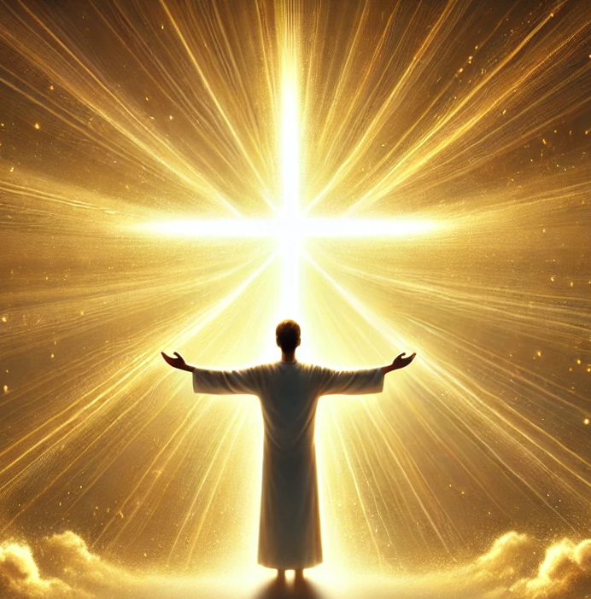
25. I have been made complete in Christ.
So you also are complete through your union with Christ, who is the head over every ruler and authority.
Colossians 2:10 (NLT)

