Slide 1
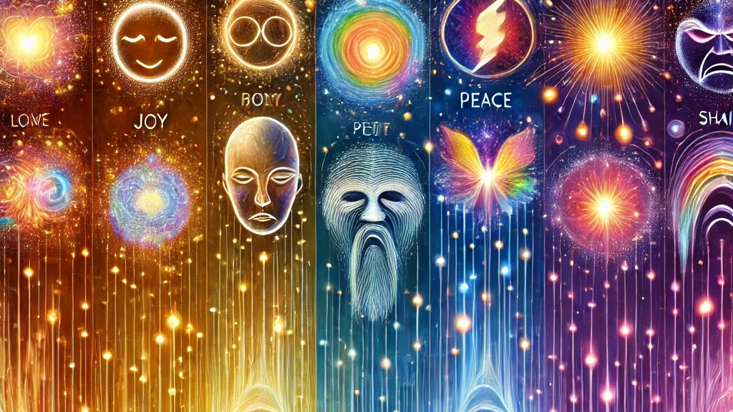
Emotions and Energy
Their capacity to heal or kill
Jeffrey E. Hansen, Ph.D.
Center for Connected Living, LLC

Slide 2
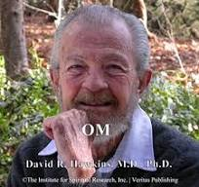
Levels of Consciousness
David Hawkins, M.D., Ph.D.
David R. Hawkins, M.D., Ph.D., was an American psychiatrist, spiritual teacher, and author known for his groundbreaking work in consciousness research.
He developed the Map of Consciousness, a scale that quantifies human consciousness levels from low, destructive states to high, enlightened states.
His most renowned book, Power vs. Force, integrates psychology, spirituality, and philosophy to explore the impact of consciousness on human behavior and well-being.
Dr. Hawkins' work has inspired many in their spiritual and personal development journeys, emphasizing the transformative power of higher consciousness and inner peace.

Slide 3
David Hawkin’s Spiritual Beliefs
David R. Hawkins was deeply influenced by various spiritual traditions and had a strong focus on non-denominational spirituality.
While he did not adhere strictly to one particular religious faith, his work integrated elements of Christianity, Buddhism, Hinduism, and other mystic teachings.
He often referenced the teachings of Jesus Christ and cited the Bible, alongside other spiritual scriptures, to highlight universal spiritual truths.

Slide 4
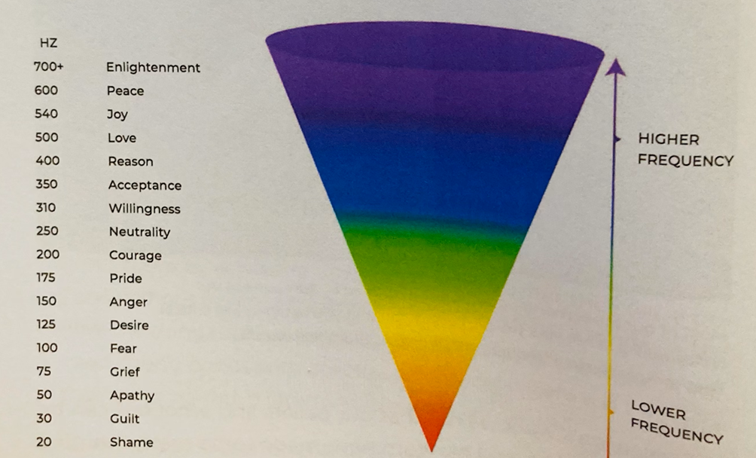
Emotional Frequencies and Health
Unresolved Toxic Shame Kills US!
Shame and guilt are seen as the heaviest emotions and are the lowest in frequency, where we feel contracted and stuck.
In contrast, emotions like love and joy are lighter, with more energy and movement, creating a sense of openness and lightness.(Dispenza, 2017)

Slide 5
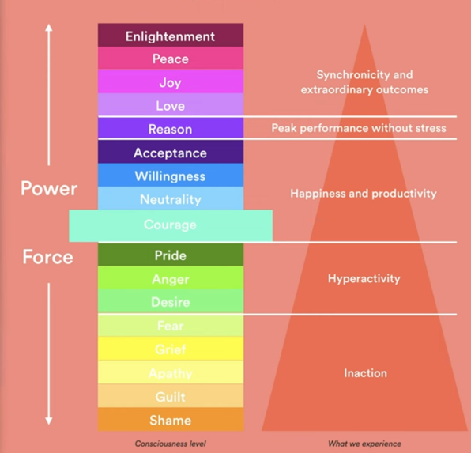
Levels of Consciousness by David Hawkins, M.D., Ph.D.

Slide 6
Energy Levels with Descriptors
Negative Energy
Positive Energy
Shame (20 Hz): The lowest level, characterized by feelings of humiliation and self-loathing. People at this level often experience destructive thoughts and depression.
Guilt (30 Hz): Associated with blame, regret, and self-recrimination. This level contributes to a paralyzing fear of punishment and self-sabotage.
Apathy (50 Hz): A state of helplessness and despair, often linked with poverty and victimhood. Energy is extremely low at this level.
Grief (75 Hz): A state marked by loss and regret. Although grief carries more energy than apathy, it still signifies a passive state of existence.
Fear (100 Hz): Characterized by anxiety and worry. It is a more energetic state than grief and apathy but can lead to control and defensive behavior.
Desire (125 Hz): Often linked to craving and addiction. While more active than lower levels, it leads to disappointment and dissatisfaction.
Anger (150 Hz): A state of frustration and resentment that can motivate change but may also result in aggression.
Pride (175 Hz): A sense of accomplishment but reliant on external validation. It lacks true empowerment and can lead to defensiveness.
Courage (200 Hz): The tipping point into positive states. Courage marks a proactive approach to life, leading to growth and positive change.
Neutrality (250 Hz): Characterized by trust and flexibility. People at this level are not attached to outcomes and are comfortable with uncertainty.
Willingness (310 Hz): A state of productivity and learning. It reflects an openness to change and a readiness to face challenges.
Acceptance (350 Hz): Associated with taking responsibility for one’s life and being proactive. Acceptance is empowering and promotes personal growth.
Reason (400 Hz): The level of the intellect, logic, and science. At this level, individuals seek knowledge and understanding.
Love (500 Hz): A state of unconditional love that transcends emotion and is characterized by compassion and forgiveness.
Joy (540 Hz): An inner sense of completeness and serenity. It is associated with profound satisfaction and a sense of peace.
Peace (600 Hz): A state of bliss and profound calm. At this level, the mind becomes quiet, and a person experiences deep serenity.
Enlightenment (700–1,000 Hz): The highest levels of consciousness. Represented by figures like Jesus, Buddha, and other enlightened masters, it is a state of complete oneness and transcendence.

Slide 7
Therapeutic Implications of David Hawkins' Work
1. Identifying Emotional States: Helps clients and therapists recognize current emotional levels (e.g., shame, anger) and work towards positive states (e.g., courage, love).
2. Energy Levels: Illustrates how low-frequency emotions (e.g., fear, guilt) drain energy, while high-frequency emotions (e.g., peace, joy) enhance resilience.
3. Holistic Healing: Integrates psychological and spiritual growth, fostering a deeper sense of purpose and motivation.
4. Trauma and Addiction: Guides clients from destructive emotions tied to trauma/addiction to empowering levels that support recovery.

Slide 8
Therapeutic Implications Continued
5. Resilience Building: Promotes practices like mindfulness and gratitude to raise consciousness and strengthen coping skills.
6. Empowerment: Highlights courage (200 Hz) as a key level for initiating positive change and growth.
7. Science and Spirituality: Bridges psychology with spiritual insights for a more holistic therapy experience.
Hawkins' scale enhances therapy by offering a structured path to move from destructive emotions to healing, fostering deeper transformation.

Slide 9
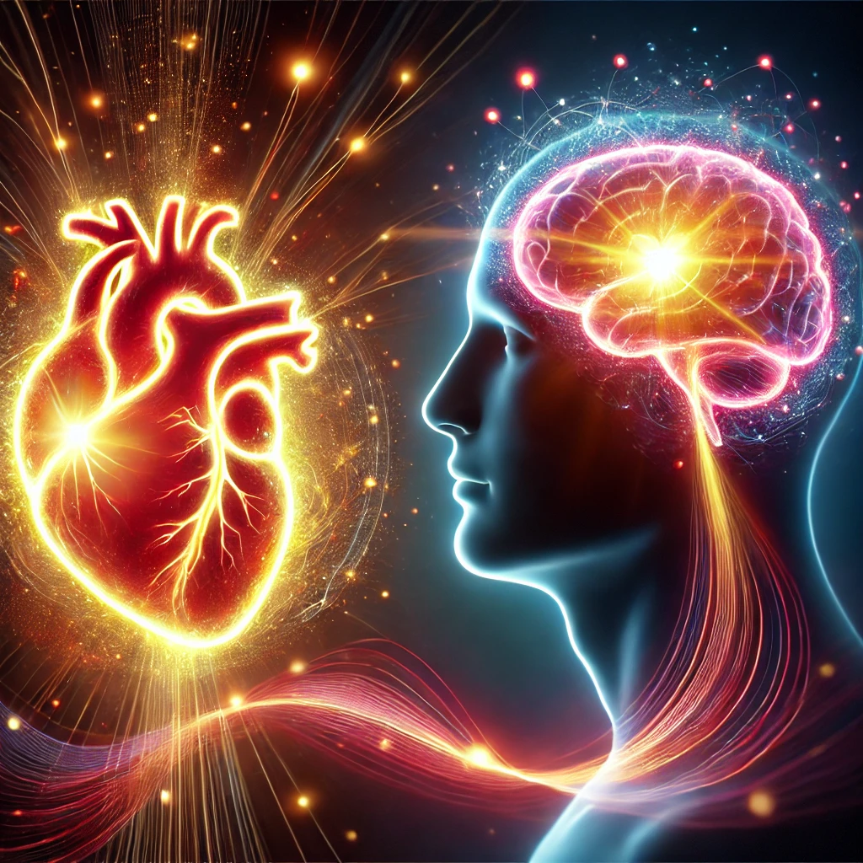
Emotional States & HeartMath Heart-Brain Coherence
Hawkins' scale of consciousness aligns with HeartMath's findings:
  Positive emotions (e.g., love, joy) create coherent heart rhythms, enhancing brain function.
  Negative emotions (e.g., anger, fear) lead to incoherent rhythms and stress.
  Higher consciousness supports emotional and physical well-being.

Slide 10

Energy Levels & Physiological Impact
Hawkins' emotional energy levels match Neurocardiology findings:
High-frequency emotions (e.g., joy, peace) promote heart-brain coherence.
Coherence supports cognitive function and physical health.
Low-frequency emotions (e.g., fear, shame) disrupt harmony and stress the body.

Slide 11

Techniques for Elevating Emotional States
HeartMath techniques align with Hawkins' levels to elevate states:
Heart-focused breathing and Quick Coherence help move from lower to higher consciousness.
Promotes positive emotions and coherent heart rhythms.
Supports emotional state improvement and resilience.

Slide 12

Spiritual & Scientific Alignment
Hawkins and HeartMath bridge science and spirituality:
Higher emotions (e.g., love, peace) link to greater consciousness.
Empirical evidence from HeartMath shows improved coherence and health.
Aligning mind, heart, and body enhances healing and well-being.

