Slide 1

Addiction in the Developing Brain
Join Dr. Crystal Collier, Ph.D. to learn how the brain becomes addicted to alcohol, drugs, and other high-risk behavior. This presentation will review the effects of substance and process addictions on the brain, how the disease of addiction creates an alcoholic psyche, and strategies for healing.
The following slides are adapted from her excellent talk: https://www.youtube.com/watch?v=ItQ1lXiEDDs&ab_channel=HopeandHealingCenter%26Institute
Jeffrey E. Hansen, Ph.D.
Center for Connected Living, LLC

Slide 2

About Dr. Collier
Crystal Collier, PhD, herself a person in long-term recovery, is a therapist and educator who has been working with adolescents and adults suffering from mental illness, behavioral problems and substance use disorders since 1991. Her area of expertise includes adolescent brain development, prevention programming, parent coaching, addiction, family-of-origin work, and training new clinicians.

Slide 3
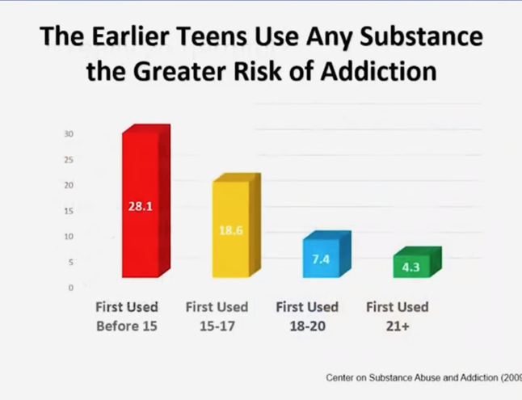
The earlier a teen uses, the greater risk of a lifetime addiction.

Slide 4
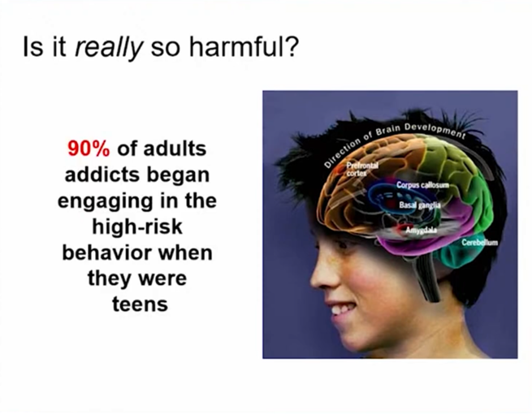
Most adult addicts started evidencing high risk behavior when they were teens

Slide 5
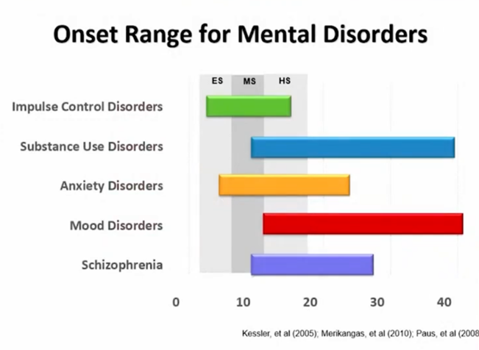
Mental health disorders typically start early and dramatically raise the likelihood of addiction.

Slide 6

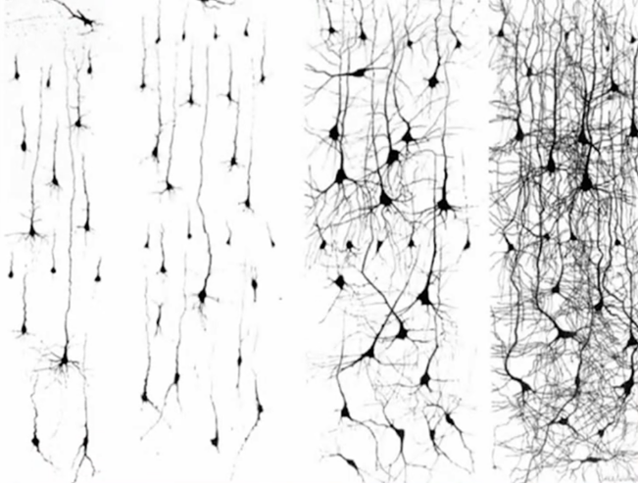
The infant neuron and its dendritic tree shown on the left is quite simple and you can see how its dendritic three increases in complexity across the lifespan.

Slide 7
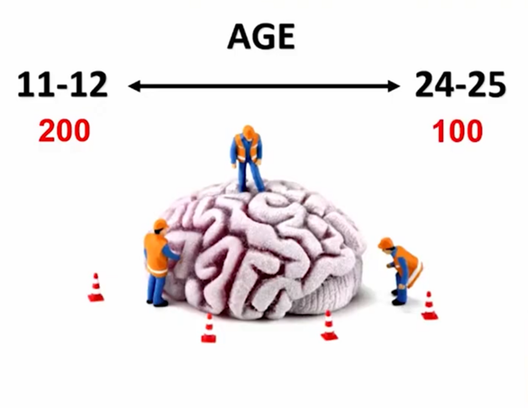
The Second Phase of Brain Growth
The second phase of brain growth starts at about 12 and continues to age 25. During this time, the brain prunes out little-used/unneeded neurons and the brain thus decreases from 200 billion to 100 billion neurons. During this time, pathways that are used myelinate to increase efficiency. So, ensure that a teen is learning and doing good things during this time as this will wire into what becomes the adult brain.

Slide 8
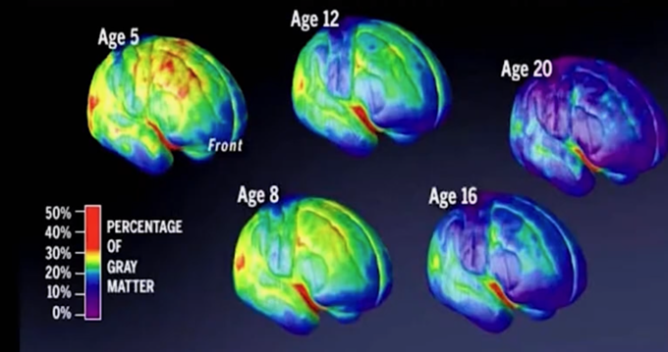
As the brain develops gray matter or unmyelinated neurons become myelinated to become white matter. This slide nicely how much growth occurs across childhood into early adulthood. THC and other drugs arrest this growth process.

Slide 9
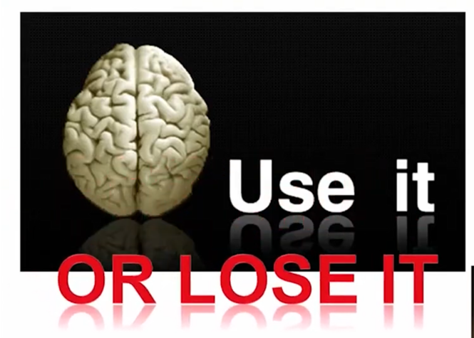
So – use the brain and wire in good stuff during adolescence or you lose good brain function in adulthood

Slide 10
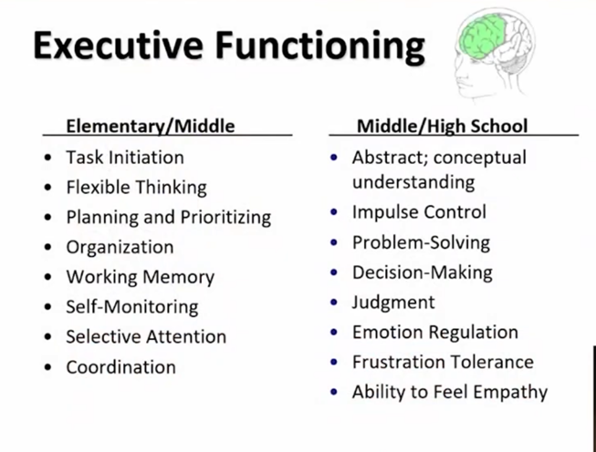
Executive functioning in the prefronal cortex run the show so it is essential that we teach our children these skills early.

Slide 11
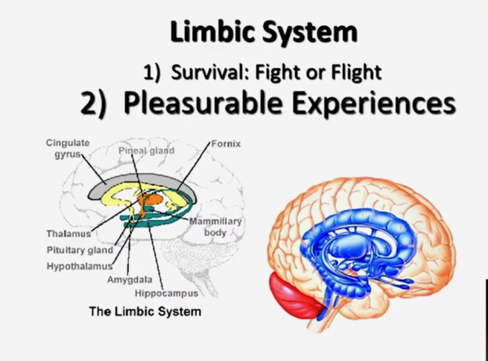
The limbic system directs the survival fight or flight system as well as pleasurable experiences.

Slide 12
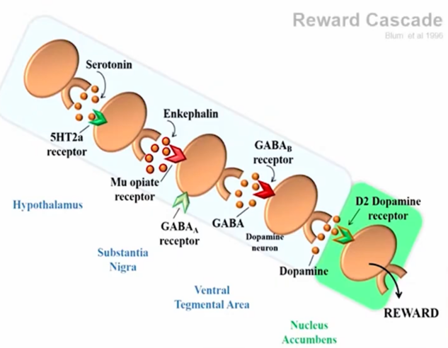
Reward Cascade
The reward cascade starts with serotonin on the 5HTa receptor which triggers Enkephalin on the Mu opiate receptor, GABAa receptor, and GABAb receptor which drives dopamine on the D2 dopamine receptor. All of this process transverses from the Hypothalamus, to the Substantia Nigra, to the Ventral Tegmental Area, and finally the Nucleus Accumbens.

Slide 13
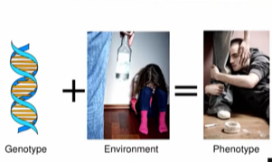
Gene expression is triggered by the environment which results in the phenotype or our observable characteristics and traits.

Slide 14
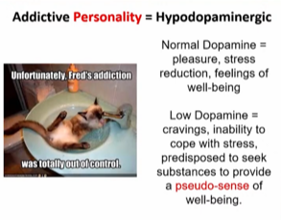
Low dopamine drives addiction and this can be caused by genetics and can be exacerbated by stress and trauma.

Slide 15
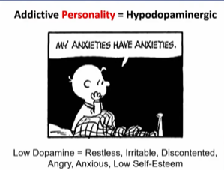
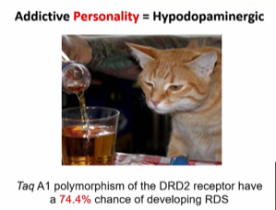
Low dopamine drives the addictive personality . If you have an A1 polymorphism of the DRD2 receptor, you will have a 74.4% chance of developing Reward Deficiency Syndrome (RDS).

Slide 16
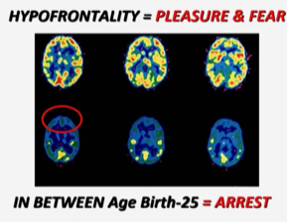
Hypofrontality drives both an inability to control impulses to overly pursue pleasure as well as exaggerated fear response. If this persists during development, you will see a developmental arrest.

Slide 17
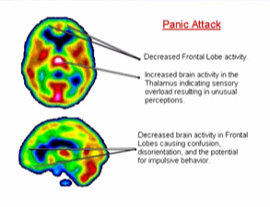
Panic attacks shut down frontal lobe activity which leads to confusion, disorientation, and possible impulsive behavior

Slide 18
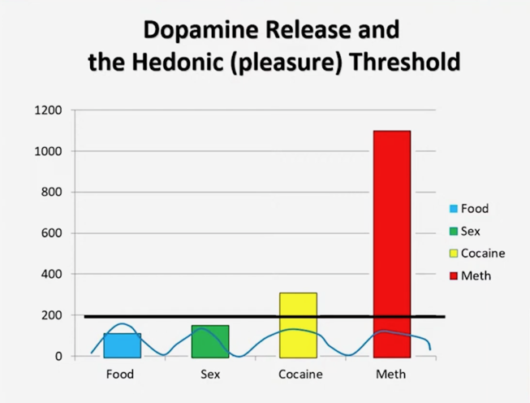
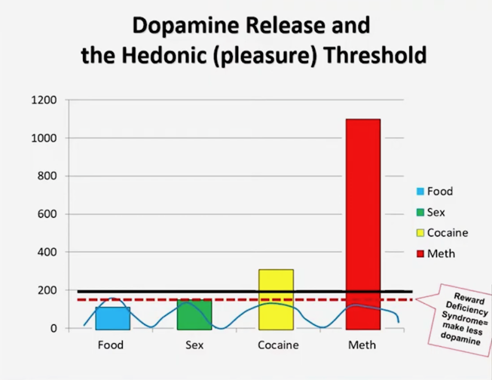
The hedonic (pleasure) threshold changes with genetics and/or with dopamine overuse which means that it will take more dopamine-driven behavior or substances to have an enjoyable effect.

Slide 19
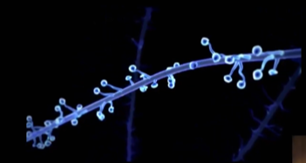
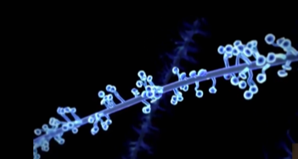
Excessive dopamine flow triggered by addiction causes dendritic growth on the neuron which results in permanent changes in the brain. This explains why craving is an everlasting consequence that must be respected throughout the lifetime.

Slide 20
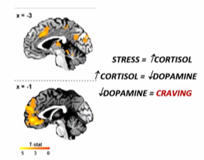
Stress increases the stress hormone cortisol which drives down dopamine levels which leads to craving.

Slide 21
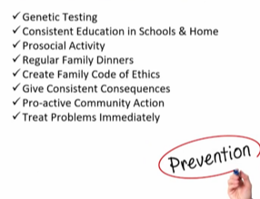
Prevention

