Slide 1

Media Addiction and the Search for Meaning
Jeffrey E. Hansen, Ph.D.
Madigan Army Medical Center
“The views expressed are those of the author and do not reflect the official policy of the Department of the Army, the Department of Defense or the U.S. Government.”

Slide 2

An Addiction Hits Close to Home

Slide 3

I began pondering: What has been going on with kids in the past 10 years or so?
An alarming increase in aggression
Increased destruction of property
Increased negative mood and irritability
Increased self-harm and suicidality
Decreased coping skills and resiliency
Poorer social skills

Slide 4
My Favorite Authors Deserve Credit:
Cash, Hilarie and McDaniel, K. (2008). Video Games and Your Kids: How Parents Stay in Control. Issues Press
Dunckley, V. (2015). Reset your Child’s Brain. Novato, CA: New World Library.
Hari, J. (2018). Lost Connections: Uncovering the Real Causes of Depression – And the Unexpected Solutions. Berryville, VA: Berryville Graphics, Inc.
Kardaras, N. (2016). Glow Kids. New York, NY: St. Martin’s Press.
Kersting, T. (2016). Disconnected: How to Reconnect our Digitally Distracted Kids. Independent Publishing Platform.
Palladino, L. (2015). Parenting in the Age of Attention-Snatchers: A step-by-step Guide to Balancing Your Child’s Use of Technology. Boston, MA: Shambhala.
Turner, A. (2017). Breaking the Feedback Loop: How I Liberated myself from Internet Addiction and you can too. Lexington, KY: Phanarian II.
Wilson, G. (2014). Your Brain on Porn. UK: Commonwealth Publishing.

Slide 5



Definition of Addiction
Adam Slater (2018)
Irresistible
In Rome being “addicted” meant that you had just been sentenced to slavery.
If you owed someone money and couldn’t repay, a judge would sentence you to work as a slave until you could repay the debt.
Addiction later evolved to describe any bond that was difficult to break.

Slide 6

Internet Addiction Test
0 = Not applicable
1 = Rarely
2 = Occasionally
3 = Frequently
4 = Often
5 = Always
How often do you find that you stay online longer than you intended? ­­____
How often do others in your life complain about the amount of time you spend on the internet? ____
How often do you check your email before something else that you need to do? ____
How often do you lose sleep because of late night log-ins? ____
How often do you find yourself saying “just a few minutes” when online? ____
7 or less No signs of Internet addiction
8 – 12 Mild internet addiction
13 – 20 Moderate Internet addiction
21 – 25 Severe Internet addiction
From: netaddiction.com/Internet-addiction-test/

Slide 7
Disruptive Mood Dysregulation Disorder – Real or a Sign of the Times:
Dunckley 2015 States:
“But what if this ‘disorder’ characterized by dysregulation is not some mysterious new plague, but environmentally related? If we ask ourselves, ‘What is the biggest change in our children’s environment compared to only one generation ago?’ the answer is not gluten, pesticides, plastics, or food dye, but the advent of the Internet, cell phones, and wireless communication. Might DMDD really be a by-product of constant bombardment from electronic screen devices, causing the brain to short-circuit? And what if the systematic removal of such screen devices provided much-needed relief, almost immediately?”

Slide 8

Part One:
Some Facts and Terms:

Slide 9

Current Trends
In a ten-year span from 1994 to 2003, the diagnosis of bipolar disorder in children increased forty-fold (Moreno et al., 2007).
Childhood psychiatric disorders such as ADHD, autism spectrum disorders, and tic disorders are on the rise (Atladottir et al., 2007).
Between 1980 and 2007, the diagnosis of ADHD has increased by 800 percent (Dunckley, 2012).
A December 2015 study in the Journal of Clinical Psychology found that ADHD diagnoses rose 43 percent in the United States, with more than one in ten children now diagnosed with the disorder.
Between 2001 and 2005, ADHD medication prescription rose by 40%.
Mental illness is now the number one reason for disability findings for children, representing half of all claims filed in 2012, compared to just 5 to 6 percent of claims twenty years ago (SSI Annual Statistical Report, 2012).

Slide 10
Current Trends - continued
Childhood psychosocial and neurodevelopmental issues have increased in lock step with the insidious growth of electronic screen exposure in daily life. Children 2 to 6 spend 2 to 4 hours per day screen-bound – during a period of their lives when sufficient healthy play is critical to normal development (Rideout et al., 2004).
Computer training in early education – including preschool – has become commonplace, despite a lack of empirical support for its efficacy (Facing the Screen Dilemma: Young Children, Technology and Early Education, 2012).
According to a long-term study by the Kaiser Family Foundation in 2010, children 8 to 18 spend on average 7½ hours per day on some form of screens – a 20% rise from just 5 years earlier (Rideout et al., 2010).
8-10-year-old children spend nearly 8 hours per day on media and older children spend more than 11 hours (AAP, 2013).
71% of children have a TV or Internet device in their room (AAP, 2013).
Teens receive and send on average 3,705 texts per month or about 6 per hour (Rosen, 2012).

Slide 11
Current Trends – continued
And what about we adults in the room?
Cited in Adam Alder, Irresistible (2018)
46 percent of adults say they couldn’t bear/fear to be without their smartphones (Nomophobia) - some would rather suffer physical injury (Rosenberg and Feder, Behavioral Addictions).
In 2008 adults spent on average of 18 minutes on their phones and in 2015 that rose to 2 hours and 48 minutes (Rosenberg and Feder, Behavioral Addictions).
Up to 59% of adults say they are dependent on social media and they report that this reliance makes them unhappy (Rosenberg and Feder, Behavioral Addictions).
There were an estimated 280 million smartphone addicts in 2015, which would make the fourth largest country in the world after China, India, and the United States (Rosenberg and Feder, Behavioral Addictions).

Slide 12
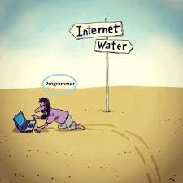
Sadly, many kids these days would go left I think:

Slide 13
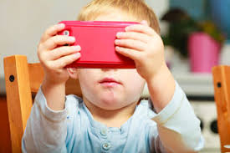
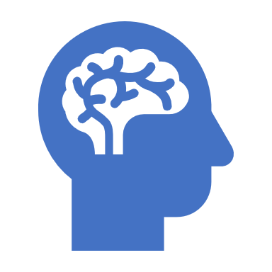
Electronic Screen Syndrome (ESS) - as Defined by Dr. Dunckley (2015):
A disorder of dysregulation caused by exposure to screens
Hyperarousal (fight or flight)
Mood dysregulation
Dysregulation of various biological systems
Sometimes immediate and obvious - sometimes more subtle
Can cause various chemical, hormonal, and sleep disturbances in the same way that powerful stimulants can
Can impact the central nervous system long after the offending device has been removed

Slide 14

Warning Signs of ESS:
Is revved up all the time
Has meltdowns over minor frustrations
Has full-blown rages which can lead to aggression and destruction of property
Becomes irritable when asked to stop playing video games or to get off the computer
Pupils are dilated after using electronics
Hard time making eye contact after screen-time or in general
Attracted to screens – like a moth to a flame

Slide 15
Warning Signs of ESS - continued
Less happy than normal or a loss of interest in otherwise pleasurable activities (anhedonia)
Difficulty making or keeping friends
Narrowed range of interests, or that these interests mostly revolve around screens
Thirst for knowledge and natural curiosity have dampened
Grades have fallen and/or is not working up to potential
Teachers, pediatricians, or therapists have suggested ADHD, bipolar disorder, depression, an anxiety disorder, or possibly even psychosis, and there is no family history of the disorder

Slide 16
Warning Signs of ESS - continued
Multiple practitioners have given differing or conflicting diagnoses
Preexisting conditions such as autism spectrum disorder or ADHD appear to be getting worse
Is “wired and tired,” like being exhausted but can’t sleep, or sleeps but doesn’t feel rested
Seems lazy and unmotivated and has poor attention to detail
Seems stressed, despite no evident stressors
Receiving services at school but they don’t seem to be helping

Slide 17


Screen-time Devices:
Screen-time refers to any and all time spent in front of any device that involves a screen to include:
Desktop computers
Laptops
Tablets
Smartphones
Televisions
Video games
Digital cameras
E-readers

Slide 18
Screen-time Activities:
Time spent texting
Video chatting
Surfing the Internet
Gaming
Emailing
Engaging in social media
Using apps
Shopping online
Writing and word processing
Reading from an electronic device such a tablet or Kindle
Scrolling through pictures on a phone

Slide 19
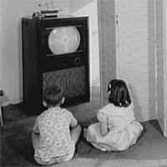
Interactive versus Passive Screen-Time:
Interactive screen-time: Screen activity whereby the user regularly interfaces with an electronic device whether it is a touch screen, keyboard, console, motion sensor, etc.
Passive screen-time: Activities such as watching programs on a TV across the room

Slide 20
Effects of Interactive versus Passive Screen-time
Research indicates that both forms of screen-time are connected with health problems and developmental issues such as obesity, depression, sleep problems, attentional problems, slower reading development, and decreased creativity, etc.
Research indicates that interactive screen-time is more problematic than passive screen-time, (Dunckley, 2015).
2012 Study of 2,000 Elementary and Middle School kids: Sleep problems occurred with just 30 minutes of interactive versus 2 hours of passive screen time (Dunckley,2015).

Slide 21

Part Two:
How the Brain Gets Hooked on Media
DA
Dopamine - guilty as charged

Slide 22
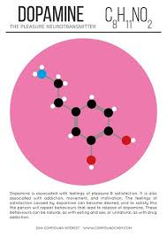
How the Brain Gets Hooked on Digital Drugs
As Kardaras(2016) stated in his book, Glow Kids, in order to fully understand addiction, we need to understand the brain’s reward system and the impact of dopamine on that reward pathway.
Specifically, how much dopamine is activated by a substance or behavior is correlated directly with the addictive potential of that substance or behavior.
Dopamine, as many of us know, is the “feel-good” neurotransmitter that is the most critical and important part of the addiction process. Dopamine was discovered in 1958 by Arvid Carlsson and Niles-Ake Hillarp at the National Heart Institute of Sweden.

Slide 23
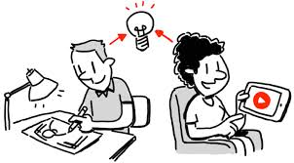
Functions of Dopamine
Dr. Susan Weinschenk (2009) noted that dopamine is created in various parts of the brain and is critical in several brain functions to include:
Thinking
Moving
Sleeping
Mood
Attention
Motivation
Seeking and reward
Inspired to watch because of Dopamine

Slide 24
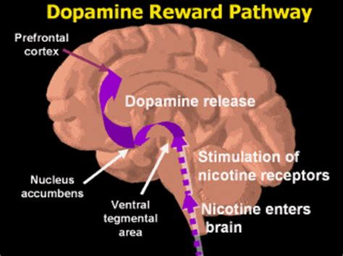
Dopamine Reward Pathway
The mesolimbic pathway is a collection of dopaminergic(i.e., dopamine-releasing) neurons that project from the ventral tegmental area (VTA) to the ventral striatum, which includes the nucleus accumbens (NAcc) and olfactory tubercle. It is one of the component pathways of the medial forebrain bundle, which is a set of neural pathways that mediate brain stimulation reward.

Slide 25
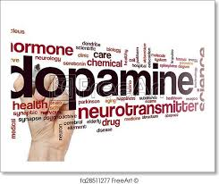
More on Dopamine
When an individual performs an action that is satisfying to a need or fulfills a desire, dopamine is released into the nucleus accumbens, a cluster of nerve cells beneath the cerebral hemispheres that are specifically associated with reward and pleasure. This is also known as the brain’s “pleasure center.”
Natural dopaminergic activities, such as eating and sex, usually come after effort and delay and serve a survival function.
These are called the “natural rewards” as contrasted with addictive chemicals/behaviors (which can highjack the same circuity).
Addictive drugs and behaviors, such as gambling and video gaming, actually offer a short-circuit to this process which only ends up flooding the nucleus accumbens with dopamine and does not serve any biological function.

Slide 26
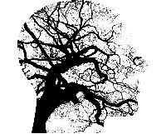
Dopamine vs Endogenous Opioids
Although dopamine has been referred to as the “pleasure molecule,” it is in actuality more about seeking and searching for pleasure, rather than pleasure itself. Dopamine is more involved in drive and motivation to seek.
The “final reward” or what we experience as feelings of pleasure, Wilson (2014) writes, involve the release of endogenous opioids.
You can think of dopamine as “wanting” and opioids as “liking.”
As psychologist Dr. Weinschenk explains, “Dopamine causes us to want, desire, seek out and, search; however, the dopamine system is stronger than the opioid system and we hence seek more than we are as satisfied…” (Weinschenk, 2009).
“Addicts want it more but gradually like it less. Addiction might be
thought of as “wanting gone amok.” (Wilson, 2014).

Slide 27


Bought and liking the BMW but still Wanting the Ducati Diavel

Slide 28

Dopamine and DeltaFosB “Keep doing it!”
Highly salient activities, in this case addiction, lead to the accumulation of DeltaFosB, a protein that activates the genes involved with addiction. The molecular changes it potentiates are almost identical for both sexual conditioning and chronic drug use. Specifically, DeltaFosB rewires the brain to crave IT whatever IT is.
In a sense, dopamine is like the foreman on a construction site barking orders and DeltaFosB is the worker on the site. Dopamine is yelling, “This activity is really important, and you should do it again and again.”
DeltaFosB is responsible for ensuring that you remember and repeat the activity.
This repeated process produces what is called sensitization which is based on the
principle, “Nerve cells that fire together wire together” as noted by Canadian
researcher Donald Hebb in 1949. Repeated activity strengthens
cell connections.

Slide 29
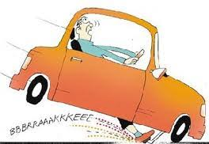
Dopamine and CREB – “Slow it Down, Silver!”
As the brain recognizes that it needs a rest, it will kick out CREB in an effort to slow things down (Wilson, 2014).
In essence, DeltaFosB acts like the gas pedal and CREB functions as the brakes.
CREB specifically inhibits dopamine and endogenous opioids in an effort to take the joy out of the binging/addictive behavior or substance so that you can give it a rest.
This numbed pleasure response that is induced by CREB is often identified
as desensitization which leads to tolerance - the need of increasingly
higher doses to achieve the same effect. Tolerance is a key factor in
addiction.

Slide 30
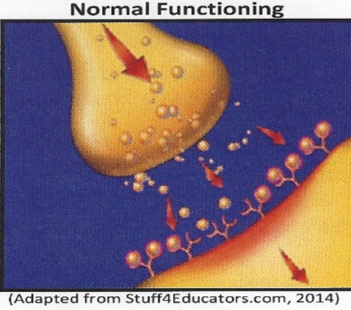
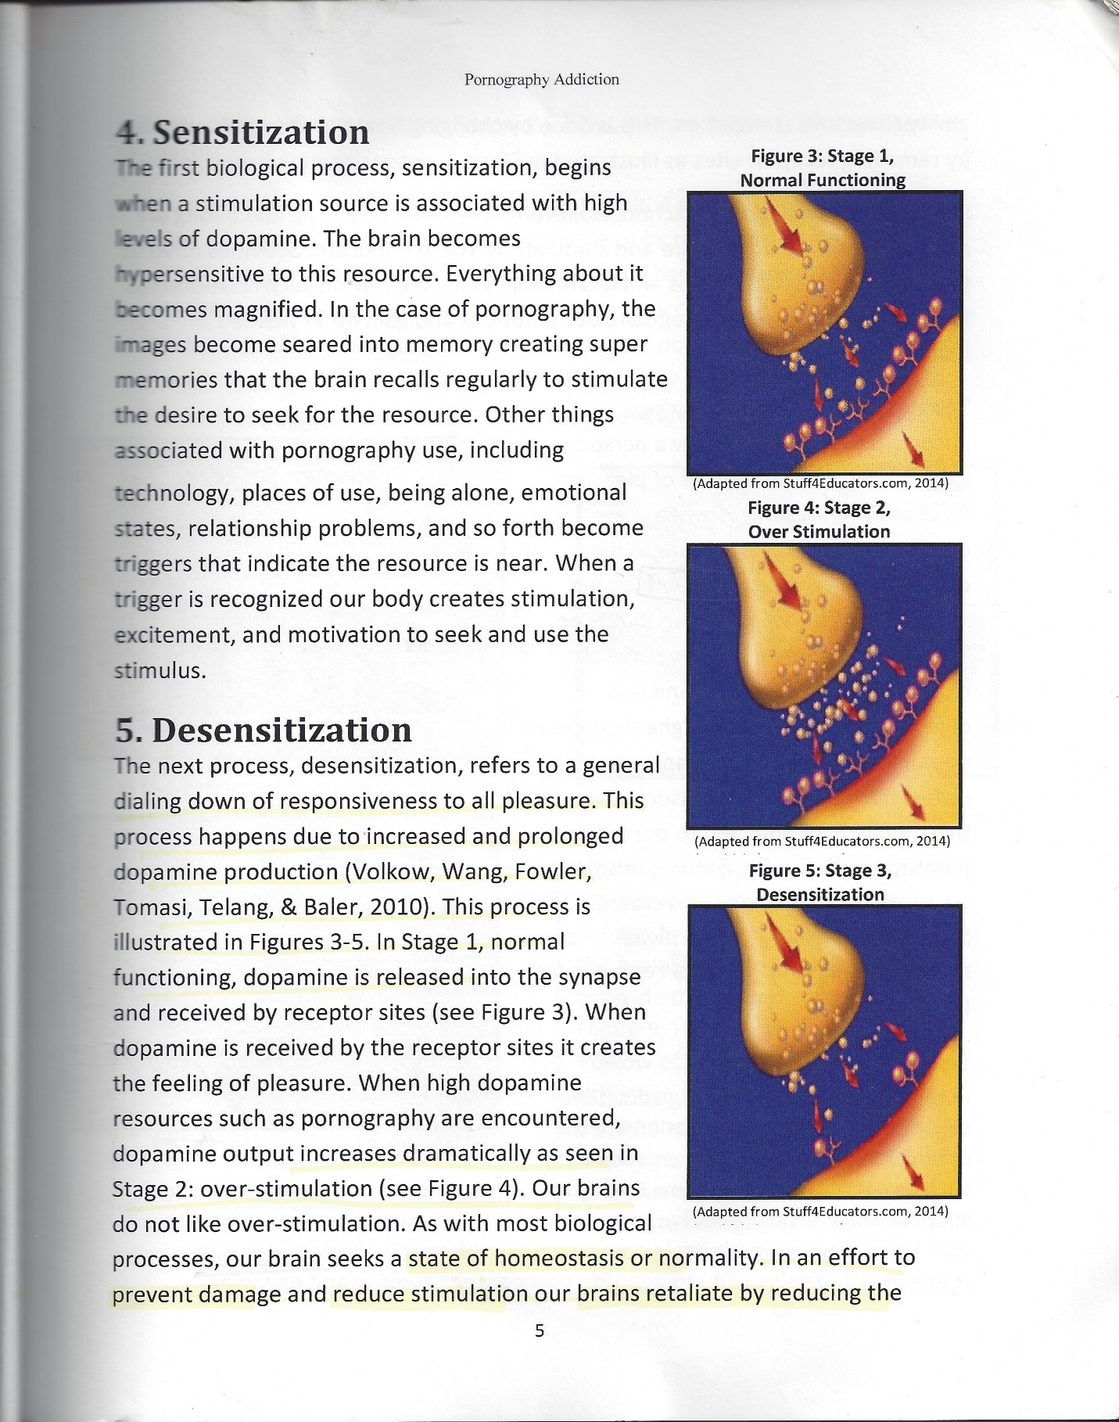
Dopanergic Downregulation at the Synaptic Level

Slide 31
So, we see that chronic overstimulation can lead to two opposite effects:
Increased dopamine activity (wanting/seeking it more) –
sensitization via DeltaFosB
01
Decreased dopamine and opioid activity (liking it/enjoying it less) – desensitization via CREB
02

Slide 32
The Three C’s of Addiction
Wilson (2014) notes that all addictions, regardless of their differences, result in an established set of “core brain changes” which, in turn, present as recognized signs, symptoms, and behaviors such as those listed in the Three C’s:
Craving and Preoccupation with obtaining, engaging in or recovering from the use of the substance or behaviors in question.
Loss of Control in using the substance or of engaging in the behavior and noted by increasing frequency or duration, larger amounts or intensity, and/or increasing the risk and behavior in an effort to obtain the desired effect.
Negative Consequences in physical, social, occupational, financial, or psychological areas.

Slide 33
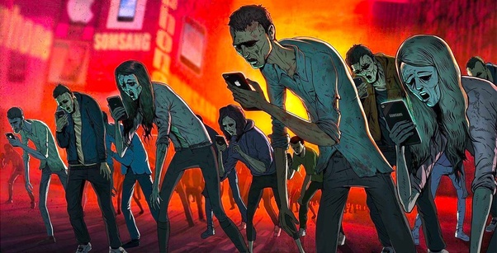
Factoids about Dopamine Increases (Koepp et al., 1998; Guangbheng et al., 2012)
Chocolate – 50% increase
Sex – 100% increase
Snorting cocaine – 350%
Crystal meth – 1,200%
Video gaming – 100%

Slide 34

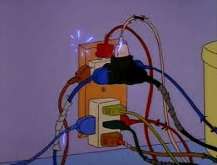
Part Three:
The impact of Media on Your Child’s Brain, Body, and Behavior
“I like to play indoors better,
‘cuz that’s where all the electrical outlets are.”
--Paul, fourth grader in San Diego

Slide 35
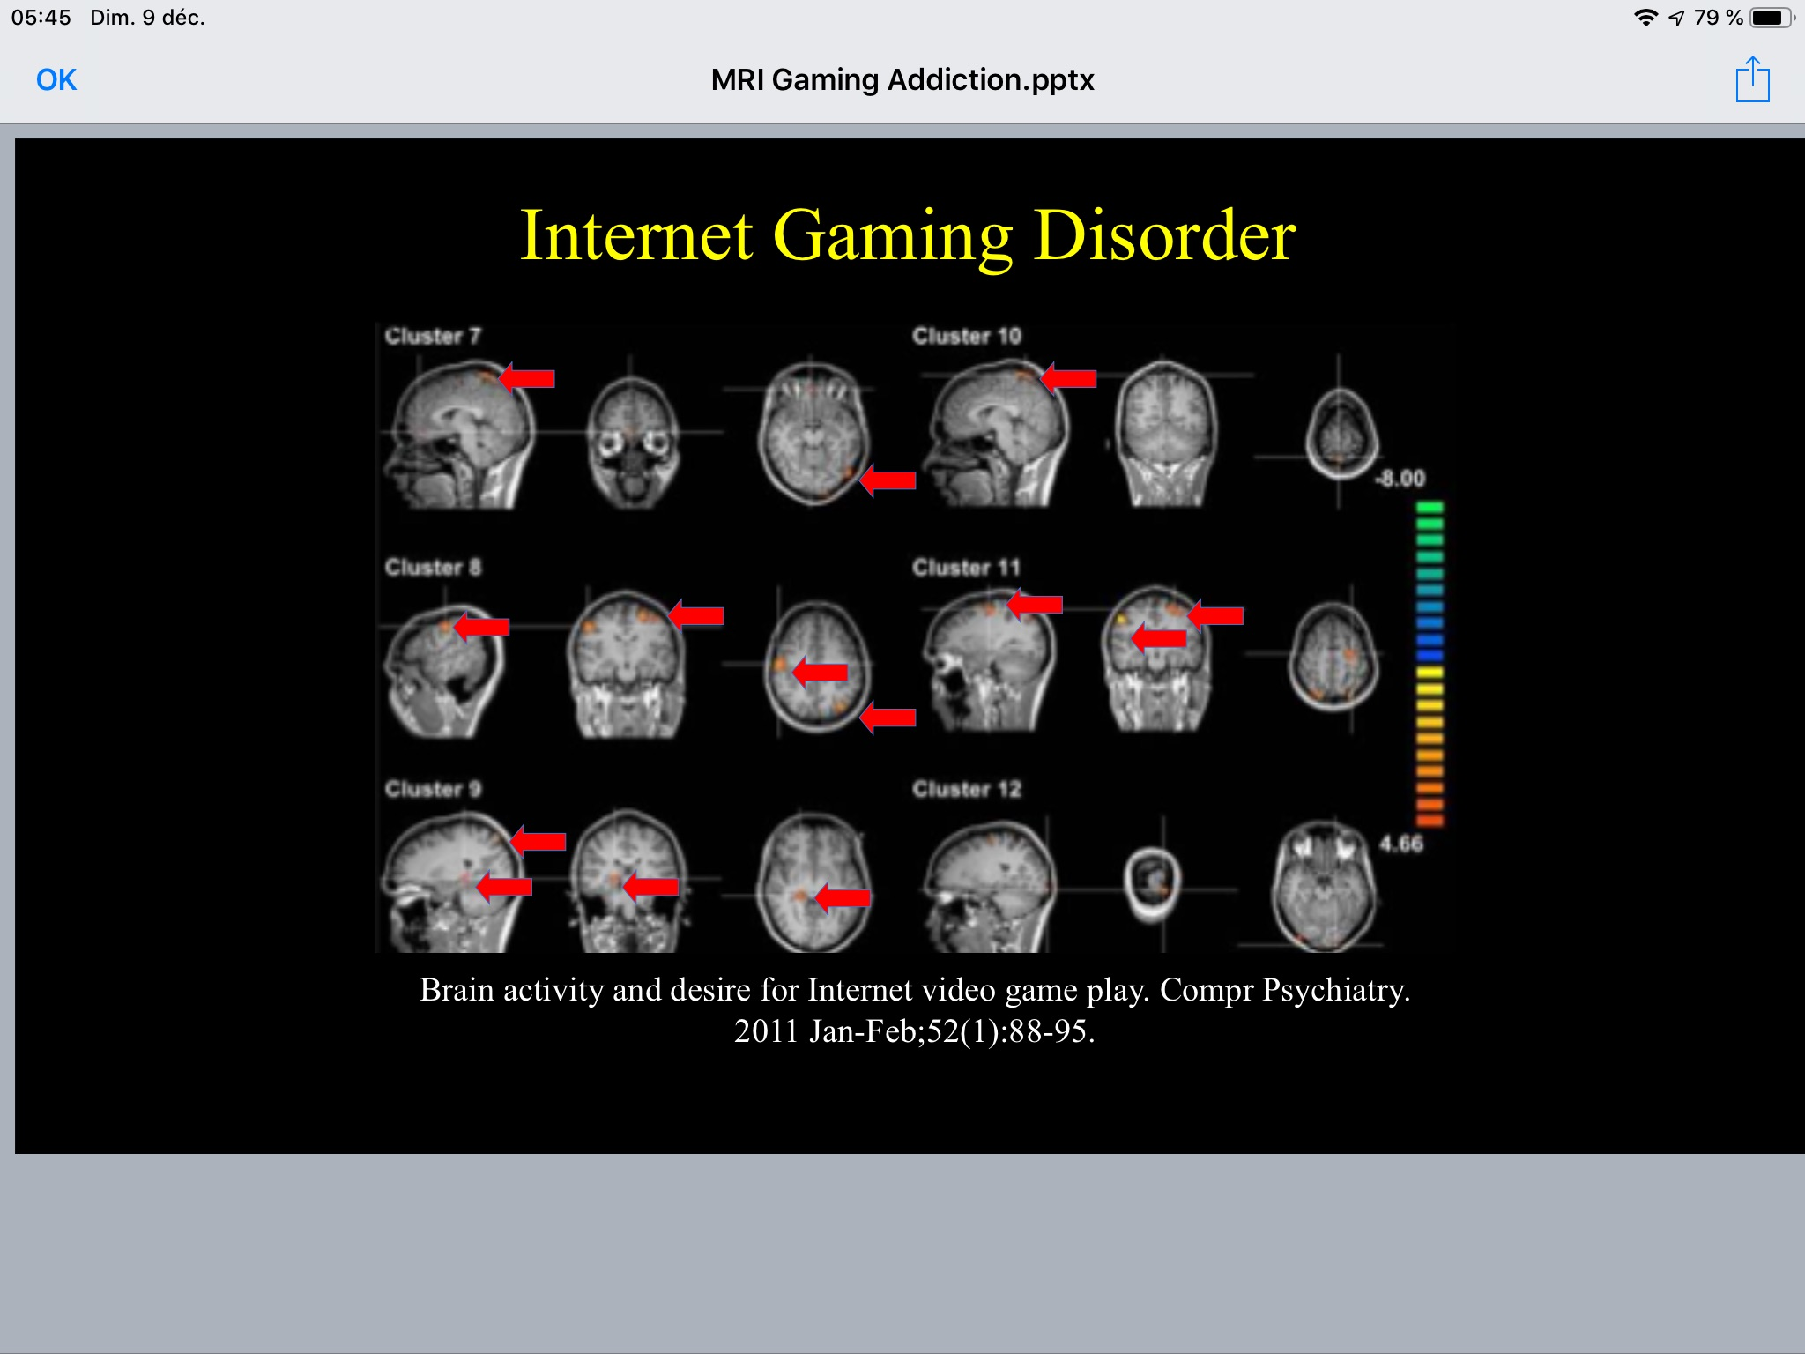
MRI of “Gaming Brain”
This slide displays areas of brain activity after showing video game addicts triggers consisting of video game footage. The areas of activation occur in similar patterns in brains of people addicted to drugs and gambling.
Cerebral Blood Flow Activity of a brain after gaming.

Slide 36

Impact of Excessive Media on Eyes
Excessive media can desynchronize the body clock and other important biological rhythms (Dunckley, 2015).
Can affect normal eye movements to include those used for changes in depth perception which influences visual and vestibular development (Dunckley, 2015).
Can cause Computer Vision Syndrome - resulting in blurred vision, headaches, and dry, irritated eyes (Dunckley, 2015).
Implicated in actual damage to the retina in some laboratory and animal studies, specifically blue and intense light (Dunckley, 2015).

Slide 37
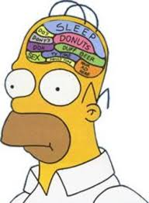
Impact of Excessive Media on the Brain
Excessive Media can hijack the “orienting response” which helps us assess a threat before we determine to fight, flee, or freeze by creating chemical, electrical, and mechanical shifts that end up raising arousal levels (Dunckley, 2015).
01
Stimulation by excessive media can damage myelin in neuropathways, most specifically the oligodendrocytes, the brain cells that produce cholesterol for proper myelination. (Kardaras, 2016).
02
When myelin is destroyed by overstimulation during key developmental periods, problems such as our ability to focus, feel empathy, and/or discern reality can all be negatively affected (Kardaras, 2016).

Slide 38

Impact of Excessive Media on the Body
Excessive media can trigger Metabolic Syndrome. Metabolic syndrome is a combination of the following (Dunckley, 2015):
  High blood pressure
  Midsection weight gain (spare tire)
  Abnormal cholesterol levels
  High fasting blood sugar
Metabolic Syndrome is a serious condition and, if left unchecked, can
promote:
  Diabetes
  Heart disease
  Stroke

Slide 39
In the words of Dr. Andrew Doan:
“I had pain from my clicking finger all the way up to my forearm. And my cortisol levels were shot - through my hypothalamic-adrenal-pituitary axis (HPA), so I was getting fat because I had all of this cortisol floating around. I didn’t exercise, so I was retaining more body fat. And then finally my HPA axis was all dysregulated so I was more prone to infection - I had pimples all over my face, I had stretch marks beginning. And then, finally, I got an infection in my armpit!
So, in addition to the carpel tunnel, I had this armpit infection that was streaking down my arm. And on top of that, because my blood pressure was going up because of the gaming adrenaline rush - my blood pressure was high, my cholesterol was high. And because my blood pressure was high, and I was sitting all of the time, I had hemorrhoids the size of walnuts. - I mean, literally! I was a young man - I was pissed off. Why do I have hemorrhoids like some pregnant women do? We’re talking about bloody, painful hemorrhoids…So I’m convinced that if people are addicted to this thing, it’s going to ruin their lives. It almost ruined mine - and it almost ruined my son and almost destroyed his confidence and his opportunities” (Kardaras, 2016).

Slide 40


Impact of Excessive Media on Arousal
Excessive media consumption sends unnatural and overstimulating messages via the eyes, brain, and body to the nervous system which in turn trigger:
- Fight, freeze, or flee response
- Electronic Screen Syndrome
-Poorer ability to manage and handle stress

Slide 41
Impact of Excessive Media on Arousal
Excessive media consumption sends unnatural and overstimulating messages via the eyes, brain, and body to the nervous system which in turn trigger:
- Fight, freeze, or flee response
- Electronic Screen Syndrome
-Poorer ability to manage and handle stress

Slide 42

The Impact of Chronic Hyperarousal
Blood Flow Shifts: When a person is under stress, blood flow to the brain is shunted away from the higher regions of the brain, i.e., the cortex, and directed to the more primitive parts of the brain, i.e., the limbic or old brain in an effort to promote survival.
Elevated Cortisol: Chronically elevated cortisol is associated with obesity, diabetes, hormone imbalance, metabolic syndrome, and high blood pressure as previously noted (Pervanidou et al., 2011).
Oxidative Stress: When the cell’s natural defenses are overwhelmed due to excessive stress, the antioxidants or scavengers are depleted, and oxidative stress or excessive free radicals develop. Free radicals cause inflammation, tissue damage, and decreased efficiency.

Slide 43
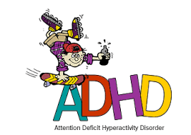
Impact of Media on Attention - The ADHD Effect
Prefrontal Cortex directs “executive function” or the ability to get things done which involves:
Planning
Organizing
Revising
Strategizing
Attending to details
Managing time and space
Inhibition of negative behaviors (putting on the brakes)
Deficits in any one of these areas can have huge impact on the child.

Slide 44
Impact of Media on Attention - The ADHD Effect - continued
Exposure to video games and television in childhood leads to subsequent attention problems (Kardaras, 2016).
When you see something exciting, it is hard to downshift to something less exciting.
The more TV a child watches between the ages of one and three, the more likely the child is to be diagnosed with ADHD by age seven (Kardaras, 2016).
Symptoms of ADHD can be environmentally induced – Microsoft (2015) report: The average attention span has shortened from 12 to 8 seconds in a decade (Turner, 2017).

Slide 45

Impact of Media on Attention - The ADHD Effect - continued
Excessive media can degrade Focused or Voluntary Attention as shown in the Marshmallow Test (Mischell, 1972).
Follow-up studies on these kids up until age 40 showed that those children who were able to wait the distance, did better on multiple aspects of life (Palladino, 2015):
Higher Scholastic Aptitude Test (SAT) scores
More successful education
Better success at keeping friends
Greater financial success
Dr. John Ratey, Clinical Professor of Psychiatry at Harvard School of Medicine, coined the term, Acquired Attention Deficit Disorder.

Slide 46


Impact of Distracted Parents
Dr. Catherine Steiner noted that many American children first encounter the digital world when they notice their parents are Missing-in-Action.
Penny (7) complains, “I always keep asking her let’s play, let’s play and she’s always texting on her phone.”
Distracted parents produce distracted children because parents can’t focus to teach their kids the necessary attention patterns for success.
Caregivers who appear distracted or whose eyes wander a lot while their children play appear to negatively impact on infants’ burgeoning attention spans (Indiana University, 2016).

Slide 47

The Impact of Media on Depression
A.N. Turner (2017) eloquently writes of his own struggle with depression secondary to media overconsumption:
“My relationship with the Internet was not alleviating feelings of loneliness; it was amplifying my loneliness, bringing me to a state of frustrated depression. I felt boxed in, unable to breathe, trapped in an inescapable thought bubble of my own f*ed up, addictive desires. I conditioned myself to need constant stimulation. I couldn’t read, talk, study, or play the piano – all things that I love – because it all seemed too slow, too one-note…I was always tired, yet always racing in a mad frenzy. I couldn’t focus. I was anxious. I was unable to engage in solitude. My thoughts were a jumble. “

Slide 48

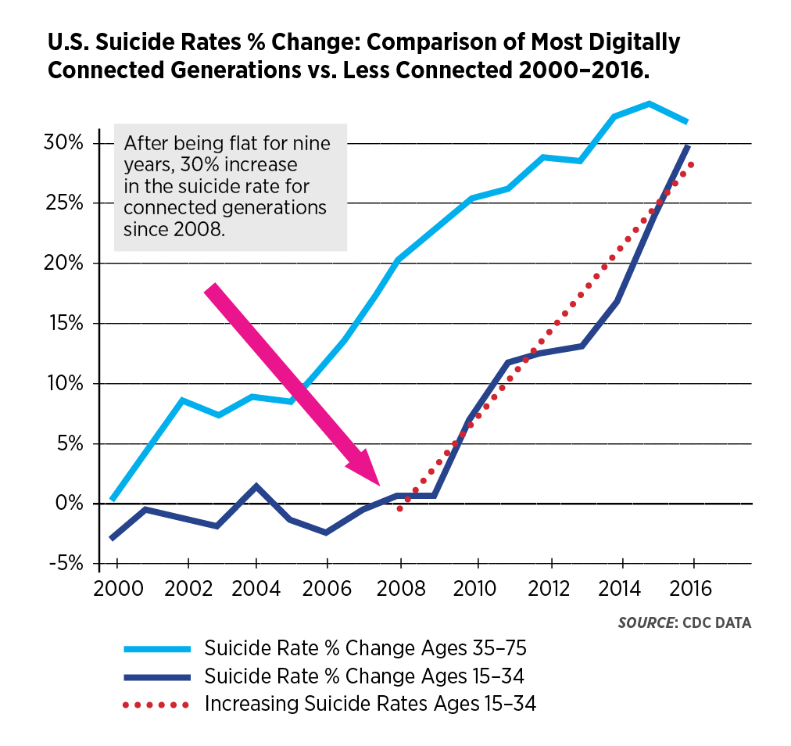
The Impact of Media on Depression – continued:

Slide 49
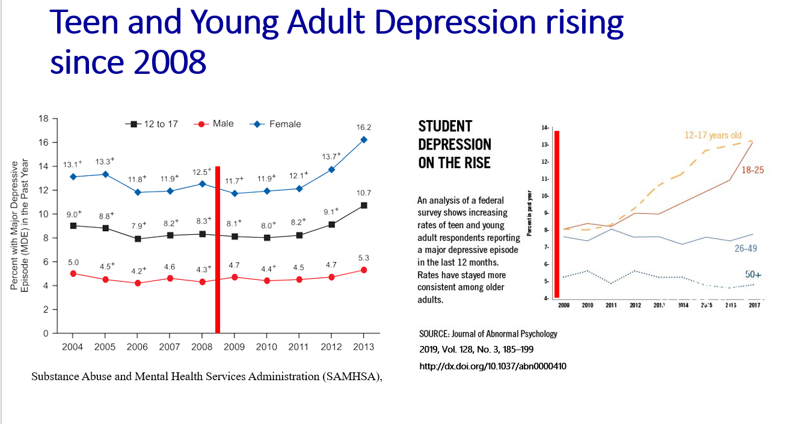
The Impact of Media on Depression – continued:
Shared with permission – Peter Ryan, CAPT, USN (R)

Slide 50
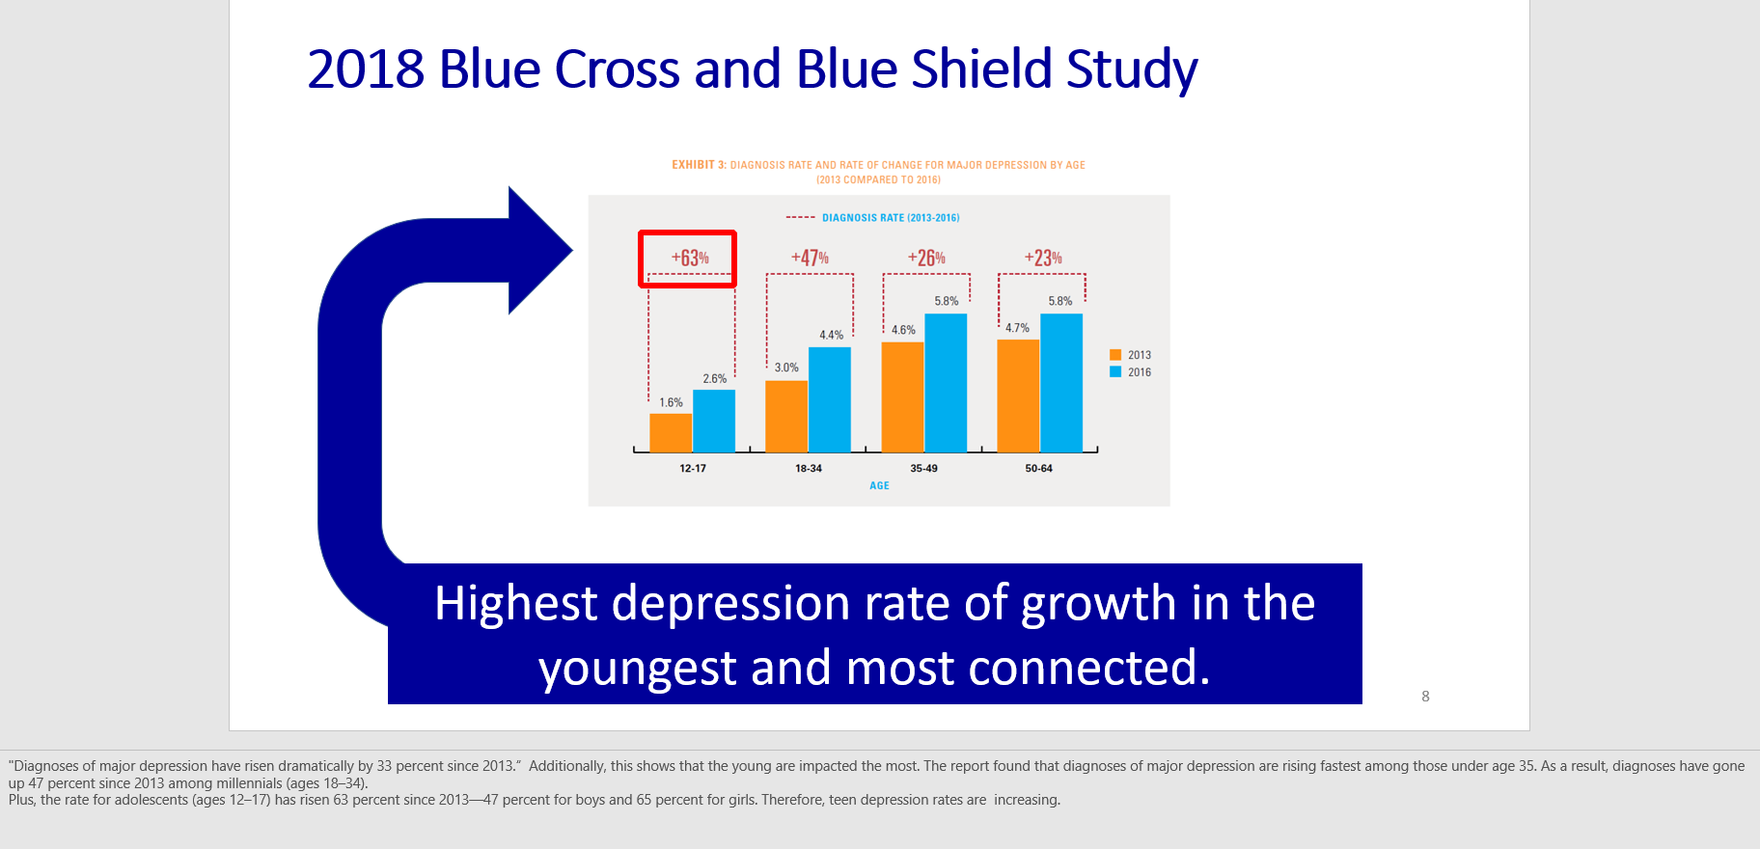
The Impact of Media on Depression – continued:
Shared with permission – Peter Ryan, CAPT, USN (R)

Slide 51
The Impact of Media on Depression – continued:
Kardaras (2016) cites the following alarming statistics:
A 2012 Missouri State University study of 216 students revealed that 30 percent of Internet users showed signs of depression and that the depressed kids were more intense web users.
A 2014 study looked at 2,293 seventh-graders and found that Internet addiction led to increased depression, hostility, and anxiety.
A 2014 study conducted in Pakistan with 300 graduate students found a positive correlation between Internet addiction and depression and anxiety.
A 2006 Korean study involving 1,573 high school students found a correlation between Internet addiction, depression, and thoughts of suicide.
Recently, the term Facebook Depression has emerged – namely, the more “friends” one has on Facebook, the higher the likelihood of depressive symptoms (Kardaras, 2016).

Slide 52
The Impact of Media on Depression – continued
Case Western Reserve University School of Medicine study found that “hypernetworkers” were prone toward (Pederson, 2015):
  Higher rates of depression
  Increase substance abuse
  Poor sleep
  Greater reported stress
  Poor academic performance
  Higher rates of suicide
  69 percent more likely to have sex
  60 percent more likely to report four or more sexual partners
  84 percent more likely to have used illegal drugs
  94 percent more likely to have been in a physical fight

Slide 53

The Impact of Media on Psychosis:
Game Transfer Phenomenon: Gamers transfer elements of the game content, or the interface, into their real lives, usually harmlessly (Griffiths, 2011).
In 2007 a Chinese boy poured gasoline on another gamer, lit him on fire, and later stated that he had “lost himself in World of Warcraft” believeing that he had become a “fire mage.” (Kardaras, 2015)
In December 27, 2004, after playing World of Warcraft for 36 hours straight, a 13 y/o Chinese boy jumped to his death after leaving a note stating that he wanted to join his heroes (Kardaras, 2015).

Slide 54

The Impact of Media on Psychosis - continued:
Griffiths (2011) notes that video game playing can induce pseudo-hallucinatory-like experiences.
Two recent single case studies reported rapid onset psychosis after immediate cessation of gaming. Successfully treated with antipsychotics.
Dunckley (2015) suggests that dopamine dysregulation might be, in part, the underlying mechanism for screen-related psychosis. Medications that increase dopamine such as stimulants are very capable of producing psychosis and, on the other hand, many of the medications used to treat psychosis block dopamine

Slide 55
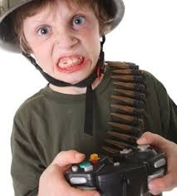
The Impact of Median on Aggression:
A meta-analysis of 381 studies on over 130,000 participants conducted by Dr. Greenfield (2015) indicated that violent video games significantly increased aggressive cognition, aggressive behavior, and physical arousal.
Dr. Craig Anderson from Iowa State University summarized 130 research studies with more than 130,000 participants and, likewise, concluded that exposure to violent video games makes for more aggressive and less caring kids – regardless of age, sex, or culture (Kardaras, 2016).
Greenfield (2015) noted that gaming is associated with less activity in a region of the brain which is involved in emotionally charged memory; namely, the amygdala.
Brain imaging research at the Indiana School of Medicine (2011) found a direct relationship between playing violent video games and quantifiable brain changes involving “less activation in certain frontal brain regions.”

Slide 56

The Impact of Median on Aggression – continued:
We all remember the tragic Sandy Hook Elementary School mass shooting involving the infamous 20-year-old Adam Lanza on December 14, 2012 (Kardaras, 2016):
  Shot 20 innocent children between the ages of six and seven and six adult staff members
  83,000 online kills and 22,000 head shots
  Was obsessed with “World of Warcraft, Combat Arms, Call of Duty, and Modern Warfare 2
  “School Shooter” on his hard drive

Slide 57
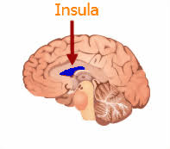
Impact of Media on Social/Emotional Development:
Brain imaging studies indeed indicate that gaming addiction damages the insula, an area of the brain that has been specifically involved in empathy (Weng, et al., 2012; Suzuki, 2012).
Dunckley (2015) notes that the more time a child spends behind a screen, the more socially anxious or inept he or she becomes which creates a self-perpetuating spiral in socially anxious children, in particular.

Slide 58
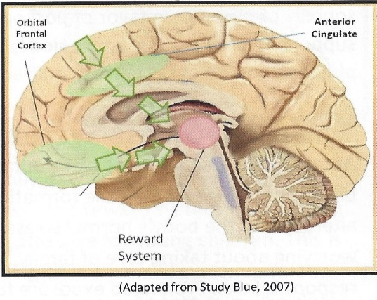

Impact of Media on Social/Emotional Development:
Two areas of the brain, the anterior cingulate and the orbital frontal cortex, serve as a protective mechanism to override the reward system’s desire for ever increasing dopamine increase. Sadly, hypofrontality involves the rewiring of our brains so that when an impulse to engage in a dopamine-related behavior activated, the brain ends up shutting down its ability to override the reward system. This is the breeding ground for horrible choices an impacts on social development

Slide 59
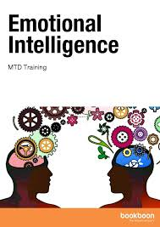
Impact of Media on Social/Emotional Development – continued:
Excessive media impairs Emotional Intelligence (EQ) (Kersting, 2016).
Goleman’s (2016) “Mixed Model” of Emotional Intelligence:
Self-Awareness: The ability to know your own feelings. This means that you are aware of your emotional triggers and have an ability to deal with them.
Self-Management: This involves the ability to keep your emotions in check when they start to ramp up and become problematic or disruptive.
Motivation: Most people are motivated by external/outside events such as money. Emotionally intelligent people are more internally/intrinsically motivated (i.e., internal peace or a sense of pride for doing the right thing).
Empathy: Empathy involves the ability to appreciate and support the feelings of someone else by responding appropriately to their situation and feelings. This will often lead the person to suspend the needs/feelings of oneself in support of the needs/feelings of another.
Social Skills: This involves, among other things, the ability to deal with others in that you are able to find a common ground with other people. It involves the ability to negotiate, problem-solve, and compromise.

Slide 60

Impact of Media on Social/Emotional Development – continued:
Gray (2015) noted the following trends in college students which are, in part, thought to be a function of excessive media (Kersting, 2016):
Students are needier and less resilient.
Students are increasingly afraid to fail, and they do not take risks. Failure is perceived as catastrophic and totally unacceptable.
Faculty, especially younger ones, feel extreme pressure to give into student wishes in fear of getting low ratings from students.
Students email faculty about increasingly trivial matters and become demanding about wanting prompt replies.

Slide 61
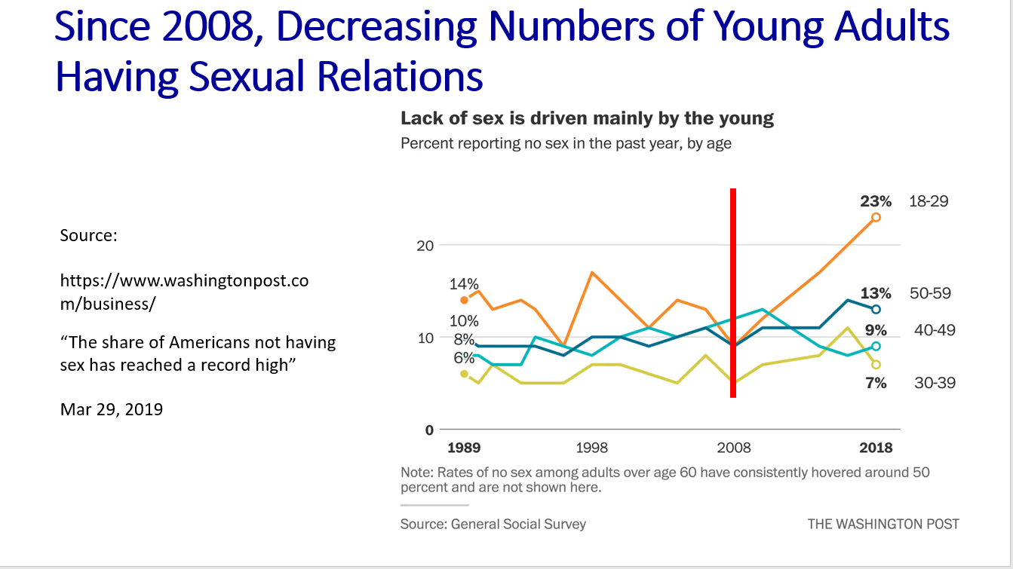
Impact of Media on Social/Emotional Development – continued:
Shared with permission – Peter Ryan, CAPT, USN (R)

Slide 62
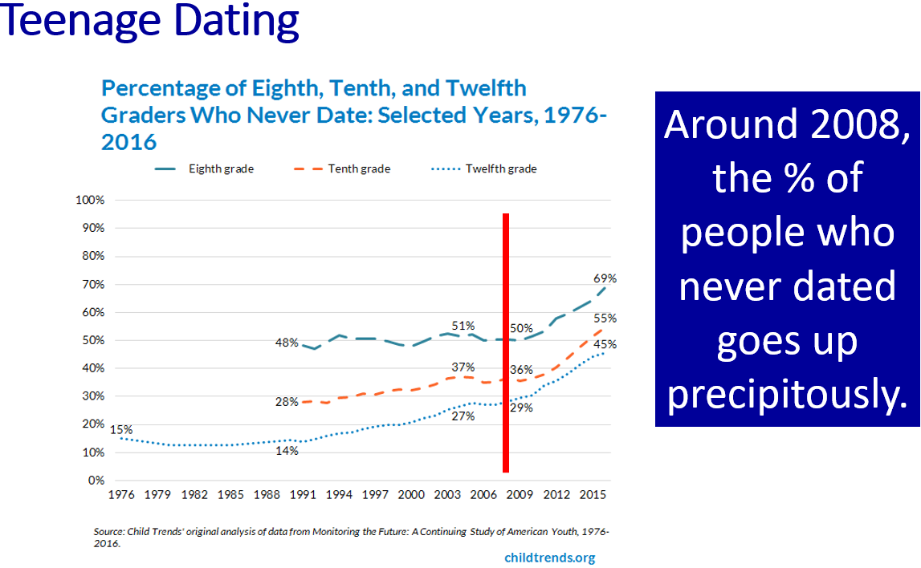
Impact of Media on Social/Emotional Development – continued:
Shared with permission – Peter Ryan, CAPT, USN (R)

Slide 63



Impact of Media on Social/Emotional Development - continued:
According to Dr. Twenge (2017) in her new book, iGen: Why Today’s Super-Connected Kids Are Growing Up Less Rebellious, More Tolerant, Less Happy – and Completely Unprepared for Adulthood, conducted a meta-analysis of 4 studies involving 11 million young Americans and found that they:
Are more insecure
Evidence a significant decline in person-to-person interaction
Are obsessed with safety
Are insecure about income and their ability to make it in the world
Tend to extend their childhood
Are ill-prepared for adulthood
Are less happy
Are more tolerant and less rebellious

Slide 64
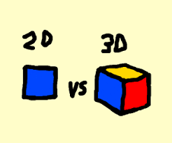

Impact of Media on Social/Emotional Development - continued:
Kersting (2016) points out that EQ is not something that we are born with and can only be learned by observing voices, body posture/language, and/or facial expressions. You must have direct face-to-face 3D interaction or connection with other people as opposed to face-to-screen 2D interaction.
01
Nass (2013) writes that this learning starts at infancy and that it is not an easy thing to acquire. It was much easier for previous generations to build a strong EQ because they had so much more face-to-face interaction.
02

Slide 65

Before and After

Slide 66
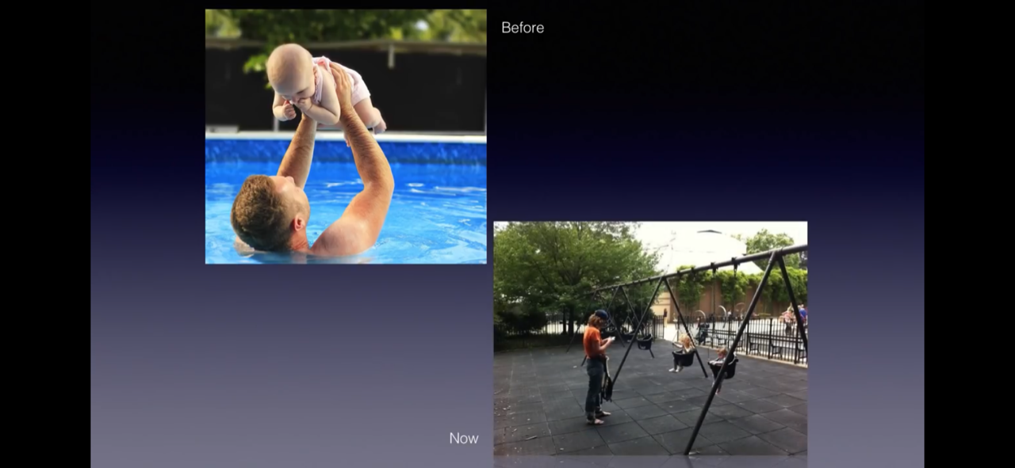
Before and After

Slide 67
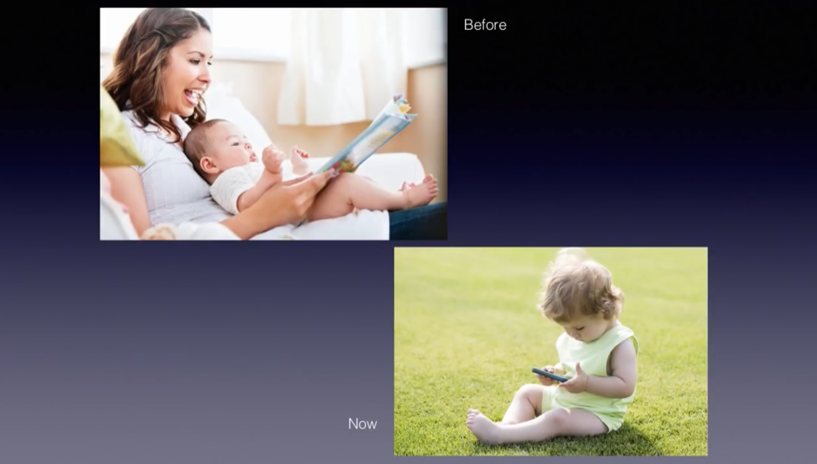
Before and After

Slide 68
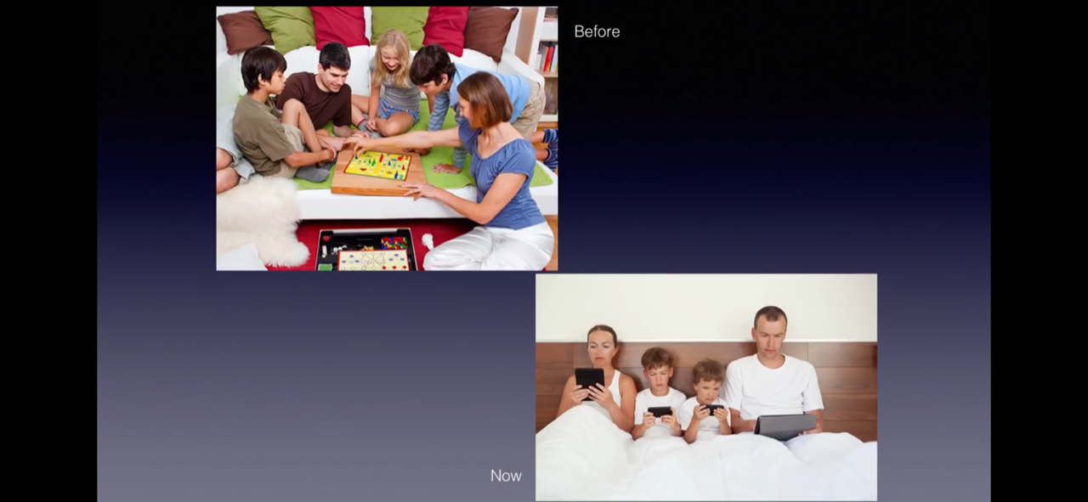
Before and After

Slide 69


My media happiness rating
____ My media and I are the best of friends – love it ! (5)
____ My media and I get along okay but nothing spectacular (4)
____ My media and I need to cut back a little (3)
____ My media is really hurting my life and we need to break up for awhile (2)
____ My media is damaging my life and we need to break up forever (1)

Slide 70

Part Four:
A Few Positives: As summarized by Dr. Zimbardo (2016) in Man Interrupted
When video games go well, they can provide stimulating environment for learning, triumph, and offer some social bonding.
Players in MMORPG (Massively multiplayer online role-playing games) can develop reputations which allow them to build trust with players, which is oftentimes difficult for them to acquire in the “real world.”
Positive gaming can also take the form of learning and/or training programs which can have “real world” impacts – for example:
Jane McGonigial’s World without Oil – helped people become engaged in promoting real changes in people’s attitudes about possible oil crises
The game Foldit is a protein designing game which has helped scientists solve problems related to HIV that had puzzled them for years.

Slide 71
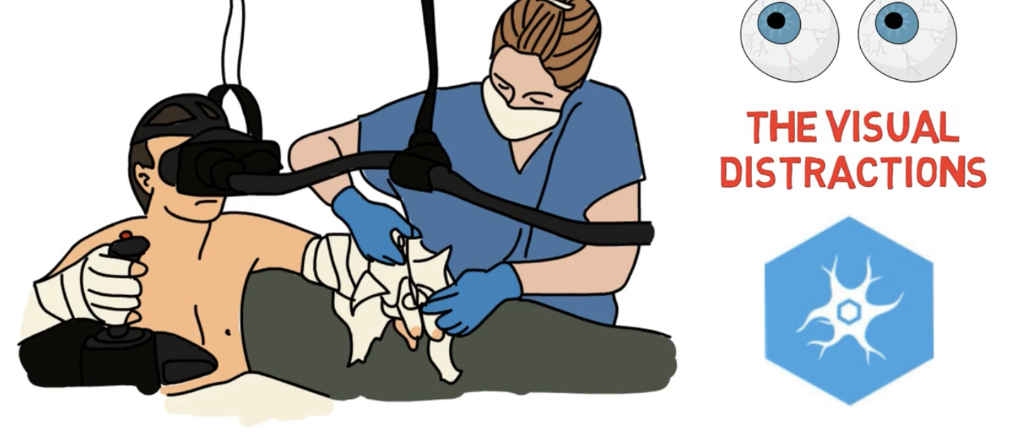
A Few Positives – continued:
Used with permission from Dr. Andy Doan
Xbox and Nintendo Wii encourage and promote exercise in certain programs.
Directing attention toward a virtual world can be a very good thing – even therapeutic. For example, researchers at the University of Washington and Loyola University have found that burn patients who played video games were oftentimes distracted from and experienced less pain than when they were not distracted. In fact, MRI studies confirmed that being in a virtual world actually decreased the amount of pain-related activity in the brain.

Slide 72
A Few Positives – continued:
Surgeons who play video games for at last three hours per week have been shown to make fewer surgical errors on more advanced surgeries and performed faster that the control group (Dobnik, 2004, cited in Zimbardo, 2016).
Young men who play single-player video games in moderation (between once a month and most days a week but not every day) have been shown to perform better in math, reading, science, and problem-solving as compared to students who never or almost never play, but those who play collaborative online games do worse than those who don’t play at all (ABC of Gender Equality in Education, cited in Zimbardo, 2016).

Slide 73
Part Five:
Treatment - How do we fix this and save our children?
“The opposite of addiction is not sobriety; the opposite of addiction is connection.”
“We’re the most disconnected society that’s ever been, surely.”
--Johann Hari (2015)

Slide 74

There are four essential components to the treatment of media addiction:
Connection to Healthy Living
Detox
Rules for reintegration of media
Safety guards for monitoring and support

Slide 75
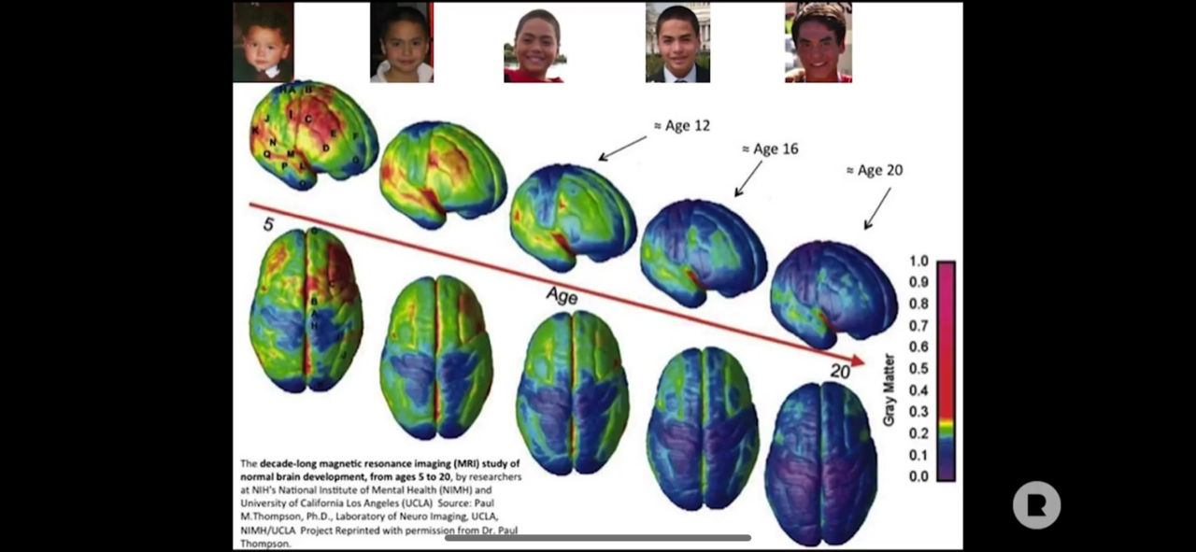
Treatment – the earlier the better as it hardwires in
Used with permission from Dr. Andy Doan

Slide 76
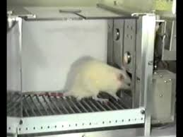
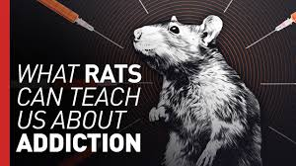

Connection is a Big Deal – The Rats Know
In the 1960’s, psychologist, B.F. Skinner, conducted a series of studies involving rat behavior in what became known as Skinner Boxes.
  Skinner’s rats became hopelessly addicted.
  Skinner concluded that the power of the addiction was solely in the drug itself.
Dr. Bruce Alexander – There is something more to this! Rat Park experiments (Alexander, 1979, 2010)
  Rat Park rodents never became addicted, in fact, most of them never even touched the morphine water at all.

Slide 77

In the Words of Johann Hari (2015)
In the Words of Johann Hari (2015)
“Addiction is about bonding.
If you can’t do it with people, you will do it with a substance.
Now that might be gambling, that might be media, that might be cocaine, that might be cannabis.
You will bond to something because that is our nature.
That’s what we want as human beings.”
“Addiction is about bonding.
If you can’t do it with people, you will do it with a substance.
Now that might be gambling, that might be media, that might be cocaine, that might be cannabis.
You will bond to something because that is our nature.
That’s what we want as human beings.”

Slide 78

Johann Hari’s 8 Point Model for Connected Living:
One: Connection to Meaningful Work:
  A lack of control and little connection between effort and reward are highly predictive of depression and suicide in the workplace. (Marmot et al., 2002).
  Gallup study found that twice as many people in 2011 to 2012 hated their jobs as love their jobs (Marmot et al.,2002).
  Takeaway: Ensure your child is connected with work at home, in school, and possibly in the community.

Slide 79

Johann Hari’s 8 Point Model for Connected Living – continued:
Two: Connection to Meaningful People:
  Pinker (2015) followed both isolated and highly connected people over nine years and found that isolated people were two to three times more likely to die during lonely periods.
  Cacioppo (2006, 2008, 2010), a neuroscience researcher, studied the impact that loneliness has on health. He and his colleagues determined that loneliness causes cortisol levels to go through the roof.

Slide 80
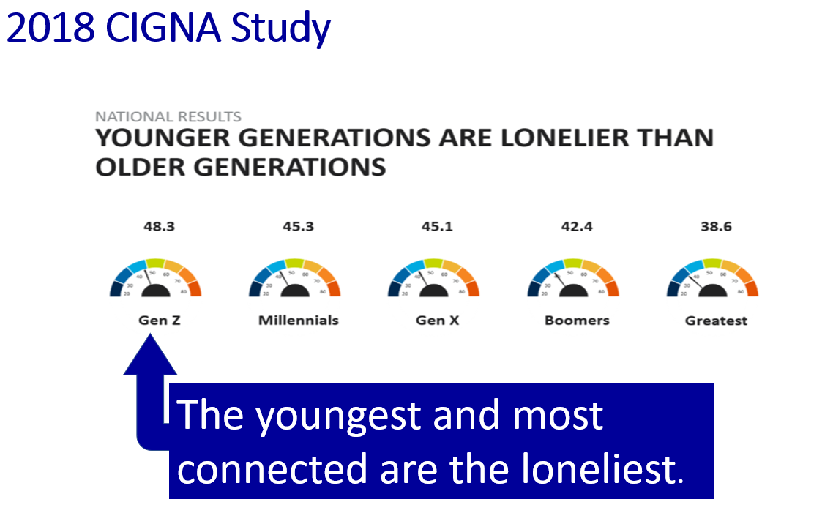
Johann Hari’s 8 Point Model for Connected Living – continued:
Two: Connection to Meaningful People - continued:
Shared with permission – Peter Ryan, CAPT, USN (R)

Slide 81


Johann Hari’s 8 Point Model for Connected Living – continued:
Two: Connection to Meaningful People - continued:
Cacioppo (2013) reported a rather shocking meta-analysis study of over 100,000 participants which found increased risks of dying early due to living with the following:
  Air pollution: 5% increased risk of dying early
  Obesity: 20% risk of dying early
  Alcoholism: 30% risk of dying early
  Loneliness: 45% risk of dying early
Takeaway: Ensure your child is connected with family, good friends, and other adults in 3D, face-to-face relationships.

Slide 82

Johann Hari’s 8 Point Model for Connected Living – continued:
Three – Connection to Meaningful Values:
  Overvaluing money and possessions leads to higher scores of depression (Belk, 1983). Kasser’s (2002) research specifically determined that the more materialistic you are the more likely you are to score higher on measures of depression.
  Takeaway: Ask families to define their values and create a simple “Coat of Arms” depicting those values.
Four – Disconnection from Childhood Trauma:
    Kaiser Study of Adverse Childhood Experiences (ACEs) - The results indicated that for every category of trauma experienced as a child, he/she was dramatically more likely to be depressed as an adult (Felitti et al., 2014; Felitti, 2004).
    Takeaway: Parents need to be more mindful of how ACEs impact the child, not just “Big Traumas.” Don’t let the child self-medicate with media.

Slide 83

Johann Hari’s 8 Point Model for Connected Living – continued:
Five – Connection to Status and Respect:
  Similar to our primate cousins, low ranking individuals show changes in the brain, specifically the pituitary and adrenal glands. (Sapolsky, 1992; 2002).
  As Twenge (2006) in her book Generation Me astutely pointed out, self-esteem is not based on air, but on mastery and real-world competence.
  Takeaway: Build self-respect and confidence based on competence.

Slide 84

Johann Hari’s 8 Point Model for Connected Living – continued:
Six: Connection to the Natural World:
  Bonobos in the wild can become sad or depressed, but there is a limit to how far they will go. In captivity, they become extremely depressed and often self-injure and/or rock compulsively (interview with Isabel Behncke cited in Hari, 2018).
  “Nature Deficit Disorder” - Humans are hard-wired for a genuine nature connection (Louv, 2005).
  Louv (2005) stated that many psychological problems in kids today are related to an erosion of their connection with nature and immersion into the digital world.
  Takeaway: Get your child outside having fun in nature and get him/her exercising!

Slide 85

Johann Hari 8’s Point Model for Connected Living - continued
Seven – Connection to a Hopeful and Secure Future:
  As Native Americans were stripped of their identities, they lost their connection to the future, they became increasingly depressed, and then often resorted to alcohol which often culminated in addiction (Hari, 2018).
  Takeaway: Many of our children are in the same boat and have lost sight of a secure future. We need to foster competence and hope.
Eight – Connection to Faith (emphasis mine):
  Observational studies suggest that people who have regular spiritual practices tend to live longer (Strawbridge et al., 1997).
  Religious commitment may improve stress control by affording better coping mechanisms, richer social support, and the strength of personal values and worldview (Koenig et al., 1997).
  Takeaway: Encourage your child to have faith in something beyond themselves.

Slide 86

Detox Time:
Get your own media use under control before you begin.
Explain to your child the rationale for intervention.
Ask for your child’s cooperation but not permission. You are the parent. So be the parent!
Set up a start date and schedule.
Perform a complete clean sweep of your child’s room.
TV time – yes or no? If so, make it family viewing only.
Obtain toys, games, and activities to fill in the void of not having screen-time. But some boredom is okay and promotes creativity.

Slide 87
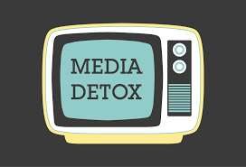
Detox Time – continued:
Increase connection with friends and family members.
Have your child surrender his/her cell phone during digital detox.
Secure access to the Internet on the family computer and any handheld devices that the parent might have.
Get your child outside and connecting with nature.
Get your child exercising.
Once you have completed the digital detox, it will be critical that you determine how much media will be allowed. Make a Media Contract. https://www.jkp.com/catalogue/book/9781785927126

Slide 88
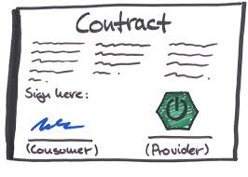
Media Contract - Non-negotiable Rules:
  You are a kind person. Being on an electronic device doesn’t change that. So, treat others on the internet the same way you would like to be treated. No cruelty and no bullying.
  You are a wonderful person just as you are, so don’t try to re-invent yourself on social media.
  Never post any text or picture that you wouldn’t want your grandmother to see.
  Do not live your life on your phone.
  No pornography - ever!
  We will have ALL of your user names and passwords to all of your accounts.
  No texting or cell phone use while driving
  You must obey all school rules about cell phone use and other technologies while on campus.
  No media at the dinner table.

Slide 89
Media Contract - Negotiable Rules:
Allowed to use electronic devices before starting homework: Yes___ No___.
All computers and devices with internet connections must be used in a central location: Yes ___ No___.
During homework, you will keep cell phone in a central location: Yes ___ No ___.
During homework time, you will turn of all notifications: Yes ___ No ___.
During homework time, you can listen to music (better a radio) Yes ___ No ___.
Maximum screen-time on school days: _________.
Maximum screen-time on non-school days: _________.
At bedtime, the cell phone will: ___ Remain in the bedroom ___ Put in central place
­­­­_________________________________­­_______________ Date: _____________________
Person granted access to the technology
________________________________________________ Date: _____________________
Person(s) who owns the technology

Slide 90
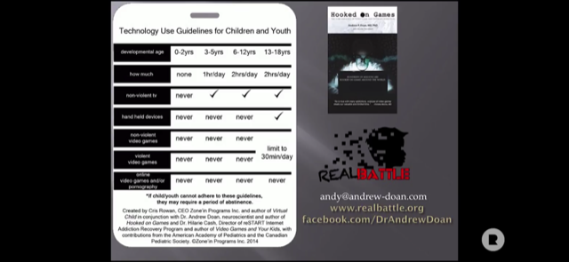

How Much is Okay?
Used with the permission of Dr. Andy Doan

Slide 91

Treatment – Safety Guards for Monitoring and Support:
www.commonsensemedia.com This site offers objective ratings and suggestions for all types of media. This is an excellent resource!
www.familysafemedia.com This offers hardware for limiting access regarding both time and content. Hardware looks a little dated. The cost is about $69.
www.getscreen.com This program allows parents to monitor and set individual controls on all digital devices in the family, including setting time limits on television and video games. Connects to a smartphone and costs around $99.
www.TimeTimer.com This site offers highly visible and easy to set timers.
www.KidsBehavioralNerology.com This is Kutcher’s website which contains information about many of the children who are particularly vulnerable to excessive screen-time such as children with ADHD and ASD. Also available is updated summaries of the American Academy of Pediatrics’ media recommendations for children.
https://meetcircle.com/ This device works with your home Wi-Fi and allows you to manage every connected device on your home network, both wireless and hard-wired and does not require any software on them. Lists for about $49.
www.drdunckley.com; www.ResetYourChildsBrain.com. These sites offer among other things, an excellent video of Dr. Dunckley's explanation of the impact of media addiction and her rationale for her media reset as well as details on how to implement the reset. Outstanding resource!

Slide 92
Treatment – Safety Guards for Monitoring and Support – continued:
http://www.realbattle.org/ Cofounded by Andrew Doan, MD, PhD – Medical Doctor & Neuroscientist and Julie Doan, RN – Mother & Family Advocate, Real Battle Ministries is a first-class, science and spiritually-based supportive website.
https://www.olganon.org/home On-Line Gamers Anonymous®, founded in 2002, is a 12-step self-help group. As noted on their website, “We share our experience, strengths and hope to help and support each other recover and heal from problems resulting from excessive video game playing (gaming disorder).” This website is a “goldmine” of supportive links to numerous resources.

Slide 93

Referrals:
If in-home interventions do not improve the situation:
  Consider a referral to a therapist knowledgeable in media addictions
  Consider inpatient in extreme cases:
    reSTART cofounded Dr. Hilarie Cash, PhD, Chief Clinical Director and Cosette Rae, CEO, Chief Executive Officer, MSW, LICSW, ACSW, CDWF: ReSTART specializes in behavioral addictions, Internet gaming disorder, video game addiction treatment, gambling, virtual reality, augmented reality, and excessive screentime and social media use.
    Launch House founded by Dr. Kardaras: Launch House offers full mental health services for adults and adolescents, including the attendant mental health and screen addiction issues that many young people face today.

Slide 94

Conclusion:
I encourage parents to be proactive and take charge.
Electronic media, in itself, is not at all a bad thing if kept in a healthy balance with connected living to meaning.
It is our job as parents, educators, and professionals to help this generation of children use it responsibly.
We must wake up not only individually but as a society to address this need.
I remain optimistic that this can be done.
12 January 2020 Draft

